Slide 1
U.S. Public Health Service “Fit for Duty, Fit for Life” Weight Management Program: Session 3

Slide 2
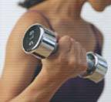
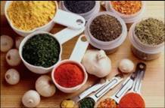
Topics for today
Physical Activity
Healthy Food Preparation
These sessions are not meant to substitute for individual recommendations from your personal health care provider(s).
Notes:
The topics that we will be discussing today are physical activity and healthy food preparation. Both physical activity and healthy food preparation are key to helping lose or prevent gain of body weight. These guidelines presented today should help guide you to adopting and establishing a routine of physical activity and a habit of healthy food preparation. Please remember that these weight management modules are not meant to be a substitute for individual recommendations from your personal health care provider.

Slide 3
Review of assignments
Were you able to keep a food or activity log? If so, did it help you make better choices?
Did you set behavioral goals?
Were you able to reduce your daily intake of calories? By how much?
How often did you weigh yourself?
Did you read any food labels?
Notes:
But before we get started, we need to first review your assignments from session 2. Were you able to keep a food or activity log? If so, did it help you make better food choices? Remember, food and activity logs will make you more conscious of what you are eating throughout the day as well as how active or inactive you are. Next, did you set behavioral goals? Did you make the goals realistic and measurable? How about your daily intake of calories? Were you able to reduce your intake, if so, by how much? Did you step on the scales? How often did you weigh yourself? Finally, did you take the time to read any food labels? Did this help you make healthier food choices?

Slide 4
Physical Activity
Check with your primary care physician before beginning an exercise regime if you have a chronic condition
Start slowly with gradual increase in intensity to avoid injury
Notes:
Now, let’s get into today’s topics, starting with physical activity. You need to check with you primary care physician before beginning an exercise regime if you have a chronic condition. Consult your health care provider about the types and amounts of activity appropriate for you when you have a chronic condition to safely perform physical activity. Also, remember to start slow with low intensity to avoid injuries.

Slide 5
Why increase your physical activity?
Important part of your weight management program
Sustained physical activity helps prevent weight regain
Reduces risk of heart disease and diabetes
You will feel and look better when you are physically active
Notes:
So why increase your physical activity? None of us are getting any younger, and managing our weight is not only harder as we age, but also very important. Sustained physical activity can help prevent weight regain. So many people will start an exercise program, lose the weight, stop the physical activity and then gain their weight back. An increase in physical activity reduces the risk of heart disease and Type 2 diabetes, both prevalent diseases that can lead to mortality. Finally, a big motivator for many is that an increase in physical activity will make you both feel and look better.

Slide 6
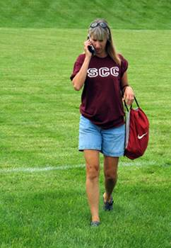
Are you the sedentary type?
Try putting a treadmill in front of the TV
Play Wii Fit with your family
Go walking with your favorite music or cell phone headset.
Notes:
So what type of person are you now? Are you the sedentary type? If so, try putting a treadmill in front of the television if you just cannot find the time or inclination to leave the house for various reasons. Another great way to exercise along with your kids or significant other is to play Wii Fit. If you need to multi-task, try walking with your favorite music (motivates you to move) or cell phone headset.

Slide 7
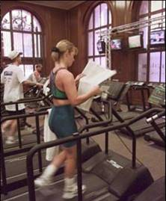
Working at proper intensity
Prevents injury and increases strength
Time depends on intensity: higher intensity activities require less time, lower intensity require more time
Notes:
Working at the proper intensity is vital for exercise. It not only prevents injury, but it increases strength. Time depends on intensity, in that higher intensity activities require less time and lower intensity activities require more time.

Slide 8
Exercise intensity indicator
The best indicator for monitoring exercise intensity during strength or cardiovascular training sessions is the Rating of Perceived Exercise Exertion Scale (RPE)
1 – Very light Activity 2-3 – Light Activity 4-6 – Moderate Activity 7-8 – Vigorous Activity 9 – Very Vigorous Activity 10 – Maximum Effort
Notes:
The Rating of Perceived Exercise Exertion Scale is the best indicator of exercise intensity for strength and cardiovascular training sessions. Rating 1 would be the equivalent to sitting in a chair. Rating 10 is maximum effort equivalent to a cardiac stress test or 1 rep max. Recommended training levels vary based on health and fitness level, but at least a rating of 4-6 is recommended to achieve health or weight management efforts for most healthy people.
8

Slide 9
Try the ‘sing-talk test’
The ‘sing-talk test’ measures intensity
Light intensity: able to sing while doing physical activity
Moderate: carry on a conversation comfortably while doing activity
Vigorous: winded or out of breath when speaking
Notes:
Try to talk test to measure intensity. During light intensity exercise, you should be able to sing while exercising. With moderate intensity, you should be able to carry on a conversation comfortably while exercising. Finally, during vigorous intensity, you should be winded or out of breath when you are speaking while exercising.
The goal is: to be able to carry on a slightly winded conversation while exercising.
The Sing/Talk test. If you’re able to sing then the intensity is too low and if you’re not even able to talk the intensity is too high.
In general, this applies to everyone because the low, medium, or high intensity is individualized and everyone should pretty much strive for the middle with the exception possibly being during short bursts of intense exercise.

Slide 10
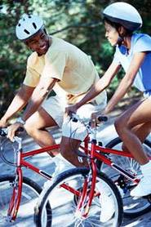
Light-intensity activities:
Walking slowly
Golf, powered cart
Swimming, slow treading
Gardening or pruning
Bicycling, very light effort
Dusting or vacuuming
Conditioning exercise, light stretching or warm up
Notes:
So what are the light-intensity activities? They include: walking slowly, playing golf using a powered cart, swimming-slow treading, gardening or pruning, bicycling with very light effort, dusting or vacuuming, and doing conditioning exercise, such as light stretching or warming up.

Slide 11
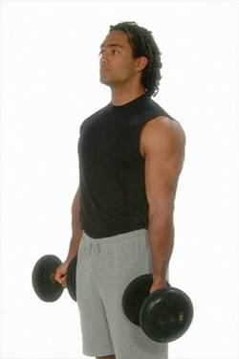
Moderate-intensity activities:
Walking briskly
Golf, pulling or carrying clubs
Swimming, recreational
Mowing lawn, power motor
Tennis, doubles
Bicycling 5 to 9 mph, level terrain, or with a few hills
Scrubbing floors or washing windows
Weight lifting, Nautilus machines or free weights
Notes:
The moderate-intensity activities include: walking briskly, golfing with pulling or carrying your own clubs, recreational swimming, mowing the lawn with a power mower, playing doubles in tennis, bicycling at 5 to 9 miles per hour on a level terrain with a few hills, scrubbing floors or washing windows, and weight lifting using Nautilus machines or free weights.

Slide 12
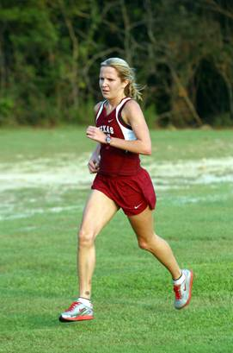
Vigorous-intensity activities:
Speed walking, jogging or running
Swimming laps
Mowing lawn, hand mower
Tennis, singles
Bicycling more than 10 mph, or on steep, uphill terrain
Moving or pushing furniture
Circuit training
Shoveling snow
Raking leaves for 30 minutes
Notes:
Finally, vigorous-intensity activities include: speed walking, jogging, or running, swimming laps, mowing the lawn with a hand mower (not gas or electric powered), playing singles in tennis, bicycling more than 10 miles per hour or on a steep uphill terrain, moving or pushing furniture, circuit training, shoveling snow, and raking leaves for 30 minutes.

Slide 13
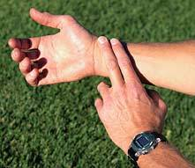
Taking your heart rate
Stop exercising briefly to take your pulse.
Take the pulse at the neck, the wrist, or the chest.
Feel the radial pulse on the artery of the wrist in line with the thumb. Place the tips of the index and middle fingers over the artery and press lightly. Do not use the thumb.
Take a full 60-second count of the heartbeats, or take for 30 seconds and multiply by 2.
Notes:
Now we are going to discuss taking your heart rate. You need to stop briefly from your exercise to take your pulse. The areas to take your pulse is at the neck (just to the left or the right of your Adam’s apple), the wrist, or the chest. Remember to feel the radial pulse on the artery of the wrist in line with the thumb. Place the tips of the index and middle fingers over the artery and press lightly. Remember to not use the thumb. Next, take a full 60-second count of the heartbeats, or your can count for 30 seconds and multiply by 2.
Minor change indicates why its important to take ones heart rate.

Slide 14
Target heart rate
Moderate intensity physical activity: 50-70% of max heart rate
Vigorous intensity: 70-85% of max heart rate
Max heart rate based on age
Example: 50 year old
220 – 50 [your age] = 170
50%: 170 x .50 = 85 bpm (beats per minute)
70%: 170 x .70 = 119 bpm
Target heart rate for 50 year old = 85-119 bpm
Notes:
So what is your target heart rate? Moderate intensity physical activities cause you to reach 50-70% of your maximum heart rate. Vigorous intensity exercises cause you to reach 70-85% of your maximum heart rate. Your maximum heart rate is based on age. We will use a 50 year old individual as an example on figuring out the target heart rate for moderate and vigorous intensity physical activities. First, you subtract your age from 220. So 220 minus 50 equals 170. For moderate intensity physical activities with 50% of the maximum heart rate, you multiply 170 times point 50 which equals 85 beats per minute. To find 70% of the maximum heart rate, which is the maximum percentage for moderate intensity activities and the minimum percentage for vigorous intensity activities, you would multiply 170 times point 70 and get 119 beats per minute. The target heart rate for a 50 year old individual would be between 85 and 119 beats per minute.

Slide 15
How much intensity?
Adults should engage in moderate-intensity for 2 hours and 30 minutes per week, or vigorous-intensity aerobic physical activity for 75 minutes/week, or an equivalent combination of moderate- and vigorous-intensity aerobic activity.
Notes:
So how much intensity do you need? It is recommended that adults engage in moderate-intensity for 2 hours and 30 minutes per week, or in vigorous-intensity aerobic physical activities for 75 minutes per week or an equivalent combination of moderate and vigorous intensity aerobic activites.

Slide 16
How much intensity, continued
Adults should engage in moderate or high intensity muscle-strengthening activities involving all major muscle groups 2 or more days a week.
- 2008 Physical Activity Guidelines for Americans (U.S. Department of Health and Human Services).
Notes:
In addition, the 2008 Physical Activity Guidelines for Americans recommend that adults should also engage in moderate or high intensity muscle-strengthening activities involving all the major muscle groups 2 or more days per week.

Slide 17
Moderate physical activities
Activity | Duration
Washing/waxing a car | 45-60 minutes
Gardening | 30-45 minutes
Shoveling snow | 15 minutes
Walking 2 miles | 30 minutes
Bicycling 5 miles | 30 minutes
Swimming laps | 20 minutes
Running 1.5 miles | 15 minutes
Notes:
Some examples of moderate physical activities are washing and/or waxing a car for 45 to 60 minutes; gardening for 30 to 45 minutes; shoveling snow for 15 minutes; walking a distance of 2 miles in 30 minutes; bicycling 5 miles in 30 minutes; swimming laps for 20 minutes; and running 1 and ½ miles in 15 minutes.

Slide 18
Calories per hour burned in common moderate physical activities
Activity | Approximate calories/hr for a 154 lb person
Hiking | 370
Light Gardening/yard work | 330
Dancing | 330
Golf (walking and carrying clubs) | 330
Bicycling (<10 mph) | 290
Walking (3.5 mph) | 280
Weight lifting (general light workout) | 220
Stretching | 180
Notes:
Need to know how many calories are burned while performing moderate physical activities? Here is an example of how many calories a 154 pound individual would burn per hour while performing these moderate intensity physical activities. Hiking: 370 calories. Light gardening or yard work; dancing, and golfing while walking and carrying your own clubs all would burn 330 calories. Bicycling less than 10 miles per hour: 290 calories. Walking at 3 ½ miles per hour: 280 calories. Weight lifting: 220 calories. And stretching: 180 calories per hour burned for a 154 pound individual.

Slide 19
Calories per hour burned in common vigorous physical activities
Physical Activity | Approximate Calories/hr for a 154 lb person
Running/jogging (5 mph) | 590
Bicycling (>10 mph) | 590
Swimming (slow freestyle laps) | 510
Aerobics | 480
Walking (4.5 mph) | 460
Heavy yard work (chopping wood) | 440
Weight lifting (vigorous effort) | 440
Basketball (vigorous) | 440
Notes:
In burning calories per hour for vigorous activities, a 154 pound individual would burn 590 calories by running or jogging at 5 miles per hour or bicycling over 10 miles per hour. Swimming slow freestyle laps burns 510 calories; aerobics: 480 calories; walking at 4 ½ miles per hour burns 460 calories per hour; and heavy yard work, such as chopping wood, weight lifting vigorously, and playing basketball vigorously all burn 440 calories per hour.

Slide 20
Tips to keep in mind
You can exercise all at once or in short 10-15 minute bouts throughout the day
Wear proper clothing and shoes to prevent injuries
Maintain adequate hydration
Find a spouse, significant other, or friend to exercise with you
Find what type of exercise you enjoy –
weight training classes as opposed to working with
a trainer
swimming instead of running
yoga/pilates instead of aerobics class
Notes:
Some tips to keep in mind: you can exercise all at one time or in short 10-15 minute bouts throughout the day; always wear proper clothing and shoes to prevent injuries; always maintain adequate hydration; find a partner to exercise with, such as a friend, spouse, or significant other; and engage in the types of exercises that you enjoy such as participating in weight training classes as opposed to working with a trainer; swimming instead of running; or participating in yoga and/or pilates instead of an aerobic class.

Slide 21
How to stick with it
Make work-out time a priority as you would eating or attending religious services
Find a partner for support or even your children (Wii Fit)
Buy yourself comfortable clothes/shoes to wear that you enjoy being seen in
Add music to your workouts for extra motivation
If you get off schedule, don’t throw in the towel - GET BACK ON TRACK
Notes:
So how do you stick with continuing to exercise? Make work-out time a priority as you would for eating or attending religious services. Find a partner for support or even your children (remember the Wii Fit). Purchase comfortable clothes and shoes to wear and those that you like to be seen in. Be sure and add music to your workouts for extra motivation. And remember, if you get off your exercise schedule, don’t throw in the towel-get back on track!

Slide 22
Safe Physical Activity Guidelines
Understand the risks but realize that physical activity is safe for almost everyone.
Choose activities that are appropriate for your fitness level.
Increase activity gradually over time.
Wear appropriate gear and equipment depending on the activity.
Consult your health-care provider if you have chronic conditions or symptoms.
Notes:
Always remember to follow safe physical activity guidelines. You need to understand the risks but realize that physical activity is safe for almost everyone. Always choose activities that are appropriate for your fitness level. Increase your activity gradually over time. Make sure you wear appropriate gear and equipment depending on the activity. If you have chronic conditions or symptoms, consult your health-care provider.

Slide 23
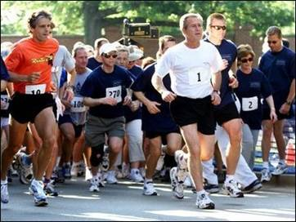
Helpful links on physical activity
Physical Activity Guidelines for Americans
NHLBI Guide to Physical Activity
CDC Physical Activity for Everyone
Physical Activity Readiness Questionnaire (PAR-Q )
Notes:
Here are some Internet links that you may find helpful to guide you with your physical activities. The 2008 Physical Activity Guidelines for Americans. National Heart Lung and Blood Institute at the National Institutes of Health. And CDC’s Physical Activity for Everyone. Finally, the Physical Activity Readiness Questionnaire to determine if you should consult a physician prior to engaging in physical activity.

Slide 24
Healthy Food Preparation
Cooking low fat, low calorie meals can be simple
Learn how adding certain ingredients can add unwanted fat and calories
Notes:
Now lets us look at healthy food preparation. Cooking low fat, low calorie meals can be simple. Learn how adding certain ingredients can add unwanted fat and calories.

Slide 25
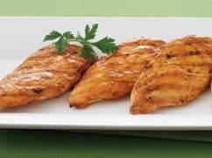
Low fat cooking methods
Bake
Broil
Microwave
Steam
Grill
Roast
Stir-fry or sauté
Notes:
Some low fat cooking methods to use are: baking, broiling, microwaving, steaming, grilling, roasting, and stir-fry or sauté.

Slide 26
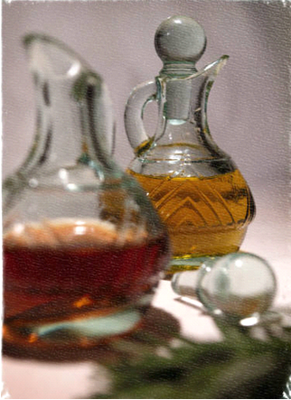
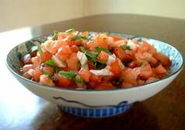
How to save calories and fat
2 Tbsp regular Italian salad dressing
= 136 calories/14 g fat
2 Tbsp reduced fat Italian dressing
= 30 calories/2 g fat
2 Tbsp butter on baked potato
= extra 200 calories/22 g fat
¼ cup salsa on baked potato
= extra 18 calories/0 g fat
Notes:
Ways to save calories and fat are: using 2 tablespoons of reduced fat Italian dressing instead of regular salad dressing which provides only 30 calories and 2 gram of fat as opposed to 136 calories and 14 grams of fat. Try ¼ cup of salsa on your baked potato for only 18 calories and 0 grams of fat instead of 2 tablespoons of butter which provides 200 calories and 22 grams of fat.

Slide 27
Healthy flavorings
Fat free mayonnaise
Fresh ginger
Lemon or lime juice
Sprinkle parmesan cheese
Jelly or fruit preserves on toast
Red pepper
Reduced sodium soy sauce
Fat free sour cream or yogurt
Herbs and spices with no added sodium
Notes:
Try these healthy flavorings: fat free mayonnaise, fresh ginger, lemon or lime juice, a sprinkle of parmesan cheese, jelly or fruit preserves on toast, red pepper, reduced sodium soy sauce, fat free sour cream or yogurt,, and herbs and spices with no added sodium.

Slide 28
Favorite recipe substitutions
Instead of | Use
Whole milk | Fat free or low fat (1%)
Oil | In baking recipes, use ½ oil and an equal amount of applesauce or mashed bananas
1 cup butter | 1 cup soft margarine or 2/3 cup vegetable oil *
Shortening or lard | Soft margarine *
Mayonnaise or salad dressing | Fat free or light mayonnaise or salad dressing; mustard on sandwiches
1 whole egg | ¼ cup egg substitute or 2 egg whites
Cheese | Fat free or reduced fat cheese
*The texture of baked goods may be different when you use these substitutions.
“Light” margarine is not recommended for baking
Notes:
Here are some favorite recipe substitutions: instead of whole milk, use fat free or low fat, which is 1%, milk. Instead of oil in baking, try using ½ oil and equal amounts of applesauce or mashed bananas. Instead of 1 cup of butter, use 1 cup of soft margarine or 2/3 cup of vegetable oil. Instead of shortening or lard, use soft margarine. For mayonnaise or salad dressing, try fat free or light mayonnaise or salad dressing, or mustard on sandwiches. Try using ¼ cup egg substitute or 2 egg whites instead of 1 whole egg. Fat free or reduced fat cheese is a good substitute for regular cheese. Please note that the texture of baked goods may be different when you use vegetable oil or soft margarine as a substitute for butter, shortening, or lard and that light margarine is not recommended for baking.

Slide 29
Favorite recipe substitutions, continued
Instead of | Use
Cream cheese | Reduced or fat free cream cheese
Sour cream | Reduced or fat free sour cream or plain yogurt
Fat for greasing pans | Nonstick cooking spray
1 ounce baking chocolate | 3 Tbsp cocoa powder + 1 Tbsp vegetable oil
Fatback, neck bone, or ham hocks | Broth or bullion, lean ham, smoked turkey breast, or skinless chicken thighs
Pork bacon | Turkey bacon, lean ham, or Canadian bacon
Pork sausage, ground beef or ground pork | Ground skinless turkey breast, or at least 90% lean ground beef
Notes:
Other substitutions are reduced or fat free cream cheese for regular cream cheese, reduced or fat free sour cream or plain yogurt for sour cream, nonstick cooking spray for fat that is used for greasing pans, 3 tablespoons of cocoa powder plus 1 tablespoon of vegetable oil for 1 ounce of baking chocolate. Instead of fatback, neck bone, or ham hocks, try broth or bullion, lean ham, smoked turkey breast, or skinless chicken thighs. Instead of pork bacon, try turkey bacon, lean ham, or Canadian bacon. Finally, instead of pork sausage, ground beef or ground pork, use ground skinless turkey breast or at least 90% lean ground beef.

Slide 30
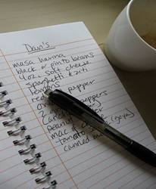
Try these tips
Grocery shop with a supportive friend.
Cook ahead and freeze portions.
Keep frozen or canned vegetables, beans, and fruits on hand for quick and healthy additions to meals.
Don’t grocery shop when you are hungry.
Make a list of healthy items needed for menu for the week.
Notes:
For healthy food preparation, try these tips. Grocery shop with a supportive friend. Cook ahead and freeze portions. Keep frozen or canned vegetables, beans, and fruits on hand for quick and healthy additions to meals. Remember not to grocery shop when you are hungry. And make a list of healthy items needed for the menu of the week.

Slide 31
Try these tips, continued
Try new recipes or different herbs and spices to spark your interest in food.
Eat regularly with someone whose company you enjoy.
To make mealtime special, set the table with a nice tablecloth and even a flower in a vase.
Notes:
Try new recipes or different herbs and spices to spark interest in food. Eat regularly with someone whose company you enjoy. And to make mealtime special, set the table with a nice tablecloth and even a flower in a vase.

Slide 32
To stay on track
Do not skip meals.
Select high fiber foods.
Choose lean beef, turkey breast, fish, or skinless chicken.
Have 3 servings of low fat/fat free milk, yogurt, or cheese every day.*
Keep nutrient-rich snacks like dried apricots, whole wheat crackers, peanut butter, and low fat cheese on hand.
Drink plenty of water or water based fluids.
* If you are lactose intolerant, lactose-free alternatives are available. Try soy, rice, or Lactaid milk.
Notes:
To stay on track with healthy food preparation, do not skip meals, select high fiber foods, choose lean beef, turkey breast, fish, or skinless chicken, have 3 servings of low fat or fat free milk, yogurt, or cheese daily, keep nutrient rich snacks like dried apricots, whole wheat crackers, peanut butter, and low fat cheese on hand, and drink plenty of water or water based fluids. Remember-if you are lactose intolerant, lactose free alternatives such as soy, rice or Lactaid milk are available.

Slide 33
Assignments for the next session
Set 1-2 behavioral goals for physical activity.
Determine your target heart rate.
Set up a physical activity schedule.
Look at ways to reduce calories in your cooking.
Choose lean cuts of meats, fresh herbs, and light toppings for meal preparation.
Notes:
Your assignments for the next session are to set 1 to 2 behavioral goals for physical activity.
Example of a behavioral goal with regards to exercise and healthy cooking.
I will cook with one new dry or fresh herb before our next session.
2. I will walk briskly for 30 minutes 5 times a week next week.
2. Determine your target rate.
3. Set up a physical activity schedule.
4. Look at ways to reduce calories in your cooking.
And finally, choose lean cuts of meats, fresh herbs, and light toppings for meal preparation.
Thank you.

