Slide 1
The United States Public Health Service Commissioned Corps
2022 Benchmarks and Promotion Curriculum Vitae (CV)
Dental Category
Mentoring and Retention Workgroup
October 1st, 2021

Slide 2
Promotion Year 2022 Benchmarks and CV Overview
Objectives
Share the intent of the new, standardized approach for benchmarks and CV.
Identify benchmark considerations specific to the Dental Category.
Provide clarity and direction to prepare for transition to the new promotion CV.

Slide 3
USPHS Dentist Locations

Slide 4
PY 2022 Benchmarks
Standardization based on rank/grade, not discipline.
Promote objective evaluation and feedback during the promotion board review.
Incorporate mission priority areas.

Slide 5
PRECEPTS and FACTORS
1. Performance
2. Education, Training, and Professional Development
3. Career Progression and Potential
COER
ROS
Award History
Credentials
Licensure
Continuing Education
Public Health Training & Experience
Mission Priority
Billet Level, Assignments
Mobility
Collateral Duties
4. Officership
Honor/Integrity/Duty
Other PHS/Professional Contributions
Presentations and Outreach

Slide 6
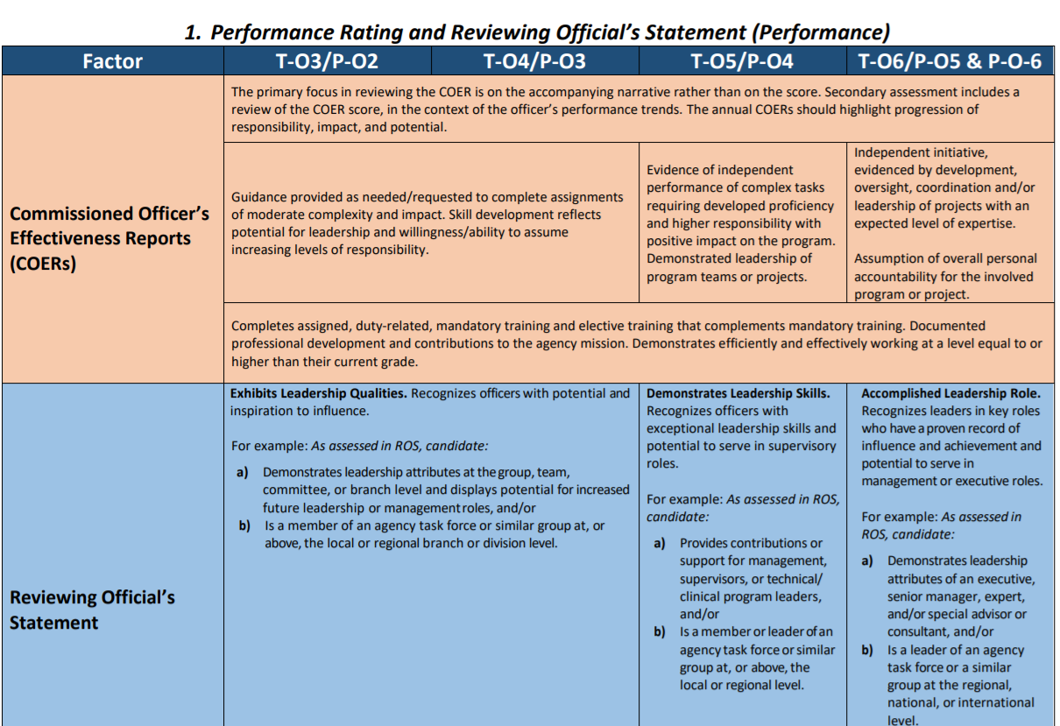
Precept 1: Performance
COER, ROS
Reflects performance at your duty station with progression through increasing levels of independence, initiative, and leadership.
“See → Do → Teach”
COER score and narrative must align.
ROS describes readiness for promotion.

Slide 7
Precept 1: Performance
Awards
Reflects increasing levels of achievement
Examples of awards that reflect the benchmark level of achievement
Includes awards and recognition from PHS, agency, and professional organizations.

Slide 8
Precept 2: Education, Training, Professional Development
Credentials, Licensure
Promotes and reflects continued learning and professional development beyond qualifying degree for Dentists (DDS or DMD), such as AGPR, FAGD, MPH.
New CV does not specify or require a specific degree beyond qualifying degree.
Requires officers to address how the credential enhances their knowledge, expertise, practice and value-add.

Slide 9
Precept 2: Education, Training, Professional Development
Continuing Education
Reflects the progression from participating in continuing education, to teaching or planning, and then developing or independently leading activities.
Includes clinical education (e.g., skills training, preceptorships) obtained to maintain licensure and/or certifications.

Slide 10
Precept 2: Education, Training, Professional Development
Public Health Training & Experience
Dental officers are commissioned with varied levels of public health knowledge and leadership skills.
Reflects expected progression in public health dental knowledge and leadership development.

Slide 11
Precept 3: Career Progression & Potential
Mission Priority
Mission Priority Areas are as identified for PHS Modernization.
[MP Bucket 1] Permanent duty assignment in organizations that primarily serve underserved and vulnerable populations (e.g., IHS, BOP, DHS-IHSC)
[MP Bucket 2] Permanent duty assignment in organization that provides direct clinical care (e.g., IHS, BOP, DHS-IHSC, NIH Clinical Center, DoD, USCG)
[MP Bucket 3] Serve in a difficult to retain discipline (physician, veterinarian, nurse practitioner, dentist, physician assistant)
[MP Bucket 4] Permanent duty assignment in a hazardous duty or isolated hardship location, or in national health security
[MP Bucket 5] Assignments that demonstrate leadership (e.g., supervisor, manager, executive); considered a subject matter expert; independently leads programs, projects, and/or teams

Slide 12
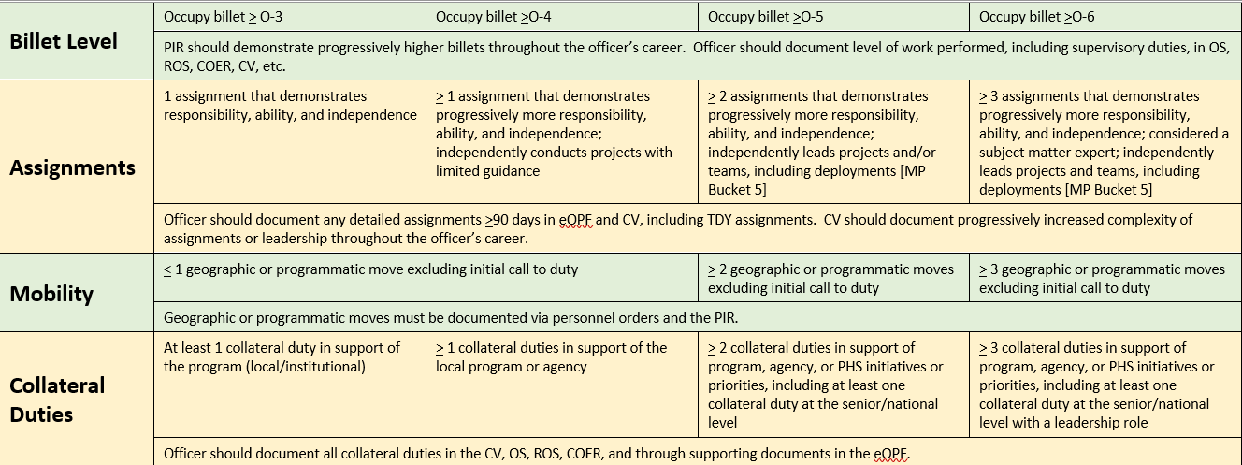
Precept 3: Career Progression & Potential
Mobility may be geographic or programmatic; however, must be documented.

Slide 13
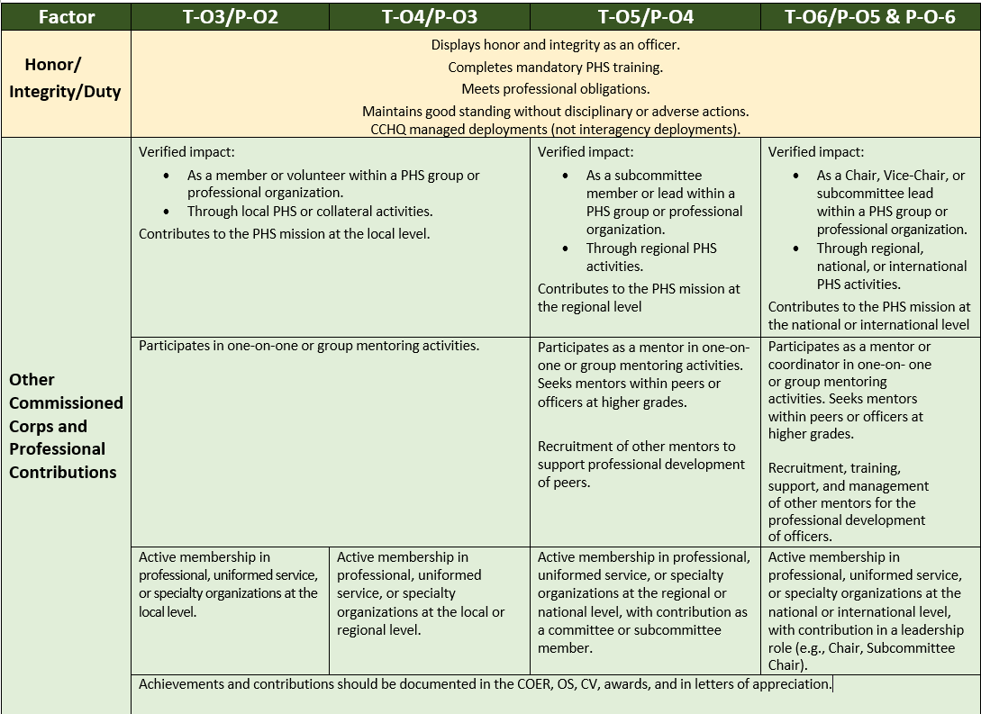
Precept 4: Officership
Honor/Integrity/Duty and Other Contributions
CCHQ-managed deployments are specified for this precept.
Reflect progression from member or volunteer, to leadership roles for initiatives, subcommittees, groups, or organizations.
Highlights mentoring and engagement with professional organizations.

Slide 14
Precept 4: Officership
Presentations and Outreach
Reflects contributions to increasing dental knowledge and promotion of PHS and outreach at regional or national meetings.
Includes PHS recruitment, agency-specific, and other public health initiatives.
Progressive impact with increasingly wider target audience.

Slide 15
Promotion CV
The Promotion CV is the OFFICIAL CV REQUIRED to be maintained by all PHS Commissioned Corps officers for the purposes of promotion.
Standardized format that aligns with benchmarks.
Facilitate review of information during the promotion board process.
Allow officers to identify and describe their role within mission priority areas.
Flexibility within boundaries.

Slide 16
Highlighted Changes in the new Promotion CV
Must transition to the new format no later than 12/31/2022.
The Promotion CV aligns with the Promotion Benchmarks, reflects an officer’s career progression, and demonstrates leadership, officership, responsibilities, and complexity in work assignments based on the following promotion precepts:
Performance Rating and Reviewing Official’s Statement (Performance)
Education, Training, and Professional Development
Career Progression and Potential
Professional Contributions, Basic Level of Force Readiness History, and Service to the PHS Commissioned Corps (Officership)

Slide 17
Highlighted Changes in the new Promotion CV
Must transition to the new format no later than 12/31/2022.
Promotion CV Cover Page
Presents an “at-a-glance” summary of an officer’s impact on your agency, PHS, and the nation.
Organized based on the precepts and factors.
One page maximum. Times New Roman, Font size 11 or 12pt. Margin limits 0.5inch each side.
Focuses on accomplishments since CAD or date of last promotion, whichever is latest.

Slide 18
Highlighted Changes in the new Promotion CV
Must transition to the new format no later than 12/31/2022.
Important points:
Focus on impact in your job description
Be concise
Use action verbs rather than passive words
All entries must be in reverse chronological order in all sections
Front: Times New Roman 11 or 12 pt

Slide 19
Highlighted Changes in the new Promotion CV
Continuing Education Summary Sheet
New document to identify a rolling 5-year period for continuing education.
Update the sheet annually to add the new year and remove CE that are older than 5 years.
Include CE obtained to maintain licensure and/or certifications.

Slide 20
Acknowledgment
Special thanks to LCDR Max Klingenstein, LCDR Cam-Van Huynh, and CDR Rodica Popescu for their work to help make this presentation.

Slide 21
Thank You, PHS Dentists, for all that you are!

