Slide 1
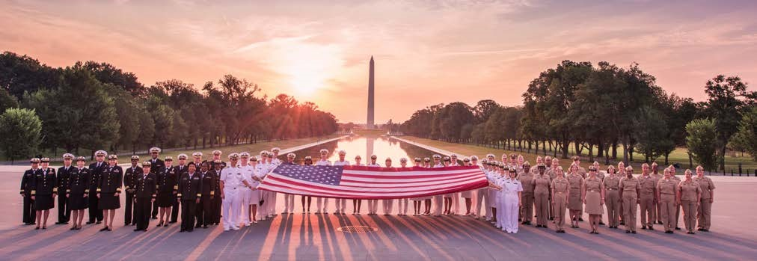
The United States Public Health Service (USPHS) Commissioned Corps
America’s Health Responders
Presenter Name, Title
Date

Slide 2
Topics of Discussion
Who We Are
Our Mission and Values
What We Do
Where We Work
Professional Categories
What We Offer
Ready Reserve Corps
PHERST
Officer Qualifications
Application Process
Engineer Category Details
Emergency Response Deployment
Student Opportunities
Topics of Discussion
Notes:
The topics of discussion I will be speaking about are the history of the United States Public Health Service (USPHS), Who we are, Our Mission and Values, What We Do, Where we work, Professional Categories, What we Offer, Ready Reserve Corps, PHERST, Officer Qualifications, the Application Process, Engineer Category Details, Emergency Response Deployment, and Student Opportunities.

Slide 3
USPHS Commissioned Corps INTRODUCTION
In Officio Salutis
Established in 1889, the U.S. Public Health Service Commissioned Corps is solely committed to protecting the public’s health.
The Commissioned Corps is part of the U.S. Department of Health and Human Services and is overseen by the Assistant Secretary for Health.
The U.S. Surgeon General and the Deputy Surgeon General provide operational command of the USPHS Commissioned Corps.
OVERVIEW
Notes:
The USPHS Commissioned Corps established in 1889 is part of the Department of Health and Human Services (DHHS) and led by the Assistant Secretary of Health (ASH).
The Surgeon General, oversees the Commissioned Corps . The Surgeon General is America’s chief health educator, responsible for giving Americans the best scientific information available on how to improve their health and reduce the risk of illness and injury.
In carrying out all responsibilities, the Surgeon General reports to the ASH, who is the principal advisor to the Secretary of HHS on public health and scientific issues. The Surgeon General is appointed by the President of the United States with the advice and consent of the United States Senate for a 4-year term of office.

Slide 4
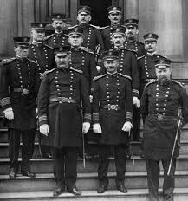
USPHS Commissioned Corps ABBREVIATED HISTORY
1798 Act for the Relief of Sick and Disabled Seamen
1870 Marine Hospital Service
1871 First Supervising Surgeon (later Surgeon General)
Dr. John Maynard Woodworth
1878 National Quarantine Act
1889 Legislation created the Commissioned Corps
Public Health Service (with broadened powers)
1930 Parker Act: Expanded Public Health Service to Non-Physicians
1955 Establishment of the Indian Health Service
Department of Health and Human Services established
1999 First Dedicated Disaster Response Mission for the USPHS Commissioned Corps (20,000 Kosovo refugees)
OUR HISTORY
Notes:
USPHS Commissioned Corps has a great history. In July of 1798, Congress passed "An Act for the Relief of Sick and Disabled Seaman," which was signed by President John Adams. This law authorized the creation of a government operated system of marine hospitals and mandated that laboring merchant marine sailors pay a tax to support it.
The earliest predecessor of the USPHS Commissioned Corps was the Marine Hospital Service. At the time—the early 1800s—our country relied on a healthy merchant marine for trade and security. Our seamen traveled widely. Often, those who became ill brought their sicknesses back home, which made their health care a Federal concern.
The Marine Hospital Service eventually grew into the Public Health and Marine Hospital Service. In 1912, Congress shortened this name to the U.S. Public Health Service, with the Commissioned Corps as its uniformed service.
The responsibilities of the U.S. Public Health Service also changed, as new threats to our country’s public health emerged.
Congress charged the U.S. Public Health Service with preventing the introduction and spread of major epidemic diseases such as smallpox, yellow fever, and cholera. To meet this responsibility, the service and its Corps took over many national quarantine, disinfection, and immunization functions.
Congress also charged the U.S. Public Health Service to carry out the medical inspection of arriving immigrants, such as those landing at Ellis Island in New York.
The workplace environment and its effect on the health of workers became a major concern for the service in the early 1900s.
By 1912, the U.S. Public Health Service was authorized to investigate human diseases (such as tuberculosis, hookworm, malaria, and leprosy), sanitation, water supplies, and sewage disposal.
Today, the USPHS Commissioned Corps officers work abroad, as well as in the United States to help prevent the spread of infectious and communicable diseases. New threats to our public health, such as SARS, avian flu, drug-resistant TB, MRSA, Ebola, and COVID-19—continue to develop.
That’s a brief history of the Corps.

Slide 5
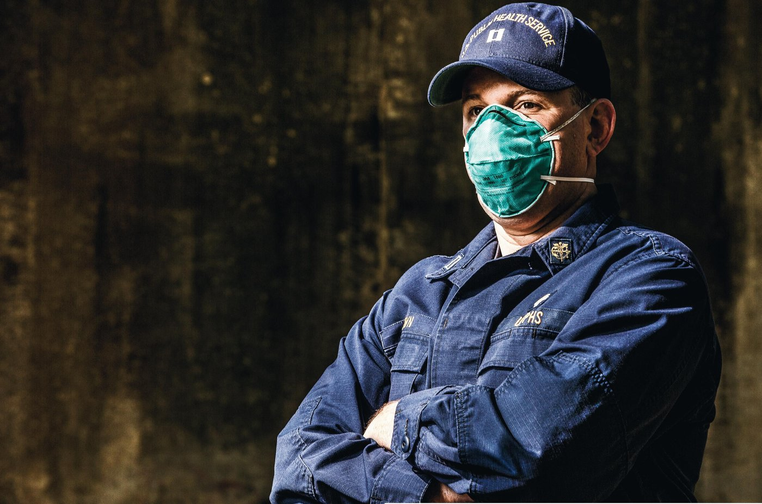
Who We Are
The USPHS Commissioned Corps is one of the eight uniformed services, and is the only one dedicated solely to protecting America’s public health
Approximately 6,000 public health professionals dedicated to addressing public health and providing clinical care
WHO WE ARE
Notes:
One of eight uniformed services and inspired by the call to serve vulnerable and underserved communities through addressing public health issues.

Slide 6
Our Mission and Values
Protect, promote, and advance the health and safety of the nation
Service
Leadership
We provide vision and purpose in public health through inspiration, dedication and loyalty.
We are committed to public health through compassionate actions and stewardship of time, resources, and talents.
Core Values
Integrity
Excellence
We exemplify uncompromising ethical conduct and maintain the highest standards of responsibility and accountability.
We exhibit superior performance and continuous improvement in knowledge and expertise.
MISSION AND VALUES
Notes:
The mission of the U.S. Public Health Service Commissioned Corps is to protect, promote, and advance the health and safety of our Nation. This has been the Public Health Service’s mission and method since 1798, when John Adams—the second President—signed into law the Act for the Relief of Sick and Disabled Seamen.
The Commissioned Corps achieves its mission through:
Rapid and effective response to public health needs
Leadership and excellence in public health practices, and
Advancement of public health science.

Slide 7
What We Do
Protect, promote and advance the health and safety of our nation.
Provide essential health services We go where most do not go to provide care for vulnerable and underserved populations.
Serve on the frontlines of public health emergencies We respond quickly to natural disasters, disease outbreaks and global public health emergencies as well as serve on humanitarian missions.
Lead public health programs and policy development We utilize our experience, skills, and networks to provide leadership within the U.S. Department of Health and Human Services and throughout the federal government.
Advance innovation and science We work at the forefront of medical challenges like COVID-19, cancer, and the opioid crisis.
WHAT WE DO
Notes:
The USPHS Commissioned Corps officers work on the front lines of public health. Our officers respond quickly to natural disasters, fight disease, conduct research, advance public health science and care for patients in underserved communities across the nation and throughout the world.

Slide 8
USPHS Commissioned Corps WHERE WE WORK
Approximately 6,000 officers in 800 locations, all 50 states and numerous foreign assignments including the World Health Organization
Department of Health and Human Services
Department of Defense
Department of Homeland Security
U.S. Agency for International Development
Federal Bureau of Prisons
Department of the Interior
Department of Veterans Affairs
State Governments and Local Agencies
WHERE WE WORK
Notes:
The USPHS Commissioned Corps currently has a presence in more than 800 locations, including all 50 states and numerous foreign assignments, such as the World Health Organization and World Bank.
Officers work at the U.S. Departments of Health and Human Services, Defense, and Homeland Security and other federal agencies involved with public health. (List some of the agencies we work for including IHS, BOP, IHSC, CDC, FDA, and NIH).

Slide 9
Professional Categories
DIETITIAN
S
PROFESSIONAL CATEGORIES
Notes:
The USPHS Commissioned Corps is comprised of officers from 11 distinct professional categories: Dietitian, Health Service Officer, Environmental Health Officer, Pharmacist, Scientist, Engineer, Therapist, Veterinarian, Physician, Dentist, and Nurse.

Slide 10
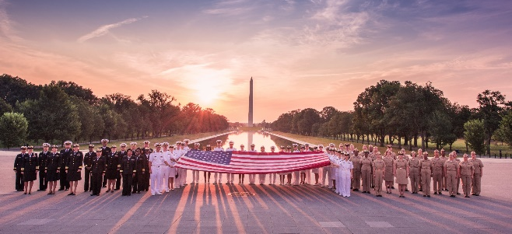
We Offer
Uniformed service benefits featuring comprehensive, low-cost medical, dental, and vision care for officers and their dependents, retirement, and the Post-9/11 GI Bill education benefit, which can be transferred to dependents after 10 years of service
Diverse career opportunities and professional growth
Potential ability to transfer from civil service or other uniformed services
Opportunities for involvement in the response to disasters and epidemics
CANDIDATES MUST
Meet basic requirements and basic education and training requirements
Meet height and weight standards, maintain physical fitness, and be medically qualified (if you have specific concerns about medical eligibility, please email PHSCADMedical@hhs.gov)
Commit to displaying respect for our country and service by wearing the USPHS Commissioned Corps uniform
To become a Public Health Service officer, an interested applicant must complete the commissioning process and secure a position in an agency where Public Health Service officers serve. Applicants pursue both processes simultaneously during the 6 to 9 months commissioning process.
WE OFFER
Notes:
As a Public Health Service officer, you will receive comprehensive benefits include but are not limited to:
30 days of paid vacation per year
Paid Federal holidays
Low-cost medical, dental, and vision care for you and your dependents
Thrift Savings Plan (TSP)
Excellent retirement eligibility after 20 years of service
Post-9/11 GI Bill education benefit
Post-Graduate opportunities

Slide 11
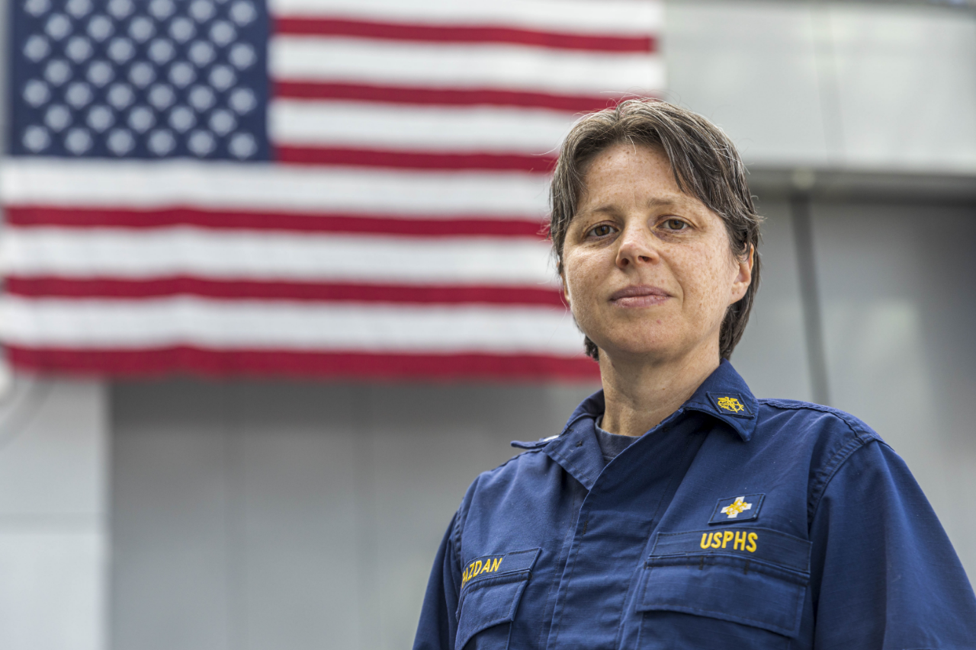
Ready Reserve Corps
The Coronavirus Aid, Relief, and Economic Security (CARES) Act, signed into law on March 27, 2020, provides both the authority and funding for the establishment of the Ready Reserve Corps, the reserve component of the USPHS Commissioned Corps. Applicants must meet same appointment requirements as Regular Corps.
The Ready Reserve Corps provides trained and ready personnel to fill critical public health needs and:
Supports the USPHS Commissioned Corps’ capacity to respond to regional, national, and global health emergencies and improve access to health services
Preserves clinical care positions by maintaining a surge capacity of health professionals available for deployment without jeopardizing the service of clinicians in hard to fill roles
Offers an opportunity to serve for mission-driven clinical and public health professionals who cannot commit to a full-time active duty position in the USPHS Commissioned Corps
Enables access to highly specialized skill sets that would be impractical in full-time active duty positions
READY RESERVE CORPS
Notes:
The Ready Reserve Corps offers a unique opportunity for its officers to serve their local community as well as their country in times of public health emergencies or in underserved areas.
The Ready Reserve Corps under “CARES” Act that signed into law on March 27, 2020, will preserve clinical care positions available for deployment without jeopardizing the service of clinicians in hard to fill roles; and will authorize access to highly specialized skill sets during critical public health needs.
The Ready Reserve Corps provides trained, ready and equipped public health professionals, capable of mobilizing and deploying to augment the active duty Commissioned Corps, under the authorities of the Secretary for Health in response to national emergencies and public health crisis.
The Ready Reserve Corps offers a unique opportunity for officers to lead their own lives in the civilian world and serve their country when needed in under-served communities and during public health emergencies.

Slide 12
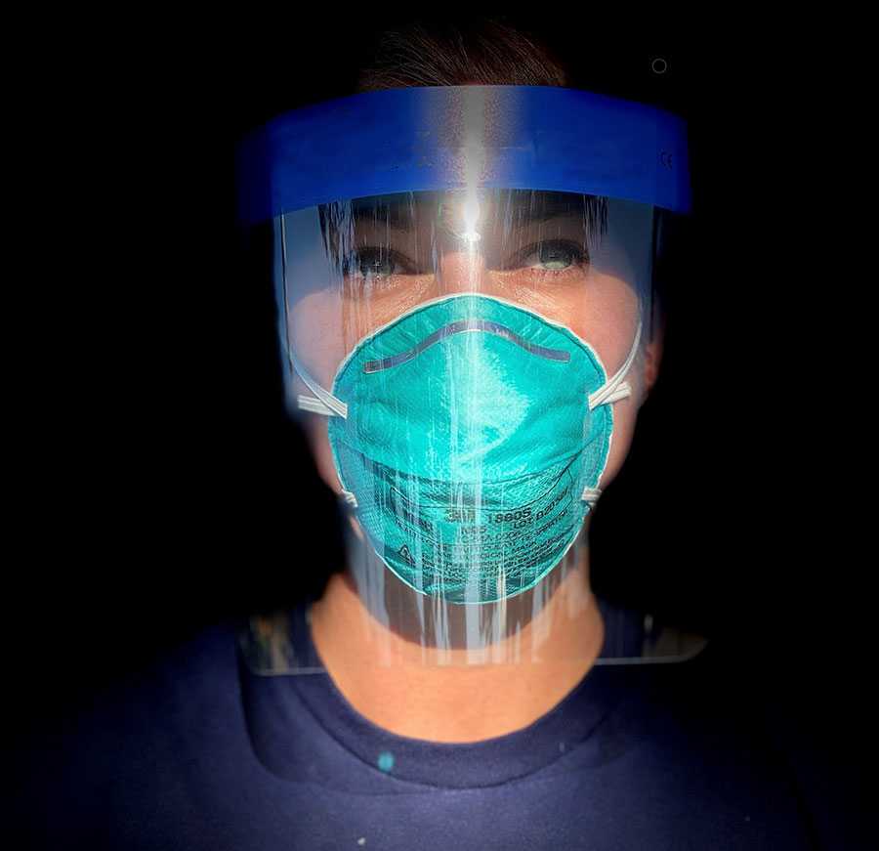
Public Health Emergency Response Strike Team (PHERST)
The USPHS Commissioned Corps deploys in support of numerous natural disasters and public health emergencies to provide essential clinical care to those in need, as well as ensure sustainable health-care service delivery. The Public Health Emergency Response Strike Team (PHERST) is comprised of active duty Public Health Service officers who rapidly deploy as first responders to regional, national, and global public health emergencies.
PHERST provides the capability to surge during national emergencies and public health crises, providing trained and ready personnel to fill critical public health needs and will:
Be First to Respond - Active duty officers who are “first on the ground.” PHERST is available to deploy immediately (within 8 hours) at the request of the President, the Secretary of Health, the Assistant Secretary for Health, or the Surgeon General.
Extended Deployment - Deploy for extended durations (30-60-90 days) if needed.
Preserve Care Positions - When not deployed, PHERST officers train, maintain skills, and fill short-term staffing in agencies.
Be Clinically Prepared - Offer advanced clinical competencies and innovative techniques required for community stabilization.
PHERST

Slide 13
Engineer Category

Slide 14
Officer Highlight
Rank/Name (credentials): Position:
Education:
Service time:
Prior Branches of Service (if applicable):
Practice areas:
Deployments:
What is it like to work on your current assignment?
* Include officer photograph on the right-hand side of this slide
Officer Highlight
41

Slide 15
Engineer Professional Category
“Machinatores Vitae: Paratus, Volens, Peritus.”
The USPHS Engineer Category is comprised of all engineering disciplines that contribute to medical research, safety, population health, critical infrastructure (health care and water systems), and the health of the environment. Our engineering disciplines include environmental, civil, biomedical, chemical, computer, electrical, mechanical, and any other that contribute to our public health mission.
ENGINEER CATEGORY
Notes:
Template from USPHS Overview _Final_7.29.20 (003).pptx, content from USPHS CC Engineer Category Motto.

Slide 16
Mission of USPHS CC Engineer Category
Provide sound engineering expertise in the support of specific agency objectives
Use engineering skills to safeguard the public and to research and identify solutions to the many health-related problems that face our nation
Provide assistance directly to the American people in the form of professional consultation and the provision of health-related facilities
Remain on the cutting edge of engineering disciplines and technology as we face the health and environmental challenges of the future
ENGINEER CATEGORY
Notes:
Engineer Category Mission:
Use engineering skills to safeguard the Public and to research and identify solutions to the many health related problems that face our nation. For example, USPHS CC engineers work with Native American/Alaskan Native Village reservations providing essential water and wastewater engineering services to these communities. This traditionally underserved population is assisted by engineering activities both with individual homes and community systems and at facilities such as health clinics on a daily basis.
Remain on the cutting edge of engineering disciplines and technology as we face the health and environmental challenges of the future. PHS CC engineers also protect and promote public health by evaluating, enhancing, and ensuring compliance with medical device, tobacco, food and drug laws. These activities include approval of prescription drugs and high-risk medical devices; regulate tobacco products, including preventing underage use; and foods, dietary supplements, or cosmetics, providing ongoing review of safety through inspections and surveillance
Source: https://dcp.psc.gov/OSG/engineer/documents/Engineers_FDA.pdf
Provide assistance directly to the American people in the form of professional consultation and the provision of health-related activities. PHS CC engineers are resolute in activities that advance public health. In addition to designing and building systems that deliver potable drinking water and ensuring the safety of the food and drug that we ingest, PHS Engineers also conduct research and development that result in solution-based products, assist with disaster relief and emergency response, and engage in public health program management.
Source: Excerpted from https://www.cdc.gov/mmwr/preview/mmwrhtml/su5502a5.htm

Slide 17
What We Do: Engineer Officers
Prevent the spread of disease by designing and installing water treatment and delivery systems as well as sustainable wastewater collection, treatment, and disposal systems for underserved populations.
Promote and empower individuals, tribes, and communities in public health activities.
Provide facilities management, planning, and construction services for health care delivery facilities and laboratory research complexes.
Research/evaluate occupational hazards to improve workers' health and safety.
Provide guidance on designing, constructing, and operating "healthy and sustainable" buildings.
USPHS ENGINEER CATEGORY
Notes:
Source: 17-10-25 UWF Oct2017 Job Fair Main Presentation USPHS Only.pptx (slides 8-10)

Slide 18
What We Do: Engineer Officers cont.
Evaluate the safety of medical devices, electronic products, and inspect domestic and international facilities where these products are manufactured.
Support the Family Smoking Prevention and Tobacco Control Act by setting performance standards and regulating tobacco products and manufacturers.
Protect human health and the environment by identifying, assessing, and remediating the health risks associated with hazardous waste sites, unplanned releases of hazardous substances, and environmental contamination or pollution.
Maintain a mobile engineering capability to respond to natural and man-made disasters.
USPHS ENGINEER CATEGORY
Notes:
Source: 17-10-25 UWF Oct2017 Job Fair Main Presentation USPHS Only.pptx (slides 8-10)

Slide 19
Where Engineers Serve
USPHS ENGINEER CATEGORY

Slide 20
Organizations Where USPHS CC Engineer Officers Serve
USPHS ENGINEER CATEGORY
Notes:
EPAC data: ENG Agency State 202104.xlsx (updated values April 2021)

Slide 21
Welcome, I’m Dr. Vivek Murthy,
21st U.S. Surgeon General As the Nation’s Doctor, my office is focused on the most pressing public health issues of our time. Read about our current priorities.
COVID-19
Health Misinformation
Health Worker Burnout
Youth Mental Health
www.hhs.gov/surgeongeneral/priorities
Notes:
Surgeon General is the leader of the Commissioned Corps of the USPHS
The Surgeon General’s Priorities: Public health impacts all of us. We aim to help everyone understand these important issues and how we can work together to take action.
COVID-19: Keeping our families and communities safe during the COVID-19 pandemic is a key priority for the nation and for the Surgeon General.
Health Misinformation: With the abundance of health information available today, it can be hard to tell what is true or not. Many people are exposed to health misinformation: information that is false, inaccurate, or misleading according to the best available evidence at the time.
Health Worker Burnout: The pandemic has brought our nation’s healthcare workers to a breaking point. They are experiencing never-before-seen rates of burnout, psychological distress, and workforce shortages. We must act to support our health care workers with all that they need to heal and to thrive.
Youth Mental Health: Far too many young people are struggling with their mental health and unable to get the support they need. Maintaining healthy children and families requires all of society—including policy, institutional, and individual changes in how we view and prioritize mental health.
Engineer officers are force multipliers for these priorities.
To learn more about the Surgeon General’s priorities go to https://www.hhs.gov/surgeongeneral/priorities/index.html

Slide 22
USPHS Engineer Officers Roles
Underserved Leadership Health Hazardous
Population Security
Officers Deployed on One or More Missions
USPHS ENGINEER CATEGORY
Notes:
This graph is based on the R&R survey conducted 10/2020 from 92 respondents. Although we did not receive 100% participation, the survey responders’ agency distribution compared to the overall engineers’ agency distribution was similar, suggesting the responses are a good representation of all engineers.
In the table below, the All Engineers column represents the percentage of engineers working at each of the Agencies based on the PHS Eng 2020 06 Statistic Graphs REVISED.xlsx. The Survey Participants column represents the percentage of engineers working at each of the Agencies based on the Oct 2020 R&R survey.
Agency All Engineers Survey Participants
IHS 0.485411141 0.489130435
FDA 0.217506631 0.130434783
DOI 0.095490716 0.152173913
EPA 0.071618037 0.076086957
CDC 0.047745358 0.065217391
NIH 0.031830239 0.065217391
OS 0.015915119 0.010869565
ASTDR 0.00795756
CMS 0.00795756 0.010869565
DHS 0.00530504
HRSA 0.00530504
DOD TMA 0.00265252
PSC 0.00265252
SAMHSA 0.00265252

Slide 23
How USPHS Engineer Officers Advance Public Health
ENGINEER CATEGORY
Notes:
This word cloud comes from the Oct 2020 R&R survey describing the work officers reported they do. The larger the words, the higher the frequency the word was used.

Slide 24
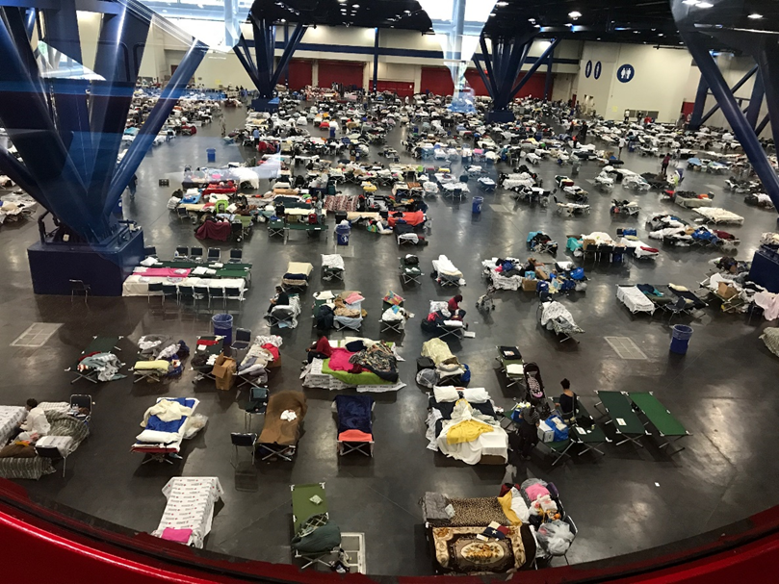
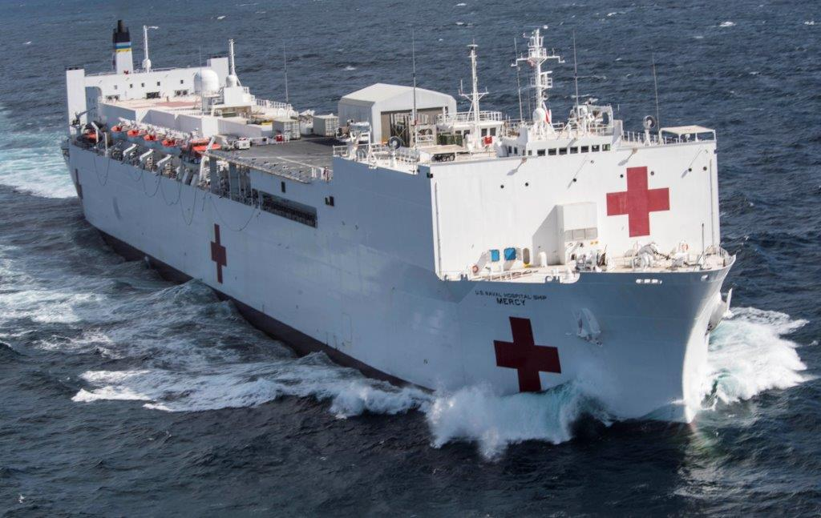
Emergency Response Deployments
Notes:
PHS mission: To Protect, Promote and Advance the Health and Safety of our Nation
An important part of being an officer is readiness, and being willing to deploy for public health emergencies

Slide 25
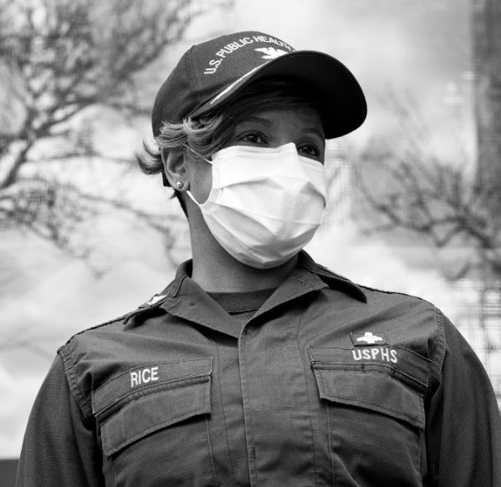
Readiness and Deployment
The Office of the Surgeon General, through Commissioned Corps Headquarters, is responsible for the coordination of readiness and deployment for:
Domestic and international operations
Teams and individuals
Humanitarian assistance
Disaster relief
Emergency response
Global training
READINESS AND DEPLOYMENT

Slide 26
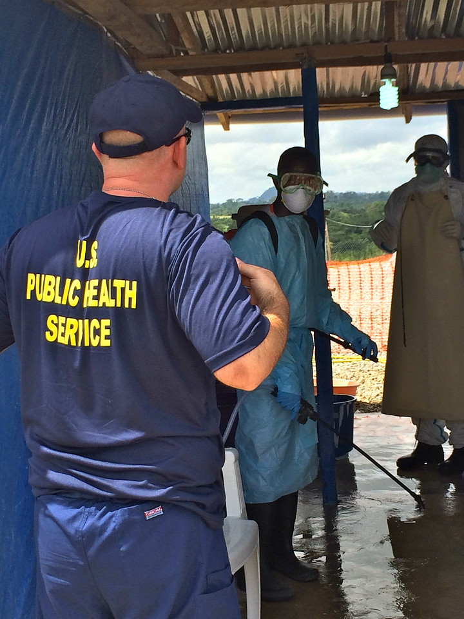
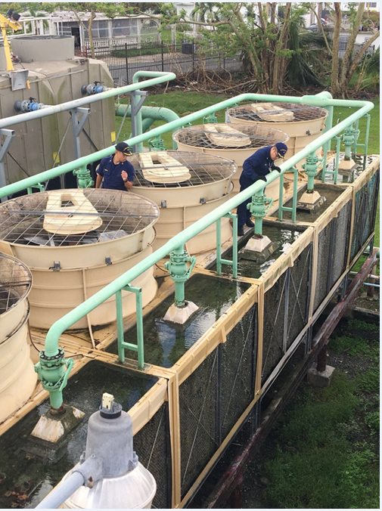
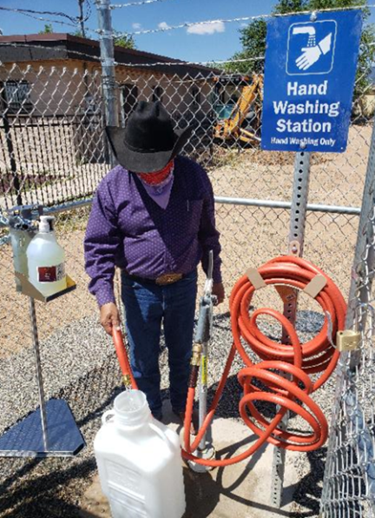
Engineer Officers & Deployments
As USPHS Officers and America’s Health Responders, we stand ready to preserve public health and national security during national or global health emergencies
Liberia 2014
Ebola Epidemic
Engineers constructed a decontamination site to deliver 0.5% chlorine solution to Ebola Treatment Areas.
Puerto Rico 2017
Hurricane Maria
Engineers assessed water loss from a cooling tower at Bayamon Hospital.
Navajo Nation 2020
COVID-19 Water Access Mission
Engineers designed and installed water points and provided training and outreach. ~20% of the Navajo Nation population (~37,000 people) had no piped water access prior to this mission.
USPHS ENGINEER CATEGORY
Notes:
Officers deploy on missions initiated by the USPHS or their detailed agencies.

Slide 27
Engineer Deployment Roles
Other Roles
Incident Administrative & Logistics
Incident Response Leadership
Incident Operational Support
Engineer Focused
Unique Specialties
Incident Response Facility Planning / Support
Facility Assessments
Project Manager / Engineer
Disaster Response – Damage Assessments
DEPLOYMENT ROLES
Notes:
As USPHS Officers, our deployment roles can be engineer focused, or other roles as requested by the specific mission tasking.
During engineering specific deployments USPHS engineer officers may be called upon as:
Project Engineers/Staff Engineers:
The Navajo Water Access Mission (2020)
Project Officer - design of a $123M, six-story addition to the National Institute of Allergy and Infectious Diseases Vaccine Research Center (2020) that will expand biomedical research space for the development of lifesaving vaccines that protect against coronaviruses and other infectious disease threats.
Facility manager/engineer for IHS facility address CMS violations and maintain vital hospital facility equipment: water treatment, electrical generation, medical equipment sterilization– Rosebud IHS Healthcare Facility (2016)
Coordinated onsite with FEMA on a large facility retrofit (a defunct College) for the beddown of Unaccompanied Minors with Administration for Children and Families (Unaccompanied Minors 2014)
Facility Assessments:
COVID-19 IHS Healthcare Facilities – Ventilation System Assessments - Isolation Units (2020)
Incident Response Facilities Planning/Support:
COVID-19 Javitz Center Facility Support (2020)
Ebola Support Mission Supporting facility needs (2014-2015) - Ensuring continuous operations of the two 100 KW generators, the chlorinated water supply/distribution, and all packaged HVAC units.
Setup FMS for Hurricane Ike (2008)
Disaster Response – Damage Assessments: Healthcare Facility, Critical Infrastructure Assessment Teams
Hurricane Harvey, Irma, Maria – Puerto Rico (2017) - critical infrastructure assessments for 14 priority hospitals identified by the Puerto Rico Department of Health
Hurricane Matthew (2016) - assessments of damaged facilities; developed cost estimates and work orders for repair.
Hurricane Sandy (2012) – assessed 30 buildings with analysis and repair recommendations, along with an assessment for a 280,000 gpd wastewater treatment plant
Hurricane Irene (2011)
Other Unique Specialties:
Respirator/mask fit testing N95 for COVID-19 (2020) – NIOSH Related
Developing decontamination stations for Ebola response Liberia (2014)
Radiation testing after Japanese Tsunami (2012) – need to validate.
Our Engineering officers also serve, when and where needed in a number of other interesting deployment roles.
Incident Response Leadership Roles:
Incident Management Team (IMT) roles: Operations Section Chief, Division Group Supervisor, Safety Officer, Logistics Section Chief, Plans Chief, Liaison Officer, etc); during a variety of incidents such as COVID-19 (2020-2022), wildfires, hurricanes, tsunami’s, etc.
We’ve also took on leadership roles in operational areas such as :
Stood up Guam’s home quarantine program (2020)
Behavioral Health Federal Coordinators (Operation Allies Welcome 2022)
Incident Administrative and Logistics Roles:
Contracting Officer’s Representative, COR for Operation Artemis (2021) and ASPR’s Supply Chain Stabilization Task Force (2020) – Officers help stand up over $500 million dollars of swab and media contracts from ground zero; distributed 14.8M swabs, 13.7M media to all states, territories, and federal partners, including 2M in surges; and have started a national swabs and media stockpile.
Data Management (2020/2021): Track the availability status and deployment of over 6,000 USPHS Commissioned Corps Officers for CCHQ RDB Mission
Princess Cruise Line Quarantine Mission (2020) – supported facility logistics providing lodging for quarantined guests.
Hurricane Maria (2017) – Logistics: Property management of equipment; delivery of equipment, supplies and pharmaceuticals.
Support disaster response efforts as logistics support staff (variety of missions)
Incident Operational Support:
Conduct welfare/wellness checks on Quarantined guests for COVID-19 (Grand Princess Cruise Ship, Travis Air Force Base 2020)
Augment clinical staff at a 2,500-bed emergency medical facility at the Javits Convention Center (2020).
Served on Community Based Testing Site Task Forces (2020/2021)
Support quarantine stations for COVID-19 (2020/2021)

Slide 28
Engineer Deployment Missions
Other
Natural Disasters
COVID-19 (2020-22) Hurricanes
Command Center
Cruise Ship Missions
Phoenix Indian Med. Ctr. Mission
Health Screener
Quarantine Station
Medical Procurement Support
Laura (‘20)
Maria (‘17-‘18)
Harvey-Irma (‘17)
Matthew (‘16) * Sandy (‘12)
Gustav-Ike (‘08)
Katrina-Rita (‘06)
California Fires (‘17, ‘19, ‘20)
Oregon Fires (‘20)
Hawaii Volcano (‘18)
Louisiana Flooding (‘16)
Minot, ND Flood (‘11)
Native American
Missions
International Missions Other Missions
Navajo Water Access (‘20)
Gallup Indian Medical Center (‘16)
Crow Flooding (‘12)
Typhoon Yutu (‘18-‘19)
Ebola – West Africa (’14,’15,‘19)
American Samoa Tsunami (‘09-‘10)
Haiti Earthquake (‘10)
USS Mercy Humanitarian (‘06)
Operation Allies Welcome (‘21-‘22)
Child Reunification (‘18)
Unaccompanied Minor
(‘14, ‘16, ‘18)
Oil Spill Responses
Inaugurations
USPHS DEPLOYMENT MISSIONS
Notes:
Not a comprehensive list, includes the myriad of missions and breadth of contribution on deployment missions submitted by engineers

Slide 29
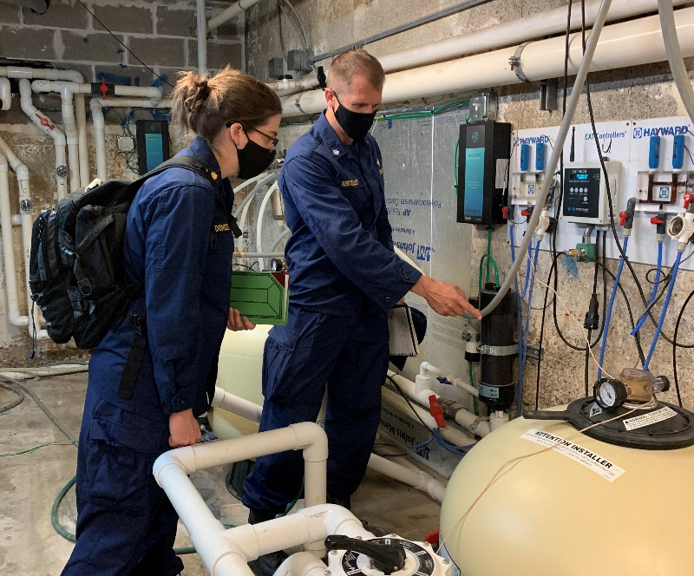
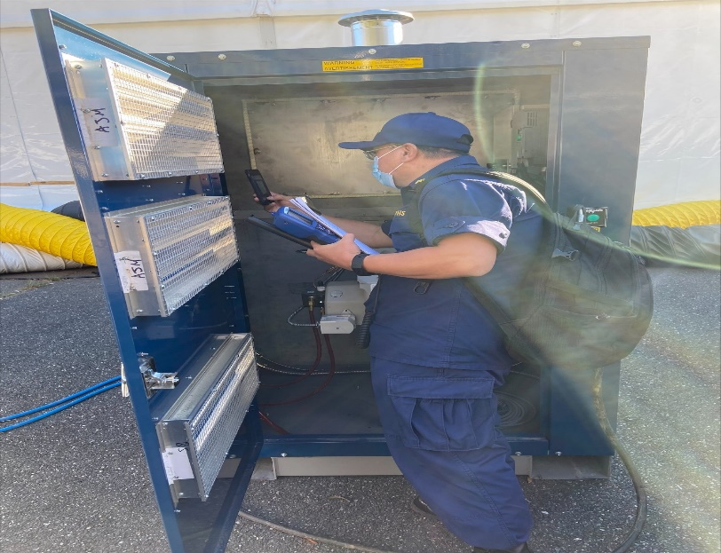
Student Opportunities What You Can Do
Notes:
There are several opportunities for students to learn about and get a flavor of PHS.

Slide 30
JRCOSTEP
Programs last between 30 to 120 days (during official school breaks)
Benefits include pay, health benefits, housing and travel allowances
There is no obligation to join the USPHS Commissioned Corps
Participants become inactive PHS officers upon completing the program
May select to activate upon graduation
Work with professionals at federal agencies including:
Indian Health Service (IHS); Food and Drug Administration (FDA); National Institutes of Health (NIH)
Centers for Disease Control and Prevention (CDC); National Park Service (NPS); Environmental Protection Agency (EPA)
Learn more at: JRCOSTEP - https://www.usphs.gov/students/
JRCOSTEP

Slide 31
SRCOSTEP
Participants are full-time students entering their final year of academic study toward a bachelor’s degree.
Participants must meet certain physical, medical, and security background requirements.
Participants commit to serve in the USPHS Commissioned Corps upon graduation.
Participants receive up to 12 months of pay equivalent to an Ensign (O-1) while finishing their coursework.
Learn more at: SRCOSTEP - https://www.usphs.gov/students/
SRCOSTEP

Slide 32
ARE YOU READY? HERE IS HOW YOU GET STARTED…
Review:
1. Medical standards
2. Applicant checklist
Visit www.usphs.gov
Apply!
Ready to Serve?

Slide 33
Engineer Officer Required Qualifications
Bachelor's or Master's degree in engineering from a program accredited by the Accreditation Board for Engineering and Technology (ABET)
Degrees in an engineering-related curriculum such as engineering technology and architecture do not qualify
Must have a GPA of 2.8 or higher
A candidate with qualifying Bachelor’s degree with a GPA below 2.8 may include qualifying Master’s or Doctoral degree for a cumulative average GPA of at least 2.8, provided the Bachelor’s degree GPA is at least 2.5
Must be a United States citizen
Mandatory eight-year commissioned service obligation
Less than 44 years of age for Active Duty
Can be offset by up to 8 years of prior uniformed service
Some officers may qualify for an age waiver
Less than 40 years of age for Ready Reserve (may be adjusted based on eligible federal PHS civil service and uniform service active-duty time)
Must meet medical requirements
Must pass initial suitability investigation
USPHS ENGINEER CATEGORY
Notes:
No notes

Slide 34
8 Steps to Become a USPHS Commissioned Corps Engineer Officer
Visit the USPHS.GOV
Create & Activate Your Account
Start Your Pre-Screen
Submit Required Materials
Stand Ready to Interview for the Engineer Category Board
Complete remaining Three Commissioning Requirements (Medical, Security, & Nomination Clearances)
Seek Employment Opportunities with Federal Agencies (if search not started/secured already)
Call to Active Duty
USPHS ENGINEER CATEGORY

Slide 35
Join Our Noble Effort
The USPHS Commissioned Corps offers rewarding careers for public health professionals who desire to protect and promote our nation’s health and treat those most in need.
We are recruiting service-driven clinicians and public health professionals in 11 professional categories, including engineers, physicians, dentists, and veterinarians.
Learn more by visiting USPHS.gov.
Career Growth
Financial Incentives
Work/Life Balance
30 Days of Paid Vacation
Paid Sick Leave
Paid Maternity Leave
Paid Federal Holidays
Professional Development
Leadership Training
Mentorship
Assignment Mobility
Continuing Education Credits
Post-9/11 GI Bill
Competitive Compensation Package
Housing Allowance
Comprehensive Health Care
Student Loan Repayment Programs
401-Style Retirement Plan
Life Insurance & Survivor Benefits
JOIN OUR EFFORT
Notes:
If you want to contribute to protecting and promoting the nation’s health and to help underserved populations/those in need, USPHS Commissioned Corps may be for you. It offers an exciting and fulfilling career with unique opportunities and incentives:
Close-knit community with mentorship and leadership opportunities
Move around geographically and among agencies
Post-9/11 GI bill to pay for furthering your education, or paying for dependent’s education
Financial Incentives - Non-taxable income, military pay scale; housing allowance
Excellent healthcare through Tricare – medical, dental, prescription
Retirement plan and pension
We encourage you all to take a deeper look and examine if it may be a fit for you.

Slide 36
Learn More:
For more information visit:
www.usphs.gov
www.usphs.gov/professions/engineer
#USPHS
usphs.gov

Slide 37
Questions?
Notes:
Please let me know if you have any questions.

Slide 38
Thank You!
Name
Rank USPHS
Title
Phone number
Email
usphs.gov

