Slide 1
Commissioned Corps Women’s Issues Advisory Board (CCWIAB)

Slide 2
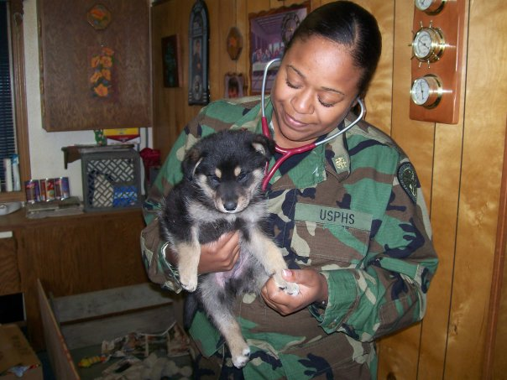
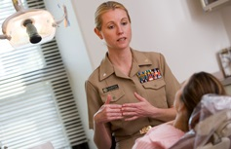
MISSION
Identify and analyze key issues that impact Women in the Commissioned Corps
Develop action plans to address issues

Slide 3
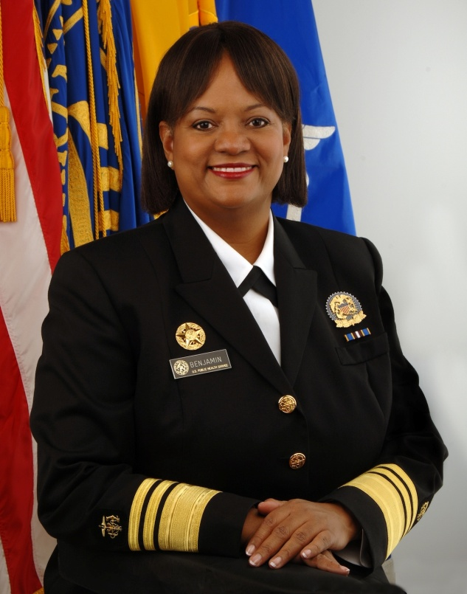
Background and History
Established in 2011
Supports 2009 Executive Order establishing the White House Council on Women and Girls
Former Surgeon General
VADM Regina M. Benjamin

Slide 4
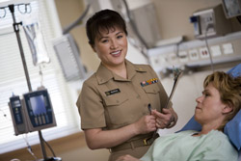
Membership
Chairperson – Flag Officer
Co-chairperson
Executive Assistant
Twelve voting members
Must have officers from Medical, Dental, Engineering, and Environmental Health categories
Appointed by the Surgeon General
Staggered terms of two, three, or four years

Slide 6
Issues
Pregnancy
Breastfeeding
Interpersonal Violence
Deployment
Promotion

Slide 7
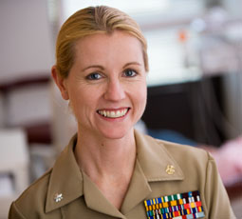
Accomplishments
Committees established
Outreach
Membership
Pregnancy
Violence Prevention
Outreach Committee
Development of Outreach Resources
Outreach Survey
Membership Committee

Slide 8
Accomplishments
Pregnancy Committee
Breastfeeding Guidance Approved
“The Resource Guide for Expectant Parents of the USPHS Commissioned Corps”
Violence Prevention Committee
Post deployment questions
Policy review

Slide 9
Future Directions
2014 Outreach Survey revealed top 3 issues of concern:
Work-life balance
Leadership opportunities
Family care
Prioritize effort and develop action plans

Slide 10
CCWIAB Contacts
Agency/OPDIV/Dept CDC CDR Dunnick CDR McKernan DCCPR LCDR Powell DHS LT Clement DoD CDR Dobmeyer FDA CAPT Blakely CDR Jordan Garner LCDR Patel
LCDR Gooen Bizjak HRSA RADM Linde CDR Cavanaugh IHS LCDR Shannon
LCDR Hill NIH CDR Davidson
Category Dentist LCDR Shannon Dietician CAPT Blakely Engineer LCDR Gooen Bizjak EHO CDR McKernan HSO CDR Cavanaugh CDR Dunnick LT Clement Nurse LCDR Amanda Hill Pharmacist LCDR Patel Physician RADM Linde Scientist CDR Dobmeyer
LCDR Powell Therapist CDR Jordan Garner Veterinarian CDR Davidson

Slide 11
Questions?
CDR Anne Dobmeyer
301-312-1876
anne.c.dobmeyer.mil@health.mil

