Slide 1
The Value of Mentoring
Dr. Kathleen Y. McDuffie
CAPT US Public Health Service
Senior Workforce Development Consultant
Career Development Team, CDC University
Office of the Director
Human Resources Office

Slide 2
Overview
Mentoring as part of Talent Development
Types of Mentoring Relationships
The Value of Mentoring
CDC’s Mentoring Program
Office of the Director
Human Resources Office

Slide 3
Mentoring: A Key Method of Talent Development
Office of the Director
Human Resources Office

Slide 4
Why is Mentoring Critical to Talent Development ?
70% from assignments;20% connection;10% Courses
Source: Center for Creative Leadership/CCL Learning model

Slide 5
Talent Development via Connection
20% actual impact on learning
Getting candid feedback
Observing and learning from others
Active role models
Coaching and Mentoring (according to CCL)
Social Learning-Good old fashion conversations and social media (Forman 2011, HCI)
Overall message is: Mentoring and related practices should be a key part of the professional development portfolio

Slide 6
Types of Mentoring Relationships
Office of the Director
Human Resources Office

Slide 7
How are they formed ? Much like life mates.
Arranged (Formal Mentoring Program)
Application-based
Matching by CDC University staff (pre-matches are accepted)
1 year of support
“Love” (Informal Mentoring)
We know it happens to a large extent
Promoted
Shot gun (Formal and non voluntary)
Believed to not be common in federal government
Office of the Director
Human Resources Office

Slide 8
Let’s focus on “Love”: Informal Mentoring
Sometimes can occur by chance
Can occur with strategy—
What do you have in mind ?
What resources/ opportunities are available?
What can I commit to ?
Office of the Director
Human Resources Office

Slide 9
The Value of a Mentor
Office of the Director
Human Resources Office

Slide 10
Mentors Areas of Expertise
Getting to know the institution
Culture
Resources
Network
Social and Political dynamics
Career Development
Formal and Informal requirement for promotion, leadership opportunity
Information about key organizations, conferences, etc
Professional Development
Constructive feedback
Advice related to Continuing education
Access to a network of professionals
Office of the Director
Human Resources Office

Slide 11
CDC’s Program
Office of the Director
Human Resources Office

Slide 12
FORMAL MENTORING
CDC Formal Mentoring Program, est 1995
Application and matching process
Mentors: GS 11 and above
Recruitment for Mentors and Mentees
Formal agreement, support activities, year long commitment
Office of the Director
Human Resources Office

Slide 13
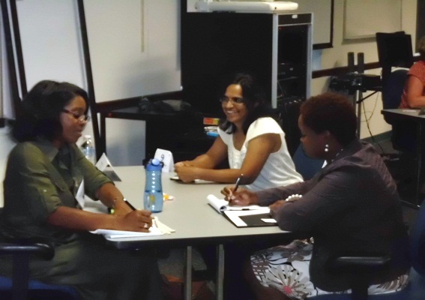
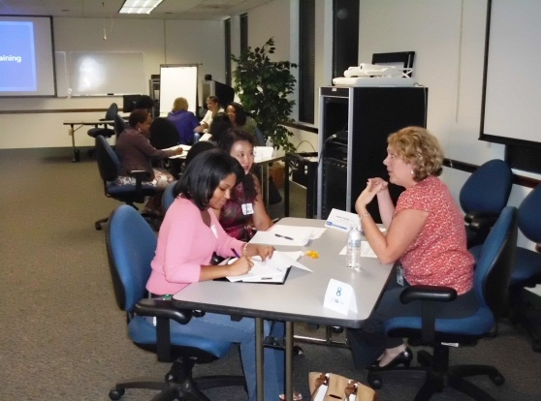
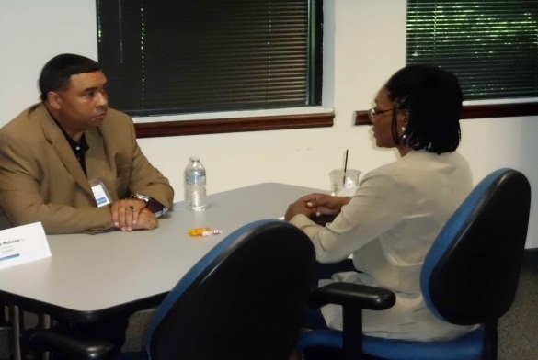
SPEED MENTORING
Rotational style
Short focused engagements (7-8 minutes)
Groups with characteristics in common (Series, Educational Background, Personnel System)
Office of the Director
Human Resources Office

Slide 14
Informal Mentoring
Valuable learning occurs when learning from experienced others
Technical, organizational culture, professional strategy
Chemistry is compatible; Organic
Can have multiple mentor/mentee relationships
Office of the Director
Human Resources Office

Slide 15
QUESTIONS?
Office of the Director
Human Resources Office

