Slide 1
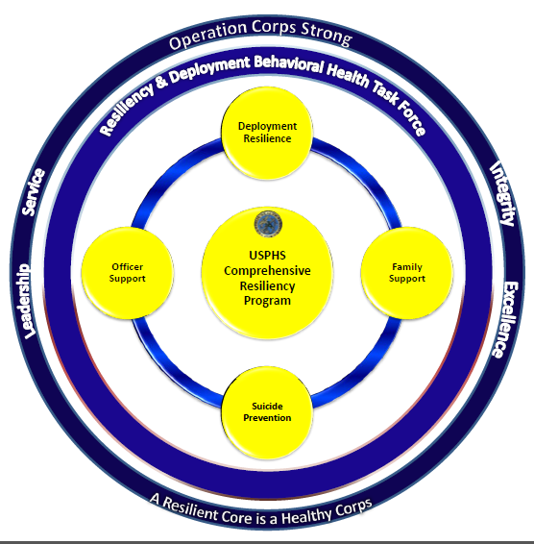
“Operation Corps Strong” Resiliency and Deployment Behavioral Health Task Force (RDBHTF)
CDR Marivic Fields, LMSW, BCD
CDR Indira Harris, LCSW, BCD
CDR William Bolduc, MS, LCSW, BCD
CDR Josefine Haynes-Battle, MSN, BSN, RN
LCDR Joy Mobley, PsyD
“A Resilient Core is a Healthy Corps”

Slide 2
Background
#OperationCorpsStrong (OpsCS) was developed by a small team of multidisciplinary Officers who recognized key gaps in providing behavioral health resources to all Commissioned Corps Officers
Some of these gaps became exposed during the Ebola mission in 2014 and were temporarily addressed through the formation of a Family Support Network
Key initiatives include development of a resiliency program, a coordinated suicide prevention plan, and Officer and family support throughout the deployment cycle
OpsCS organized 4 pillars to develop training and provide subject matter expertise to the Corps based on the identified gaps
Recognizing the resources developed by the Armed Services for their Service Members, OpsCS aims to create an array of resources and supports that speak to the unique needs and challenges of the Commissioned Corps
OpsCS believes that resilience initiatives should be incorporated into all aspects of the Corps, beginning at OBC, regardless of professional discipline, location or agency assignment
“A Resilient Core is a Healthy Corps”

Slide 3
“A Resilient Core is a Healthy Corps”

Slide 4
Task Force Objectives
Develop a resilience focused program for USPHS Officers and their families that supports the unique culture of the Corps
Promote a Resilient and Ready Corps through innovative initiatives focused on Deployment Resilience, Suicide Prevention, Officer and Family Support
Synthesize services and resources and make them accessible to Officers and their families
Strengthen and unify our Corps through cross category collaborations and initiatives
“A Resilient Core is a Healthy Corps”
Notes:
Talking points: Closes gaps, bring USPHS in allignment with our sister services
Integrate relevant resources from sister services

Slide 5
Operation Corps Strong
Resiliency and Deployment Behavioral Health Task Force
Deployment Resilience
Suicide Prevention
Officer Support
Family Support
Trainings, resources and support to Officers throughout deployment cycle
Corps Suicide Prevention Plan for Officers and Leadership
Referral and Resources
USPHS Responder Resiliency Course
Resilience Through Meditation Program
Resource Compendium
Training, Referral and Resources to Build Resilience in PHS Families
“A Resilient Core is a Healthy Corps”

Slide 6
Implementation
RDBHTF will develop clear policies to define resilience and streamline training and resources that enhance resiliency
Train and gain buy in from other categories, deployment teams, and Corps leadership
Identify, assign and train resiliency coordinators
“A Resilient Core is a Healthy Corps”
Notes:
Create a network
Identify gaps in Officer and Family support programs and implement innovative
Integrate relevant resources from sister services

Slide 7
Next Steps
Pilot resiliency presentations at OBC classes
CPO Board training
Deployment leader training
Cultivating topic specific programs, trainings and resources to support Officers and their Families throughout an Officer’s career
“A Resilient Core is a Healthy Corps”

Slide 8
Questions?
“A Resilient Core is a Healthy Corps”

