Slide 1
Section 508 – A Reference for Comuncations Staff
Mark D. Urban
CDC Section 508 Program Manager
HHS Section 508 Co-Chair
2019

Slide 2
Agenda
When to do Section 508
Making format choices
Basic document accessibility

Slide 3
When to do 508
Making a document:
  Only for yourself or a select group of people personally known to you
    Don’t make accessible unless it needs to be.
  For your Branch, Team, or a SharePoint site with limited access (and not to be distributed)
    Run automated checkers and correct issues.
  For public or agency wide distribution
    Use the Checklists at http://508.hhs.gov/.

Slide 4
Making Format Choices
Choosing content format is a joint responsibility
Discuss content format at the beginning of the project
Consider the following:
  Will the document EVER need to be distributed and posted on the Web?
  What business or organizational requirement does this product fulfill?
  What will the end users need to do with this product?
  Is this a print product?
Examples and rationale to use: HTML, PDF, and Print Only
Notes:
This page covers each type of digital document and why it should be used.
Example Documents Using HTML as the standard Format
At-A Glance/Fact Sheets
Presentations smaller than 10 slides
Programs/Agendas
Guidance
Most content items!
Example Documents Using PDF as the 508 Format
Fillable Forms
Complex Manuals
Periodicals
Long Presentations
Complex Publications
Complex Reports
Example Print-Only Documents that Do Not Require 508 Compliance
Binders
Coloring Books
Booklets
Tri-fold Brochures
Certificates
Exhibit Displays
MASO Printed Forms
Name Badges/Tags
Pocket Folders
Posters, Signs & Banners
Printed Forms
Retired Materials
Scientific Posters
Table Tent Cards

Slide 5
Basic Document Accessibility: Office documents
Checking for accessibility
Biggest challenges
Reducing Remediation
Checklists

Slide 6
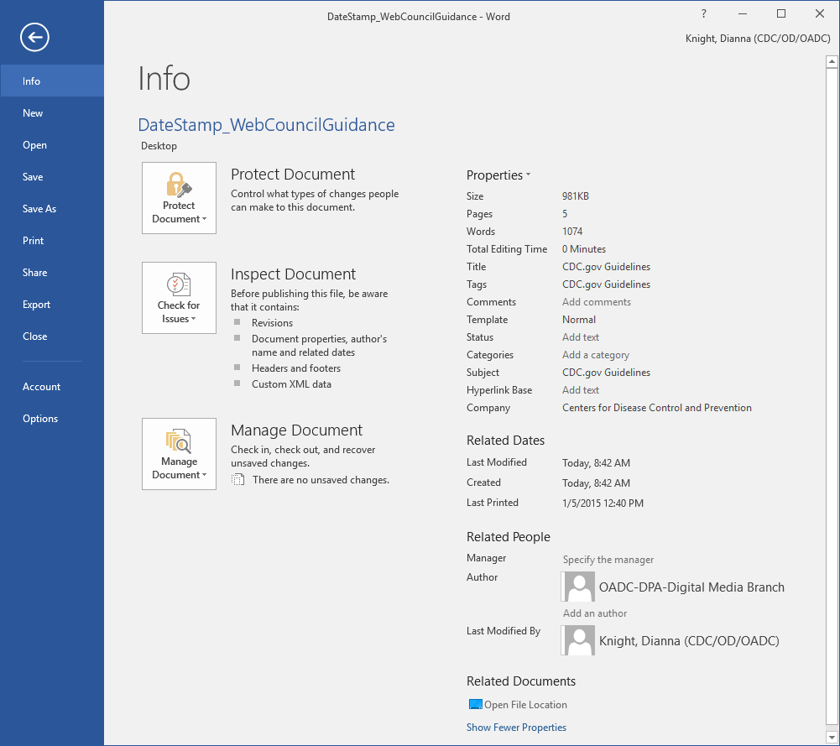
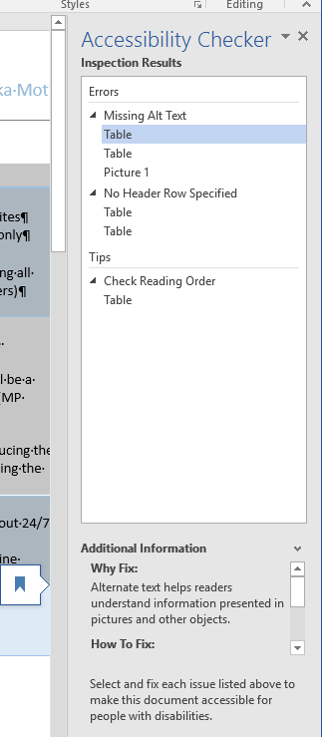
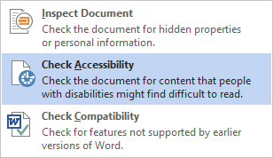
Checking for Issues
Select File Tab: top-left-tab
Click “Check for Issues” and select “Check Accessibility”
You will be returned to your document with the Inspection Results to the right with Errors, Warnings, and Tips.
As you select the errors, the additional information will list why and how to fix step by step.

Slide 7
Word: Biggest Challenges
Alternative text
Color contrast and color conveying meaning
Document order/headings
Custom tables and using tables for formatting
Setting metadata
Notes:
Alt Text: title and description. Use description

Slide 8
Power Point: Biggest Challenges
All text is available in outline view
Alternative text
Color contrast
Color conveying meaning
Graphs and Tables
Setting metadata
Slide reading order
Unique titles

Slide 9
Reducing or Eliminating Remediation
Use the HHS Checklist as a guide as you fill it out
Make and test for 508 as you build
Save your changes after each test
Maintain one version for all updates

Slide 10
Word Checklist and Resources
Checklist: Word Document 508 Checklist
Step by Step: Creating Accessible PDF Files from Word – PDF
Video: Overview of Requirements for Accessible Word Documents
Video: Templates and Style Basics
Video: Lists, Columns, & Table of Contents
Video: Tables
Video: Figures
Notes:
Through an additional soundtrack or alternate video with soundtrack, the visual images that carry meaning or value for the sighted viewer are audibly conveyed to people with disabilities.
Audible descriptions of actions and elements shown in the video are announced during natural pauses in the audio. In short, all significant information gathered through sight should have a spoken equivalent.
In many cases, the need for formal AD as a separate audio track added in post-production can be lessened or removed if, at the time of initial scripting, writers and producers build descriptions into the original script with narration of visually important elements such as graphics, actions, and other text-based information displayed on the screen.

Slide 11
PowerPoint Checklist and Resources
Checklist: PowerPoint Document 508 Checklist
Step by Step: Creating accessible PowerPoint presentations
Video: Make a Presentation Accessible
Video: Tables, Charts, and Images

Slide 12
PDF Checklist and Resources
Checklist: PDF File 508 Checklist
Step by Step: Create accessible PDFs in Microsoft Word
Video: Eight Essentials for Creating Accessible PDF Documents
Video: Ensuring your PDF is Accessible

Slide 13
Reference
Web Content Accessibility Guidelines (WCAG) 2.0 AA
Guidance Contacts – who does what
CDC Standards and Guidance
Good to Know:
  page structure, tables, images, hyperlinks, and translations
Creating Accessible Documents
Prerecorded Audio and Video

Slide 14
Section 508 and the Web Content Accessibility Guidelines (WCAG) 2.0 AA
Introduction to Web Accessibility and W3C Standards

Slide 15
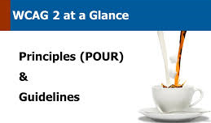
508? WCAG?
Section 508
  List of tag requirements: a long checklist
  Concentrated on HTML and Videos
WCAG 2.0 AA
  Broadened the focus of digital assets we have or use
    PDFs, Word documents, spreadsheets, eBooks, etc.
  Four principles: perceivable, operable, understandable, and robust
  Making things digitally accessible for people with disabilities
Notes:
Target sued successful: https://jimthatcher.com/law-target.htm
https://arstechnica.com/uncategorized/2008/08/target-to-pay-6-million-to-settle-site-accessibility-suit/
2006 - The NFB has sued Target alleging first that Target.com is inaccessible and second, that the inaccessibility of Target.com violates the ADA, the California Unruh Civil Rights Act, and The California Disabled Persons Act.
HHS and 508: https://www.hhs.gov/web/section-508/compliance-and-remediation/framework/index.html
In November 2007, HHS began receiving notices of Section 508 non-compliance from Accessing Digital America (ADA). Each notice included a survey of a sampling of pages from a Department-owned Web site. As of February 1, 2008, HHS had received 13 such notices covering the Office of the Secretary and 10 OPDIVs. It became clear that many Departmental Web sites were not in compliance with Section 508. HHS is establishing a Memorandum of Understanding (MOU) with ADA that will describe how the Department will address its Section 508 issues over a five-year period. Each OPDIV’s Plan will follow the template below and will implement the necessary actions to achieve Section 508 compliance and fulfill the MOU agreement. Once it is established, the MOU will be provided to each OPDIV.

Slide 16

Four Principles of Accessibility (WCAG) 2.0 AA (POUR)
Perceivable: see the content or hear it
Operable: use the computer by typing or voice
Understandable: get clear & simple language
Robust: use different assistive technologies
Notes:
Perceivable: Text Alternative, Use of Color, Meaningful Sequence, Audio Descriptions
Operable: Key board accessible, Audio/Video Controls, Voice Commands, and is the area of a link large enough for someone to use
Understandable: Plain Language Principals, Avoid Abbreviation, Consider reading level, Consistent navigation
Robust: Content must be robust enough that it can be interpreted reliably by a wide variety of user agents, including assistive technologies.

Slide 17
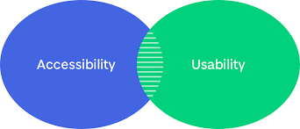
Tips for Usability
Design for diverse users
Don’t use color as the only way to convey meaning
Ensure sufficient contrast between foreground text and background
Provide clear visual focus indicator
Provide clear defined boundaries and visible labels for forms
Avoid component identity issues
Avoid hiding actionable items under hover
Notes:
Definition of Usability
Usability is a quality attribute that assesses how easy user interfaces are to use. The word "usability" also refers to methods for improving ease-of-use during the design process.
Usability is defined by 5 quality components:
Learnability: How easy is it for users to accomplish basic tasks the first time they encounter the design?
Efficiency: Once users have learned the design, how quickly can they perform tasks?
Memorability: When users return to the design after a period of not using it, how easily can they reestablish proficiency?
Errors: How many errors do users make, how severe are these errors, and how easily can they recover from the errors?
Satisfaction: How pleasant is it to use the design?
Source: Usability 101: Introduction to Usability

Slide 18
Risk and level of effort
Making a document:
  Only for yourself or a select group of people personally known to you
    Don’t make accessible unless it needs to be.
  For your Branch, Team, or a SharePoint site with limited access (and not to be distributed)
    Run automated checkers and correct issues.
  For public or agency wide distribution
    Use the Checklists at http://508.hhs.gov/.

Slide 19
Guidance Contacts

Slide 20

CDC Section 508 Program
Sets the acceptance standards for all CDC
Authority to approve acquisitions and IT systems
  EPLC, eLearning, software, data applications – including mobile data apps.
Approve all exceptions to 508 and WCAG
Contacts:
  OS 508 Coordinator: Kate Maynor
  CDC 508 Coordinator: Mark Urban
CDC 508 Help Desk
The 508 help desk supports people when they have questions about interpretations or implementations of the standards.
Notes:
Authority to approve acquisitions and IT systems: EPLC, eLearning, software, data applications – including mobile data apps.

Slide 21
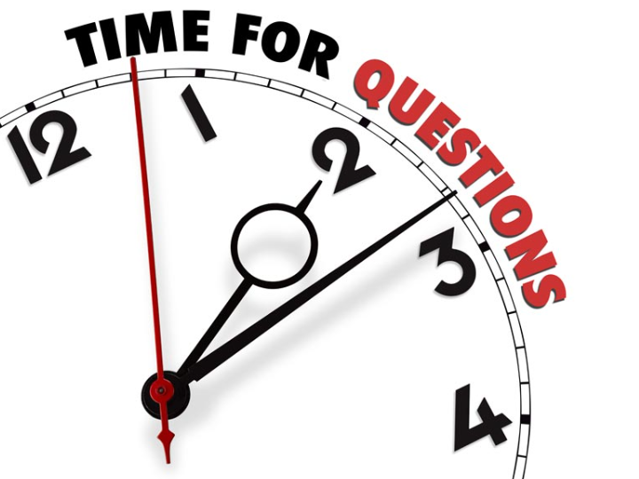
Questions-2
        THANKS for your support!

Slide 22
Standards and Guidance

Slide 23

What You Need to Know - 1
All Web content must be 508 compliant
  Exceptions to this policy are RARE
HTML is the default method for delivering electronic information
  Other formats with the SAME information do not have to be accessible
Contracts for electronic products
  MUST have Section 508 requirements
Notes:
WCAG 2.0 January 18, 2018
Talk about Digital First

Slide 24
Content Format
Choosing content format is a joint responsibility
Discuss content format at the beginning of the project
Consider the following:
  Will the document EVER need to be distributed and posted on the Web?
  What business or organizational requirement does this product fulfill?
  What will the end users need to do with this product?
  Is this a print product?
Examples and rationale to use: HTML, PDF, and Print Only
Notes:
This page covers each type of digital document and why it should be used.
Example Documents Using HTML as the standard Format
At-A Glance/Fact Sheets
Presentations smaller than 10 slides
Programs/Agendas
Guidance
Most content items!
Example Documents Using PDF as the 508 Format
Fillable Forms
Complex Manuals
Periodicals
Long Presentations
Complex Publications
Complex Reports
Example Print-Only Documents that Do Not Require 508 Compliance
Binders
Coloring Books
Booklets
Tri-fold Brochures
Certificates
Exhibit Displays
MASO Printed Forms
Name Badges/Tags
Pocket Folders
Posters, Signs & Banners
Printed Forms
Retired Materials
Scientific Posters
Table Tent Cards

Slide 25
What You Need to Know - 2
Rare Situations: When You Can Use an Approved non-HTML format
  Print-only products that are not intended to be read electronically
  PDF content as the primary way a reader interacts with the content
  Multilingual content not supported by HTML
  Content where no electronic version exists
  Non-HTML formats (Word, Power Point, and Excel)
    Example: Excel that must be used by readers in this native format
  Office 365 formats when providing items internal to HHS
  Note: Word, Power Point, and Excel should not be posted on the internet without an accessible PDF or HTML
More What You Need to Know
Notes:
Multilingual: Languages that use the Latin character set should be section 508 accessible
Pictorial languages can not be made accessible
Suggestion for Non-HTML formats: sharing Rare situations when discussing this slide. For example, some countries don’t have all the electronic technology we have. They may not have the browsers or tools (like Excel) to open the documents.

Slide 26
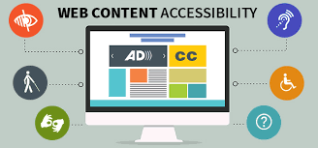
Roles and Responsibilities
Content Creators
  Consult with Web POC
  Content Tagging: alternative text, text only versions, and summaries
  Use the HHS PDF Fillable checklist as you create your documents
  If you are working with a creative developer:
    Identify the format and requirements
    Connect them with the Web POC
Notes:
Content Creators
The Content Creator (author) is responsible for:
Contacting their 508 Web Approving Official to identify the 508 format in which their content will be delivered based on the Content Format and Implementation Guidance. Typically, the 508 Web Approving Official will assign a point of contact (usually the Web Developer) to discuss the business requirements, product specs, file types, potential file size, etc.
Tagging cleared documents in the original source file (MS Word, PPT, etc.) to send to the Web Developer. This includes:
Alternative text for all graphics or photos.
Properly marked up headers, paragraphs, bullets, and appropriate styles.
Long descriptions and/or summary text for data tables, charts, and graphs.
Proper color contrast/use of color.
Note: All tagging that requires content is the responsibility of the Content Creators; such as alternative text, table summary, etc.
Do you really want your web developers creating your alt text?

Slide 27
Roles and Responsibilities: Web Developer
Web Developer
  Ensure 508 compliance of HTML
  Ensure PDFs are received as a 508 accessible tagged files from the Content Creator or Creative Developer and the accompanying HHS completed 508 checklist
  When needed, Convert acquired fully tagged documents (Word, PowerPoint, and Excel) to PDF
    Add additional tagging to PDFs to ensure compliance
    Complete the HHS PDF File 508 Checklist to document test results
Notes:
Creative Developers can also be vendors, external contractors, etc..

Slide 28
PDF Implementation Guidance - 1
Non 508 compliant PDF accompanying an HTML
  PDF must include a link to the compliant HTML
    Located below the header on the first page and in the documents metadata description tag
      Link title example - Accessible Version: <URL>
  Note: Information in the header and footer are NOT read by assistive technology once the document is converted to PDF.
Compliant PDF
  All PDFs must be tested using the HHS PDF File 508 Checklist.
    “HHSChecklist[doc type]-[document name-date].pdf”
  Completed HHS Checklist should accompany each PDF
Notes:
HTML is always fully compliant

Slide 29
PDF Implementation Guidance - 2
True Print-only PDF or other print formats
  Print-only products are not intended to be read electronically and do not have to be fully 508 compliant.
    Print requirements: text legibility and color contrast
  If posted on the Web or distributed via email:
    Describe the basic content and declare “print-only”
A non-compliant PDF (very rare!)
  Non-compliant PDFs CANNOT be posted without an approved accommodation request
Notes:
Accommodation example: 450 page PDF needs to be posted ASAP

Slide 30
CDC 508/WCAG Resources
508 Accessibility: http://intranet.cdc.gov/cdcweb/508-accessibility/
Checklists & Tools: http://intranet.cdc.gov/cdcweb/508-accessibility/checklists-tools/
508 Requirements for Video
508 for Images: http://intranet.cdc.gov/cdcweb/web/images/#508
  Infographic Guidance
Recommendations for accessible translated Web documents
External Linking Standard
508 Accessibility Testing for Mobile Apps

Slide 31
Questions-3
        THANKS for your support!

Slide 32
How-To:
Page Structure, Tables, Images, Hyperlinks, and Translations

Slide 33
Accessible Page Structure
Assistive technology interaction:
  Identify sections: header, footer, menus, content, etc.
  Page navigation:
    Links within a page – can be pulled without reading content
    Link text should be meaningful
    External Linking Standard
  Headings:
    Headers is the map of your page and sets the structure.
    One <h1> per page (automatically assigned to page title)
    Maintain correct reading order
    Break page into digestible chunks
    Do not skip heading levels (e.g., <h3> to <h5>).
      Can skip backwards (e.g., <h5> to <h3>).
Notes:
Explain how the page structure assist users in jumping thru the information.
Emphasize the need to have limit to Title.
This is especially important when converting an article to a HTML page.
Articles can have long titles. Titles also play into UX, assistive technology, etc…
Make sure headers/titles are front loaders.
Usability Tips:
1. Immediately confirm what the page is once it has loaded
2. Avoid using pop-up windows. If use pop-up windows make sure the default action is the most forgiving.
3. Avoid opening new browser windows. If open new browser windows, always provide a simple way to get back to the site’s main page
4. Do not rely on rollover text to convey any information
5. Limit number of links on a page
6. Avoid very small buttons and tiny text for links
7. Ensure that important commands appear as their own unique links
8. Underline all links
9. When users make a choice, warn them that the choice is coming, and tell them how many options they have
10. Design pages consistently
11. Make sure tab order is logical

Slide 34
Tables
How assistive technology reads tables
    Examples of Good and Bad Table Layout for Screen Readers
    Table Accessibility with a Screen Reader
Table should never be used for formatting purposes
Header cells should always be identified (th cells).
Table caption explains the table.
Always associate data (td) cells to header (th) cells one of two ways:
  Scope attribute (most tables)
  ID and Headers attributes (complex tables)
Guidance for Creating Accessible Tables
W3C Table Tutorials
Notes:
Usability Tips:
Summarize all tables
Before using a column layout, consider how it will appear for screen magnifier users.
Avoid using large tables for any reason. If you must use them, consider providing the information in text as well.

Slide 35
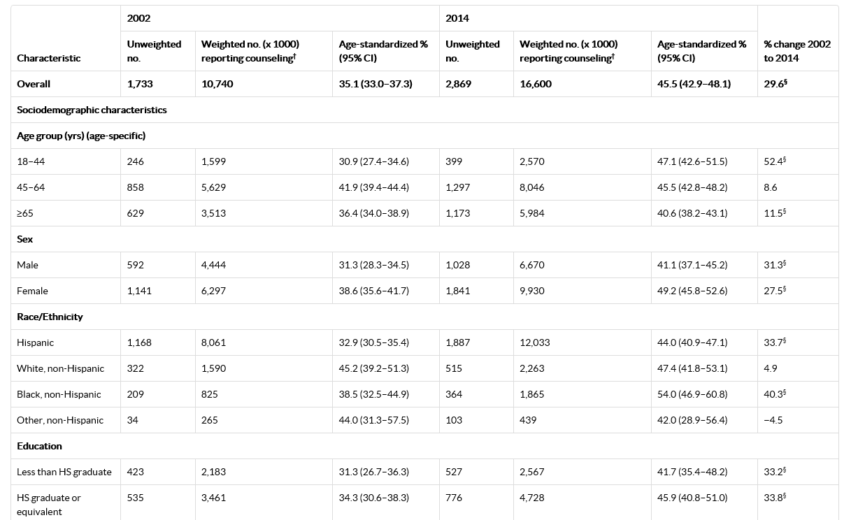
What is a Complex Table?

Slide 36
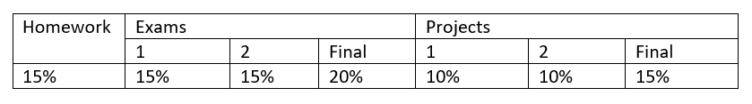
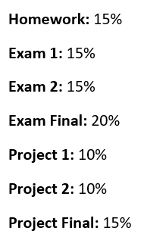
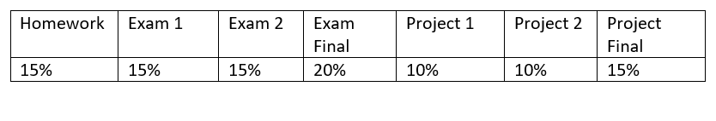
Avoid Complex Tables When Possible
Original Example:
Best solution – no table tag:
Simpler Solution:

Slide 37
Tables: More Best Practices
Do not use tables for layout
Avoid empty data/header cells
Do not nest tables – the simpler the better
Provide meaningful alt text
  Table descriptions should answer the question, “What is the table’s purpose and how is it organized?
Use table caption to provide a very brief description of the table
Summary attribute
  Provides a summary of a data table structure (not content)
  Screen reader specific and not well supported
  Not part of HTML 5 specification
  Never used for layout tables
Avoid complex tables and tables when possible

Slide 38
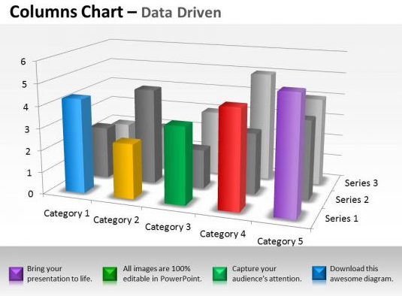
Image Guidance
Avoid using color as the only way to convey meaning
  Legends for charts and graphics
Avoid low contrast
  Colour Contrast Analyzer
TP4 Preferred Color Pairings
Avoid text embedded in images
  When it scales the text gets smaller
All non-decorative images require alt text
Info-graphics are posted as images not PDFs
Guidance for Images
Notes:
We have always required captions for secondary images, but now we are requiring alt text for every image for 508 and SEO purposes.
In the past, which is like lest week at this point, if a program didn’t provide alt text the programmer would create it. However, that is a missed opportunity for you. Alt text that ties the image back to the content is helpful to those who need it and may improve your SEO.
Emphasize during training that Infographics are images, not a PDF.
Usability Tips:
Choose text colors for good contrast
Create good contrast between text and the page background
Make sure it is possible to magnify your site
Do not rely on background image as a page background to create contrast with text.

Slide 39
Complex Images
Infographics, charts, and graphics
Include alternative text version of image content
  Can include text version below the image
  If more complex include a link to HTML page with text version
If using WCMS Image Share Widget, include links to HTML and 508-compliant PDF supporting information (HTML is preferred)
Alternative text for figures, charts and maps
Describe each figure as if you were describing it to someone who could not see it. Be sure to capture the essence behind the reason for including it.

Slide 40
Decorative Images
borders, spacers, thumbnails, and corners
Still requires an alternative text tag, but the content of the tag is blank
  Alternative HTML text code: image alt=“”/image
  Alternative Text for Images, charts/graphics, and infographics

Slide 41
Alt Text – Best Practices
Alternative text should be less than 125 +/- characters
It’s easy to add in WCMS but can be challenging to write
  Think about context and target audiences (when image used in multiple locations, WCMS users can customize alt text for each use)
    Are scientific terms relevant to topic/audience?
    Which visual details are relevant to topic/audience?
  Content owners should be involved in writing
Don’t use the phrases “image of…” or “graphic of…” to describe the image

Slide 42
Image Caption vs Alt Text
Image Captions
  The caption should relate the photo to the content
  Should include key words and messages
Alt Text
  Be accurate in the description -- alt text represents an image in any situation where it can’t be seen or displayed (e.g., screen-reader users, search engines)
  Every non-decorative image requires an alt text for 508
  Leave alt text field empty for decorative images (and check “Image is Decorative”)
Notes:
We have always required captions for secondary images, but now we are requiring alt text for every image for 508 and SEO purposes.
In the past, which is like lest week at this point, if a program didn’t provide alt text the programmer would create it. However, that is a missed opportunity for you. Alt text that ties the image back to the content is helpful to those who need it and may improve your SEO.

Slide 43


Examples of Alt Text and Captions
Alt text: A mom taking her son's temperature.
Caption: A fever is a common symptom of strep throat.
Alt text: A doctor examining a bottle of antibiotics.
Caption: Antibiotics reduce the length of time you’re sick and reduce your symptoms.
Notes:
Alt text for secondary images should be intentional and support the message in the caption.

Slide 44
Hyperlinking
Best Practices
  Don’t link to redirects
  Use meaningful link text (not “Click here” or “more”)
  Avoid reusing the same link text within a page
  Link to high-quality and reputable material
  Check for broken links regularly (WCMS provides report)
  External Linking Standard
Notes:
WCMS UX Recommendation:
Standard Links
Blue, underlined by default
Defaults to opening in same window
Exception to Standard Link Behavior
Can override the default link behavior and open in a new window.
Can hide underline on lists.
Links: External

Slide 45
Questions-4
        THANKS for your support!

Slide 46
Creating Accessible Documents

Slide 47
Setting Document Metadata
Select “File” Tab
Document Properties
  Title
  Tag
  Comments
  Status
  Categories
  Subject
  Date created and reviewed
  Author
  Restrictions, copyright, and language
Notes:
Alternate for Slide 10

Slide 48
Checking for Issues
Select File Tab: top-left-tab
Click “Check for Issues” and select “Check Accessibility”
You will be returned to your document with the Inspection Results to the right with Errors, Warnings, and Tips.
As you select the errors, the additional information will list why and how to fix step by step.

Slide 49
Word: Biggest Challenges
Alternative text
Color contrast and color conveying meaning
Document order
Custom tables and using tables for formatting
Setting metadata
File Name Examples
  Do this:
    LSRB-GUI-FWInactivationValidation.pdf
    LSRB-GUI-MTCRequirements.pdf
  Not this:
    LSRB-GUI-FWrameworkforInactivationValidation-20171113.pdf
    LSRB-GUI-MTCRequirements-20171113.pdf
Notes:
Alt Text: title and description. Use description

Slide 50
Power Point: Biggest Challenges
All text is available in outline view
Alternative text
Color contrast
Color conveying meaning
Graphs and Tables
Setting metadata
Slide reading order
Unique titles

Slide 51
Reducing or Eliminating Remediation
Use the HHS Checklist as a guide as you fill it out
Make and test for 508 as you build
Save your changes after each test
Maintain one version for all updates

Slide 52
Word Checklist and Resources
Checklist: Word Document 508 Checklist
Step by Step: Creating Accessible PDF Files from Word – PDF
Video: Overview of Requirements for Accessible Word Documents
Video: Templates and Style Basics
Video: Lists, Columns, & Table of Contents
Video: Tables
Video: Figures
Notes:
Through an additional soundtrack or alternate video with soundtrack, the visual images that carry meaning or value for the sighted viewer are audibly conveyed to people with disabilities.
Audible descriptions of actions and elements shown in the video are announced during natural pauses in the audio. In short, all significant information gathered through sight should have a spoken equivalent.
In many cases, the need for formal AD as a separate audio track added in post-production can be lessened or removed if, at the time of initial scripting, writers and producers build descriptions into the original script with narration of visually important elements such as graphics, actions, and other text-based information displayed on the screen.

Slide 53
PowerPoint Checklist and Resources
Checklist: PowerPoint Document 508 Checklist
Step by Step: Creating accessible PowerPoint presentations
Video: Make a Presentation Accessible
Video: Tables, Charts, and Images

Slide 54
PDF Checklist and Resources
Checklist: PDF File 508 Checklist
Step by Step: Create accessible PDFs in Microsoft Word
Video: Eight Essentials for Creating Accessible PDF Documents
Video: Ensuring your PDF is Accessible

Slide 55
Questions-5
        THANKS for your support!

Slide 56
WCAG 2.0 Success Criteria for
Prerecorded Audio and Video

Slide 57
Video Compliance should be implemented at the beginning of video creation!

Slide 58
Audio Requirements
Audio Files
  Requirement: Access for Hearing Impaired
    Provide transcript. This requirement has not changed.

Slide 59
Video Requirements - 1
Video Files
  Requirement One: Access for Hearing Impaired
    Provide synchronized captions, including important sound elements; closed captions are recommended.
  Requirement Two: Access for Visually Impaired
    Describe all important visual elements in an audio description. Visual elements include on-screen text, charts, scene changes, important actions, etc.

Slide 60
Video Requirements – Audio Description (AD)
Three Approved AD Solutions | When Solutions Should/Can be Used
Video is scripted so that the audio contains all needed descriptions of visual elements. | Any video Example: NHANES Longitudinal Studies
Video posted with a transcript that contains added narrative descriptions describing important visual elements | Videos under 3 minutes Example: Vital Signs Videos of talking head Example: I Am CDC - Margo Riggs
Two videos developed and posted: one with and one without audio descriptions (narration) Note: The Audio Description track does not need to be included in captions | Videos where including audio descriptions in the existing video interferes with the soundtrack Videos where more optimization is needed for visually impaired experience Example: Be Someone’s Hero | Audio Described
Notes:
Notes: If there is no sound in the video except some background music, the caption can say “Music playing” and audio descriptions must be available to describe what is taking place in the video.

Slide 61
Pricing for AD, Transcript, and Captioning
VITAC: AD, Transcript and Captioning Service
  Factors that determine price
    type of accessibility need
    turnaround time
    languages
    how the captioning is viewed
Automatic Sync Technology
  Automated Captioning & Transcription Pricing - GSA Contract GS-35F-0220X
*An “Industrial Funding Fee” of 0.75% is included in all GSA prices and remitted to the GSA.
Turnaround | 2-3 Day | 1 Day | 1 Hour+
Captioning Only (have transcript) |  |  | $1.31 / min.* ($78.60 / hr.)
Transcription Only | $1.49 / min. * ($89.40 / hr.) | $2.01 / min. * ($120.60 / hr.)
Captioning & Transcription | $2.79 / min. * ($167.40 / hr.) | $3.27 / min. * ($196.20 / hr.)

Slide 62
        THANKS for your support!

