Slide 1
USPHS Officer Leadership
We are “one team with one purpose”, working toward a common and extremely important goal – to protect, to promote, and advance the health and safety of our Nation.
Mike Flanigan, vice president of Expressionary

Slide 2
Why is leadership important?
Leading people effectively is three to four times more important to a leader’s career than are other skills and knowledge.
Anthony Thompson, USDA
Notes:
Leadership IQ, “Talent Management in America and China”

Slide 3
Leadership Over the Years
The last 50 years has been the story of “the individual”.
However, in the last 15 years this model has become less effective…
Notes:
Center for Creative Leadership

Slide 4
Why?
Given the complexity of today’s environment, it is not possible for any one individual to know the solution or even define the problem.
Notes:
According to the Center for Creative Leadership, what Ronald Heifetz calls

Slide 5
Think Like a Leader
Share “your” strategic thinking.
Solicit ideas; be the one to ask, “why”
Be open to questions and push-back, and learn!
Promote knowledge, tools, and resources
Engage others to be the “Best Version” of themselves
Consider transition or change as a “gift” that can bring new and unexpected opportunities

Slide 6
Five Critical Competencies for Leading People
Honesty
Level with people
Provide Feedback
Inform employees and identify areas of excellence and improvement
Task Alignment
If you love what you do, you never work a day in your life

Slide 7
Five Critical Competencies for Leading People
Clear Expectations
People are best equipped to get the job done when they know what to do
Humility and Gratitude
Be sincere

Slide 8
Leaders on Leadership

Slide 9
Goal is for USPHS Officers to Have:
The head to think for themselves
The voice to inspire their organization
The heart to serve others
The courage to act when others will not
Anthony Thompson, USDA

Slide 10
Leadership
“You cannot lead where you will not go”
Former SG Jocelyn Elders

Slide 11
Evaluating Others
Before you criticize someone, you should walk a mile in their shoes.
That way, when you criticize them, you are a mile away from them
And you have their shoes
SG Boris Lusinak

Slide 12
Seize the High Road
I learned long ago not to wrestle with a pig.
You get dirty; and besides the pig likes it.
Curys Chang

Slide 13
Know Yourself
What are your strengths?
Identify and be honest about your weaknesses
Be the first to admit that you are wrong or made a mistake
Present solutions
Lou Ann Rector, USDA

Slide 14
Integrity
“Integrity – Don’t leave home without it”

Slide 15
Honor Your Word
Every time you break your word, you lose power. Successful leaders keep their word and their promises. You can accumulate all the toys and riches in the world, but you only have one reputation in life. Your word is gold. Honor it.
Sharif Khan

Slide 16
Recognize Success
A simple “Thank You” works wonders
Create milestones for yourself
Do not depend on public recognition or awards
Be humble, yet proud of accomplishments
Lou Ann Rector, USDA

Slide 17
Seek Lasting Rewards
It is better to deserve honors and not have them than to have them and not deserve them
Mark Twain

Slide 18
Army War College on Leadership Qualities
Keeps calm and cool under pressure
Deal with quick-paced happenings
Not an unemotional rock
Functions, thinks, and is a source of strength for others
Is a good communicator

Slide 19
Egos and Empathy
A leader shows more empathy than ego and remains dedicated to the betterment of the whole and not the advancement of one
Dave Ramsey

Slide 20
Remember
“At the end of the day, the only thing you really have control over is how you handle something”

Slide 21
HRSA on Leadership
Leaders are called to stand in that lonely place between the no longer and the not yet, and intentionally make decisions that will bind, forge, move, and create history.
We are not called to be popular, we are not called to be safe, we are not called to follow
We are the ones called to take risks, we are the ones called to change attitudes, to risk displeasures, we are the ones called to gamble our lives, for a better world.
Mary Lou Anderson, HRSA (April 1970)

Slide 22
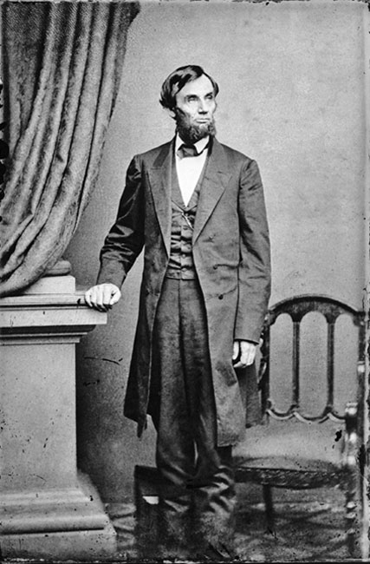

Slide 23
