Slide 1
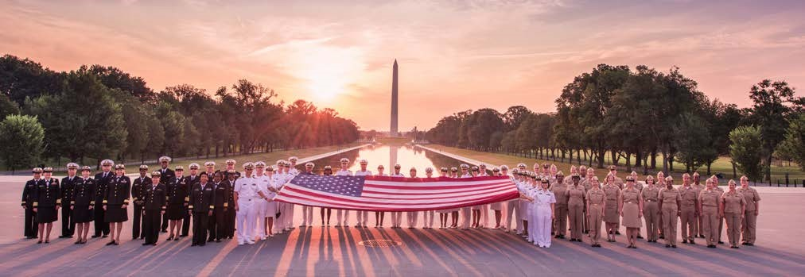
The United States Public Health Service (USPHS) Commissioned Corps
America’s Health Responders
Presenter Name, Title
Date

Slide 2
Topics of Discussion
Who We Are
Our Mission and Values
What We Do
Where We Work
Professional Categories
What We Offer
Ready Reserve Corps
PHERST
Officer Qualifications
Application Process
Pharmacist Category Details
Emergency Response Deployment
Student Opportunities
Topics of Discussion
Notes:
The topics of discussion I will be speaking about are the history of the United States Public Health Service (USPHS), Who we are, Our Mission and Values, What We Do, Where we work, Professional Categories, What we Offer, Ready Reserve Corps, PHERST, Officer Qualifications, the Application Process, Pharmacist Category Details, Emergency Response Deployment, and Student Opportunities.

Slide 3
USPHS Commissioned Corps INTRODUCTION
In Officio Salutis
Established in 1889, the U.S. Public Health Service Commissioned Corps is solely committed to protecting the public’s health.
The Commissioned Corps is part of the U.S. Department of Health and Human Services and is overseen by the Assistant Secretary for Health.
The U.S. Surgeon General and the Deputy Surgeon General provide operational command of the USPHS Commissioned Corps.
OVERVIEW
Notes:
The USPHS Commissioned Corps established in 1889 is part of the Department of Health and Human Services (DHHS) and led by the Assistant Secretary of Health (ASH).
The Surgeon General, oversees the Commissioned Corps . The Surgeon General is America’s chief health educator, responsible for giving Americans the best scientific information available on how to improve their health and reduce the risk of illness and injury.
In carrying out all responsibilities, the Surgeon General reports to the ASH, who is the principal advisor to the Secretary of HHS on public health and scientific issues. The Surgeon General is appointed by the President of the United States with the advice and consent of the United States Senate for a 4-year term of office.

Slide 4
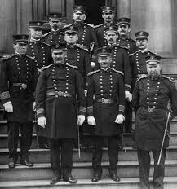
USPHS Commissioned Corps ABBREVIATED HISTORY
1798 Act for the Relief of Sick and Disabled Seamen
1870 Marine Hospital Service
1871 First Supervising Surgeon (later Surgeon General)
Dr. John Maynard Woodworth
1878 National Quarantine Act
1889 Legislation created the Commissioned Corps
Public Health Service (with broadened powers)
1930 Parker Act: Expanded Public Health Service to Non-Physicians
1955 Establishment of the Indian Health Service
Department of Health and Human Services established
1999 First Dedicated Disaster Response Mission for the USPHS Commissioned Corps (20,000 Kosovo refugees)
OUR HISTORY
Notes:
USPHS Commissioned Corps has a great history. In July of 1798, Congress passed "An Act for the Relief of Sick and Disabled Seaman," which was signed by President John Adams. This law authorized the creation of a government operated system of marine hospitals and mandated that laboring merchant marine sailors pay a tax to support it.
The earliest predecessor of the USPHS Commissioned Corps was the Marine Hospital Service. At the time—the early 1800s—our country relied on a healthy merchant marine for trade and security. Our seamen traveled widely. Often, those who became ill brought their sicknesses back home, which made their health care a Federal concern.
The Marine Hospital Service eventually grew into the Public Health and Marine Hospital Service. In 1912, Congress shortened this name to the U.S. Public Health Service, with the Commissioned Corps as its uniformed service.
The responsibilities of the U.S. Public Health Service also changed, as new threats to our country’s public health emerged.
Congress charged the U.S. Public Health Service with preventing the introduction and spread of major epidemic diseases such as smallpox, yellow fever, and cholera. To meet this responsibility, the service and its Corps took over many national quarantine, disinfection, and immunization functions.
Congress also charged the U.S. Public Health Service to carry out the medical inspection of arriving immigrants, such as those landing at Ellis Island in New York.
The workplace environment and its effect on the health of workers became a major concern for the service in the early 1900s.
By 1912, the U.S. Public Health Service was authorized to investigate human diseases (such as tuberculosis, hookworm, malaria, and leprosy), sanitation, water supplies, and sewage disposal.
Today, the USPHS Commissioned Corps officers work abroad, as well as in the United States to help prevent the spread of infectious and communicable diseases. New threats to our public health, such as SARS, avian flu, drug-resistant TB, MRSA, Ebola, and COVID-19—continue to develop.
That’s a brief history of the Corps.

Slide 5
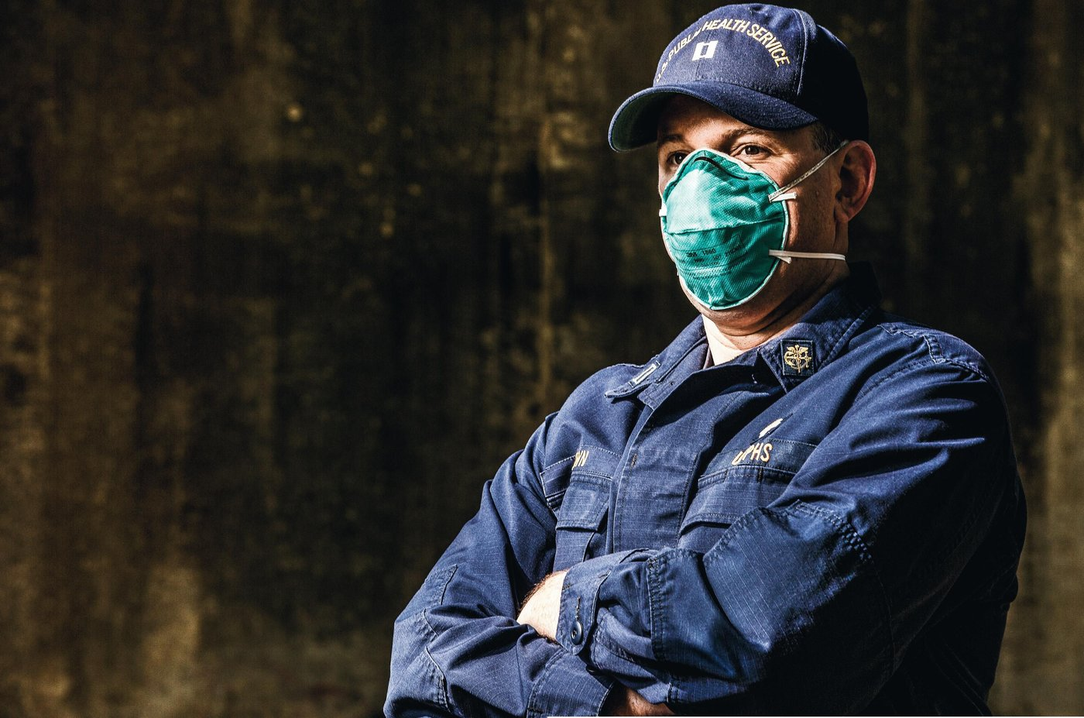
Who We Are
The USPHS Commissioned Corps is one of the eight uniformed services, and is the only one dedicated solely to protecting America’s public health
Approximately 6,000 public health professionals dedicated to addressing public health and providing clinical care
WHO WE ARE
Notes:
One of eight uniformed services and inspired by the call to serve vulnerable and underserved communities through addressing public health issues.

Slide 6
Our Mission and Values
Protect, promote, and advance the health and safety of the nation
Service
Leadership
We provide vision and purpose in public health through inspiration, dedication and loyalty.
We are committed to public health through compassionate actions and stewardship of time, resources, and talents.
Core Values
Integrity
Excellence
We exemplify uncompromising ethical conduct and maintain the highest standards of responsibility and accountability.
We exhibit superior performance and continuous improvement in knowledge and expertise.
MISSION AND VALUES
Notes:
The mission of the U.S. Public Health Service Commissioned Corps is to protect, promote, and advance the health and safety of our Nation. This has been the Public Health Service’s mission and method since 1798, when John Adams—the second President—signed into law the Act for the Relief of Sick and Disabled Seamen.
The Commissioned Corps achieves its mission through:
Rapid and effective response to public health needs
Leadership and excellence in public health practices, and
Advancement of public health science.

Slide 7
What We Do
Protect, promote and advance the health and safety of our nation.
Provide essential health services We go where most do not go to provide care for vulnerable and underserved populations.
Serve on the frontlines of public health emergencies We respond quickly to natural disasters, disease outbreaks and global public health emergencies as well as serve on humanitarian missions.
Lead public health programs and policy development We utilize our experience, skills, and networks to provide leadership within the U.S. Department of Health and Human Services and throughout the federal government.
Advance innovation and science We work at the forefront of medical challenges like COVID-19, cancer, and the opioid crisis.
WHAT WE DO
Notes:
The USPHS Commissioned Corps officers work on the front lines of public health. Our officers respond quickly to natural disasters, fight disease, conduct research, advance public health science and care for patients in underserved communities across the nation and throughout the world.

Slide 8
USPHS Commissioned Corps WHERE WE WORK
Approximately 6,000 officers in 800 locations, all 50 states and numerous foreign assignments including the World Health Organization
Department of Health and Human Services
Department of Defense
Department of Homeland Security
U.S. Agency for International Development
Federal Bureau of Prisons
Department of the Interior
Department of Veterans Affairs
State Governments and Local Agencies
WHERE WE WORK
Notes:
The USPHS Commissioned Corps currently has a presence in more than 800 locations, including all 50 states and numerous foreign assignments, such as the World Health Organization and World Bank.
Officers work at the U.S. Departments of Health and Human Services, Defense, and Homeland Security and other federal agencies involved with public health. (List some of the agencies we work for including IHS, BOP, IHSC, CDC, FDA, and NIH).

Slide 9
Professional Categories
DIETITIAN
S
PROFESSIONAL CATEGORIES
Notes:
The USPHS Commissioned Corps is comprised of officers from 11 distinct professional categories: Dietitian, Health Service Officer, Environmental Health Officer, Pharmacist, Scientist, Engineer, Therapist, Veterinarian, Physician, Dentist, and Nurse.

Slide 10
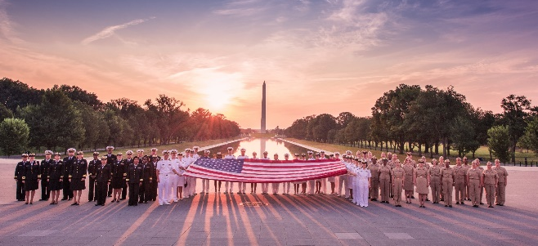
We Offer
Uniformed service benefits featuring comprehensive, low-cost medical, dental, and vision care for officers and their dependents, retirement, and the Post-9/11 GI Bill education benefit, which can be transferred to dependents after 10 years of service
Diverse career opportunities and professional growth
Potential ability to transfer from civil service or other uniformed services
Opportunities for involvement in the response to disasters and epidemics
CANDIDATES MUST
Meet basic requirements and basic education and training requirements
Meet height and weight standards, maintain physical fitness, and be medically qualified (if you have specific concerns about medical eligibility, please email PHSCADMedical@hhs.gov)
Commit to displaying respect for our country and service by wearing the USPHS Commissioned Corps uniform
To become a Public Health Service officer, an interested applicant must complete the commissioning process and secure a position in an agency where Public Health Service officers serve. Applicants pursue both processes simultaneously during the 6 to 9 months commissioning process.
WE OFFER
Notes:
As a Public Health Service officer, you will receive comprehensive benefits include but are not limited to:
30 days of paid vacation per year
Paid Federal holidays
Low-cost medical, dental, and vision care for you and your dependents
Thrift Savings Plan (TSP)
Excellent retirement eligibility after 20 years of service
Post-9/11 GI Bill education benefit
Post-Graduate opportunities

Slide 11
Ready Reserve Corps
The Coronavirus Aid, Relief, and Economic Security (CARES) Act, signed into law on March 27, 2020, provides both the authority and funding for the establishment of the Ready Reserve Corps, the reserve component of the USPHS Commissioned Corps. Applicants must meet same appointment requirements as Regular Corps.
The Ready Reserve Corps provides trained and ready personnel to fill critical public health needs and:
Supports the USPHS Commissioned Corps’ capacity to respond to regional, national, and global health emergencies and improve access to health services
Preserves clinical care positions by maintaining a surge capacity of health professionals available for deployment without jeopardizing the service of clinicians in hard to fill roles
Offers an opportunity to serve for mission-driven clinical and public health professionals who cannot commit to a full-time active duty position in the USPHS Commissioned Corps
Enables access to highly specialized skill sets that would be impractical in full-time active duty positions
READY RESERVE CORPS
Notes:
The Ready Reserve Corps offers a unique opportunity for its officers to serve their local community as well as their country in times of public health emergencies or in underserved areas.
The Ready Reserve Corps under “CARES” Act that signed into law on March 27, 2020, will preserve clinical care positions available for deployment without jeopardizing the service of clinicians in hard to fill roles; and will authorize access to highly specialized skill sets during critical public health needs.
The Ready Reserve Corps provides trained, ready and equipped public health professionals, capable of mobilizing and deploying to augment the active duty Commissioned Corps, under the authorities of the Secretary for Health in response to national emergencies and public health crisis.
The Ready Reserve Corps offers a unique opportunity for officers to lead their own lives in the civilian world and serve their country when needed in under-served communities and during public health emergencies.

Slide 12
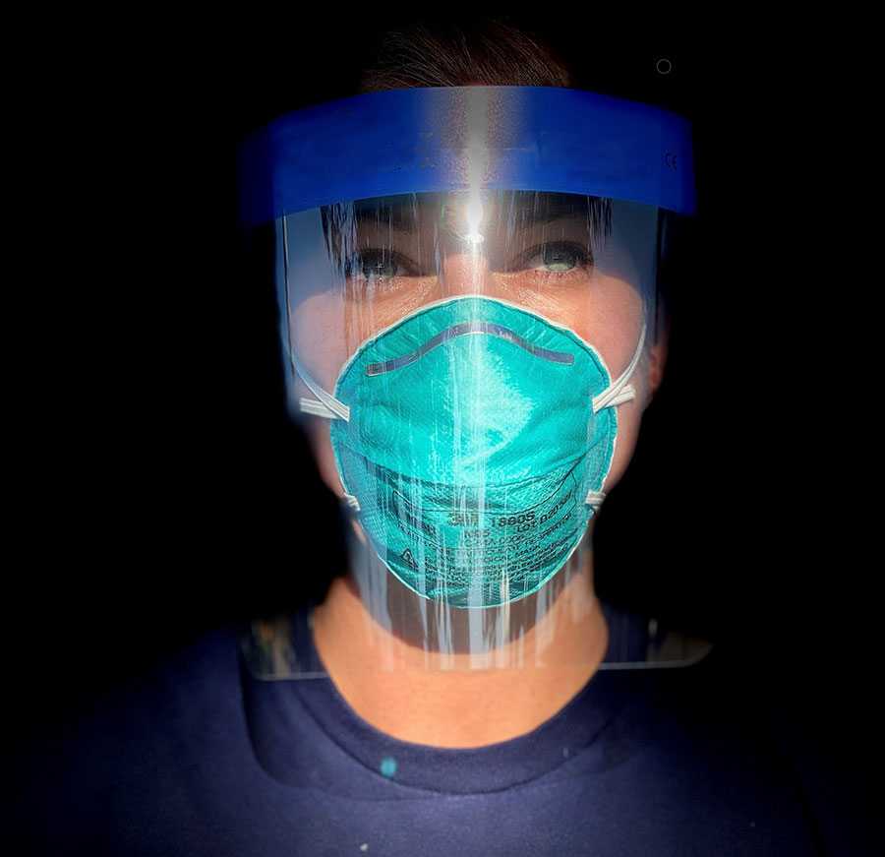
Public Health Emergency Response Strike Team (PHERST)
The USPHS Commissioned Corps deploys in support of numerous natural disasters and public health emergencies to provide essential clinical care to those in need, as well as ensure sustainable health-care service delivery. The Public Health Emergency Response Strike Team (PHERST) is comprised of active duty Public Health Service officers who rapidly deploy as first responders to regional, national, and global public health emergencies.
PHERST provides the capability to surge during national emergencies and public health crises, providing trained and ready personnel to fill critical public health needs and will:
Be First to Respond - Active duty officers who are “first on the ground.” PHERST is available to deploy immediately (within 8 hours) at the request of the President, the Secretary of Health, the Assistant Secretary for Health, or the Surgeon General.
Extended Deployment - Deploy for extended durations (30-60-90 days) if needed.
Preserve Care Positions - When not deployed, PHERST officers train, maintain skills, and fill short-term staffing in agencies.
Be Clinically Prepared - Offer advanced clinical competencies and innovative techniques required for community stabilization.
PHERST

Slide 13
Pharmacy Category
Notes:
Now I am going to cover information about the Pharmacist Category, the JRCOSTEP application process, and the Active Duty Application Process.

Slide 14
Officer Highlight
Rank/Name (credentials): Position:
Education:
Service time:
Prior Branches of Service (if applicable):
Practice areas:
Deployments:
What is it like to work on your current assignment?
* Include officer photograph on the right-hand side of this slide
Officer Highlight
41

Slide 15
What We Do: Pharmacists
Improving drug therapy for underserved communities:
Traditional pharmacists roles
Pharmacist providers roles with expanded scopes of practice
Improving patient outcomes through direct patient care; chronic care clinics
Administrative roles
Leading multi-disciplinary healthcare teams
Beyond traditional pharmaceutical care:
Work in various regulatory, clinical, and scientific research roles
Review, approve, and monitor safety of new drugs
Assist in public health emergencies
USPHS Pharmacist Category
Notes:
Improve patient care through collaborative practice agreements.
Work to prevent, mitigate, and solve clinical drug shortages
Protect the integrity of the drug supply chain
Play a key role in new and generic drug approvals
Support medical countermeasures to be used during public health emergency response

Slide 16
Where Pharmacists Serve
USPHS Pharmacist Category

Slide 17
How You Can Serve
Students
JRCOSTEP
SRCOSTEP
Pharmacist
Active Duty
Interservice Transfer
Ready Reserve
Initial Appointment
PHERST
OPPORTUNITIES
Notes:
Talking Points:
There are two competitive programs for which students can apply.
2. We are actively seeking motivated pharmacists with active and unrestricted licenses to join us. Those serving in other Uniformed Services may request an interservice transfer. If you have more than 8 years but less than 15 years of prior active duty military service in another uniform service or will reach over 8 years of active duty service prior to becoming a Public Health Service officer, you will require an additional Time In Service (TIS) waiver approval.

Slide 18
Welcome, I’m Dr. Vivek Murthy,
21st U.S. Surgeon General As the Nation’s Doctor, my office is focused on the most pressing public health issues of our time. Read about our current priorities.
COVID-19
Health Misinformation
Health Worker Burnout
Youth Mental Health
www.hhs.gov/surgeongeneral/priorities
Notes:
Surgeon General is the leader of the Commissioned Corps of the USPHS
The Surgeon General’s Priorities: Public health impacts all of us. We aim to help everyone understand these important issues and how we can work together to take action.
COVID-19: Keeping our families and communities safe during the COVID-19 pandemic is a key priority for the nation and for the Surgeon General.
Health Misinformation: With the abundance of health information available today, it can be hard to tell what is true or not. Many people are exposed to health misinformation: information that is false, inaccurate, or misleading according to the best available evidence at the time.
Health Worker Burnout: The pandemic has brought our nation’s healthcare workers to a breaking point. They are experiencing never-before-seen rates of burnout, psychological distress, and workforce shortages. We must act to support our health care workers with all that they need to heal and to thrive.
Youth Mental Health: Far too many young people are struggling with their mental health and unable to get the support they need. Maintaining healthy children and families requires all of society—including policy, institutional, and individual changes in how we view and prioritize mental health.
Pharmacist officers are force multipliers for these priorities.
To learn more about the Surgeon General’s priorities go to https://www.hhs.gov/surgeongeneral/priorities/index.html

Slide 19
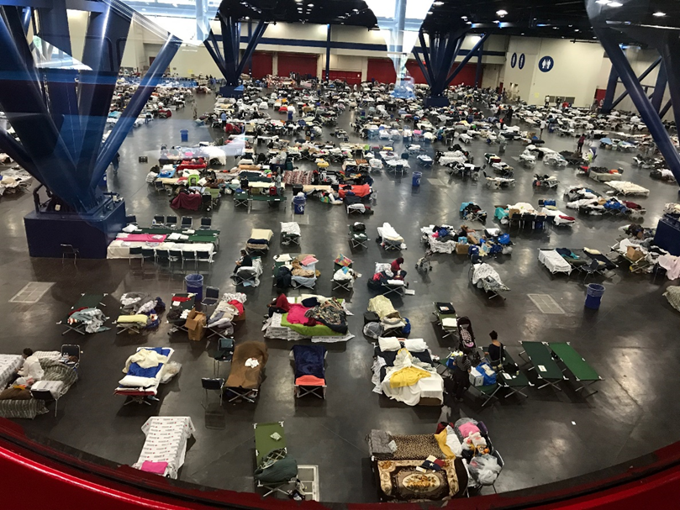
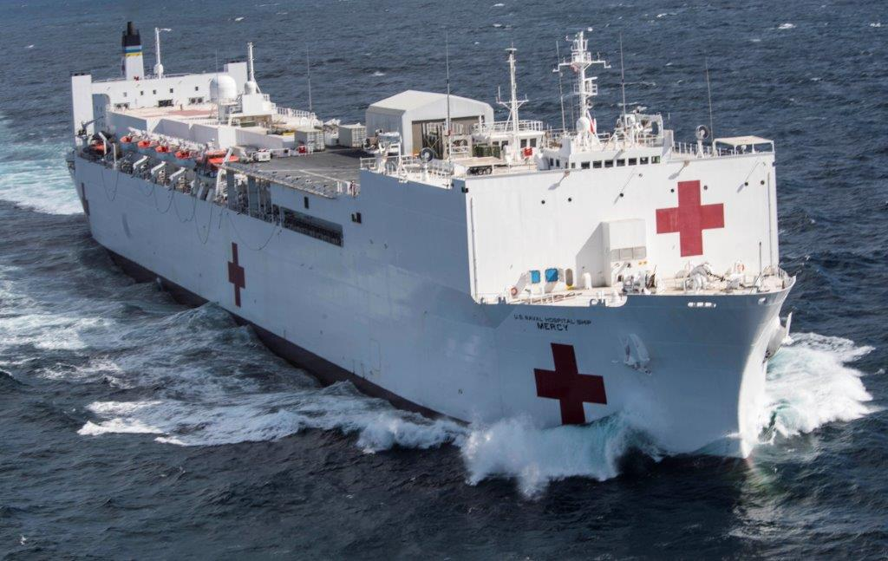
Emergency Response Deployments
Notes:
PHS mission: To Protect, Promote and Advance the Health and Safety of our Nation
An important part of being an officer is readiness, and being willing to deploy for public health emergencies
The left is a picture of the sleep quarters for patients and uniformed services in the Puerto Rico convention center.
The right is a picture of a U.S. Navy Hospital ship. The USPHS has deployed with DoD/Navy to help support humanitarian missions in the past.

Slide 20
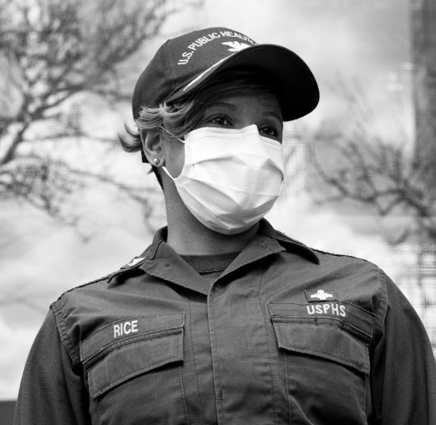
Readiness and Deployment
The Office of the Surgeon General, through Commissioned Corps Headquarters, is responsible for the coordination of readiness and deployment for:
Domestic and international operations
Teams and individuals
Humanitarian assistance
Disaster relief
Emergency response
Global training
READINESS AND DEPLOYMENT

Slide 21
Pharmacist Deployment Roles
Non-Clinical Pharmacist
Administrative
Logistics
Leadership
Clinical Pharmacist
Counseling
Patient Care
Dispensing Medications
Medication Procurement
Education
Immunizations
DEPLOYMENT ROLES

Slide 22
Pharmacist Deployment Missions
Other
Natural Disasters
COVID-19 (2020-22) Hurricanes
Command Center
Cruise Ship Missions
Phoenix Indian Med. Ctr. Mission
Health Screener
Quarantine Station
Medical Procurement Support
Laura (‘20)
Maria (‘17-‘18)
Harvey-Irma (‘17)
Matthew (‘16) * Sandy (‘12)
Gustav-Ike (‘08)
Katrina-Rita (‘06)
California Fires (‘17, ‘19, ‘20)
Oregon Fires (‘20)
Hawaii Volcano (‘18)
Louisiana Flooding (‘16)
Minot, ND Flood (‘11)
Native American
Missions
International Missions Other Missions
Navajo Water Access (‘20)
Gallup Indian Medical Center (‘16)
Crow Flooding (‘12)
Typhoon Yutu (‘18-‘19)
Ebola – West Africa (’14,’15,‘19)
American Samoa Tsunami (‘09-‘10)
Haiti Earthquake (‘10)
USS Mercy Humanitarian (‘06)
Operation Allies Welcome (‘21-‘22)
Child Reunification (‘18)
Unaccompanied Minor
(‘14, ‘16, ‘18)
Oil Spill Responses
Inaugurations
USPHS DEPLOYMENT MISSIONS
Notes:
Not a comprehensive list, includes the myriad of missions and breadth of contribution on deployment missions.

Slide 23
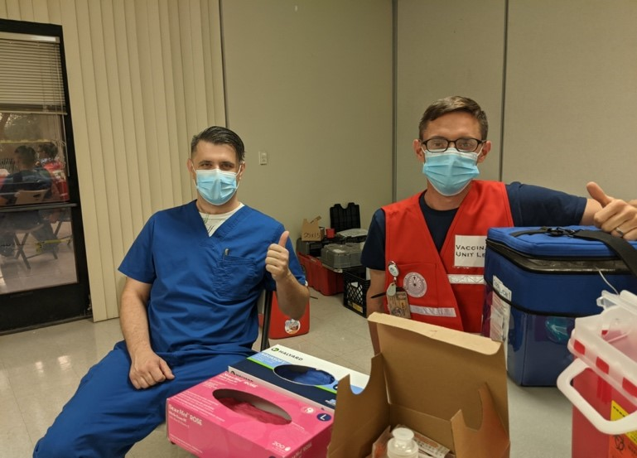
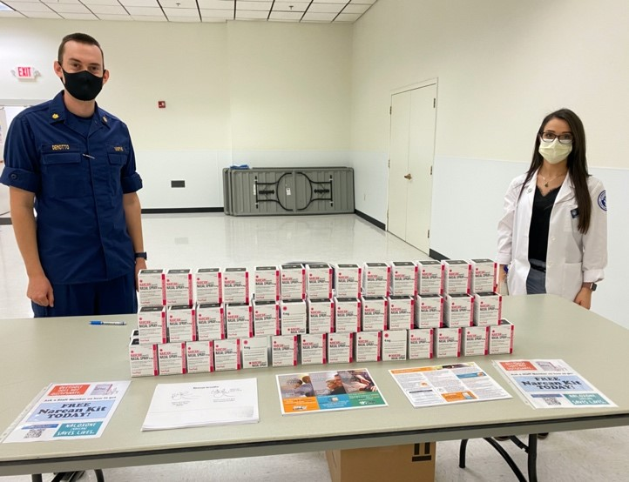
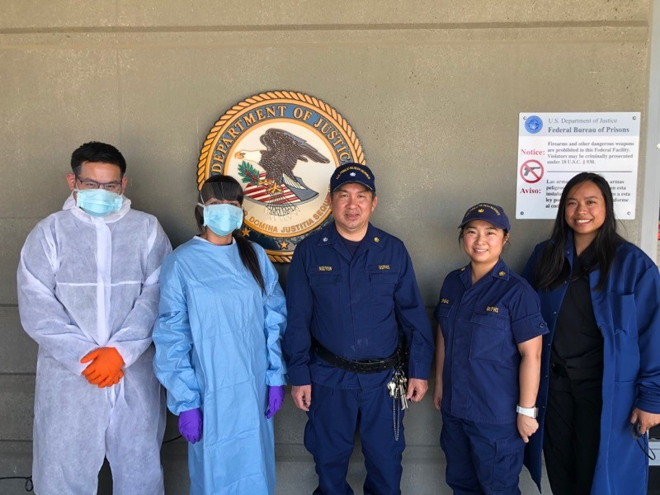
Student Opportunities What You Can Do
Join the Pharmacy Student Listserv!
Notes:
There are several opportunities for students to learn about and get a flavor of PHS.
We love students – you are the future pharmacists and we want you to get involved.

Slide 24
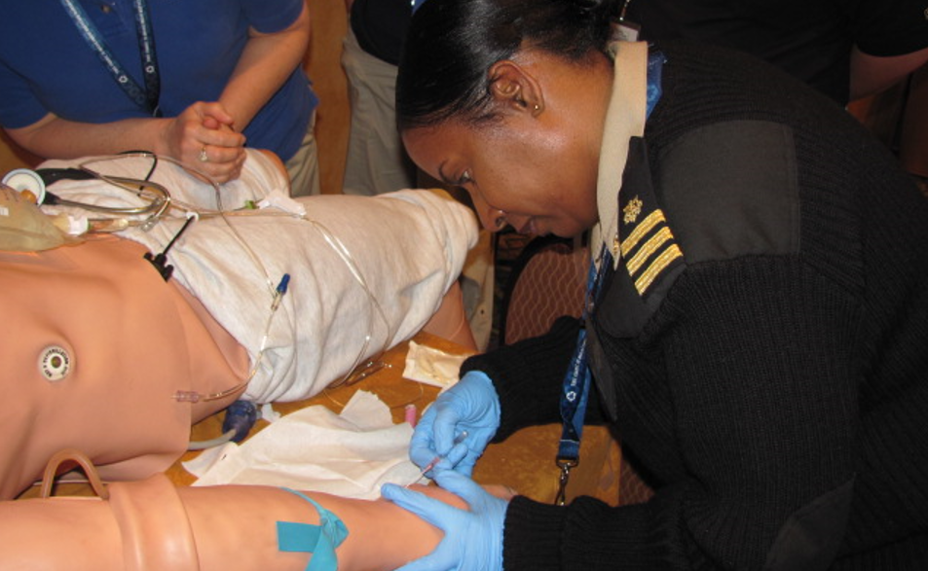
JRCOSTEP
No obligation after graduation
Eligibility
1+ years of study towards a PharmD
Benefits
Paid salary during externship (work 1 to 4 months during school breaks)
Tax-free housing allowance
Learn more at: JRCOSTEP - https://www.usphs.gov/students/
JRCOSTEP
Notes:
Opportunity to serve the country while gaining valuable professional experience
Participants are paid, receive health benefits, housing and travel allowances
Participants become inactive PHS officers upon completing the program and can activate upon graduation
No obligation to join the USPHS CC
Eligibility:
At least 2 years of study toward your pharmacy degree
Masters students who have completed at least one year of graduate study
Doctoral students who have completed at least one year of study in a doctoral program

Slide 25
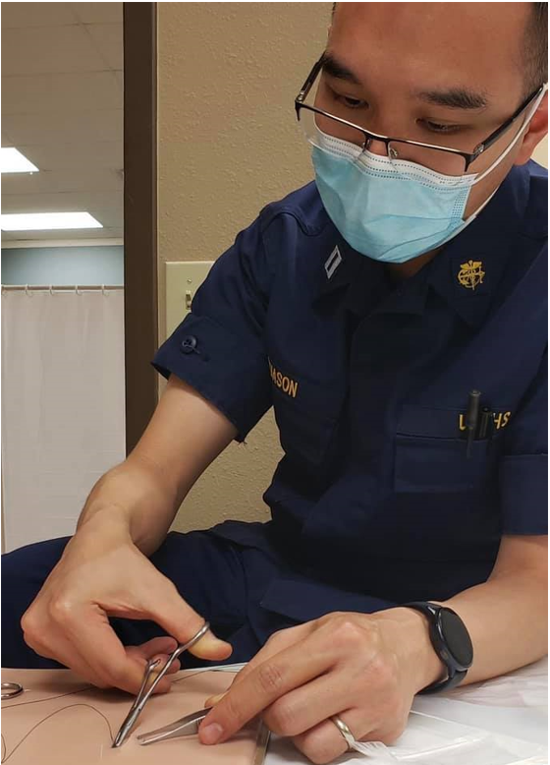
SRCOSTEP
PHS service obligation equal to twice time sponsored
Eligibility
Pharmacy students within 1 year of receiving a degree
Benefits
Up to 12 months of full pay and benefits while finishing coursework
Full-time position as a PHS officer immediately upon graduation
Tax-free housing allowance
Free health care coverage through TRICARE
Learn more at: SRCOSTEP - https://www.usphs.gov/students/
SRCOSTEP
Notes:
SRCOSTEP is a competitive PAID program designed to assist students financially during their final academic year of professional health care training
Available to individuals who are enrolled as full-time students prior to beginning their final year
Competitive selection process based on transcripts, GPA, resume, references, security and medical. Applications submitted between June 1st and September 30th for the following years’ program.
Student will receive emails by December 23rd of the application year.
Final year start dates must be after May 1st of the following year.
Benefits:
Financial assistance: Pay equivalent to an Ensign (0-1) based on the military pay scale (more for those with prior service).
Job upon graduation: A full-time position as a PHS officer immediately upon graduation
Housing: tax-free allowance for your rent or mortgage calculated based on your rank, duty station, and dependent status
Free health care: Coverage through TRICARE (including dependent coverage)
The same privileges and benefits given to Public Health Service officers
In return, these students agree to work for the Commissioned Corps after graduation for twice the time sponsored.
Offers job security after graduation
As with JR CoSTEP, it is very unlikely that students can choose their location.
Students are matched at duty stations based on their degree, skill qualifications, and the needs of the agency.

Slide 26
Educational and Training Opportunities
Pharmacy Student Experiential Clinical Opportunities:
Indian Health Service
Bureau of Prisons
Pharmacy Student Experiential Programs:
CDC
FDA
USPHS Pharmacist Category
Notes:
Opportunities for student clinical rotations in agencies such as IHS and BOP
Not only do you learn what these pharmacists do, but you also get the opportunity to work in remote (and many times very beautiful) areas and underserved populations – things you may not encounter or experience on your typical rotations
CDC and FDA also offer student rotations, providing the opportunity to learn about the regulatory process, which is often not emphasized in schools
Truly experience the versatility of pharmacists

Slide 27
Post-Graduate Opportunities
Indian Health Service Residency Program
PGY1 and PGY2 Pharmacy Practice Residencies
IHS Residency Program
Bureau of Prisons Residency Program
Clinical Pharmaceutical Care and Primary Care
BOP Student Programs
NIH Clinical Center Pharmacy Department
Pharmacokinetics/Pharmacogenetics Fellowship
PGY2 Oncology Specialty Residency
NIH Pharmacy Department
FDA Regulatory Pharmaceutical Fellowship
Includes rotations with the pharmaceutical industry
USPHS Pharmacist Category
Notes:
Many unique post graduate opportunities also available
IHS and BOP offer pharmacy practice residences – will definitely enhance your skills and provide a new perspective on pharmaceutical care
NIH offers a fellowship program on pharmacokinetics/pharmacogenetics, and also offers an oncology specialty residency
FDA offers a fellowship rotational program in Drug Advertising and Promotion; Drug Information; and Medication Safety
Prepares pursuit of careers in government, academia, or industry

Slide 28
ARE YOU READY? HERE IS HOW YOU GET STARTED…
Review:
1. Medical standards
2. Applicant checklist
Visit www.usphs.gov
Apply!
Ready to Serve?

Slide 29
Pharmacist Officer Required Qualifications
U.S. citizen
Mandatory eight-year commissioned service obligation
Less than 44 years of age for Active Duty
Can be offset by up to 8 years of prior uniformed service
Some officers may qualify for an age waiver
Less than 40 years of age for Ready Reserve (may be adjusted based on eligible federal PHS civil service and uniform service active-duty time)
Meet professional, medical, and security requirements
Qualifying degree from an accredited institution
Current, unrestricted, and valid license to practice in one of the 50 States, U.S. territories, or Washington, DC
USPHS Pharmacist Category
Notes:
Pharmacists do need to meet some basic eligibility requirements to qualify for USPHS.
U.S. citizen
Less than 44 years of age (can be offset by up to 8 years of prior uniformed service)
Less than 40 years of age for Ready Reserve (may be adjusted based on eligible federal PHS civil service and uniform service active-duty time)
Meet professional, medical, and security requirements
Qualifying degree from an accredited institution (varies depending on profession)
Current, unrestricted, and valid license to practice in one of the 50 States; Washington, DC; Commonwealth of Puerto Rico; U.S. Virgin Islands; or Guam

Slide 30
8 Steps to Become a USPHS Commissioned Corps Public Health Service Officer
Visit the USPHS.GOV
Create & Activate Your Account
Start Your Pre-Screen
Submit Required Materials
Stand Ready to Interview with Pharmacy Category Board
Complete remaining Three Commissioning Requirements (Medical, Security, & Nomination Clearances)
Seek Employment Opportunities with Federal Agencies (if search not started/secured already)
Call to Active Duty
USPHS 8 Steps

Slide 31
Join Our Noble Effort
The USPHS Commissioned Corps offers rewarding careers for public health professionals who desire to protect and promote our nation’s health and treat those most in need.
We are recruiting service-driven clinicians and public health professionals in 11 professional categories, including physicians, dentists and veterinarians.
Learn more by visiting USPHS.gov.
Career Growth
Financial Incentives
Work/Life Balance
30 Days of Paid Vacation
Paid Sick Leave
Paid Maternity Leave
Paid Federal Holidays
Professional Development
Leadership Training
Mentorship
Assignment Mobility
Continuing Education Credits
Post-9/11 GI Bill
Competitive Compensation Package
Housing Allowance
Comprehensive Health Care
Student Loan Repayment Programs
401-Style Retirement Plan
Life Insurance & Survivor Benefits
JOIN OUR EFFORT
Notes:
If you want to contribute to protecting and promoting the nation’s health and to help underserved populations/those in need, USPHS Commissioned Corps may be for you. It offers an exciting and fulfilling career with unique opportunities and incentives:
Close-knit community with mentorship and leadership opportunities
Move around geographically and among agencies
Post-9/11 GI bill to pay for furthering your education, or paying for dependent’s education
Financial Incentives - Non-taxable income, military pay scale; housing allowance
Excellent healthcare through Tricare – medical, dental, prescription
Retirement plan and pension
We encourage you all to take a deeper look and examine if it may be a fit for you.

Slide 32
Learn More:
For more information visit:
www.usphs.gov
www.usphs.gov/professions/pharmacist
#USPHS
@USPHSPharmacy

Slide 33
Questions?
Notes:
Please let me know if you have any questions.

Slide 34
Thank You!
Name
Rank USPHS
Title
Phone number
Email
usphs.gov

