Slide 1
The United States Public Health Service Commissioned Corps
America’s Health Responders
School/Event
Presenter Name
Date

Slide 2
U.S. PUBLIC HEALTH SERVICE COMMISSIONED CORPS INTRODUCTION
In Officio Salutis
Established in 1889, the U.S. Public Health Service (USPHS) Commissioned Corps is solely committed to protecting the public’s health.
The USPHS Commissioned Corps is part of the U.S. Department of Health and Human Services and is overseen by the Assistant Secretary for Health.
The U.S. Surgeon General and the Deputy Surgeon General provide operational command of the USPHS Commissioned Corps.
USPHS Pharmacist Category
Notes:
USPHS established in 1889; it’s part of DHHS and led by the ASH.
The Surgeon General, oversees the Commissioned Corps . The Surgeon General is America’s chief health educator, responsible for giving Americans the best scientific information available on how to improve their health and reduce the risk of illness and injury.
In carrying out all responsibilities, the Surgeon General reports to the Assistant Secretary for Health, who is the principal advisor to the Secretary on public health and scientific issues. The Surgeon General is appointed by the President of the United States with the advice and consent of the United States Senate for a 4-year term of office.

Slide 3
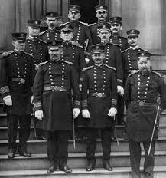
U.S. PUBLIC HEALTH SERVICE COMMISSIONED CORPS ABBREVIATED HISTORY
1798 Act for the Relief of Sick and Disabled Seamen
1870 Marine Hospital Service
1871 First Supervising Surgeon (later Surgeon General)
Dr. John Maynard Woodworth
1878 National Quarantine Act
1889 Legislation created the USPHS Commissioned Corps
Public Health Service (with broadened powers)
1930 Parker Act: Expanded Public Health Service to Non-Physicians
1955 Establishment of the Indian Health Service
Department of Health and Human Services established
1999 First Dedicated Disaster Response Mission for the USPHS Commissioned Corps (20,000 Kosovo refugees)
USPHS Pharmacist Category
Notes:
USPHS has a great history. In July of 1798, Congress passed "An Act for the Relief of Sick and Disabled Seaman," which was signed by President Adams. That law authorized the creation of a government operated system of marine hospitals and mandated that laboring merchant marine sailors pay a tax to support it.
The earliest predecessor of the Commissioned Corps was the Marine Hospital Service. At the time—the early 1800s—our country relied on a healthy merchant marine for trade and security. Our seamen traveled widely. Often, those who became ill brought their sicknesses back home, which made their health care a Federal concern.
The Marine Hospital Service eventually grew into the Public Health and Marine Hospital Service. In 1912, Congress shortened this name to the U.S. Public Health Service, with the Commissioned Corps as its uniformed service.
The responsibilities of the U.S. Public Health Service also changed, as new threats to our country’s public health emerged.
Congress charged the U.S. Public Health Service with preventing the introduction and spread of major epidemic diseases such as smallpox, yellow fever, and cholera. To meet this responsibility, the service and its Corps took over many national quarantine, disinfection, and immunization functions.
Congress also charged the U.S. Public Health Service to carry out the medical inspection of arriving immigrants, such as those landing at Ellis Island in New York.
The workplace environment and its effect on the health of workers became a major concern for the service in the early 1900s.
By 1912, the U.S. Public Health Service was authorized to investigate human diseases (such as tuberculosis, hookworm, malaria, and leprosy), sanitation, water supplies, and sewage disposal.
Today’s Commissioned Corps officers work abroad as well as in the United States to help prevent the spread of infectious and communicable diseases. New threats to our public health, such as SARS, avian flu, drug-resistant TB, and MRSA—continue to develop.
That’s a very brief history of the Corps.

Slide 4
Who We Are
The Commissioned Corps of the U.S. Public Health Service is one of the eight uniformed services, and is the only one dedicated solely to protecting America’s public health
6,000 public health professionals dedicated to addressing public health and providing clinical care
One of eight uniform services and the only one dedicated solely to protecting America’s public health
USPHS Pharmacist Category
Notes:
Inspired by the call to serve vulnerable and underserved communities through addressing public health issues.
Led by the Assistant Secretary for Health, with operations and activities overseen by the U.S. Surgeon General.

Slide 5
OUR MISSION AND VALUES
Protect, promote, and advance the health and safety of the nation
Service
Leadership
We provide vision and purpose in public health through inspiration, dedication and loyalty.
We are committed to public health through compassionate actions and stewardship of time, resources, and talents.
Core Values
Integrity
Excellence
We exemplify uncompromising ethical conduct and maintain the highest standards of responsibility and accountability.
We exhibit superior performance and continuous improvement in knowledge and expertise.
USPHS Pharmacist Category
Notes:
The mission of the U.S. Public Health Service Commissioned Corps is to protect, promote, and advance the health and safety of our Nation. This has been the Public Health Service’s mission and method since 1798, when John Adams—the second President—signed into law the Act for the Relief of Sick and Disabled Seamen.
The Commissioned Corps achieves its mission through:
Rapid and effective response to public health needs
Leadership and excellence in public health practices, and
Advancement of public health science.

Slide 6
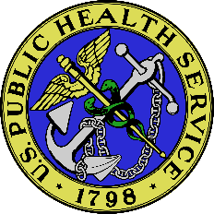
PROFESSIONAL CATEGORIES
S
USPHS Pharmacist Category
Notes:
Today’s Corps includes several professions involved in public health.
The Commissioned Corps is an elite uniformed service with more than 6,000 full-time, highly qualified public health professionals, serving the most underserved and vulnerable populations domestically and abroad.

Slide 7
U.S. PUBLIC HEALTH SERVICE COMMISSIONED CORPS WHERE WE WORK
More than 6,000 officers in 800 locations, all 50 states and numerous foreign assignments including the World Health Organization
Department of Health and Human Services
CDC, CMS, FDA, HRSA, IHS, NIH, SAMHSA
Department of Defense
Department of Homeland Security
U.S. Agency for International Development
Federal Bureau of Prisons
State Governments and Local Agencies
USPHS Pharmacist Category
Notes:
The Commissioned Corps currently has a presence in more than 800 locations, including all 50 states and numerous foreign assignments, such as the World Health Organization and World Bank.
CDC, CMS, FDA, HRSA, IHS, NIH, SAMHSA– are just some of the top agencies. Other agencies include: ACF, AHRQ, CMS, EPA, OS, PSC, USDA, NOAA, USMS, DOI-NPS, VA,
Please note there are contingencies associated with assignments at the State and local agencies.
Commissioned Corps officers serve throughout the U.S. Department of Health and Human Services and other Federal agencies that are involved in public health.
These agencies are as diverse as the Centers for Disease Control and Prevention, the Indian Health Service, the National Institutes of Health, and the Bureau of Prisons, just to name a few.

Slide 8
What We Do
Protect, promote and advance the health and safety of our nation.
Provide essential health services We go where most do not go to provide care for vulnerable and underserved populations.
Serve on the frontline of public health emergencies We respond quickly to natural disasters, disease outbreaks and global public health emergencies as well as serve on humanitarian missions.
Lead public health programs and policy development We utilize our experience, skills, and networks to provide leadership within the U.S. Department of Health and Human Services and throughout the federal government.
Advance innovation and science We work at the forefront of medical challenges like COVID-19, cancer, and the opioid crisis.
USPHS Pharmacist Category
Notes:
The USPHS Commissioned Officers work on the front lines of public health. Our medical, health and engineering professionals respond quickly to natural disasters, fight disease, conduct research, advance public health science and care for patients in underserved communities across the nation and throughout the world.

Slide 9
Ready Reserve Corps
The Coronavirus Aid, Relief, and Economic Security (CARES) Act, signed into law on March 27, 2020 provides both the authority and funding for the establishment of the Ready Reserve Corps, the reserve component of the Corps. Applicants must meet same appointment requirements as Regular Corps.
The Ready Reserve Corps will provide trained and ready personnel to fill critical public health needs and will:
Support the USPHS Commissioned Corps’ capacity to respond to regional, national, and global health emergencies and improve access to health services
Preserve clinical care positions by maintaining a surge capacity of health professionals available for deployment without jeopardizing the service of clinicians in hard to fill roles
Offer an opportunity to serve for mission-driven clinical and public health professionals who cannot commit to a full-time active duty position in the USPHS Commissioned Corps
Enable access to highly specialized skill sets that would be impractical in full-time active duty positions
USPHS Pharmacist Category
Notes:
The Ready Reserve Corps offers a unique opportunity for its officers to serve their local community as well as their country in times of public health emergencies or in underserved areas.
The Ready Reserve Corps under “CARES” Act that signed into law on March 27, 2020, will preserve clinical care positions available for deployment without jeopardizing the service of clinicians in hard to fill roles; and will authorize access to highly specialized skill sets during critical public health needs.

Slide 10
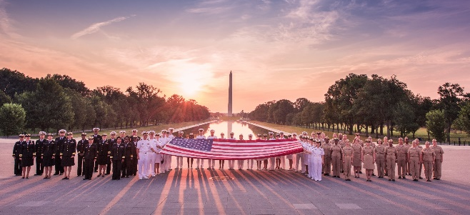
WE OFFER
Uniformed service benefits featuring comprehensive, low-cost medical, dental, and vision care for officers and their dependents, retirement, and the Post-9/11 GI Bill education benefit, which can be transferred to dependents after 10 years of service
Diverse career opportunities and professional growth
Potential ability to transfer from civil service or other uniformed services
Opportunities for involvement in the response to disasters and epidemics
CANDIDATES MUST
Meet basic requirements and basic education and training requirements
Meet height and weight standards, maintain physical fitness, and be medically qualified (if you have specific concerns about medical eligibility, please email PHSCADMedical@hhs.gov)
Commit to displaying respect for our country and service by wearing the USPHS uniform
To become a USPHS officer, an applicant interested in Regular Corps or Ready Reserve Corps must complete the commissioning process and secure a position in an agency where USPHS officers serve. Applicants pursue both processes simultaneously during the commissioning process.
Notes:
As a Public Health Service officer, you will receive comprehensive benefits include but are not limited to:
30 days of paid vacation per year
Paid Federal holidays
Low-cost medical, dental, and vision care for you and your dependents
Thrift Savings Plan (TSP)
Excellent retirement eligibility after 20 years of service
Post-9/11 GI Bill education benefit
Post-Graduate opportunities

Slide 11
Pharmacist Officer Required Qualifications
U.S. citizen
Less than 44 years of age
can be offset by up to 8 years of prior uniformed service
Ability to pass a physical health examination
Ability to pass a security background check
Qualifying degree from an accredited institution (varies depending on profession)
Current, unrestricted, and valid license to practice in one of the 50 States; Washington, DC; Commonwealth of Puerto Rico; U.S. Virgin Islands; or Guam
USPHS Pharmacist Category
Notes:
Pharmacists do need to meet some basic eligibility requirements to qualify for USPHS.
U.S. citizen
Less than 44 years of age (can be offset by up to 8 years of prior uniformed service)
Ability to pass a physical health examination
Ability to pass a security background check
Qualifying degree from an accredited institution (varies depending on profession)
Current, unrestricted, and valid license to practice in one of the 50 States; Washington, DC; Commonwealth of Puerto Rico; U.S. Virgin Islands; or Guam

Slide 12
What We Do: Pharmacists
Improving drug therapy for underserved communities:
Traditional pharmacists roles
Pharmacist providers roles with expanded scopes of practice
Improving patient outcomes through direct patient care; chronic care clinics
Administrative roles
Leading multi-disciplinary healthcare teams
Beyond traditional pharmaceutical care:
Review, approve, and monitor safety of new drugs
Work in variety of regulatory, clinical, and scientific research roles
Assist in public health emergencies
USPHS Pharmacist Category
Notes:
Improve patient care through collaborative practice agreements.
Work to prevent, mitigate, and solve clinical drug shortages
Protect the integrity of the drug supply chain
Play a key role in new and generic drug approvals
Support medical countermeasures to be used during public health emergency response

Slide 13
The Surgeon General’s Priorities (1)
Opioids and Addiction
Tobacco Cessation and Prevention
Community Health and Economic Prosperity
Preventable chronic diseases and behavioral health issues
Oral Health
Emerging Public Health Threats
COVID-19, Ebola and Zika virus
USPHS Pharmacist Category
Notes:
Surgeon General is the leader of the Commissioned Corps of the USPHS
Focused on improving the country’s health
The opioid epidemic and substance abuse disorders more broadly have become one of the most chronic illnesses in the U.S.
Tobacco is the leading cause of preventable death in the U.S. and worldwide
America’s health and prosperity can improve with the help of the business community. Many of our poor health problems are rooted in inadequate investments in prevention and unequal economic opportunities in our communities.
Oral health is essential to the general health and well-being of all Americans, and it is a window into the health of the body.
SG provides the facts on emerging public health threats, gives an update on the government response, and lists steps individuals can take to protect themselves and their families
https://www.hhs.gov/surgeongeneral/priorities/index.html

Slide 14
The Surgeon General’s Priorities
Improving the country’s health
Priorities
Calls to Action
Science-based documents intended to stimulate action to urgent public health problems
Reports
Developed from expertise of scientific, medical, and public health professionals nationwide
Advisories
Public statements of recommendations on public health issues
Pharmacist officers are force multipliers for these priorities.
USPHS Pharmacist Category
Notes:
Calls to action, reports, and advisories have been issued on topics including but not limited to addiction and substance misuse, tobacco cessation, suicide prevention, mental health, breastfeeding, oral health, and health misinformation.

Slide 15
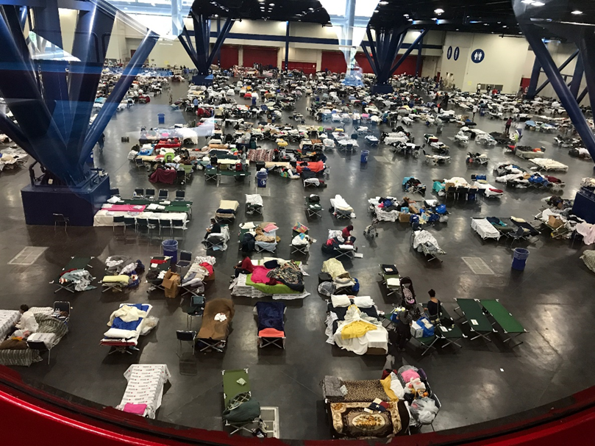
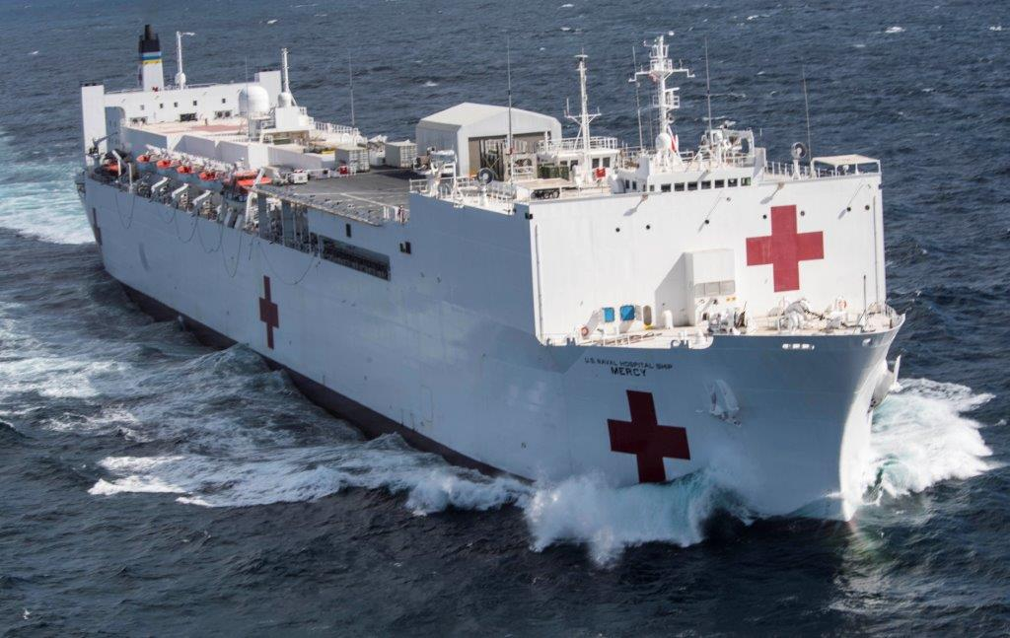
Emergency Response Deployments
Notes:
PHS mission: To Protect, Promote and Advance the Health and Safety of our Nation
An important part of being an officer is readiness, and being willing to deploy for public health emergencies

Slide 16
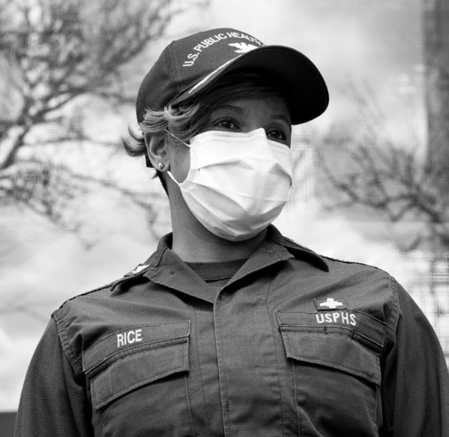
READINESS AND DEPLOYMENT (2)
The Office of the Surgeon General, through USPHS Commissioned Corps Headquarters, is responsible for the coordination of readiness and deployment for:
Domestic and international operations
Teams and individuals
Humanitarian assistance
Disaster relief
Emergency response
Global training
USPHS Pharmacist Category
Notes:
As the cornerstone of U.S. crisis response, officers deploy to natural disasters, disease outbreaks, global public health emergencies, and serve on
humanitarian assistance missions.
Recent examples of deployment missions include hurricane response, vaccination clinics, and assisting with the border crisis and unaccompanied children mission.
The Office of the SG/Commissioned Corps Headquarters (CCHQ) coordinates these deployments
Deployments may be local, national, or international
Deployments can occur as part of a large response/team, or officers may be called individually
The common theme is humanitarian assistance, disaster relief, and emergency response.
We are America’s health care responders

Slide 17
Pharmacist Officers Roles in Emergency and Humanitarian Responses
Pharmacy and Clinical Roles
Medication procurement and coordination of care
Dispensing, counseling, drug information
Immunizations, glucose screening, etc.
Monitor and titrate blood pressure medications and insulin
Leadership, Logistics, Administrative
Other Roles
Assisting other clinical personnel (e.g. dental assistant)
Maintain laboratory services (appropriate collection and storage of labs)
USPHS Pharmacist Category
Notes:
What exactly do pharmacists do on deployment?
It depends on the mission.
Important to remain flexible and versatile, and jump in where ever we are needed
Also important to maintain skills in a variety of areas
Pharmacy and Clinical Roles
Leadership, logistics, administrative roles
Assisting other clinical personnel
Help with lab services

Slide 18
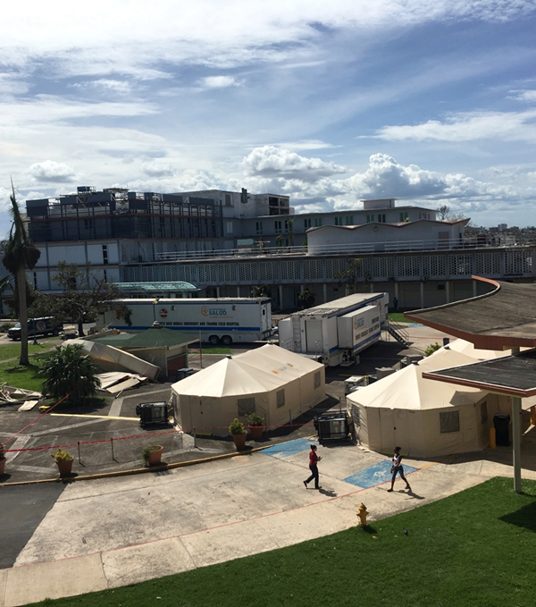
Emergency Response Deployments (2)
USPHS Pharmacist Category
Notes:
This slide shows various pictures of PHS deployments.
The top left is a picture of the sleep quarters for patients and uniformed services in the Puerto Rico convention center.
The top right is a picture of Federal Medical Stations (FMS) which provide beds to support healthcare systems anywhere in the U.S. that is impacted by natural disasters or public health emergencies.
The bottom left is a picture of officers in their Operational Dress Uniform, or ODU, alongside other uniformed services.
The bottom right is a picture of a U.S. Navy Hospital ship. The USPHS has deployed with DoD/Navy to help support humanitarian missions in the past.

Slide 19
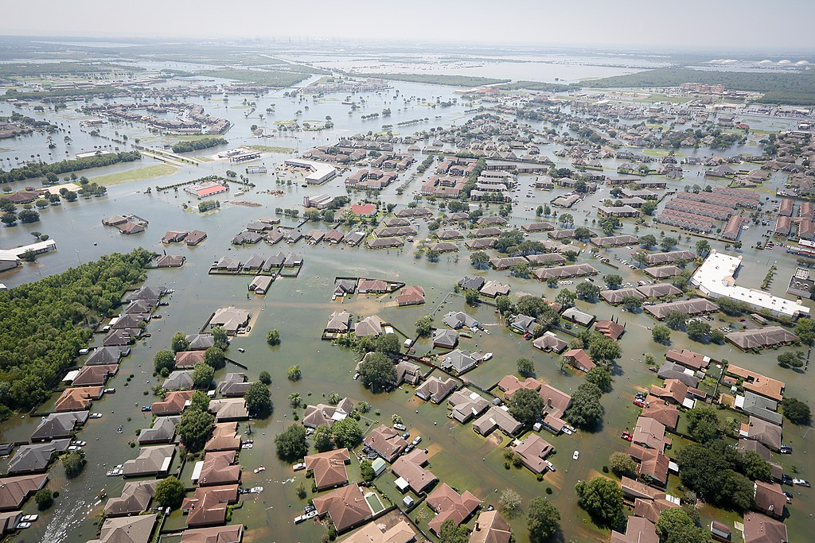
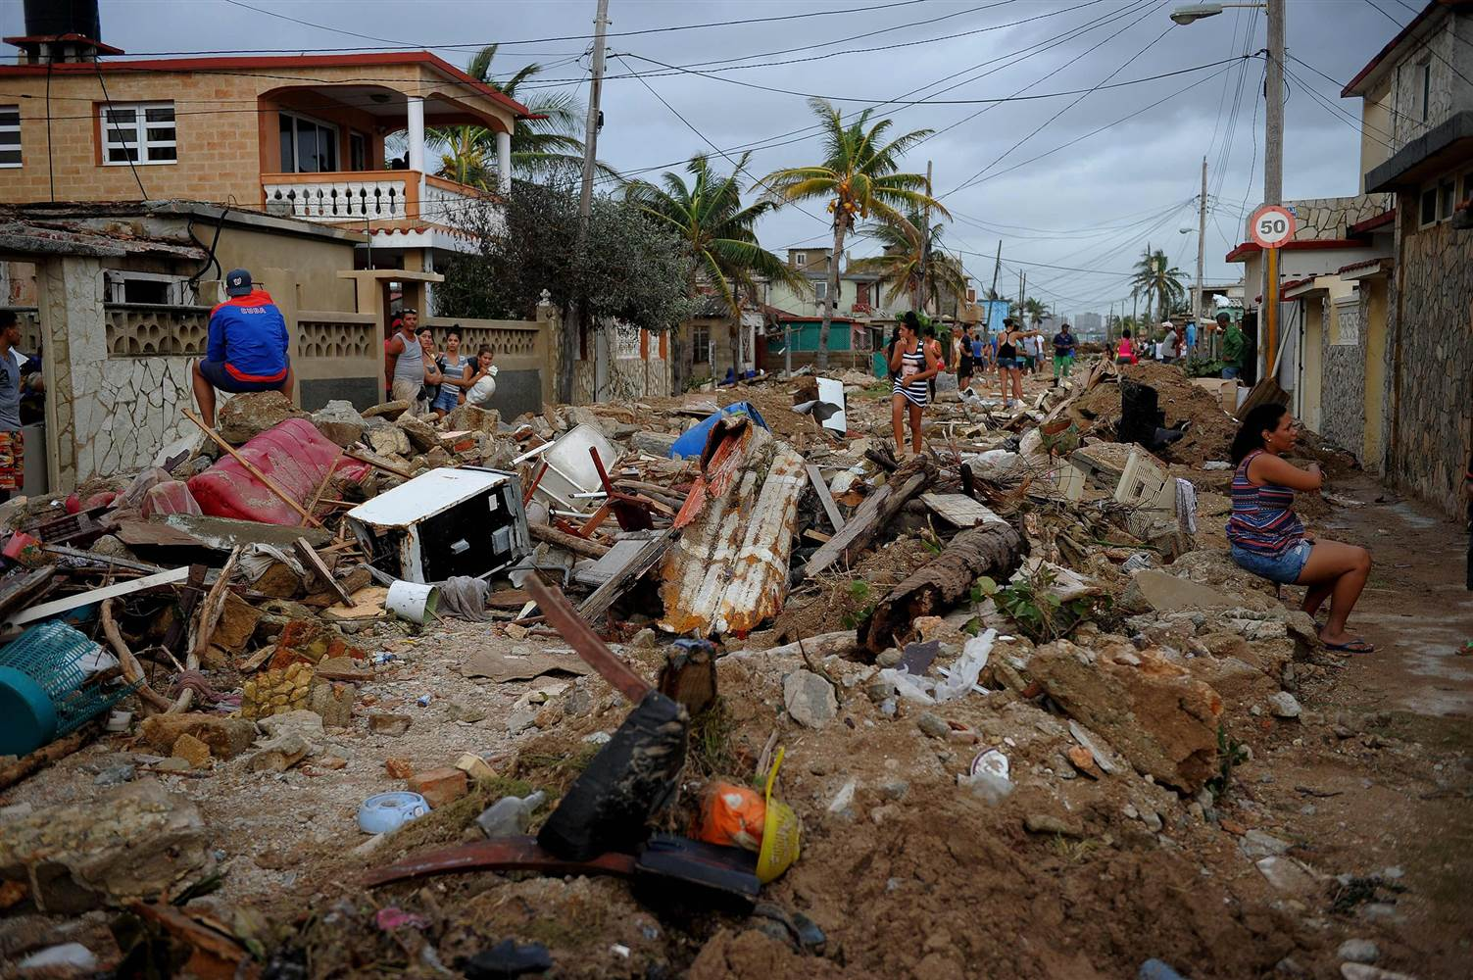
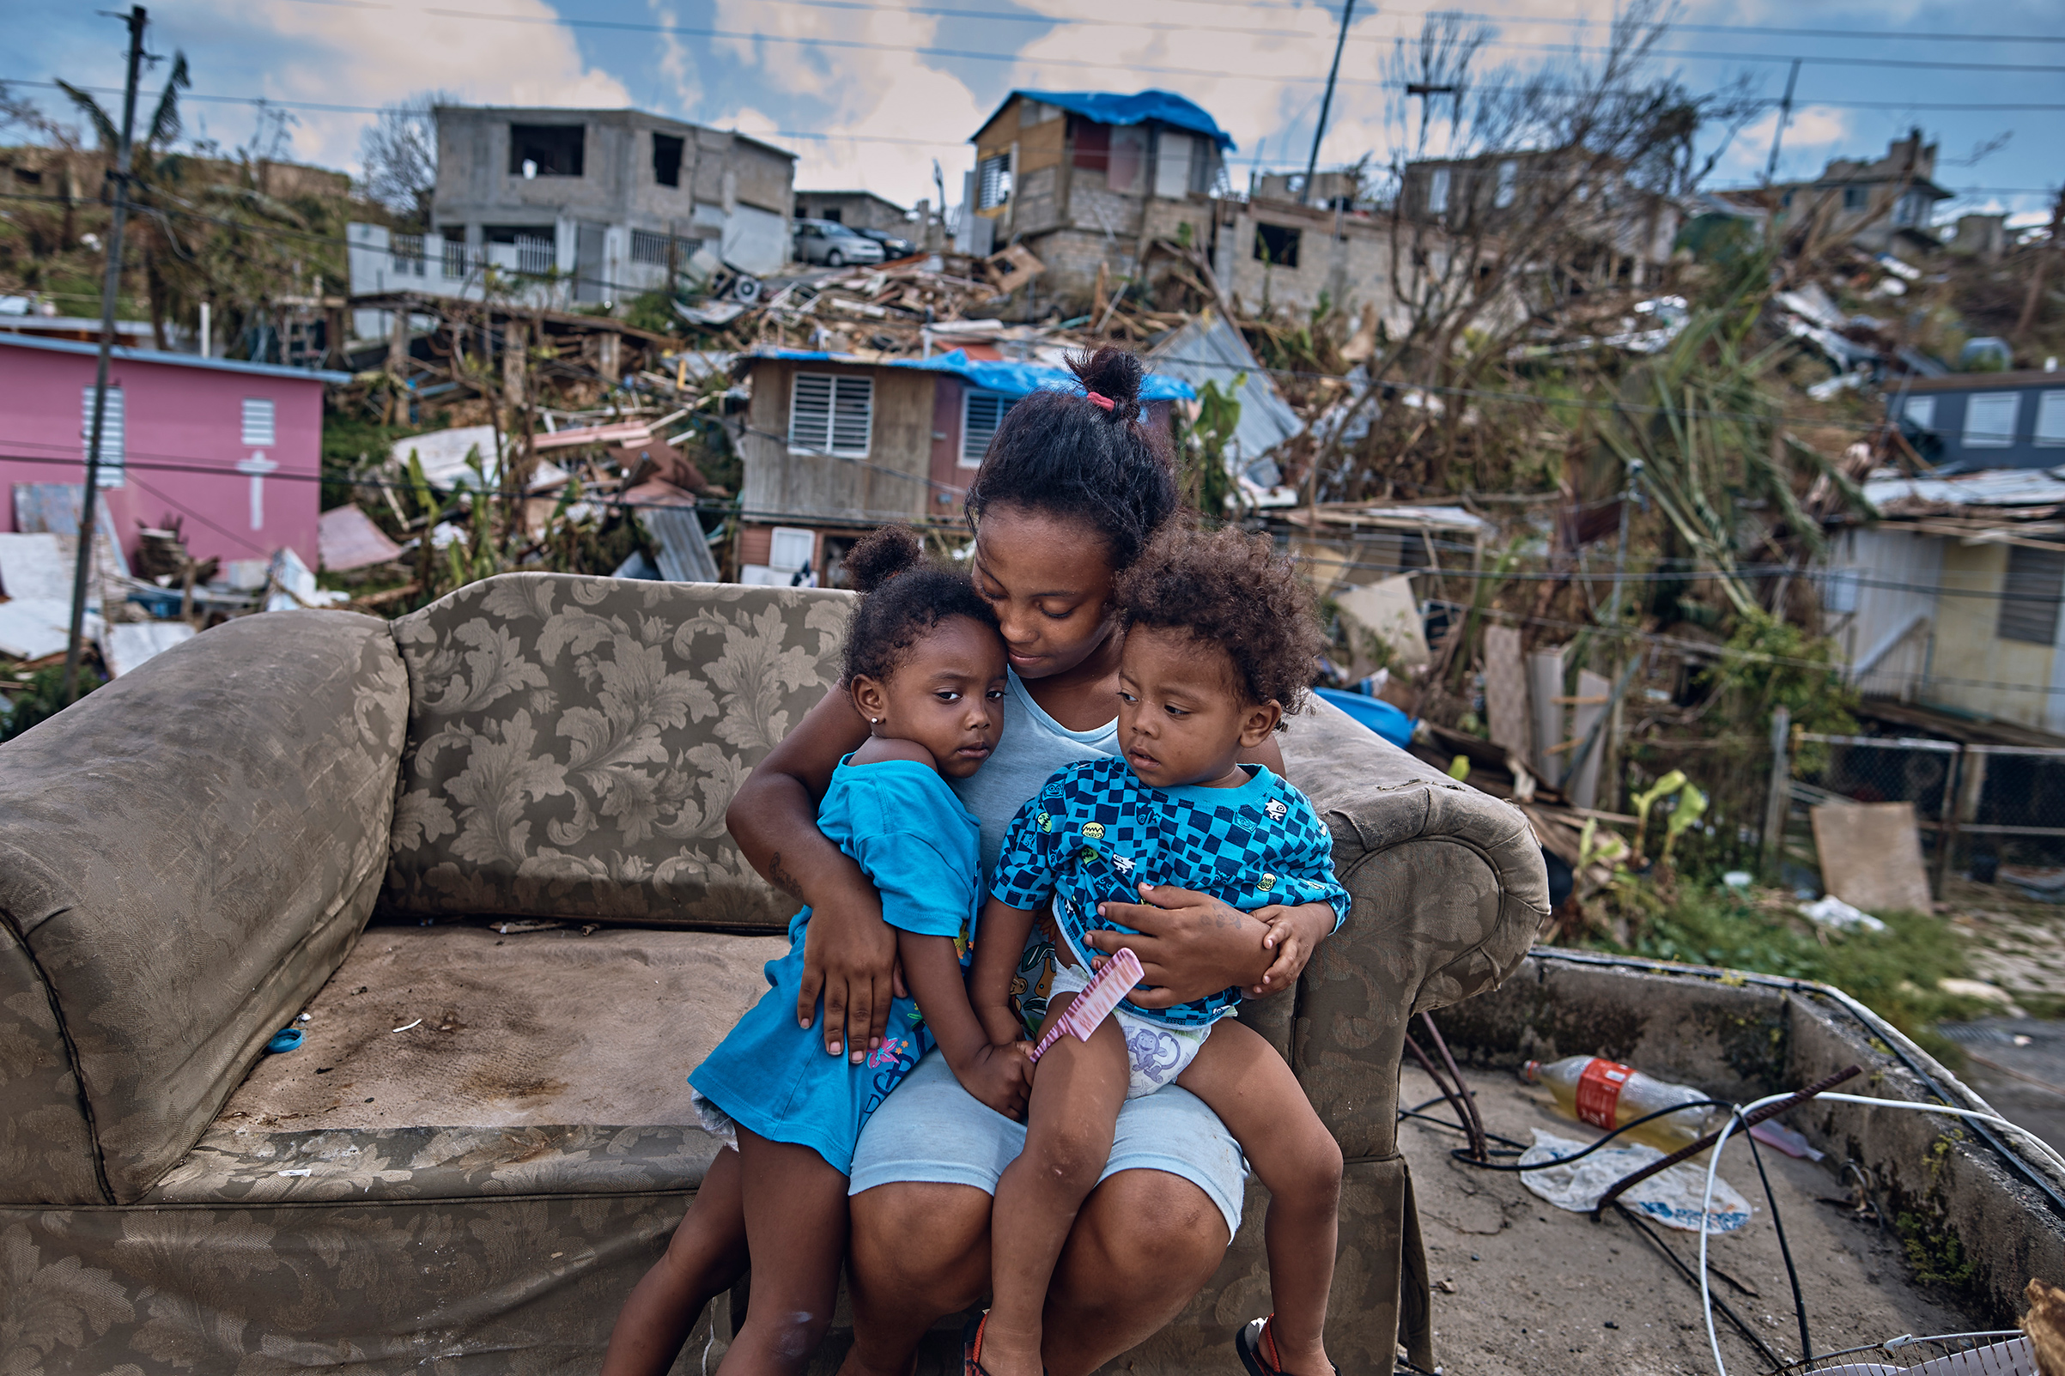
Public Health Disasters in 2017
Hurricane Harvey (Category 4)
Hurricane Irma (Category 4)
Hurricane Maria (Category 5
USPHS Pharmacist Category
Notes:
Statistics:
Hurricane Harvey:
Occurred in Texas and Louisiana from August 17, 2017 through September 2, 2017. 125 billion in damage, 107 American fatalities.
Hurricane Irma:
Occurred in Florida and US Virgin Islands from August 30, 2017 through September 16, 2017. 65 billion in damage. 106 American fatalities.
Hurricane Maria:
Occurred in Puerto Rico, US Virgin Islands from September 16, 2017 through October 3, 2017. 92 billion in damage. All of Puerto Rico 3.4 million residents without electricity. 64 to 1,085 American fatalities.

Slide 20
2017 HHS / USPHS / NDMS / DMAT Humanitarian Mission Response
Integrated federal response teams coordinated humanitarian response activities
These teams included:
> 2,000 USPHS CC officers
> 300 PHS CC pharmacists deployed in multiple roles
Hundreds of HHS, National Disaster Medical System (NDMS), and Disaster Medical Assistance Team (DMAT) team members
Partnerships with federal, territorial, state, county, city, local, community, and non-governmental organizations
USPHS Pharmacist Category
Notes:
The 2017 hurricane response efforts
Over 2000 PHS officers were deployed, and of that over 300 were pharmacists
Coordinated humanitarian mission response across several federal response teams
Also partnered with other organizations – federal state, county, local
Often worked side by side with other federal team members

Slide 21
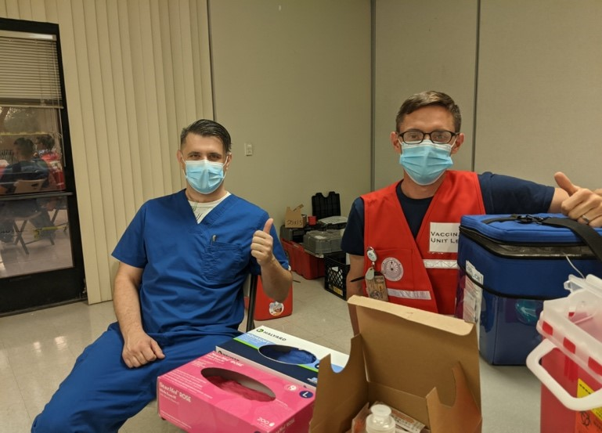
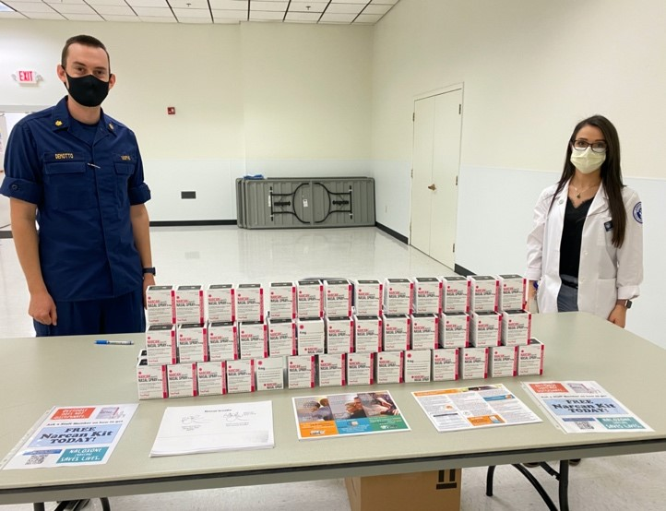
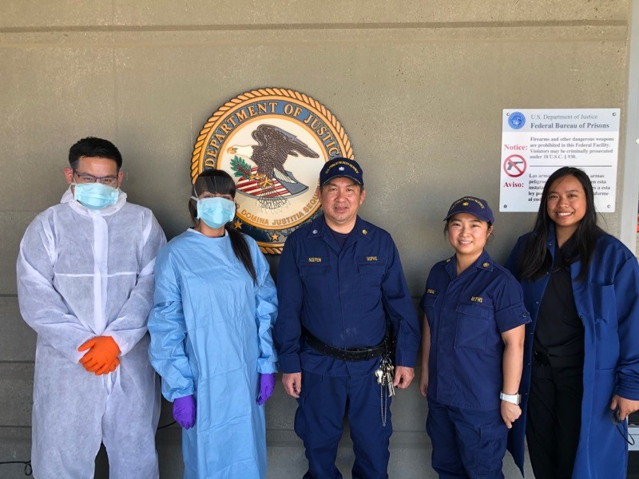
Student Opportunities What You Can Do
Join the Pharmacy Student Listserv!
Notes:
There are several opportunities for students to learn about and get a flavor of PHS.
We love students – you are the future pharmacists and we want you to get involved.

Slide 22
Educational and Training Opportunities
Pharmacy Student Experiential Clinical Opportunities:
Indian Health Service
Bureau of Prisons
Pharmacy Student Experiential Programs:
CDC
FDA
USPHS Pharmacist Category
Notes:
Opportunities for student clinical rotations in agencies such as IHS and BOP
Not only do you learn what these pharmacists do, but you also get the opportunity to work in remote (and many times very beautiful) areas and underserved populations – things you may not encounter or experience on your typical rotations
CDC and FDA also offer student rotations, providing the opportunity to learn about the regulatory process, which is often not emphasized in schools
Truly experience the versatility of pharmacists

Slide 23
Post-Graduate Opportunities
Indian Health Service Residency Program
PGY1 and PGY2 Pharmacy Practice Residencies
IHS Residency Program
Bureau of Prisons Residency Program
Clinical Pharmaceutical Care and Primary Care
BOP Student Programs
NIH Clinical Center Pharmacy Department
Pharmacokinetics/Pharmacogenetics Fellowship
PGY2 Oncology Specialty Residency
NIH Pharmacy Department
FDA Regulatory Pharmaceutical Fellowship
Includes rotations with the pharmaceutical industry
USPHS Pharmacist Category
Notes:
Many unique post graduate opportunities also available
IHS and BOP offer pharmacy practice residences – will definitely enhance your skills and provide a new perspective on pharmaceutical care
NIH offers a fellowship program on pharmacokinetics/pharmacogenetics, and also offers an oncology specialty residency
FDA offers a fellowship rotational program in Drug Advertising and Promotion; Drug Information; and Medication Safety
Prepares pursuit of careers in government, academia, or industry

Slide 24
Junior Commissioned Officer Student Training and Extern Program (JRCOSTEP)
Are you looking for financial assistance during official school breaks while gaining valuable professional education for a public health career?
USPHS Pharmacist Category
Notes:
USPHS also offers opportunities for students to intern with pay, and even become an officer upon graduation.

Slide 25
JRCOSTEP Program Overview
Participants are employed 31 to 120 days as officers and trained by professionals who work at various federal government agencies around the country, which include:
Indian Health Service (IHS)
Food and Drug Administration (FDA)
National Institutes of Health (NIH)
Centers for Disease Control and Prevention (CDC)
Bureau of Prisons (BOP)
USPHS Pharmacist Category
Notes:
An extern program where students gain valuable professional experience and training and are paid for their work while completing and furthering their health-related professional education
Work alongside active duty officers
Job duties may range across a spectrum of public health activities in the research, clinical, regulatory, health promotion or disease prevention, and administrative areas
Opportunities available at IHS, FDA, NIH, CDC, BOP
It is very unlikely that students can choose the location. Students are matched at duty stations based on their degree, skill qualifications, and the needs of the agency.
https://www.usphs.gov/media/yunnlaiu/jrcostep-faqs.pdf

Slide 26
JRCOSTEP Program Overview (continued)
Opportunity to serve the country while gaining valuable professional experience
Eligible after one year of health professional school
Competitive
Paid salary during externship (work 1 to 4 months during official school breaks)
No obligation after graduation
Learn more at: JRCOSTEP - https://www.usphs.gov/students/
USPHS Pharmacist Category
Notes:
Amazing experience – opportunity to serve while gaining professional experience as a pharmacist
Participants are paid, receive health benefits, housing and travel allowances
Participants become inactive PHS officers upon completing the program and can activate upon graduation
No obligation to join the USPHS CC
Eligibility:
At least 2 years of study toward your pharmacy degree
Masters students who have completed at least one year of graduate study
Doctoral students who have completed at least one year of study in a doctoral program

Slide 27
Senior Commissioned Officer Student Training and Extern Program (SRCOSTEP)
Are you looking for financial assistance to complete your education for a public health career?
USPHS Pharmacist Category
Notes:
SRCOSTEP is a competitive PAID program designed to assist students financially during their final academic year of professional health care training
Designed to assist students financially during their final academic year of professional health care training
In return, these students agree to work for the Commissioned Corps after graduation for twice the time sponsored.
Offers job security after graduation
As with JR CoSTEP, it is very unlikely that students can choose their location.
Students are matched at duty stations based on their degree, skill qualifications, and the needs of the agency.

Slide 28
SRCOSTEP Program Overview
Selection is highly competitive.
Participants are full-time students about to begin final year of academic study or professional training in specific health disciplines.
Applicants selected will become Commissioned officers as an Ensign (O-1) in the U.S. Public Health Service (USPHS) for up to 12 months while finishing their education and training.
USPHS Pharmacist Category
Notes:
Highly competitive
Available to individuals who are enrolled as full-time students prior to beginning their final year
Competitive selection process based on transcripts, GPA, resume, references, security and medical. Applications submitted between June 1st and September 30th for the following years’ program.
Student will receive emails by December 23rd of the application year.
Final year start dates must be after May 1st of the following year.
Will receive the rank of 0-1 as a USPHS officer for up to 12 months while finishing school
https://www.usphs.gov/media/daoj3qxv/srcostep-faqs.pdf

Slide 29
SRCOSTEP Program Overview (continued)
Students entering their final year of graduate school or professional training get paid while in school in exchange for committing to enroll in the USPHS Commissioned Corps upon graduation.
Students receive the full basic pay salary and allowances of an Ensign (O-1) while in the program and are guaranteed a spot in the USPHS Commissioned Corps upon graduation.
Students receive full pay & benefits of an active duty officer for up to 12 months while finishing their education and training.
USPHS Pharmacist Category
Notes:
Students receive the basic pay and allowances of an O-1, Ensign, while in the program and are guaranteed a spot in the USPHS Commissioned Corps upon graduation.
The hiring agency may require SRCOSTEPs to wear the Commissioned Corps utility uniform.
Benefits:
Financial assistance: Pay equivalent to an Ensign (0-1) based on the military pay scale (more for those with prior service).
Job upon graduation: A full-time position as a PHS officer immediately upon graduation
Housing: tax-free allowance for your rent or mortgage calculated based on your rank, duty station, and dependent status
Free health care: Coverage through TRICARE (including dependent coverage)
The same privileges and benefits given to Public Health Service officers
https://www.usphs.gov/media/daoj3qxv/srcostep-faqs.pdf
https://dcp.psc.gov/OSG/hso/documents/USPHS_HSO_COSTEP_Flyer.pdf

Slide 30
SRCOSTEP Program Overview (continued)
Service obligation is equal to twice the time sponsored and completed upon graduation at various federal agencies around the country, which include:
Bureau of Prisons (BOP)
Indian Health Service (IHS)
ICE Health Service Corps (IHSC)
For example, Nine months of financial support equals 18 months of employment with the sponsoring Agency . To continue in a career as a USPHS Commissioned officer, SRCOSTEP participants must concurrently complete a 24-month obligation upon graduation.
Learn more at: SRCOSTEP - https://www.usphs.gov/students/
USPHS Pharmacist Category
Notes:
After graduation, you will work at your assigned location - Guaranteed a spot in USPHS upon graduation
Obligation commitment of two days paid back for each day as a SRCOSTEP.

Slide 31
Join Our Noble Effort
The USPHS Commissioned Corps offers rewarding careers for public health professionals who desire to protect and promote our nation’s health and treat those most in need.
We are recruiting service-driven clinicians and public health professionals in 11 different categories, including physicians, nurses, pharmacists, dentists and veterinarians to serve in Regular Corps.
Learn more by visiting USPHS.gov.
Career Growth
Financial Incentives
Work/Life Balance
30 Days of Paid Vacation
Paid Sick Leave
Paid Maternity Leave
Paid Paternity Leave
Paid Federal Holidays
Professional Development
Leadership Training
Mentorship
Assignment Mobility
Continuing Education Credits
Post-9/11 GI Bill
Competitive Compensation Package
Housing Allowance
Comprehensive Health Care
401k-Style Retirement Plan
Life Insurance & Survivor Benefits
USPHS Pharmacist Category
Notes:
If you want to contribute to protecting and promoting the nations health and to help underserved populations/those in need, USPHS may be for you
Exciting and fulfilling career
Career Growth
Unique career opportunity, close knit community with mentorship and leadership opportunities
Opportunities to move around geographically and among agencies
Post-9/11 GI bill to pay for furthering your education, or paying for dependent’s education
Financial Incentives
Non-taxable income, military pay scale
Housing allowance
Excellent healthcare through Tricare – medical, dental, prescription
Retirement plan and pension
Work/Life Balance
30 days paid vacation leave per year!
Paid sick leave, maternity/paternity leave, paid federal holidays
We encourage you all to take a deeper look and examine if it may be a fit for you

Slide 32
Learn More:
For more information, call 1-888-225-3302 or visit:
www.usphs.gov
www.usphs.gov/professions/pharmacist
#USPHS
@USPHSPharmacy

Slide 33
Thank You!
Name
Title
Phone number
Email
usphs.gov
Notes:
Fill in name, title, contact information

Slide 34
Back-up Slides

Slide 35
Indian Health Service (IHS)
Serves 2.3 million American Indians and Alaska Natives from 573 Federally recognized Tribes
12 Service Areas in 35 States
Over 700 Pharmacists in over 230 locations
Opportunities for Pharmacists
Clinical Positions
Comprehensive Chronic Disease State Management
Non-clinical positions
Pharmacy management and directors
Quality Assurance/Quality Improvement
Research/epidemiology
Pharmacy Informatics
USPHS Pharmacist Category
Notes:
The Indian Health Service is an operating division within the U.S. Department of Health and Human Services. IHS is responsible for providing direct medical and public health services to 2.3 million members of Native American Tribes (573) and Alaska Native people. There are more than 700 Pharmacists are serving now in over 230 location; they are involved in direct patients care managing chronic diseases. Of course, there are many non-clinical positions as well.

Slide 36
Federal Bureau of Prisons (BOP)
Serves 125,000 inmates in federal correctional institutions
122 institutions across the U.S., with over 190 pharmacy-specific positions
Administrative positions: Health Service Administrator, Executive Positions, Informatics, etc.
Comprehensive Clinical Services
Collaborative Practice Agreements in diabetes, anticoagulation, hypertension, dyslipidemia, and more
National Clinical Pharmacist Consultants for hepatitis C, HIV, mental health, antimicrobial stewardship, and Medication Assisted Treatment (MAT)
APPE rotation sites, SRCOSTEP program, and a PGY1 residency
USPHS Pharmacist Category
Notes:
The Federal Bureau of Prisons (BOP) is a United States federal law enforcement agency under the Department of Justice responsible for the care, custody, and control of incarcerated individuals. BOP with over 190 pharmacy-specific positions serves 125,000 inmates in 122 correctional institutions.
At the Bureau of Prisons, Commissioned Corps officers work for the Health Services Division and provide and manage a variety of physical and mental health care services.

Slide 37
Immigration and Customs Enforcement (ICE) Health Service Corps (IHSC)
20 Pharmacist-specific billets
Opportunities for career progression to administrative positions
Clinical Pharmacy/Collaborative Practice Agreements
Anticoagulation, HIV care, mental health, transgender care, cardiovascular management, diabetes, and women’s health
Ambulatory care setting, one to two pharmacist staffing with pharmacy technician support
USPHS Pharmacist Category
Notes:
The U.S. Immigration and Customs Enforcement is a federal law enforcement agency under the U.S. Department of Homeland Security. ICE's mission is to protect the United States from the cross-border crime and illegal immigration that threaten national security and public safety. For your information, there are 20 Pharmacist-specific billets. They are variety of clinical services as well.

Slide 38
U.S. Coast Guard (1)
U.S. Coast Guard (USCG) pharmacists are assigned to small, one-pharmacist ambulatory care settings where they actively engage with other healthcare personnel and patients routinely.
Pharmacists responsibilities are vast and include:
Oversight of numerous afloat and ashore sickbay units, logistical activities, inventory management and, most importantly, educating the USCG independent duty corpsmen on safe pharmacy operations.
Pharmacy patients consist of active duty members and reservists, retirees and other eligible dependents.
USPHS Pharmacist Category
Notes:
The United States Coast Guard is the maritime security, search and rescue, and law enforcement service branch of the United States Armed Forces and one of the country's eight uniformed services.
USCG pharmacists are serving at small ambulatory care settings.
You may serve at Coast Guard clinics -caring for patients; reviewing, approving, and monitoring new drugs; and assisting in public health emergencies.

Slide 39
U.S. Coast Guard
Testimonial:
“When you are a pharmacy officer in the U.S. Public Health Service (USPHS) commissioned corps, detailed to the Coast Guard your career will take you into a world of expanded scopes and diverse roles. As a USPHS pharmacy officer, you will work at Coast Guard clinics -caring for patients; reviewing, approving, and monitoring new drugs; and assisting in public health emergencies. You'll be offered greater work variety than you'll find in most pharmacy practice settings. As part of a unique team of committed health care professionals, you'll enjoy leadership opportunities, excellent benefits, and work/life balance, all while improving and advancing the health of the Coast Guard.“
US Coast Guard Pharmacy
USPHS Pharmacist Category
Notes:
Here is the U.S. Coast Guard Testimony for pharmacy officers who will serve for the Coast Guard. You will enjoy leadership opportunities, excellent benefits, and work/life balance while you’re improving and advancing the health of the Coast Guard.

Slide 40
Food and Drug Administration (FDA)
Mission Statement: Responsible for protecting the public health by ensuring the safety, efficacy, and security of human and veterinary drugs, biological products, and medical devices; and by ensuring the safety of our nation's food supply, cosmetics, and products that emit radiation.
Positions:
Regulatory Health Project Manager
Compliance Officer
Field Investigator
Clinical Reviewer
Safety Evaluator
Drug Information
Pharmacologist
USPHS Pharmacist Category
Notes:
At the Food and Drug Administration, Commissioned Corps officers ensure the safety and effectiveness of drugs and medical devices, work on new drug applications and adverse reaction reports, recalls, function as field inspectors and consumer safety officers.
Commissioned Corps officers may take enforcement actions to ensure compliance with the Tobacco Control Act and serve on expert advisory committees and review panels.

Slide 41
Centers for Disease Prevention and Control (CDC)
Over 30 pharmacists working across the agency and world
Work settings for pharmacists:
CDC Drug Service
Strategic National Stockpile (SNS)
Regulatory
HIV/AIDS
Medication Safety
Injury
Agency for Toxic Substances and Disease Registry (ATSDR)
Adolescent Health
Birth Defects
Quarantine
Chronic Diseases
Positions:
Behavioral Scientists
Biologists
Emergency Response Specialists
Epidemiologists
Health Education Specialists
Health Informatics Specialists
Health Scientists
Medical Officers
Microbiologists
Public Health Advisors
Public Health Analysts
USPHS Pharmacist Category
Notes:
CDC works 24/7 keeping America safe from health, safety, and security threats, both foreign and domestic.
At the Centers for Disease Control and Prevention, Commissioned Corps officers conduct and report on disease surveillance activities, work in different settings such as:
CDC Drug Service
Strategic National Stockpile (SNS)
Regulatory
HIV/AIDS
Medication Safety
Injury
Agency for Toxic Substances and Disease Registry (ATSDR)
Birth Defects
Quarantine
Chronic Diseases

Slide 42
National Institutes of Health (NIH)
Pharmacists serve in the 240-bed Clinical Center (CC) of the NIH in Bethesda
Pharmacists also serve in other Institutes and Centers of the NIH including but not limited to FIC, NCATS, NCI, NIAID, and NIDA
Pharmacists staff the Inpatient and Outpatient Section of the CC Pharmacy
Clinical pharmacy specialists provide services to study participants of the various Institutes
Radiopharmacists serve in Nuclear Medicine and other areas of the CC
The CC Pharmacy provides a PGY2 Oncology residency and a 2-year pharmacokinetics fellowship
USPHS Pharmacist Category
Notes:
National Institutes of Health as America’s research hospital is leading the global effort in training today’s investigators and discovering tomorrow’s cures.
Pharmacists serve in the 240-bed Clinical Center (CC) of the NIH in Bethesda. Clinical pharmacy specialists provide services to study participants of the various Institutes. The CC Pharmacy provides a PGY2 Oncology residency and a 2-year pharmacokinetics fellowship.

Slide 43
Centers for Medicare and Medicaid Services (CMS)
Providing operational oversight of Medicaid coverage
Providing operational oversight of Medicare Parts A&B (hospital and out-patient coverage)
Conducting oversight, market surveillance, public outreach and compliance activities for Medicare Parts C&D (managed care organizations and prescription drug plan sponsors)
Supporting policy and operations for implementing the Prescription Benefit portion of the Health Insurance Marketplace and Parts C&D drug benefit (e.g. formulary analysis).
Researching, writing, and enacting regulatory and sub-regulatory changes to the Part D prescription drug benefit.
Providing direct support to beneficiaries, providers, suppliers, state agencies, governments, and members of Congress.
USPHS Pharmacist Category
Notes:
At CMS, the USPHS CC Pharmacists provide operational oversight of Medicaid and Medicare Parts A&B coverage; conduct market surveillance and provide direct support to beneficiaries, providers, suppliers, state agencies, governments and member of congress.

Slide 44
Health Resources and Services Administration
Telehealth / Telemedicine (Rural Health)
Health Workforce Strengthening
American Indian / Alaska Native Health Equity
Countermeasure Injury Compensation Program
Community Health Centers
Maternal and Child Health
Office of Pharmacy Affairs (340B Drug Pricing Program)
Global Health
Poison Control
Organ Donation
HIV/AIDS
USPHS Pharmacist Category
Notes:
Opportunities for pharmacists to serve within HRSA include but are not limited to this list.
At HRSA, Project Officer/ Program Analyst overseeing grants awarded to community health centers and other organizations to improve health and achieve health equity through access to quality services, a skilled health workforce and innovative programs.

Slide 45
Defense Health Agency (DHA)
DHA administers the TRICARE Health Plan providing worldwide medical, dental and pharmacy programs to more than 9.4 million uniformed Service members, retirees, and their families
Effective October 2018, DHA will execute its mission of administration and management over the Military Treatment Facilities (MTFs)
USPHS Officers including pharmacists are assigned to DHA to assist with administration of the TRICARE Health Plan
USPHS Pharmacist Category
Notes:
At DHA, USPHS pharmacists assist with administration of the TRICARE Health Plan to more than 9.4 million uniformed service members, retirees, and their families.

Slide 46
Defense Health Agency (DHA) (continued)
Pharmacist responsibilities are vast and include:
Work Location | Description
Pharmacy Operations Division | Goal: to improve outcomes while reducing overall health care costs through the delivery of optimal pharmaceutical care though monitoring drug usage and cost trends and performs pharmacoeconomic analysis to support Department of Defense (DoD) formulary management, national pharmaceutical contracts, and clinical practice guidelines; provide administrative and technical support for the DoD Pharmacy &Therapeutics Committee
Interagency Program Office | Goal: to lead and coordinate the adoption of and contribution to national health data standards to ensure interoperability; to facilitate Interagency Program Office Town Halls; develop Engagement Strategy and Roadmap; review and vote on pharmacy related Health Level Seven (HL7) ballots to influence standards development
Solutions Delivery Division | Goal: of the Electronic Health Record (HER) Core Project Management Office (PMO) is to provide an sustain the current comprehensive electronic health record and related medical systems, and embrace the future by collaborating with Government and industry partners to support service members and beneficiaries worldwide
USPHS Pharmacist Category
Notes:
This slide shows examples of work location and job description for pharmacist's positions at DHA.

Slide 47
Agency for Healthcare Research and Quality (AHRQ)
Pharmacists serve to improve quality of health care and improve patient safety
Evidence-based Practice Center (EPC) Program
Center for Quality Improvement and Patient Safety (CQuIPS)
Pharmacists can use AHRQ’s resources including research, tools, and evidence
Pharmacists can nominate research topics
Pharmacists can seek funding opportunities
USPHS Pharmacist Category
Notes:
CC Pharmacists at AHRQ serve to improve quality of health care and patient safety. Pharmacists can seek funding and nominate research topics.

Slide 48
Office of the Secretary / Office of the Surgeon General
Since most of the positions are Multi-Disciplinary, there are numerous opportunities
Office of the Assistant Secretary of Preparedness and Response (ASPR)
Office of Emergency Management (OEM)
Division of Logistics (Branch Chief/Program Analyst/Mgr)
Commissioned Corps Headquarters (CCHQ)
USPHS Pharmacist Category
Notes:
There are Multi-Disciplinary positions available at OS and OSG.
In OS, there are 16 Staff Divisions, and each has its own Missions, Vision, and Goals, for example,
ASPR Mission: “Leading the nation in preventing, responding to and recovering from the adverse health effects of public health emergencies and disasters, ranging from hurricanes to bioterrorism."

