Slide 1
United States Public Health Service Commissioned Corps
An Overview
Rank Name

Slide 2
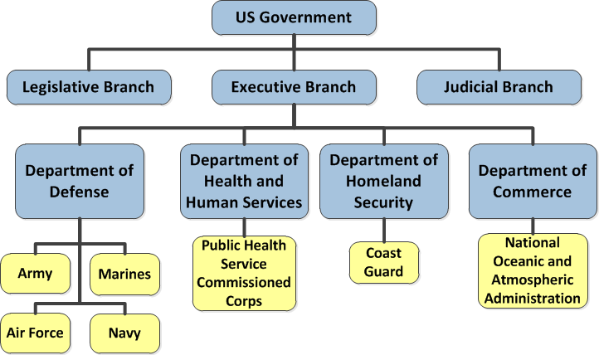
Seven Uniformed Services of the U.S.

Slide 3

A proud history
A proud history
From Ellis Island…
…To tribal lands.
Across America
Around the World
Protecting health and safety
since 1798
Notes:
Created in 1798, as Marine Hospital Service
Reorganized in 1870 along military lines
Established officially along military lines by Congress in 1889, with rank and pay similar to Navy
Renamed PUBLIC HEALTH SERVICE in 1912
After 141 years in the Treasury Department, PHS became part of the Federal Security Agency in 1939.
This agency later became the Department of Health, Education and Welfare and in 1980 the Department of Health and Human Services

Slide 4
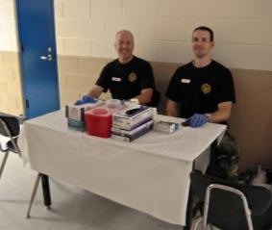
Over 6,000 PHS officers from various backgrounds:
Nurses/Nurse Practitioners
Pharmacists
Physicians
Dentists
Clinical Psychologists
Clinical Social Workers
Engineers
Environmental Health Officers
Optometrists
Physician Assistants
Scientists/Researchers
Physical, Occupational and Respiratory Therapists
Veterinarians
Many other health-related disciplines
Notes:
Under the leadership of the U.S. Surgeon General, the Commissioned Corps is part of the U.S. Public Health Service. Commissioned Corps officers are an elite team of approximately 6,500 public health professionals. We are dedicated to delivering the Nation’s public health promotion and disease prevention programs and advancing public health science. As part of the U.S. Public Health Service, the Commissioned Corps is an essential component of the largest public health program in the world.
Although the majority of USPHS CC officers are assigned to agencies in HHS, there are officers working outside of HHS such as: United States Coast Guard, the Department of Defense, the Department of Justice (Federal Bureau of Prisons), the State Department, the Department of Homeland Security, and the Department of the Interior (National Park Service).
In pharmacy alone, there are about 1,200 officers stationed around the country.

Slide 5
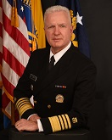
Assistant Secretary for Health
Assistant Secretary for Health
Admiral Brett P. Giroir, MD
Notes:
As the Assistant Secretary for Health (ASH), ADM Brett P. Giroir oversees the USPHS Commissioned Corps, providing it with strategic and policy direction. The ASH serves as the primary advisor to the Secretary of HHS on matters involving the Nation’s public health and science. The ASH runs the Office of the Assistant Secretary for Health (OASH) and helps coordinate the activities of the USPHS agencies on behalf of the Secretary.
5

Slide 6
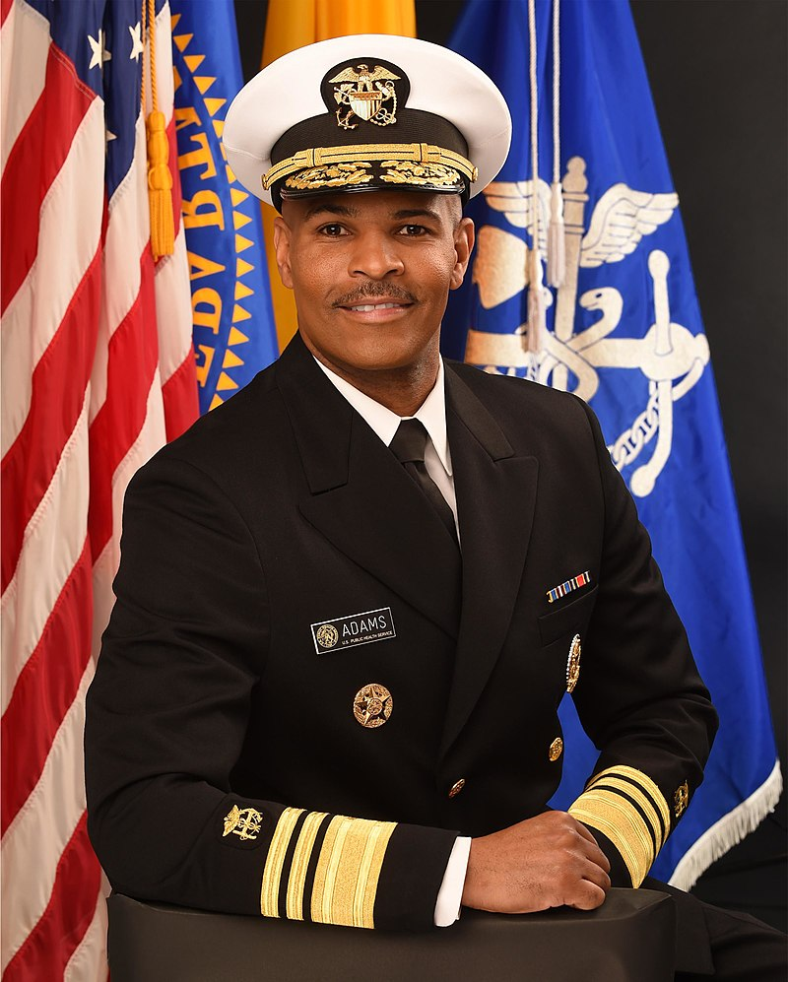
Surgeon General
Surgeon General
Vice Admiral Jerome M. Adams, MD, MPH
20th Surgeon General of the United States
Notes:
Under the supervision of the ASH, the Surgeon General of the USPHS provides operational command of the Commissioned Corps. As America’s Doctor, Dr. Adams is responsible for communicating the best available scientific information to the public regarding ways to improve personal health and the health of the nation.
6

Slide 7
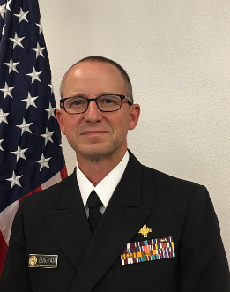
Chief professional officer,pharmacy category
Chief Professional Officer, Pharmacist Category
Rear Admiral (RADM) Ty Bingham
Chief Professional Officer, Pharmacist Category, USPHS
https://www.usphs.gov/profession/pharmacist/cpo.aspx
Notes:
There are CPO’s for some Categories within the Corps and they provide recommendations to the SG related to their respective Categories.
7

Slide 8
Vision and Purpose
Vision and purpose
Mission:
To protect, promote, and advance the health and safety of our Nation
Core Values:
Leadership, Service, Integrity, Excellence
Notes:
The mission of the Commissioned Corps is to protect, promote, and advance the health and safety of our Nation.
We pursue our mission through:
Rapid and effective response to public health needs
Leadership and excellence in public health practices, and
Advancement of public health science.
This has been the Public Health Service’s mission and method since 1798, when John Adams—the second President—signed into law the Act for the Relief of Sick and Disabled sailors.

Slide 9





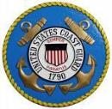











Where We Serve
Where We Serve
Notes:
This slide shows a selection of the Agencies that employ Commissioned Corps officers. Commissioned Corps officers serve throughout the U.S. Department of Health and Human Services and also with some Federal agencies outside of the Department.
Corps officers are stationed at a number of various Federal agencies and programs that are involved in public health. These agencies include Indian Health Service, Bureau of Prisons, Food and Drug Administration, Centers for Disease Control and Prevention, and the National Institutes of Health.
For example, at the Indian Health Service, Commissioned Corps officers provide health care to American Indian and Alaska Native populations. This service may take our officers to the remote areas of our country.
Other examples listed:
At the Centers for Disease Control and Prevention, some Commissioned Corps officers conduct and report on disease surveillance activities.
At the Bureau of Prisons, Commissioned Corps officers work for the Health Services Division and provide and manage a variety of physical and mental health care services.
At the Environmental Protection Agency, Commissioned Corps officers write and implement safe drinking regulations, and conduct waste management programs to contain contamination to public water systems.
At the Food and Drug Administration, Commissioned Corps officers ensure the safety and effectiveness of drugs and medical devices, work on new drug applications and adverse reaction reports, function as field inspectors and consumer safety officers, and serve on expert advisory committees and review panels.
At the Immigration and Customs Enforcement within the Department of Homeland Security, which administers the Nation's immigration laws, Commissioned Corps officers are assigned to the Division of Immigration Health Services. We provide medical consultation and technical assistance about detainees' health care, provide medical escorts for international and domestic air transport operations, and deploy medical teams on domestic and international missions.
At the National Institutes of Health, Commissioned Corps officers plan, support, and direct clinical research programs.

Slide 10
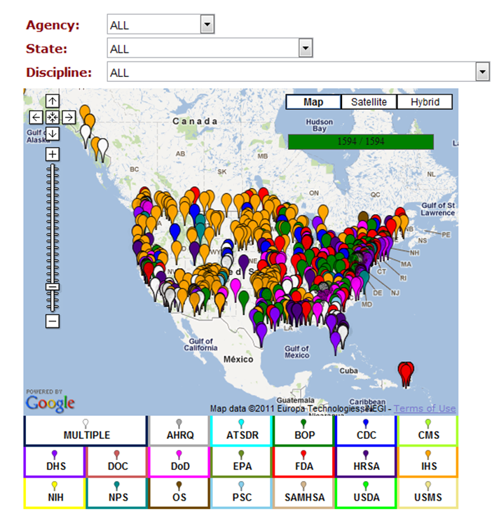
Where We Serve (Continued)
Where We Serve
Notes:
Clarify this map is domestically assigned officers but we also have officers around the world too. Link to map: https://usphs.gov/aboutus/agencies/dutystationmap.aspx

Slide 11
What We Do
What We Do
Serve underserved populations
Provide health care
  Perform clinical and pharmaceutical care
  Design and implement model clinical programs
Work with communities to educate and develop programs to improve public health
Clinical, management, and leadership positions
Notes:
The mission of the USPHS CC is to protect, promote, and advance the health and safety of the nation. This mission is achieved through rapid and effective response to public health needs, leadership and excellence in public health practices, and advancement of public health science.
Typical assignments or details may include:
Serving underserved populations
IMPORTANT emphasis HERE: State that our current priority is serving the underserved populations and filling pharmacist vacancies around the country within Indian Health Service and the Bureau of Prisons. Mention these locations are sometimes REMOTE locations.
Health care delivery (e.g. perform clinical duties)
Educate individuals and communities about public health
Develop and implement public health programs and lead public health organizations
Clinical positions are primarily found in Indian Health Service, Bureau of Prisons, Immigration and Customs Enforcement, and U.S. Coast Guard. There’s also numerous opportunities for management and leadership positions within these Agencies as well.

Slide 12
What We Do (continued)
Surveille and monitor potential drug shortage situations to ensure patients receive drugs that are medically necessary
Play a key role in new and generic drug approvals
Protect the integrity of the drug supply chain through initiatives that help protect consumers from exposure to substandard drugs and ensure that safe and effective drugs reach U.S. consumers
Respond and partner with state, tribal, and local communities for national emergencies, crisis response, and urgent public health needs
Notes:
These are some more examples of What We Do as pharmacists in the USPHS, such as….

Slide 13
Current Surgeon General (SG) Initiatives
Current Surgeon General (SG) Initiatives
Opioids and Addiction
  Opioid epidemic and substance abuse disorders
Tobacco
Health and the Economy
  Preventable chronic diseases and behavioral health issues
Health and National Security
  Wellness and obesity epidemic
Emerging Public Health Threats
  Ebola and Zika virus
Notes:
I wanted to talk a little bit about our current Surgeon General Initiatives and how pharmacists play a role in these initiatives.
For more information on SG Initiatives: https://www.surgeongeneral.gov/priorities/index.html

Slide 14
Examples of Pharmacy’s Role in SG Initiatives
Examples of Pharmacy’s Role in SG Initiatives
Opioids and Addiction
  Educate providers and patients on pharmaceutical and non-pharmaceutical pain management therapy.
  Expanding access to the overdose-reversing drug naloxone, including in Medicaid, Medicare, and for use by 1st responders.
  Encouraging the use of prescription drug monitoring programs (PDMP) by prescribers and pharmacies.
  Ensuring access to FDA-approved drugs for medication assisted treatment (MAT) for opioid and substance use disorders.

Slide 15
Examples of Pharmacy’s Role in SG Initiatives (Continued)
Examples of Pharmacy’s Role in SG Initiatives
Tobacco
  Lead and support smoking cessation programs
  Expanding the scope of pharmacy practice
  Establish tobacco cessation clinics throughout IHS and serve as tobacco cessation providers increasing access to care
  Created an online, free tobacco cessation training program (USPHS-Rx for Change: Tobacco Cessation Training Program) through collaboration with University of California-San Francisco (UCSF) and Purdue University
  Training officers, providers, and the public on the Five A’s and the Ask –Advice - Refer (AAR) model
  Provide resources for clinicians and tobacco users regarding tobacco cessation through the PharmPAC website
  Tobacco Cessation Training Program (https://dcp.psc.gov/OSG/pharmacy/sharedresources_tctp.aspx)
Notes:
Expanding the scope of pharmacy practice:
Published a document advising state Medicaid agencies on the value that expanding the scope of pharmacy practice to include the initiation, modification and discontinuation of tobacco cessation products plays in facilitation access to care.
The five A’s:
The five major steps to intervention are the "5 A's": Ask, Advise, Assess, Assist, and Arrange.

Slide 16
Examples of Pharmacy’s Role in SG Initiatives (Continued 2)
Examples of Pharmacy’s Role in SG Initiatives
Emerging Public Health Threats
  Ebola Virus Outbreak - Pharmacists deployed to Western Africa and worked to develop and manage vaccine clinical trials
  Zika Virus Outbreak
    Developed guidance for states on the coverage of insect repellants and electrolytes in Medicaid agencies.
    Worked closely with Federal Medicaid officials and drug manufacturers on initiatives to ensure access to family planning services and supplies including contraceptives in Puerto Rico.
    Published the “expanded scope of pharmacist practice” state Medicaid guidance document: discusses the role pharmacists have in facilitating access to oral emergency contraception in the community
Notes:
Transition to next slide:
Now I’m going to switch gears and spend a few minutes highlighting the Readiness and Deployment component within the USPHS.

Slide 17


Emergency Response Deployments
Emergency Response Deployments

Slide 18
What Roles Do Pharmacy Officers Play in Emergency and Humanitarian Responses?
What Roles Do Pharmacy Officers Play in Emergency and Humanitarian Responses?
  General Pharmacy
    Medication procurement and coordination of pharmacy care
    Dispensing
    Counseling
    Drug information
    Immunizations
    Glucose screening, etc.
  Leadership, Logistics, Administrative

Slide 19
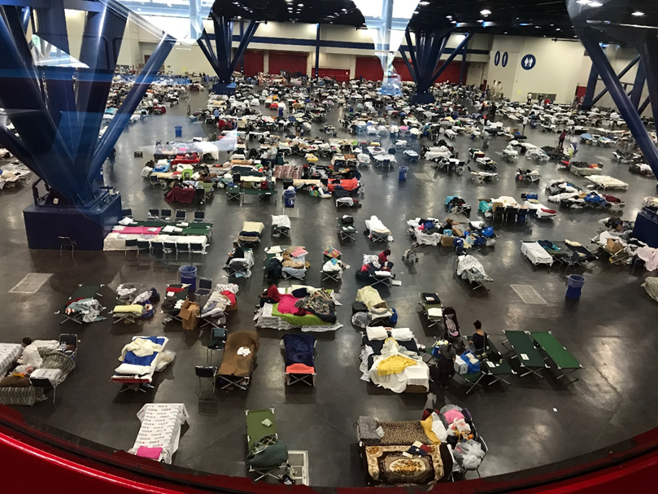
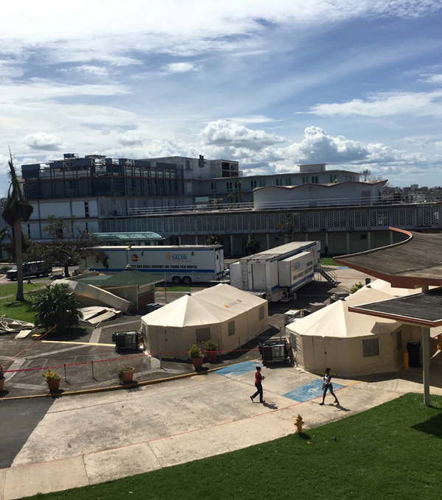

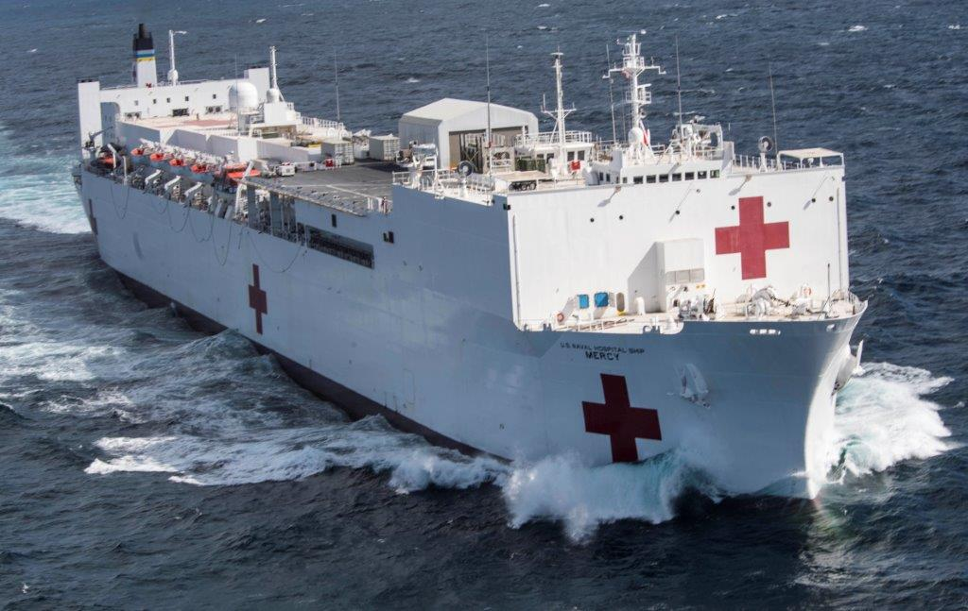
Emergency Response Deployments
Emergency Response Deployments
Notes:
This slide shows some various pictures of PHS deployments.
The top left is a picture of the sleep quarters for patients and uniformed services in the Puerto Rico convention center.
The top right is a picture of Federal Medical Stations (FMS) which provide beds to support healthcare systems anywhere in the U.S. that is impacted by natural disasters or public health emergencies.
The bottom left is a picture of officers in their Operational Dress Uniform, or ODU, alongside other uniformed services.
The bottom right is a picture of a U.S. Navy Hospital ship. The USPHS has deployed with DoD/Navy to help support humanitarian missions in the past.

Slide 20
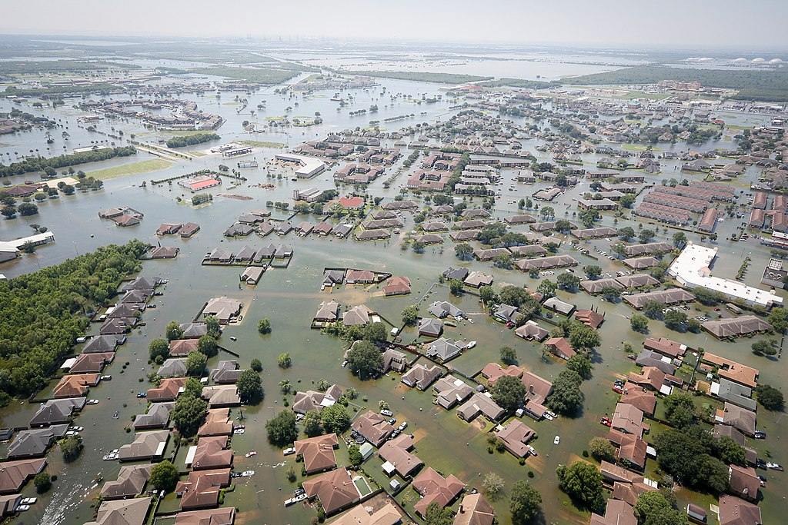
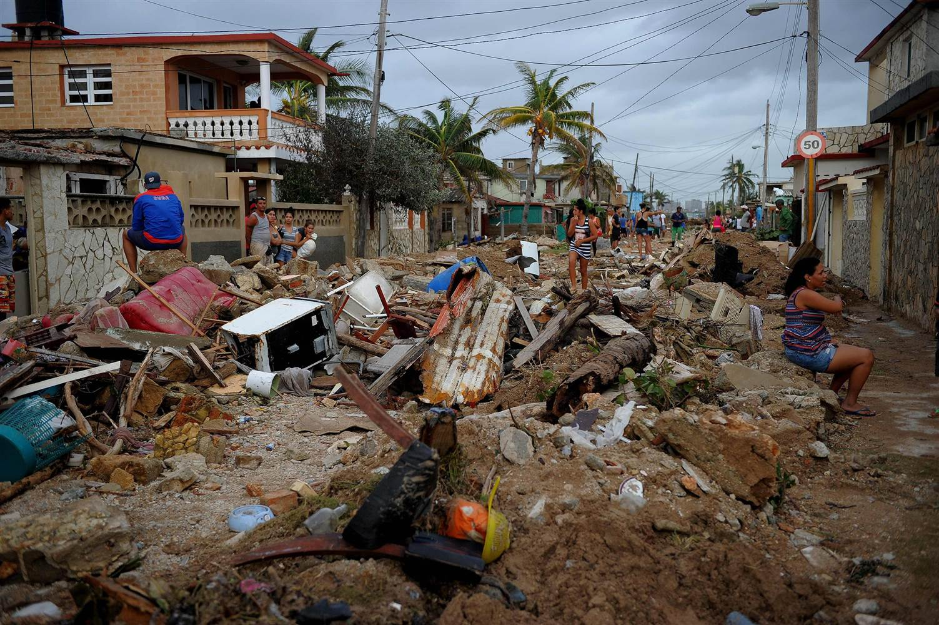
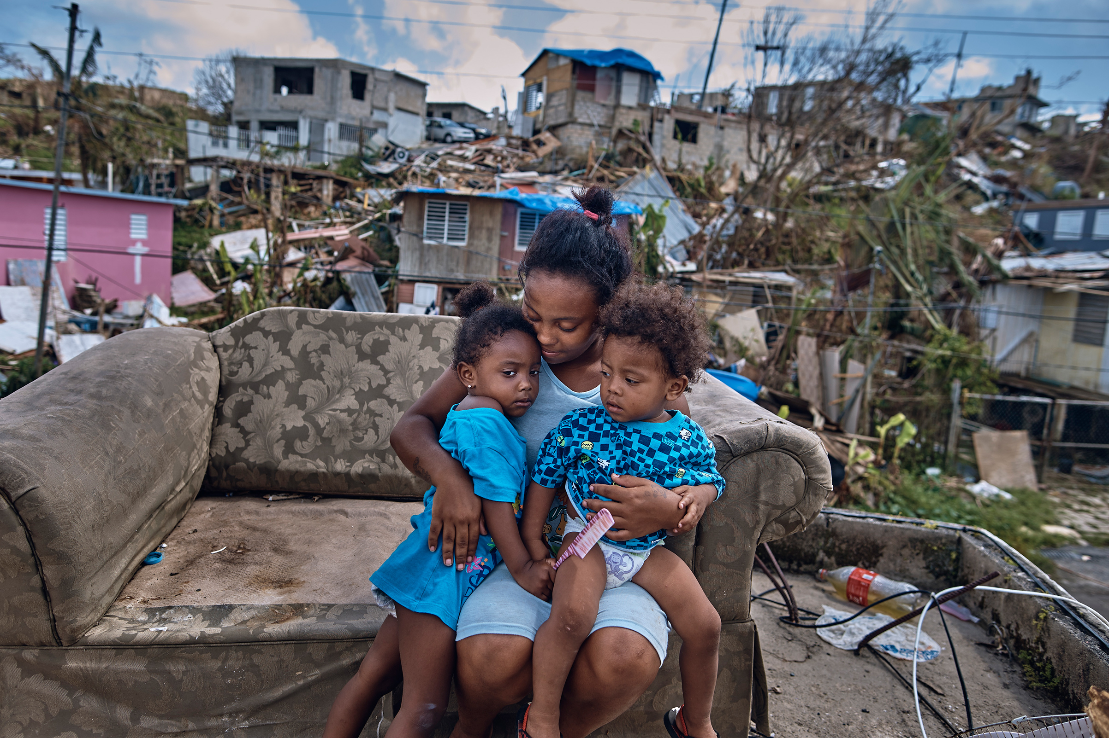
Public Health Disasters in 2017
Hurricane Harvey (Category 4)
Hurricane Irma (Category 4)
Hurricane Maria (Category 5)
Notes:
Statistics:
Hurricane Harvey:
Occurred in Texas and Louisiana from August 17, 2017 through September 2, 2017. 125 billion in damage, 107 American fatalities.
Hurricane Irma:
Occurred in Florida and US Virgin Islands from August 30, 2017 through September 16, 2017. 65 billion in damage. 106 American fatalities.
Hurricane Maria:
Occurred in Puerto Rico, US Virgin Islands from September 16, 2017 through October 3, 2017. 92 billion in damage. All of Puerto Rico 3.4 million residents without electricity. 64 to 1,085 American fatalities.

Slide 21
2017 HHS / USPHS / NDMS / DMAT Humanitarian Mission Response
Integrated federal response teams coordinated humanitarian response activities
These teams included:
  > 2,000 USPHS CC officers
    > 300 PHS CC pharmacists deployed in multiple roles
  Hundreds of HHS, National Disaster Medical System (NDMS), and Disaster Medical Assistance Team (DMAT) team members
Partnerships with federal, territorial, state, county, city, local, community, and non-governmental organizations

Slide 22

Student Opportunities
Student Opportunities
What You Can Do
Join the Pharmacy Student Listserv!

Slide 23
Educational and Training Opportunities
Pharmacy Student Experiential Clinical Opportunities:
  Indian Health Service and Bureau of Prisons
Pharmacy Student Experiential Programs:
  CDC
  FDA
  Pharmacy Student Experiential Program (CDER) - (http://www.fda.gov/AboutFDA/WorkingatFDA/FellowshipInternshipGraduateFacultyPrograms/PharmacyStudentExperientialProgramCDER/default.htm)
Notes:
IHS and BOP offer students the opportunity to gain valuable clinical experiences.
Other Agencies also offer student experiential rotations/opportunities. For example, the Center for Disease Control and Prevention places students to learn about CDC’s offices and mission. The FDA’s Program is highly competitive and places hundreds of students every year from around the country.

Slide 24
Post-Graduate Opportunities
Indian Health Service Residency Program
  PGY1 and PGY2 Pharmacy Practice Residencies
  IHS Residency Program (http://www.ihs.gov/pharmacy/resident)
Bureau of Prisons Residency Program
  Clinical Pharmaceutical Care and Primary Care
  BOP Student Programs (https://dcp.psc.gov/osg/pharmacy/student_rotations_bop.aspx)
NIH Clinical Center Pharmacy Department
  Pharmacokinetics/Pharmacogenetics Fellowship
  PGY2 Oncology Specialty Residency
  NIH Pharmacy Department (http://www.cc.nih.gov/phar)

Slide 25
Junior Commissioned Officer Student Training and Extern Program (JRCOSTEP)
Junior Commissioned Officer Student Training and Extern Program (JRCOSTEP)
Eligible after one year of health professional school
Competitive
Paid salary during externship (work 1 to 4 months during school breaks)
No obligation after graduation
Learn more at: JRCOSTEP (https://www.usphs.gov/student/jrcostep.aspx)
Notes:
JRCOSTEP: For certain professional disciplines including pharmacy

Slide 26
Junior Commissioned Officer Student Training and Extern Program (JRCOSTEP) - Continued
Senior Commissioned Officer Student Training and Extern Program (SRCOSTEP)
Competitive
Full-time students in specific health disciplines
Given a salary and active duty benefits while finishing final year of health professional school (up to 18 months)
Obligation to the Corps for twice the amount of time sponsored
Learn more at SRCOSTEP (http://www.usphs.gov/student/srcostep.aspx)

Slide 27
Testimonials, JRCOSTEP and SRCOSTEP
Testimonials, JRCOSTEP and SRCOSTEP
JRCOSTEP Testimony
  ENS Todd Marcy, pharmacy student from University of Oklahoma, pharmacy practice within Indian Health Service
  “My experience with the Indian Health Service has been outstanding. I have learned how much more the pharmacist is informed and involved in the care of the patients we serve.”
SRCOSTEP Testimony
  LT Lynde Monson, pharmacist in Indian Health Service
  “I already knew that I would be starting a challenging and exciting career with Indian Health Service upon graduation...I play an active role in patient care, and have ongoing options for additional training to expand my practice and better serve the community members.”

Slide 28
America’s Health
Responders
For more information, call
1–800–279–1605
or visit www.usphs.gov and www.facebook.com/usphs
#USPHSPharmacy
#USPHS
Notes:
For more information, call us at 1–800–279–1605 or visit our Web site at www.usphs.gov.
We look forward to hearing from you. Thank you.
28

Slide 29
Back-Up Slides
Back-up Slides

Slide 30
Basic Qualifications
  U.S. citizen
  Less than 44 years of age
  Medically and physically qualified
  Ability to pass a suitability review
  Qualifying degree from an accredited institution (varies depending on profession)
  Current, unrestricted, and valid license to practice in one of the 50 States; Washington, DC; Commonwealth of Puerto Rico; U.S. Virgin Islands; or Guam.

Slide 31
Indian Health Service (IHS)
567 Federally-Recognized Tribes
2.2 Million American Indians and Alaska Natives
12 Service Areas in 35 States
Over 700 Pharmacists in over 230 locations
Notes:
There are now 567 Federally-Recognized Tribes (Pamunkey Tribe) as of January 2016.-Damion Killsback

Slide 32
Opportunities for Pharmacists-IHS
Clinical positions
  Chronic disease management pharmacists
  Examples disease states:
    Anticoagulation
    Hypertension/Cardiovascular
    Asthma
    Diabetes
    Oncology
Non-clinical positions
  Pharmacy management and directors
  Quality Assurance/Quality Improvement
  Research/epidemiology
  Pharmacy informatics

Slide 33
Opportunities for Pharmacists
-Bureau of Prisons
Over 190 pharmacist-specific positions. Opportunities for administrative positions such as Health Service Administrator, Executive positions, Informatics, etc.
Collaborative Practice Agreements in diabetes, anticoagulation, hypertension, dyslipidemia, and more.
Pharmacist Clinical Consultants for Hepatitis C, HIV, and Mental Health.
APPE rotation sites, SRCOSTEP program, and a PGY1 residency.

Slide 34
Opportunities for Pharmacists- U.S. Immigration and Customs Enforcement (ICE) Health Service Corps (IHSC)
20 Pharmacist-specific billets
Opportunities for career progression to administrative positions
Clinical Pharmacy/Collaborative Practice Agreements
  Anticoagulation, HIV care, mental health, transgender care, cardiovascular management, diabetes, and women’s health
Ambulatory care setting, one to two pharmacist staffing with pharmacy technician support
Notes:
Immigration and Customs Enforcement (ICE) Health Service Corps (IHSC)

Slide 35
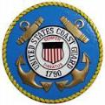
Opportunities for Pharmacists
-US Coast Guard
U.S. Coast Guard (USCG) pharmacists are assigned to small, one-pharmacist ambulatory care settings where they actively engage with other healthcare personnel and patients routinely.
Pharmacists responsibilities are vast and include:
  Oversight of numerous afloat and ashore sickbay units, logistical activities, inventory management and, most importantly, educating the USCG independent duty corpsmen on safe pharmacy operations.
Pharmacy patients consist of active duty members and reservists, retirees and other eligible dependents.

Slide 36
Opportunities for Pharmacists
-US Coast Guard (Continued)
Testimonial:
  “When you are a pharmacy officer in the U.S. Public Health Service (USPHS) commissioned corps, detailed to the Coast Guard your career will take you into a world of expanded scopes and diverse roles. As a USPHS pharmacy officer, you will work at Coast Guard clinics -caring for patients; reviewing, approving, and monitoring new drugs; and assisting in public health emergencies. You'll be offered greater work variety than you'll find in most pharmacy practice settings. As part of a unique team of committed health care professionals, you'll enjoy leadership opportunities, excellent benefits, and work/life balance, all while improving and advancing the health of the Coast Guard.“
    US Coast Guard Pharmacy (https://www.gocoastguard.com/active-duty-careers/officer-opportunities/programs/pharmacist)

Slide 37
Opportunities for Pharmacists
-Food and Drug Administration
Mission statement: Responsible for protecting the public health by ensuring the safety, efficacy, and security of human and veterinary drugs, biological products, and medical devices; and by ensuring the safety of our nation's food supply, cosmetics, and products that emit radiation.
Positions:
- Regulatory Health Project Manager
- Compliance Officer - Field Investigator
- Clinical Reviewer - Safety Evaluator
- Drug Information - Pharmacologist

Slide 38
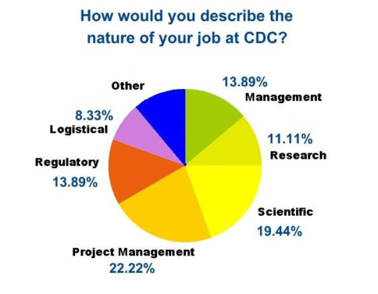
Centers for Disease Control and Prevention (CDC)
Over 30 pharmacists working across the agency and world
Work settings for pharmacists:
  CDC Drug Service
  Strategic National Stockpile (SNS)
  Regulatory
  HIV/AIDS
  Medication Safety
  Injury
  Agency for Toxic Substances and Disease Registry (ATSDR)
  Adolescent Health
  Birth Defects
  Quarantine
  Chronic Diseases
Based on Aug. 2009 CDC Pharmacist survey results

Slide 39
Opportunities for Pharmacists-CDC
Positions:
  Behavioral Scientists
  Biologists
  Emergency Response Specialists
  Epidemiologists
  Health Education Specialists
  Health Informatics Specialists
  Health Scientists
  Medical Officers
  Microbiologists
  Public Health Advisors
  Public Health Analysts

Slide 40
Who Serves in the various Institutes of the National Institutes of Health (NIH)?
Pharmacists serve in the 240-bed Clinical Center (CC) of the NIH in Bethesda
Pharmacists also serve in other Institutes and Centers of the NIH including but not limited to FIC, NCATS, NCI, NIAID, and NIDA

Slide 41
Opportunities for Pharmacists at NIH
Pharmacists staff the Inpatient and Outpatient Section of the CC Pharmacy
Clinical pharmacy specialists provide services to study participants of the various Institutes
Radiopharmacists serve in Nuclear Medicine and other areas of the CC
The CC Pharmacy provides a PGY2 Oncology residency and a 2-year pharmacokinetics fellowship

Slide 42
Opportunities for Pharmacists- Centers for Medicare and Medicaid Services (CMS)
Providing operational oversight of Medicaid coverage
Providing operational oversight of Medicare Parts A&B (hospital and out-patient coverage)
Conducting oversight, market surveillance, public outreach and compliance activities for Medicare Parts C&D (managed care organizations and prescription drug plan sponsors)

Slide 43
Opportunities for Pharmacists-CMS (continued)
Supporting policy and operations for implementing the Prescription Benefit portion of the Health Insurance Marketplace and Parts C&D drug benefit (e.g. formulary analysis).
Researching, writing, and enacting regulatory and sub-regulatory changes to the Part D prescription drug benefit.
Providing direct support to beneficiaries, providers, suppliers, state agencies, governments, and members of Congress.

Slide 44
Opportunities for a Pharmacist- Health Resources and Services Administration (HRSA)
Telehealth / Telemedicine (Rural Health)
Health Workforce Strengthening
American Indian / Alaska Native Health Equity
Countermeasure Injury Compensation Program
Community Health Centers
Maternal and Child Health
Office of Pharmacy Affairs (340B Drug Pricing Program)
Global Health
Poison Control
Organ Donation
HIV/AIDS
Notes:
Project Officer/ Program Analyst overseeing grants awarded to community health centers and other organizations to improve health and achieve health equity through access to quality services, a skilled health workforce and innovative programs.

Slide 45
Opportunities for Pharmacists-Agency for Healthcare Research and Quality (AHRQ)
Pharmacists serve to improve quality of health care and improve patient safety
  Evidence-based Practice Center (EPC) Program
  Center for Quality Improvement and Patient Safety (CQuIPS)
Pharmacists can use AHRQ’s resources including research, tools, and evidence
Pharmacists can nominate research topics
Pharmacists can seek funding opportunities

Slide 46
Defense Health Agency (DHA)
DHA administers the TRICARE Health Plan providing worldwide medical, dental and pharmacy programs to more than 9.4 million uniformed Service members, retirees, and their families
Effective October 2018, DHA will execute its mission of administration and management over the Military Treatment Facilities (MTFs)
USPHS Officers including pharmacists are assigned to DHA to assist with administration of the TRICARE Health Plan

Slide 47
Opportunities for Pharmacists-
Defense Health Agency (DHA)
Pharmacists responsibilities are vast and include:
Work Location | Description
Pharmacy Operations Division | Goal: to improve outcomes while reducing overall health care costs through the delivery of optimal pharmaceutical care though monitoring drug usage and cost trends and performs pharmacoeconomic analysis to support Department of Defense (DoD) formulary management, national pharmaceutical contracts, and clinical practice guidelines; provide administrative and technical support for the DoD Pharmacy &Therapeutics Committee
Interagency Program Office | Goal: to lead and coordinate the adoption of and contribution to national health data standards to ensure interoperability; to facilitate Interagency Program Office Town Halls; develop Engagement Strategy and Roadmap; review and vote on pharmacy related Health Level Seven (HL7) ballots to influence standards development
Solutions Delivery Division | Goal: of the Electronic Health Record (HER) Core Project Management Office (PMO) is to provide an sustain the current comprehensive electronic health record and related medical systems, and embrace the future by collaborating with Government and industry partners to support service members and beneficiaries worldwide

Slide 48
Opportunities for Pharmacists- Office of the Secretary / Office of the Surgeon General
Since most of the positions are Multi-Disciplinary, there are numerous opportunities
Office of the Assistant Secretary of Preparedness and Response (ASPR)
  Office of Emergency Management (OEM)
    Division of Logistics (Branch Chief/Program Analyst/Mgr)
Director of Division of Commissioned Corps Personnel and Readiness (DCCPR)

