Slide 1
Pharmacist Professional Advisory Committee
PY24 Promotion Preparedness Presentation
CDR Jessica Anderson and CDR Hillary Duvivier
Allied Health Promotion Preparedness Workgroup Co-leads
September 22, 2022

Slide 2
Promotion Preparedness
Objectives
Provide a brief summary of PY24 changes.
Share how promotion benchmarks can be incorporated into your promotion documents.
Provide clarity and direction to prepare for the new promotion CV format.

Slide 3
Disclaimer
The examples and information contained in this presentation are to be used as guidance only. Guidance documents and CCHQ templates should be used together to generate ideas about your own work and assist in formulating your own promotion packet. Guidance is developed and approved through PharmPAC leadership and CPO advisement. You are highly encouraged to utilize the Allied Health Promotion Packet Review program to further improve your documents. Seeking out senior officer mentors is also a valuable way to obtain feedback on your documents.

Slide 4
NEW for PY24 Promotion Cycle
Condensed Promotion Categories
Allied Health Category
Pharmacists, Social Workers, Psychologists, Dietitians
One Promotion
Assigned Permanent Grade equivalent to Temporary Grade
No officers will decrease in grade after the conversion
Pay grade and seniority credit dates should be identical.
Date of last temporary promotion and will be used for future eligibility.
Promotion Credit Date: determines total active duty time at O-2 or higher.

Slide 5
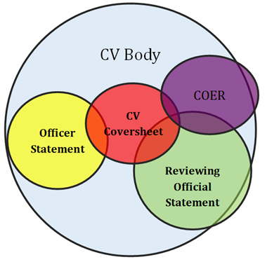
How do promotion documents work together?
Agency-related work should be included in the CV (coversheet and body), annual COER, and ROS. The CV coversheet should serve as an outline or highlights document, while the COER, ROS, OS, and CV body go into more detail.
The COER should be limited to the current year, and the CV and ROS should showcase career highlights, generally since your last promotion. The ROS should focus on the leadership perspective of your agency work and how it impacts the agency’s mission.
Officership/Corps-related work should be included in the OS and the CV (Coversheet and body).
All this change…
They just want us to be the same.
Notes:
Award Inclusion. Readability

Slide 6
Helpful Promotion Documents

Slide 7
GENERAL APPROACH TO DRAFTING YOUR DOCUMENTS
How is your work unique? What makes you stand out from other officers?
What are the impacts of your actions on the mission of the Public Health Service?
How have you demonstrated personal and professional growth as an officer throughout your career?
Can officers outside of your agency understand what you do (and why it’s important)?

Slide 8
PRECEPTS and FACTORS
40% Performance
20% Education, Training, and Professional Development
25% Career Progression and Potential
COER
ROS
Award History
Credentials
Licensure
Continuing Education
Public Health Training & Experience
Mission Priority
Billet Level, Assignments
Mobility
Collateral Duties
15% Professional contributions, basic level of force readiness history, and service to the PHS Commissioned Corps (Officership)
Honor/Integrity/Duty
Other PHS/Professional Contributions
Presentations and Outreach

Slide 9
Precept 1: Performance 40%
COER
Primary focus is the narrative, not the score
Reviewing Official’s Statement (ROS)
Progressive leadership qualities, skills, and roles
Award History
O3
Citation (or equivalent)
Unit Commendation
O4
Achievement Medal (or equivalent)
Unit Commendation
O5
Commendation Medal (or equivalent)
Unit Commendation
O6
Outstanding Service Medal (or equivalent)
Outstanding Unit Citation

Slide 10
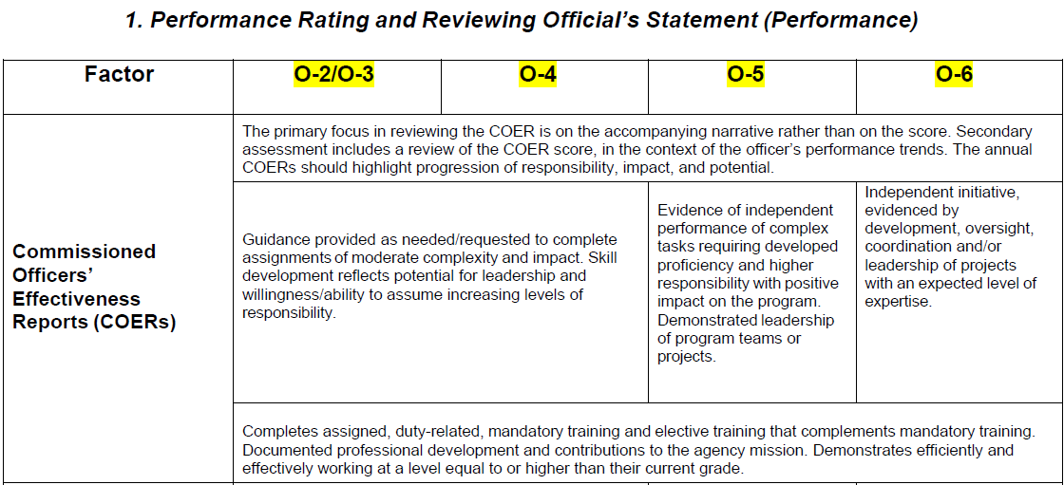
Precept 1: Performance
COER
Reflects performance at your duty station with progression through increasing levels of independence, initiative, and leadership.
“See → Do → Teach”
COER score and narrative must align, but narrative is most important.
Narrative should be in bullet form, accomplishments and impacts should be quantified wherever possible.

Slide 11
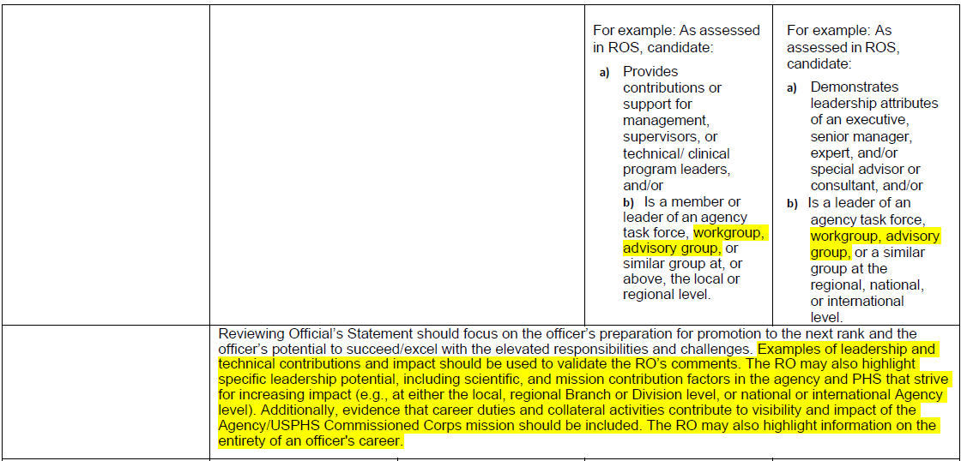
Precept 1: Performance ROS
ROS describes readiness for promotion and AGENCY accomplishments/impacts.
ROS should come from a second-line supervisors perspective of your LEADERSHIP and contributions at the AGENCY
ROS should cover the officer’s career highlights and how their work relates to the agency’s mission.

Slide 12
Precept 1: Performance Awards
Reflects increasing levels of achievement based on your impacts and accomplishments.
Includes awards and recognition from PHS, agency, and professional organizations.

Slide 13
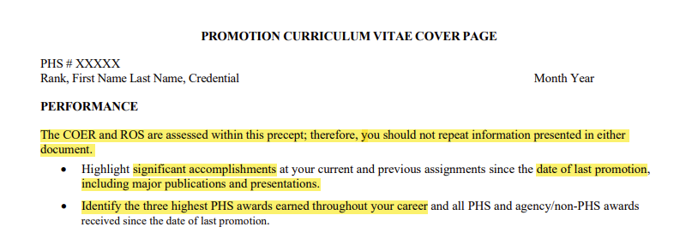
Performance: CCHQ Cover Sheet Guidance

Slide 14
Pharmacy CV Coversheet Example
Changes since PY23:
Limit information to accomplishments and impacts (including agency-related presentations and publications) since your last temporary promotion
Include 3 highest PHS awards (individual and/or group) throughout your career
Include all PHS awards since your last temporary promotion*
* The PharmPAC recommends exercising your critical judgement regarding inclusion of low-level group awards

Slide 15
Pharmacy CV Coversheet Example (2)
Changes since PY23:
Limit information to accomplishments and impacts (including agency-related presentations and publications) since your last temporary promotion
Include 3 highest PHS awards (individual and/or group) throughout your career
Include all PHS awards since your last temporary promotion*
* The PharmPAC recommends exercising your critical judgement regarding inclusion of low-level group awards

Slide 16
Pharmacy CV Coversheet Example (3)
Changes since PY23:
Limit information to accomplishments and impacts (including agency-related presentations and publications) since your last temporary promotion
Include 3 highest PHS awards (individual and/or group) throughout your career
Include all PHS awards since your last temporary promotion*
* The PharmPAC recommends exercising your critical judgement regarding inclusion of low-level group awards

Slide 17
Precept 2: Education, Training, and Professional Development 20%
Credentials
Licensure
Continuing Education
Public Health Training and Experience

Slide 18
Credentials
O3
Qualifying degree, licensure, registration, certification per appointment standards
O4
Preparing for an advance certification, licensure or degree
O5
Completion of an advance certification or licensure; enrollment and progression in a degree program
O6
Completion and integration/application of advanced knowledge and skills beyond required qualifying credentials

Slide 19
Precept 2: Education, Training, Professional Development
Credentials, Licensure
Promotes and reflects continued learning and professional development beyond qualifying degree for pharmacists
New CV does not specify a specific degree beyond qualifying degree.
Requires officers to address how the advanced certification, credential, or degree enhances their knowledge, expertise, practice and value-add.

Slide 20
Continuing Education
O3 & O4
Participates and actively engages in continuing education activities
O5
Officer helps in planning of continuing education activities
O6
Officer plans, develops, or independently leads continuing education activities

Slide 21
Precept 2: Education, Training, Professional Development Continuing Education
Reflects the progression from participating in continuing education, to teaching or planning, and then developing or independently leading activities.
Report CE you’ve completed over the last 5 years by uploading EITHER your CPE Monitor printout OR the CCHQ Continuing Education Summary Sheet to your eOPF.
Only include CE you’ve planned, instructed, taught, developed, led, etc. You do NOT need to transcribe your entire CE completion history.

Slide 22
Public Health Training & Experience
O3 & O4
Participation in leadership OR public health training OR participation in public health programs
Surgeon general priorities
Public Health Initiatives
O5
Participation in leadership AND/OR public health training; leadership in public health programs
Demonstrate experience of public health service on a local, regional or national activity or initiative
O6
Participation in executive leadership AND/OR public health training; leadership, supervision, and mentorship to others
Demonstrate experience of service on a local, regional, national, or international public health activity or initiative

Slide 23
Precept 2: Education, Training, Professional Development Public Health Training & Experience
Pharmacist officers are commissioned with varied levels of public health knowledge and leadership skills.
Reflects expected progression in public health knowledge and leadership development.

Slide 24
Pharmacy CV Coversheet Example
Changes since PY23:
Describe relevance of major credentials/certifications to your position, PHS mission, and/or career progression
Include dates of credentials/certificates. Do not include expired credentials.
Certifications that have a CE component (Immunization administration, MTM, etc) may continue to be listed on the coversheet
Include activities related to teaching, planning, developing, or leading continuing education. Do not include standard CE course completions

Slide 25
Pharmacy CV Coversheet Example (2)
Changes since PY23:
Describe relevance of major credentials/certifications to your position, PHS mission, and/or career progression.
Include dates of credentials/certificates. Do not include expired credentials.
Certifications that have a CE component (Immunization administration, MTM, etc) may continue to be listed on the coversheet
Include activities related to teaching, planning, developing, or leading continuing education. Do not include standard CE course completions
Notes:
Guidance says: Provide a brief statement about what you are doing/have done to increase your knowledge and skills beyond the qualifying degree/credential and the relevance for your current job, the PHS mission, and/or career progression.

Slide 26
Pharmacy CV Coversheet Example (3)
Changes since PY23:
Describe relevance of major credentials/certifications to your position, PHS mission, and/or career progression.
Include dates of credentials/certificates. Do not include expired credentials.
Certifications that have a CE component (Immunization administration, MTM, etc) may continue to be listed on the coversheet
Include activities related to teaching, planning, developing, or leading continuing education. Do not include standard CE course completions
Notes:
Guidance says: Provide a brief statement about what you are doing/have done to increase your knowledge and skills beyond the qualifying degree/credential and the relevance for your current job, the PHS mission, and/or career progression.

Slide 27
Precept 3: Career Progression and Potential 25%
Mission Priority
Billet Level
Assignments
Mobility
Collateral Duties

Slide 28
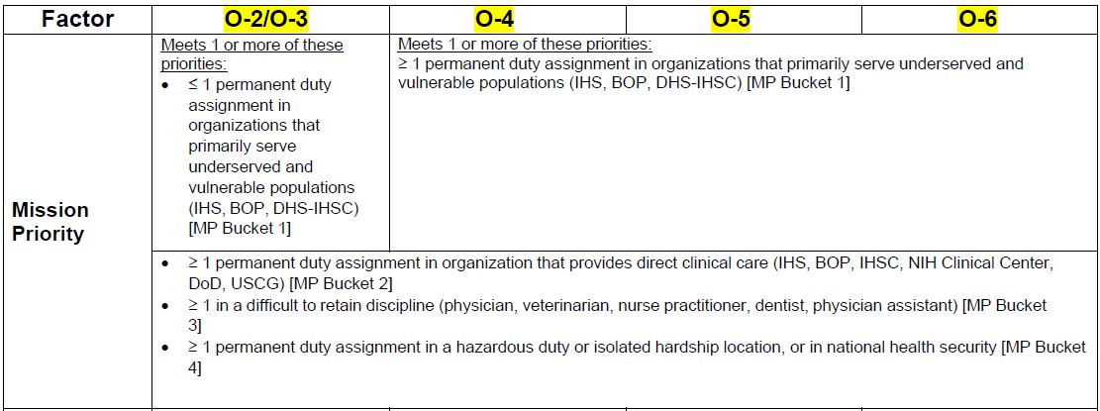
Mission Priority

Slide 29
Precept 3: Career Progression & Potential
Mission Priority
Mission Priority Areas are as identified for PHS Modernization.
Bucket 1 reflects PHS’s responsibility in providing care for underserved and vulnerable populations.
Bucket 2 reflects PHS’s focus on clinical competency; includes all clinical billets.
Bucket 4 reflects assignments that prepare and protect the nation against incidents with public health consequences.

Slide 30
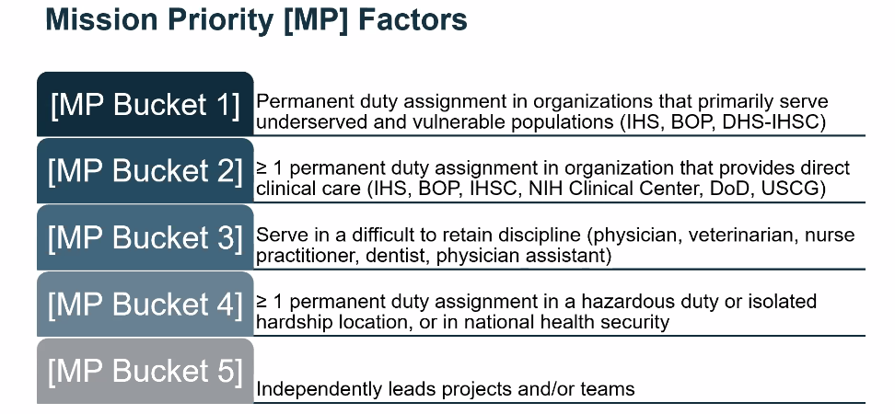
Precept 3: Career Progression & Potential Mission Priority

Slide 31
Billet Level
O3
Occupy billet ≥ O-4
O4
Occupy billet ≥ O-5
O5 & O6
Occupy billet ≥ O-6
PIR should demonstrate progressively higher billets throughout the officer’s career. Officer should document level of work performed, including supervisory duties, in OS, ROS, COER, CV, etc

Slide 32
Assignments
**Officer should document any detailed assignments >90 days in eOPF and CV, including TDY assignments. CV should document progressively increased complexity of assignments or leadership throughout the officer’s career.**
O3
1 assignment that demonstrates responsibility, ability, and independence
O4
≥ 1 assignments that demonstrates progressively more responsibility, ability, and independence; independently conducts projects with limited guidance
O5
≥ 2 assignments that demonstrates progressively more responsibility, ability, and independence; independently leads projects and/or teams [MP Bucket 5]
O6
≥ 3 assignments that demonstrates progressively more responsibility, ability, and independence; considered a subject matter expert; independently leads projects and teams [MP Bucket 5]

Slide 33
Assignments and Mobility

Slide 34
Mobility
**Geographic or programmatic moves must be documented via personnel orders and the PIR.**
O3 & O4
≤ 1 geographic or programmatic move excluding initial call to duty
O5
≥ 2 geographic or programmatic moves excluding initial call to duty
O6
≥ 3 geographic or programmatic moves excluding initial call to duty

Slide 35
Collateral Duties
**Officer should document all collateral duties in the CV, OS, ROS, COER, and through supporting documents in the eOPF.**
O3
At least 1 collateral duty in support of the program (local/institutional)
O4
≥1 collateral duties in support of the local program or agency
O5
≥ 2 collateral duties in support of program, agency, or PHS initiatives or priorities, including at least one collateral duty at the senior/national level
O6
≥ 3 collateral duties in support of program, agency, or PHS initiatives or priorities, including at least one collateral duty at the senior/national level with a leadership role

Slide 36
Pharmacy CV Coversheet Example (4)
Changes since PY23:
Move collateral duties from “Performance” section to here and include impacts
Indicate mission priorities for each of your (recent) assignments
Include TDYs and details >90 days
Notes:
Collateral duties within your agency go under career progression and PHS ones go under contributions. Include ones with outcomes.

Slide 37
Pharmacy CV Coversheet Example (5)
Changes since PY23:
Move collateral duties from “Performance” section to here and include impacts
Indicate mission priorities for each of your (recent) assignments
Include TDYs and details >90 days

Slide 38
Pharmacy CV Coversheet Example (6)
Changes since PY23:
Move collateral duties from “Performance” section to here and include impacts
Indicate mission priorities for each of your (recent) assignments
Include TDYs and details >90 days

Slide 39
Precept 4: Professional Contributions and Service to the PHS Commissioned Corps 15%
Honor/Integrity/Duty
Commissioned Corps and Professional Contributions
Presentations and Outreach

Slide 40
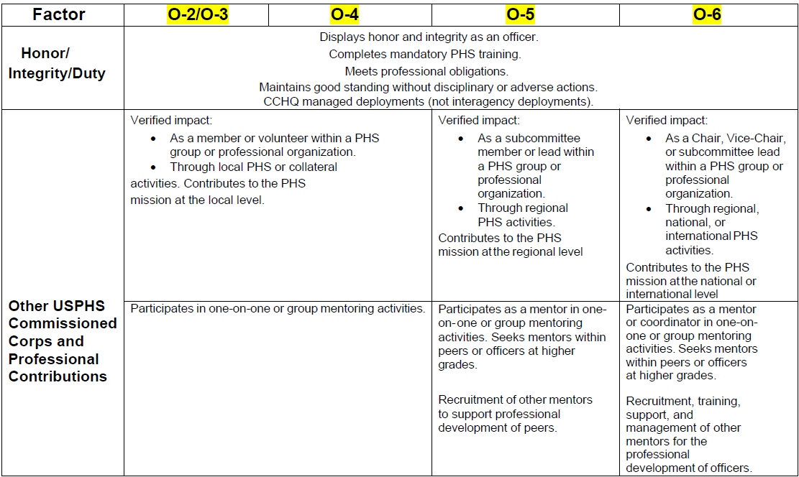
Precept 4: Officership
Honor/Integrity/Duty and Other Contributions
CCHQ-managed deployments are specified for this precept.
Reflect progression from member or volunteer, to leadership roles for initiatives, subcommittees, groups, or organizations.
Highlights mentoring and engagement with professional organizations.

Slide 41
Honor/Integrity/Duty
Displays honor and integrity as an officer.
Completes mandatory PHS training.
Meets professional obligations.
Maintains good standing without disciplinary or adverse actions.
CCHQ managed deployments (not interagency deployments).

Slide 42
Presentations and Outreach
**In support of PHS/non-Agency missions and public health initiatives**
O3
Documented participation at local and regional meetings or activities of professional organizations.
O4
Documented presentation and/or outreach at local and regional meetings or activities of professional organizations.
O5
Documented presentations and/or outreach at regional meetings or activities of professional organizations
O6
Documented presentations and/or outreach at regional, national, or international meetings or activities of professional organizations.

Slide 43
Precept 4: Officership Presentations and Outreach
Reflects contributions to the pharmacy professional body of knowledge and promotion of PHS and the Pharmacy Category.
Includes PHS recruitment, agency-specific, and other public health initiatives.
Progressive impact with increasingly wider target audience.

Slide 44
Commissioned Corps and Professional Contributions O3
Achievements and contributions should be documented in the COER, OS, CV, awards, and in letters of appreciation.
Participates in one-on-one or group mentoring activities.
Verified impact as a member or volunteer within a PHS group or professional organization on the local level
Active membership in a professional, uniformed service, or specialty organization at the local level.

Slide 45
Commissioned Corps and Professional Contributions O4
Achievements and contributions should be documented in the COER, OS, CV, awards, and in letters of appreciation.
Participates in one-on-one or group mentoring activities.
Verified impact as a member or volunteer within a PHS group or professional organization on the local level
Active membership in a professional, uniformed service, or specialty organization at the local or regional level.

Slide 46
Commissioned Corps and Professional Contributions O5
Achievements and contributions should be documented in the COER, OS, CV, awards, and in letters of appreciation.
Participates as a mentor in one-on-one or group mentoring activities.
Verified impact as a member or lead within a PHS group or professional organization on the regional level.
Active membership in a professional, uniformed service, or specialty organization at the regional or national level.

Slide 47
Commissioned Corps and Professional Contributions O6
Achievements and contributions should be documented in the COER, OS, CV, awards, and in letters of appreciation.
Participates as a mentor or coordinator in one-on-one or group mentoring activities.
Verified impact as a Chair, Vice-Chair or subcommittee lead within a PHS group or professional organization on the regional, national, or international level.
Active membership, with contribution in a leadership role, in a professional, uniformed service, or specialty organization at the regional or national level.

Slide 48
Pharmacy CV Coversheet Example (7)
Changes since PY23:
Move deployments from “career progression” section to here
Include PHS-related presentations and publications (outreach)
Include PHS groups, uniformed service organizations, and professional associations roles AND IMPACTS
Notes:
Deployments are not listed on the CCHQ guidance, but are listed in this section on the benchmarks.

Slide 49
Pharmacy CV Coversheet Example (8)
Changes since PY23:
Move deployments from “career progression” section to here
Include PHS-related presentations and publications (outreach)
Include PHS groups, uniformed service organizations, and professional associations roles AND IMPACTS

Slide 50
Pharmacy CV Coversheet Example (9)
Changes since PY23:
Move deployments from “career progression” section to here
Include PHS-related presentations and publications (outreach)
Include PHS groups, uniformed service organizations, and professional associations roles AND IMPACTS

Slide 51
Curriculum Vitae (CV) Coversheet Examples

Slide 52
Curriculum Vitae (CV) Body Templates & Examples
Notes:
Many thanks to CDR Maggie Zettle for developing the improved (gremlin-free) CCHQ CV body blank!

Slide 53
Officer Statement
The OS Guide is intended to give you ideas of where to focus
Fill in the gaps that aren’t apparent in the CV and ROS.
More is not always better. Aim to be clear and concise.
Leave white space.
Avoid information included in other promotion documents.

Slide 54
Officer Statement Example
CV statement:
2019-Current: Pharmacy Professional Advisory Committee (PharmPAC) Career Development Subcommittee member and Leader of the Career Development Guide. Provided career guidance and mentoring to dozens of junior officers through the PharmPAC Career Development Promotion Preparedness Services program.
OS statement:
Lead a group of 6 officers through the redesign of the PharmPAC Career Development Guide. Shifted focus toward leadership while improving the readability and utility of the document. Guide accessed by 326 officers.

Slide 55
PharmPAC Career Development Promotion Preparedness Services
Promotion Packet Review
CV + COER +/- ROS + OS
3 x 3 review program – each senior officer reviews 3 packets, each junior officer receives 3 reviews
Feedback is provided on benchmark review form
Offered October 1-31
Submit your documents early for the most thorough feedback

Slide 56
Additional Promotion Preparedness Resources
Writing Better Bullet Statements
Pharmacist Professional Advisory Committee (psc.gov)

Slide 57
Remember, Promotion is a Marathon… Not a Sprint
Changes you make now may not produce measurable impacts for several years.
Promotion is very competitive, and the line between promoted and non-promoted officers may be by a fraction of a point.
It’s absolutely critical to make the information you present to the board as concise, clear, and direct as possible.

Slide 58
Promotion Preparedness Program Contacts
Program Leads:
CDR Jessica Anderson
Clinical Services Administrator
IHS, White Earth Service Unit
218-983-6361
Jessica.Anderson@ihs.gov
CDR Hillary Duvivier
CP/Advanced Practice Provider
ICE Health Service Corps
305-207-2112
Hillary.L.Duviver@ice.dhs.gov
Reviewer Coordinator:
CDR Maggie Zettle
Maggie.A.Zettle@ice.dhs.gov
Lead Review Coordinator:
LCDR Briana Rider
Briana.Rider@hhs.gov

Slide 59
Any Questions?
Thank you for everything that you do!

