Slide 1


BOP PHARMACY
Chris A. Bina, Pharm.D.
Rear Admiral, US Public Health Service
Director, Pharmacy Program
Federal Bureau of Prisons
Health Services Division
320 First Street NW
Washington, DC 20534
202-353-4653
202-305-0862 (fax)
cbina@bop.gov

Slide 2
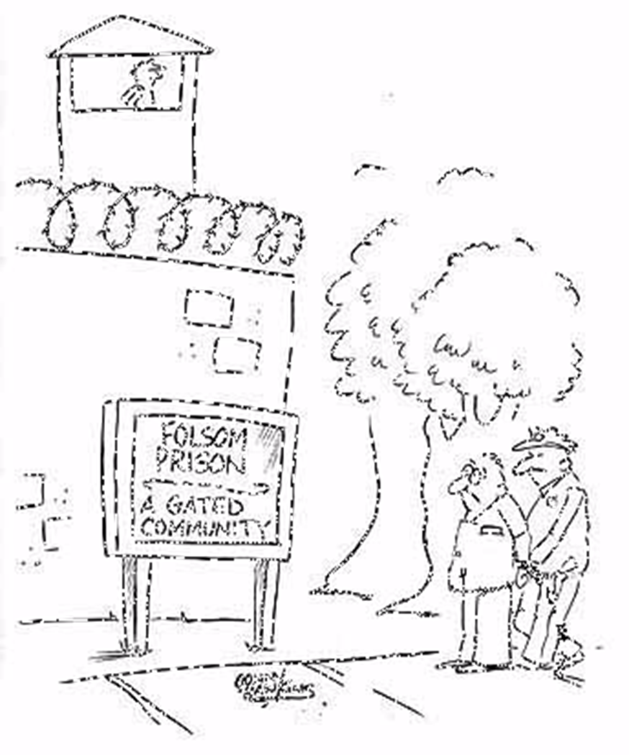
Welcome!!
Notes:
- Correctional Medicine – the ultimate Gated Community!

Slide 3
BOP Mission Statement
It is the mission of the Federal Bureau of Prisons to protect society by confining offenders in the controlled environments of prisons and community-based facilities that are safe, humane, cost-efficient, and appropriately secure, and that provide work and other self-improvement opportunities to assist offenders in becoming law-abiding citizens.

Slide 4
BOP Core Values
Correctional Excellence
Respect
Integrity

Slide 5
BOP Health Services Division
Mission Statement
The health care mission of the Bureau of Prisons is to deliver medically necessary health care to inmates effectively in accordance with proven standards of care without compromising public safety concerns inherent to the Bureau's overall mission.

Slide 6
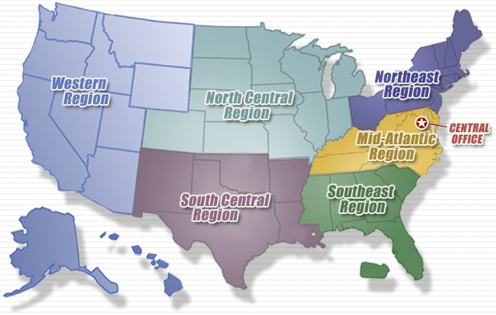
BOP Regions

Slide 7
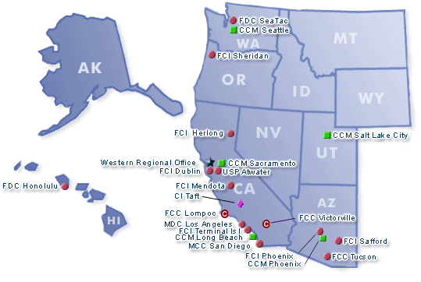
Western Region

Slide 8
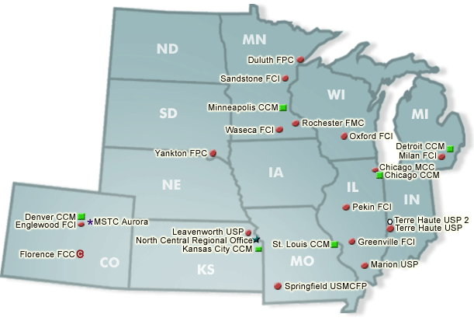
North Central Region

Slide 9
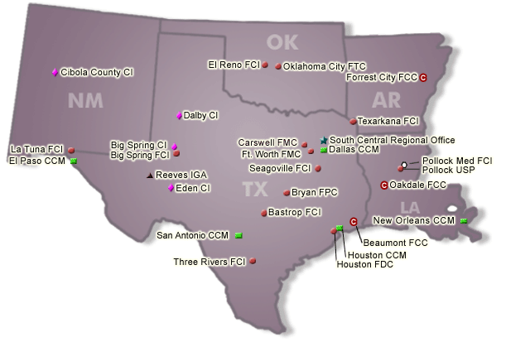
South Central Region

Slide 10
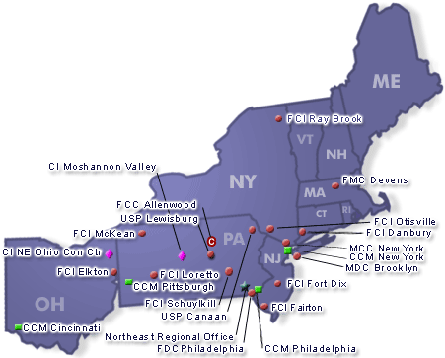
Northeast Region

Slide 11
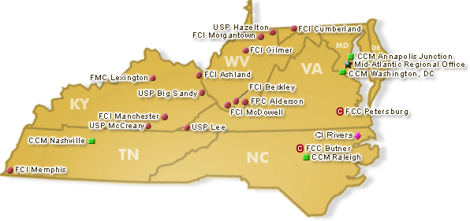
Mid-Atlantic Region

Slide 12
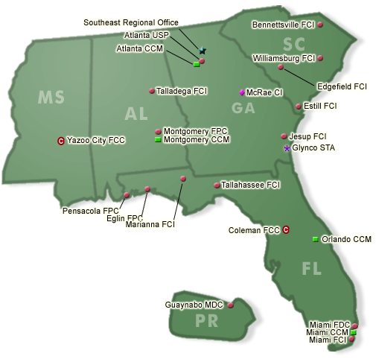
Southeast Region

Slide 13
Under Development or Activation
USP Yazoo City, Mississippi (SER) – Expected Fall 2013
Administrative USP Thomson, Illinois (NCR) – pending funding proposed through BOP’s FY 2014 President’s Budget Request

Slide 14
BOP Institution Quick Facts
119 activated institutions
219,357 inmates as of August 15, 2013 (1996: 90,000)
  42,513 located in non-BOP facilities (e.g. contract state DOC (Department of Corrections))
6 Federal Medical Centers
13 institutions w/ female inmates
7 Protective Custody Units (i.e. Witsec)

Slide 15
Inmate Breakdown (2010)
Male: 93.5% Female: 6.5%
White: 57.9% Black: 38.5% Native American: 1.8% Asian: 1.7% Hispanic 33%
United States: 73.2% Mexico: 18.1% Colombia: 1.3% Cuba: 0.9% Dominican Republic: 1.3% Other/Unknown: 5.3%
Drug Offenses: 51.3%
Average Inmate Age: 38
Sentences
  5-15 years: 50%
  Life: 3.1%
  Death Row: 55

Slide 16
Inmate Medical Issues
~1.6% are HIV + (2 to 3 times more than the general population)
~15% are Hep B or C carriers
Liver and kidney damage are common because of self-destructive lifestyles.

Slide 17
Importance of Correctional Health
2 1/2 Millions wake up in prison/jail every day
~ 5,000 correctional facilities (>3,000 local jails; 1,800 state/federal correctional institutions)
Iron Law of Corrections: 95% of those incarcerated will return to the streets
Approx. 14% of persons with HIV in the U.S. pass through the correctional system each year
35% of all TB cases, and 29% of all Hepatitis C cases pass through the nation’s correctional facilities at some point in time

Slide 18
Importance of Correctional Health
BOP recognized by Office of National AIDS Policy through work with the National HIV/AIDS Strategy (released in 2010) regarding significant HIV outcomes within the BOP
Approx. 82% of our patients that have been within institutions for 6 months have non-detectable virus

Slide 19
Health Services Overview
HSA
MLP’s
Warden
AW
CD
Dental
Pharm
Nursing/EMT
ADMIN
Support
Medical
Records
ID, x-ray, lab, IOP

Slide 20
CLINICAL PHARMACY PRACTICE
Newly created position of Chief, Clinical Pharmacy Programs
Pharmacist Immunizers
Pharmacist Practitioners
93 Collaborative Practice Agreement protocols in place, involving 56 pharmacists within 12 areas of medicine
Anticoagulation, Hyperlipidemia, Diabetes, Anemia, Psych, HIV, Hep C, Dialysis, Oncology, etc.

Slide 21
Pharmacist Positions in BOP
Staff Pharmacist (both inpatient and outpatient; ambulatory or medical center)
Assistant Chief Pharmacist
Chief Pharmacist
Regional HIV/HCV Pharmacist Consultant
Regional Chief Pharmacist
Central Processing Staff, Chief, and Clinical Pharmacists
Central Fill Staff in future

Slide 22
Where to Get More Information
  http://www.usphs.gov/corpslinks/pharmacy/bop/index.htm
    BOP Pharmacy Homepage
  http://dcp.psc.gov
    vacancy list PHS Pharmacy Job Listserv
  http://www.bop.gov
  http://www.usphs.gov

Slide 23
Initiatives
Central Fill vs Mail Order Pharmacy (BOPMOP)
Virtual Central Processing by BOP Pharmacists
Immunization Delivery
Disease State Management – Clinical Pharmacy Programs
    Anticoagulation Clinics
    Antihyperlipidemic Clinic

Slide 24
BOP Pharmacy Contact Information
RADM Chris Bina, PharmD
  Chief Pharmacist, cbina@bop.gov
  202-353-4753
CAPT A. Martin Johnston, RPh
  Chief, Pharmacy Logistics, ajohnston@bop.gov
  202-353-4758
LT Michelle Williams, PharmD
  HIV/Hep Program Manager, mrwilliams@bop.gov
  202-353-4748
Chief, Clinical Pharmacy Programs - Vacant

Slide 25
BOP Pharmacy Recruitment Workgroup
Name | Institution | Responsible Region | Email | Phone
CAPT Cassondra White – LEAD | Central Processing Pharmacist (CPPS) -CCM San Antonio | ALL | c3white@bop.gov | 210-472-4510
LCDR William Lehault | FCI Otisville | North East Region | wlehault@bop.gov | 845-386-6826
LCDR Anna Stevenson | FMC Devens | North East Region | astevenson@bop.gov | 978-796-1352
CDR Ed Houser | FMC Rochester | North Central Region | ehouser@bop.gov | 507-424-7580
CDR Mark Sellers | USMCFP Springfield | North Central Region | msellers@bop.gov | 417-836-1349
CDR Theresa Porter | FCI Ashland | Mid-Atlantic Region | tporter@bop.gov | 606-929-4118
LT Daniel True | FCI Cumberland | Mid-Atlantic Region | dtrue@bop.gov | 301-784-1000 x2160
CAPT Patrick Marshall | CPPS - FCI Edgefield | South East Region | pmarshall@bop.gov | 803-637-1728
CDR Jeff Mallette | CPPS - FPC Pensacola | South East Region | jxmallette@bop.gov | 850-458-7318
LCDR Kevan Lee | FCC Hazelton | South Central Region | kmlee@bop.gov | 304-379-5118
LT Michelle Williams | Central Office | South Central Region | mrwilliams@bop.gov | 202-353-4748
LCDR Huu Nguyen | FCC Victorville | Western Region | hnguyen@bop.gov | 760-246-2576
LT Anthony Shelton | USP Canaan | Western Region | ashelton@bop.gov | 570-488-8000 x8246
Todd Davis | Central Office BEMR Rx -USMCFP Springfield | ALL (Civil Service) | jtdavis@bop.gov | 417-837-1750
Karen Hays | FCC Yazoo City | ALL (Civil Service) | klipscomb@bop.gov | 662-716-1020 x4397

Slide 26
Federal Pharmacy Vision
Federal Pharmacists are essential to health care access and delivery in the United States; recognized as health care providers of patient-centered primary and specialty care, and as trusted public health leaders. As experts in medication use and comprehensive pharmacy services, we promote wellness, prevent and manage disease, ensure patient safety and optimize health outcomes in collaboration with the health care team.
Notes:
Leading by example.
Providing the direction and path for others to follow.
This is relevant to the Report to the Surgeon General.
Federal Vision Objectives
--Enhance collaboration and leverage unique practice environments of federal pharamcists.
--Sustain and expand the scope of pharmacy practice
--Increase access to patient-centered, cost-effective quality care.
Nine bullets of scope of practice (relevance to Clinical Pharmacy Guidance.

Slide 27
Notes:
- This is a LANDMARK report that I truly believe will be referenced 10, 20, and 50 years in the future as the report that changed the face of pharmacy practice in the United States.
FYI. This is an extremely significant and historic document for pharmacy. Something that has been in the works for about 3-4 years. RADM Giberson, CDR Lee, and CDR Yoder deserve a LOT of credit. I can't begin to thank them enough for the vision and effort they exerted to move this forward. This is an extraordinary accomplishment for which the entire pharmacy community owes each of them a tremendous amount of gratitude. As a member of the community, I know I am extremely grateful. It is a good read and very evidence based. I've had the opportunity to read through, offering edits and recommendations along the way. My most recent review was during the holiday break.
Ty - I was hoping this would come out soon so we could reference in formalizing our clinical pharmacy program. Now we can.
This Report provides a thorough evidence-based discussion of the comprehensive patient care services that pharmacists currently provide. For nearly 50 years, federal pharmacists have been afforded the opportunity to practice collaboratively with physicians and other health care providers in expanded scopes delivering comprehensive disease management, health promotion, disease prevention, medication therapy management and other cognitive clinical services. The Report presents public and private sector models, and calls for health leadership and policy makers to support and implement existing, evidence-based and cost-effective pharmacist-delivered patient care models as the demands within our health care system escalate. – Giberson
Focus Point 1 discusses how pharmacists are already integrated in many practice settings as health care providers through collaborative practice with physicians or as an essential part of a health care team. The Report presents data that interprofessional support exists for this model of care. Focus Points 2 and 3 make the case that for pharmacists to continue to improve patient and health care system outcomes as well as sustain various roles in the delivery of care, recognition as health care providers and compensation models reflective of the range of care provided are needed. Focus Point 4 outlines a robust amount of evidence-based outcomes from pharmacist-delivered care, aligned with demands on the health care system such as access, prevention, quality and cost-effectiveness.
RADM Scott Giberson, Chief Professional Officer for PHS Pharmacy stated, "I firmly believe that one of the most evidence-based and cost-effective decisions we can make as a nation is to maximize the expertise and scope of pharmacists, and minimize expansion barriers to successful health care delivery models. It is the right thing to do for our patients."

Slide 28

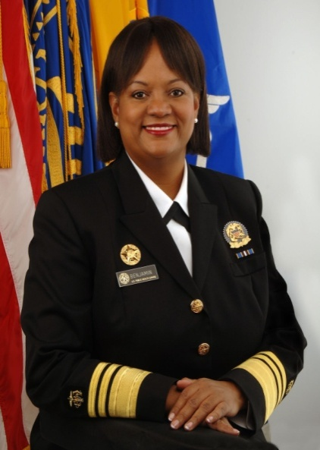

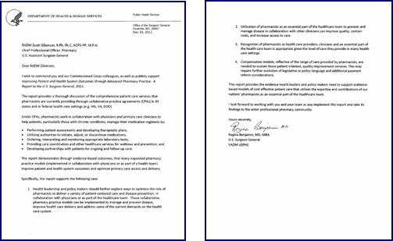
(former) Surgeon General Support

Slide 29
Summary
Correctional Health is Public Health
Save Environment
Unique, Diverse, & Rewarding
Making a Difference
Many Thank You’s
Integration into overall Federal Pharmacy Collaboration
Student Opportunities

Slide 30
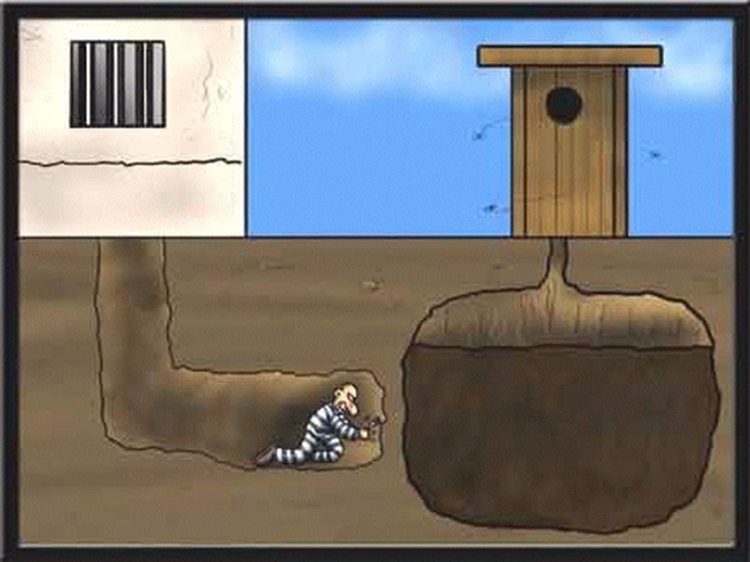
Notes:
With that, I’m out of here.

Slide 31
Questions
?

