Slide 1
An Introduction to USPHS Retirement
PPAC Retirement Subcommittee:
CDR Glen MacPherson, USCG
&
CDR Kara Tardivel, CDC
PPAC Meeting
4/27/16

Slide 2
Objectives
Introduce topic of USPHS retirement
Inform subcommittee efforts
Provide resources

Slide 3
Subcommittee Mission
Resource
Inform
Advocate
Resource
  liaisons to Separations Team
  sign posts of informational sources
Inform
  retirement news to PHS physicians
  tools to conceptually quantify retirement
Advocate
  PPAC positions for endorsement
  items promoting retirement

Slide 4
What Retirement Subcommittee
Has Done For You
Vision & Mission
PPAC ppt slides
Monthly meetings
MOAA Webinar
Action Items
Contact/Interview Separations Team
CDC Pre-Retirement Seminar
DoD-PHS Retirement Seminar
Fall 2015
Winter 2015-16
Spring 2016
Notes:
Submitted Vision, Mission, Action Items, & Membership Plans
Provided powerpoint of above for PPAC website
Monthlty mtgs
MOAA Webinar 12/16/15
Kara: CDC Retirement Seminar 4/13-14
Glen: DoD Liaison office will be hosting a retirement seminar on Monday - Tuesday, May 9-10, 2016 for all PHS officers detailed to DoD

Slide 5

Retirement Stats:
(i.e. Count Your PHS Blessings)
65% of Americans age 25-65 are “financially illiterate” (Lusgardi, 2011)
83% of DoD separate before 20 yrs
15 % of PHS separate before 20 yrs
10% of Americans are covered by a Defined Benefit Plan (60% in 1980s)

Slide 6
Types of Retirement
20 year
Voluntary
Involuntary
30 year
Mandatory
Other
>30 years
Disability

Slide 7
Current USPHS Retirement Options
(a.k.a. Legacy Retirement)
Final Pay (a.k.a. “Good Old Days”)
- entry before 9/7/80
High 36 (a.k.a. “High 3”)
- entry on or after 9/8/80
Career Status Bonus (a.k.a. “Redux”)
- additional option (“High 3 Choice”) if entry after 8/1/86
1
2
3

Slide 8
Current USPHS Retirement Options
(a.k.a. Legacy Retirement)
Final Pay
Retired Pay = (Yrs Service x 2.5%) x final base pay
Percentage multipliers > 100%
High 3
Retired Pay = (Yrs Service x 2.5%) x Avg Highest 36 mths base pay
Percentage multipliers > 100%
Redux
Retired Pay = (Yrs Service x 2.5%) Minus 1% for each yr < 30 years x Avg Highest 36 mths base pay
Percentage multipliers 2% per year thru 20 years; 3.5% from 20-30 years; 2.5% thereafter
Full Cost Of Living Adjustments (COLA)
Full COLAs
$30K Career Status Bonus @ 15yrs
Percentage multipliers > 100%
COLA minus 1%; one-time catch-up COLA at 62
Years of service 20 21 22 23 24 25 26 27 28 29 30 thru 40
Final/High-3 Multiplier% 50 52.5 55 57.5 60 62.5 65 67.5 70 72.5 75 up to 100
REDUX Multiplier% 40 43.5 47 50.5 54 57.5 61 64.5 68 71.5 75 up to 100

Slide 9
Retirement Modernization
(a.k.a. Blended Retirement System)
Created by National Defense Authorization Act (NDAA) for FY2016
Congressionally mandated Military Comp & Retirement Modernization Commission
Combines blend of defined 20 yr benefit plus TSP contribution
Both Roth & Traditional TSPs
Notes:
Add 1% after 60 days (sub for slide 23)

Slide 10

“Does This Affect Me?!”
USPHS

Slide 11
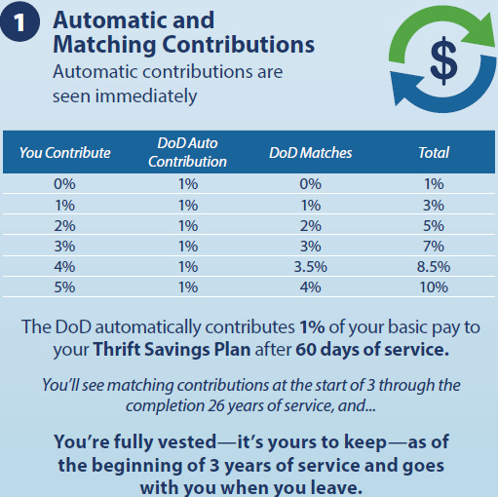
Blended Retirement – Part 1
1% is an automatic employer contribution®
3% is an automatic member contribution®
  Can opt out, but must do so annually AND
  Complete financial literacy course
Financial Literacy course required within 60 days of reporting to first unit
Beginning YOS 3 (i.e., 2 years and one day), up to 5% match ^{(T)}
Maximum Traditional and Roth contribution 2016 = $18K
® = Roth TSP and (T) = Traditional TSP
Notes:
Where ® = Roth TSP and
(T) = Traditional TSP
Having both Roth and Traditional in portfolio is good: Allows for tax diversification.
Exciting social engineering features: Financial literacy course. Annual opt out requirement.
Courses required throughout career: PCS, shortly after promotions, following “life events” like marriage and birth of child, before and after deployments

Slide 12
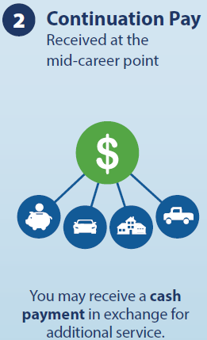
Blended Retirement – Part 2
Paid after the 12 year mark
Intended to give each service a force-shaping tool
Subject to frequent change
Available at discretion of each service
(PHS specifics unknown)

Slide 13
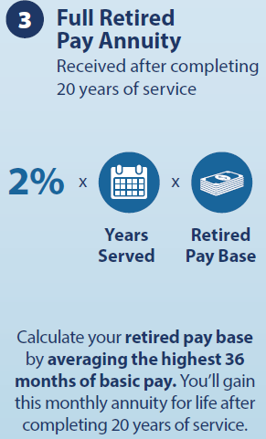
Blended Retirement – Part 3
Defined benefit plan now 40% for 20 yrs service
Serve 25 yrs for a 50% benefit

Slide 14
What We Don’t Know
About Retirement Modernization
Will PHS physician “constructive credit” survive?
Others???
PHS decision for mid-career continuation pay?
Notes:
Will PHS physician “constructive credit” survive?
Identified and being worked on
What are the specifics re: the math involved in calculating penalties for lump sum options?
In general, not advantageous to the member to opt for lump payment.

Slide 15
Why Modernize?
“Modernization” – get with the times
  greater individual autonomy
High-3: 1 in 5 left with “a” retirement benefit
Blended : 4 in 5 will leave with a benefit
  more compelling case for Military than PHS
Budget neutral

Slide 16
How to Decide
If you joined after 1/1/06 but before 1/1/18 you can choose High-3 vs. Blended
If intent <20 years, easy choice
If intent >20 years, complicated math with bottom line subject to assumptions and market performance
In general, High-3 advantageous
  Source: “Stay High-3 or Go Modern”
Must consult professional for individual best answer
Notes:
Full reference: Stay High-3 or Go Modern: An exploration of the “Modernized Retirement System” and its financial implications, LCDR Kevin Crecy, CPA and LT Stephen Hart, CPA, In the Service and Beyond Bulletin, February 2016, pp56-61.

Slide 17
Retirement Resources

Slide 18
Blended Retirement Resources
COA Webinar:
http://www.coausphs.org/news/blended-retirement-webinar/
MOAA Webinar:
http://www.moaa.org/Content/Benefits-and-Discounts/Transition-and-Careers/Transition-Center-Webinars/Transition-Center-Webinars.aspx
Stay High-3 or Go Modern?
http://issuu.com/uscgaalumni/docs/bulletin_feb_16_issuu/1?e=3910201/33413366

Slide 19

USPHS Retirement Resources
Commissioned Corps Training Academy’s online training
  http://dcp.psc.gov/CCMIS/COTA/Retirement.aspx
PPAC website (or Google search)
  https://dcp.psc.gov/osg/physician/documents/FINAL_Retirement-at-20-Pension_Sept2015.pdf
  https://dcp.psc.gov/osg/physician/documents/FINAL_Retirement-at-20-healthcare-and-disability_Sept2015.pdf
USPHS Separations Team Pre-Retirement Seminars…

Slide 20
USPHS Retirement Seminars
Retirement
  Process
  Retirement Types
  Annual Leave Balance Options
  Post Retirement Employment Restrictions
Retirement Pay
  Taxes and COLA
  Social Security
  Concurrent Compensation
Retirement Resources
  FAQs
  Retirement Checklist
Survivor Benefits Plan
Retirement Medical Insurance
  TRICARE Medical
  TRICARE Dental
Retirement Travel & Transportation
VA Benefits
  Health Care Benefits
  SGLI/VGLI
  VA Educational Benefits
Death Benefits
Notes:
Offered annually at USPHS Symposium
On demand by COAs if financial coverage (ex. CDC recently)

Slide 21
D.C. Area Military Retirement Services
Andrews AFB Retirement Services Office
  http://www.andrewsfss.com/mfsc/tap.html
Naval Support Activity Bethesda Retirement Services Office
  http://www.cnic.navy.mil/regions/ndw/installations/nsa_bethesda/ffr/support_services/military_support/transition_assistance.html
Joint Base Myer-Henderson Hall Retirement Services Office
  http://www.jbmhh.army.mil/web/jbmhh/Services/RetireeServices.html
Joint Base Anacostia-Bolling
  http://www.cnic.navy.mil/regions/ndw/installations/jbab/ffr/support_services/military_support/transition_assistance.html
FT Meade Retirement Services Office
  http://www.ftmeade.army.mil/pages/rso/rso.html
FT Detrick Retirement Services Office
  http://www.detrick.army.mil/retiree/
FT Belvoir Retirement Services Office
  https://www.belvoir.army.mil/dhr/ppb.asp
Aberdeen Proving Grounds Retirement Services Office
  http://www.apg.army.mil/apghome/sites/humanresources/retirement/index.html

Slide 22
Retirement Newsletters
  Army Echoes
    http://www.armyg1.army.mil/rso/echoes.asp
  US Air Force’s Afterburner
    http://www.retirees.af.mil/afterburner/
  US Navy’s Shift Colors
    http://www.public.navy.mil/bupers-npc/reference/Publications/ShiftColors/Pages/default.aspx
  The USCG/NOAA/USPHS Retiree’s Newsletter
    http://www.uscg.mil/ppc/ras/
  Marine Corps Semper Fidelis
    https://www.manpower.usmc.mil/portal/page/portal/M_RA_HOME/MM/SR/RET_ACT/Semper_Fidelis
  Defense Finance and Accounting Service (DFAS) Newsletter
    http://www.dfas.mil/retiredmilitary.html

Slide 23



Retirement Handbook
http://militaryhandbooks.com/

Slide 24
USPHS Retirement POCs
Separations Counselors
- CDR Mark McKinnon
- LCDR Monique Bailey
Statements of Service
- Separations Team
>30 yr Retention Board
- LCDR Monique Bailey
Travel & Transportation
- LT Andrew Okolo
Retired Pay
- USCG Pay & Personnel Ctr

Slide 25
Questions

Slide 26
Retirement Income Sources
Income
Social Security
TSP/401K
Pension
Investments
Notes:
Is this slide even necessary?

Slide 27
Beyond the Spreadsheet….
There’s value to being a “Retiree”
TriCare
Survivor Benefit Plan
Space-A
Armed Forces Vacation Club
Disney discounts

Slide 28
TriCare
Only retirees (20 YOS or more) can enroll in post-separation TriCare coverage
For Prime, $565.20/year
Kids stay on until 23 if in college

Slide 29
Survivor Benefit Plan
Only retirees are eligible to enroll in the Survivor Benefit Plan
If enrolled, your retirement pay continues to your beneficiaries after you pass away
Enrollment costs up to 6.5% of your monthly retirement pay

Slide 30
Space-A
Only active duty and retirees (20 YOS or more) can take advantage of Space-A
You and dependents fly anywhere on military aircraft, CONUS or OCONUS, for free, on a Space Available basis

Slide 31
Armed Forces Vacation Club
Only active duty and retirees can join
Beats any timeshare
  No membership/maintenance fees or cost of ownership
  Similar accommodations and locations
Typically $299 for 7 days in 2-3 bedroom condos in resort locations.

Slide 32
Disney
Only active duty and retired members eligible for “Armed Forces Salute” Tickets
E.g., 4 day Park Hopper pass: $196 retiree price vs. $394 for everyone else.

