Slide 1
Who? Why? Where?
Today’s Commissioned Corps
Notes:
I’ll start by describing today’s Commissioned Corps:
Who we are
Why we exist, and
What we do.
I’ll also introduce you to some officers who are retired or on active duty in the Corps. Their experiences, in addition to my own, can give you a good idea of what you might achieve professionally and personally as a Corps officer.
1

Slide 2
WHO WE ARE
Notes:
I imagine some of you are hearing about the U.S. Public Health Service Commissioned Corps for the first time today, so let me begin by explaining who we are.

Slide 3
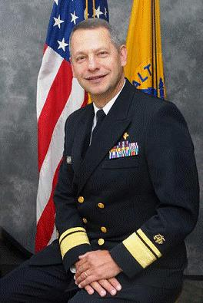
ACTING SURGEON GENERAL-
Rear Admiral (RADM) Boris D. Lushniak
PHOTO
Notes:
The Commissioned Corps is overseen by the Surgeon General, through the Office of the Surgeon General. The Surgeon General is America’s chief health educator, responsible for giving Americans the best scientific information available on how to improve their health and reduce the risk of illness and injury.
In carrying out all responsibilities, the Surgeon General reports to the Assistant Secretary for Health, who is the principal advisor to the Secretary on public health and scientific issues. The Surgeon General is appointed by the President of the United States with the advice and consent of the United States Senate for a 4-year term of office. Dr. Lushniak served as Deputy Surgeon General from November 2010, until July 17, 2013, when he assumed the duties of Acting Surgeon General.
3

Slide 4
U.S. PUBLIC HEALTH SERVICE
COMMISSIONED CORPS
Answering the Call
Notes:
Hello. We are the BCOAG, or Black Commissioned Office Advisory Group within the U.S. Public Health Services Commissioned Corps.
We are here to provide you with information on the Commission Corps, because the Corps is looking for more than “a few good men.” Instead, the Corps is looking for hundreds of public health professionals who want a career beyond standard clinical or research practice. We need individuals interested in working to promote, protect, and advance the public health and safety of our Nation.
That’s our call. During this presentation, we will do our best to give you enough information to help you decide if you’re ready to answer the call…or to at least to peak your interest and make you aware of who we are and what we do.
4

Slide 5
WHO WE ARE
6,000+ well-trained, highly qualified health care professionals
Essential component of the largest public health program in the world
Notes:
Under the leadership of the U.S. Surgeon General, the Commissioned Corps is part of the U.S. Public Health Service. Commissioned Corps officers are an elite team of approximately 6,000 well-trained, highly qualified public health professionals. We are dedicated to delivering the Nation’s public health promotion and disease prevention programs and advancing public health science.
As part of the U.S. Public Health Service, the Commissioned Corps is an essential component of the largest public health program in the world.

Slide 6
WHO WE ARE
Physicians
Dentists
Nurses
Pharmacists
Dietitians
Engineers
Environmental health officers
Mental health specialists, including clinical psychologists and clinical social workers
Optometrists
Physician assistants
Scientists/Researchers
Therapists (including occupational therapy, physical therapy, speech language pathology, respiratory therapy, and audiology)
Veterinarians
Other health-related disciplines
Notes:
Originally, the Corps was composed only of physicians.
However, as the scope of public health has grown over time, so have the variety of professionals needed to carry out the Corps’ responsibilities.
Today’s Corps includes a number of professions involved in public health.

Slide 7
WHY WE’RE HERE

Slide 8
Why we’re here
To protect, promote, and advance the public health and safety of our Nation.
Notes:
The mission of the Commissioned Corps is to protect, promote, and advance the public health and safety of our Nation.
We pursue our mission through:
Rapid and effective response to public health needs
Leadership and excellence in public health practices, and
Advancement of public health science.
This has been the Public Health Service’s mission and method since 1798, when John Adams—the second President—signed into law the Act for the Relief of Sick and Disabled Seamen.

Slide 9
A proud history
From Ellis Island… …To tribal lands. Across America
Around the World
PROTECTING PUBLIC HEALTH AND SAFETY...
…FOR MORE THAN 100 YEARS
Source: www.nlm.nih.gov/exhibition/phs_history/intro.html
Notes:
The earliest predecessor of the Commissioned Corps was the Marine Hospital Service. At the time—the early 1800s—our country relied on a healthy merchant marine for trade and security. Our seamen traveled widely. Often, those who became ill brought their sicknesses back home, which made their health care a Federal concern.
The Marine Hospital Service eventually grew into the Public Health and Marine Hospital Service. In 1912, Congress shortened this name to the U.S. Public Health Service, with the Commissioned Corps as its uniformed service.
The responsibilities of the U.S. Public Health Service also changed, as new threats to our country’s public health emerged.
Congress charged the U.S. Public Health Service with preventing the introduction and spread of major epidemic diseases such as smallpox, yellow fever, and cholera. To meet this responsibility, the service and its Corps took over many national quarantine, disinfection, and immunization functions.
Congress also charged the U.S. Public Health Service to carry out the medical inspection of arriving immigrants, such as those landing at Ellis Island in New York.
The workplace environment and its effect on the health of workers became a major concern for the service in the early 1900s.
By 1912, the U.S. Public Health Service was authorized to investigate human diseases (such as tuberculosis, hookworm, malaria, and leprosy), sanitation, water supplies, and sewage disposal.
The Office of International Health Relations was established in 1943. Today’s Commissioned Corps officers work abroad as well as in the United States to help prevent the spread of infectious and communicable diseases. New threats to our public health, such as SARS, avian flu, drug-resistant TB, and MRSA—continue to develop.
That’s a very brief history of the Corps.

Slide 10
WHAT WE DO

Slide 11
What We Do
Disease control and prevention
Biomedical research
Regulation of food and drugs
Mental health care
Substance abuse treatment
Health care delivery
International health
Emergency and humanitarian response
Notes:
For more than 200 years, the U.S. Public Health Service has been our Nation’s front line against the spread of disease from sailors returning from foreign ports, from immigrants entering the country, and from health threats posed by natural and manmade disasters.
We continue the battle for better public health today, and on multiple fronts. Corps medical officers are involved in:
Disease control and prevention
Biomedical research
Regulation of food and drugs
Mental health care
Substance abuse treatment
Health care delivery
International health, and
Emergency and humanitarian response.
I’m going to spend a few minutes highlighting this last area.

Slide 12
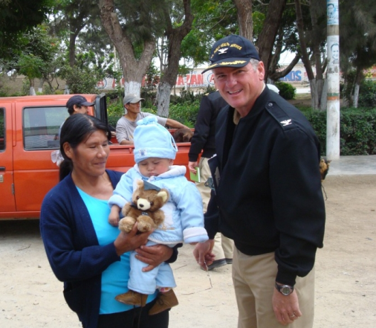
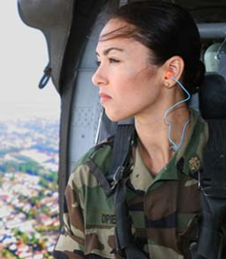
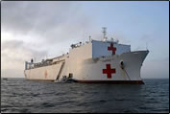
EMERGENCY AND HUMANITARIAN RESPONSE
USNS Comfort
Recent missions
Suicide response in American Indian community
Toxic exposure alerts in the Gulf Coast area
Humanitarian assistance and training for Latin American, Caribbean, Pacific Rim, and Pacific Island countries.
Notes:
Increasingly, the Commissioned Corps is being recognized for the broad public health expertise its officers can provide in response to emergency and humanitarian needs, both here in the United States and abroad.
This year, for example, teams of Corps officers successfully completed two highly visible and sensitive missions.
One mission was for the Indian Health Service, which deployed Corps officers to South Dakota in response to a spike in the number of attempted and completed suicides among American Indians. The suicide rate among American Indians, and particularly among younger Natives, is much higher than that of our general population. As a result, the Commissioned Corps is responding immediately to situations where we can possibly help prevent any future deaths to suicide among a people who are so much a part of our Nation and its heritage.
Another mission was for the Centers for Disease Control and Prevention. CDC deployed Corps officers to Louisiana and Mississippi to deliver test results to residents whose FEMA trailers had high formaldehyde levels. Exposure to toxic levels of formaldehyde can cause numerous health problems, including cancer.
This mission for CDC was in addition to services that we already had provided in response to Hurricanes Katrina and Rita. More than 2,400 Corps officers were deployed to the Gulf Coast region before, during, and after these hurricanes. They set up and staffed field hospitals and emergency medical clinics, treated sick and injured evacuees, conducted disease surveillance, and worked closely with local and State health authorities to prevent public health disasters.
The Commissioned Corps also had been integral to the International Health Diplomacy Initiative, which is led by the U.S. Secretary of Health and Human Services. The Corps has sent multidisciplinary teams on three U.S. Navy ship-based missions: two to Latin America and the Caribbean and one to the Pacific Rim and Pacific Island countries. Our part in these missions is to provide humanitarian assistance in such critical public health areas as primary and dental health services and veterinary services. We also train local health care personnel, conduct community health symposia, and even repair medical equipment.
As I mentioned earlier, the Corps is for people who want a career that goes beyond standard clinical or research practice.

Slide 13
WHAT WE DO … AND WHERE

Slide 14
What We Do… and where
(Not all agencies and programs are represented)
Notes:
Commissioned Corps officers serve throughout the U.S. Department of Health and Human Services and also with some Federal agencies outside of the Department.
Corps officers may apply to any of a variety of Federal agencies and programs that are involved in public health. These agencies are as diverse as the Centers for Disease Control and Prevention, the Indian Health Service, the National Institutes of Health, and the Bureau of Prisons, just to name a few. This slide shows a selection of some of the agencies that employ Commissioned Corps officers.
For example, at the Centers for Disease Control and Prevention, Commissioned Corps officers conduct and report on disease surveillance activities.
At the Bureau of Prisons, Commissioned Corps officers work for the Health Services Division and provide and manage a variety of physical and mental health care services.
At the Environmental Protection Agency, Commissioned Corps officers write and implement safe drinking regulations, and conduct waste management programs to contain contamination to public water systems.
At the Food and Drug Administration, Commissioned Corps officers ensure the safety and effectiveness of drugs and medical devices, work on new drug applications and adverse reaction reports, function as field inspectors and consumer safety officers, and serve on expert advisory committees and review panels.
At the Immigration and Customs Enforcement within the Department of Homeland Security, which administers the Nation's immigration laws, Commissioned Corps officers are assigned to the Division of Immigration Health Services. We provide medical consultation and technical assistance about detainees' health care, provide medical escorts for international and domestic air transport operations, and deploy medical teams on domestic and international missions.
At the Indian Health Service, Commissioned Corps officers provide health care to American Indian and Alaska Native populations. This service may take our officers to the remotest corners of our country.
At the National Institutes of Health, Commissioned Corps officers plan, support, and direct clinical research programs.
Whatever your particular interest, the chances are that you can pursue a career as a Commissioned Corps officer.

Slide 15
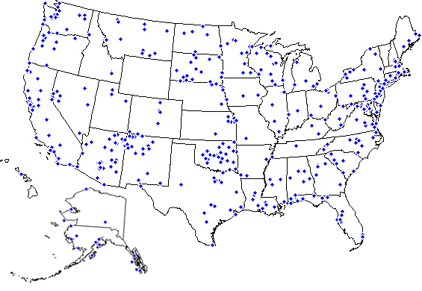
DUTY STATION MAP
This map shows some of the exciting places a career with
the U.S. Public Health Service Commissioned Corps can take you.
Notes:
There are hundreds of duty stations in which Corps officers serve across the country (and around the world). The federal agencies I just talked about have offices in many locations. So whether you’re inclined to stay close to where you are now, or are interested in having different experiences in new places, you can probably find a place in the Corps that suits you.

Slide 16
BCOAG
BLACK COMMISSIONED
OFFICERS ADVISORY GROUP
Who We Are
The Black Commissioned Officers Advisory Group (BCOAG) is a collective public health professional body whose primary mission is to serve and advise the Surgeon General on African-American matters. In addition, BCOAG supports the career advancement and professional development of African-American officers.
Role of BCOAG
To provide advice and consultation to the Surgeon General in conjunction with the Minority Officers Liaison Council (MOLC) on matters related to the Commissioned Corps and U.S. Public Health Service
To provide similar advisory assistance to the Professional Advisory Committees (PACs) and their respective Chief Professional Officers (CPOs)
To, upon request, provide advisory assistance to agency and/or program heads of the USPHS and non-PHS programs that routinely use PHS personnel
All BCOAG members are knowledgeable professionals who represent a cross-section of interests, concerns, and responsibilities of African-American Officers in agencies and organizations staffed by PHS personnel.
Notes:
The Black Commissioned Officers Advisory Group (BCOAG) was chartered February 7, 1990. Originally known as the Black Commissioned Officers Steering Committee, the group was formed out of a delegation of officers who attended the 1987 meeting of the Congressional Black Caucus Health Braintrust. Under the leadership of RADM Audrey F. Manley (ret.), the group was formally organized and developed a report of recommendations and initiatives for consideration by C. Everett Koop, M.D., who then served as the Surgeon General.
BCOAG has provided assistance and consultation to the Office of the Surgeon General on issues related to the representation and participation of African-Americans in the USPHS as officers. Since 1990, the BCOAG has successfully organized several recruitment conferences for high school and/or college students; established and annually awarded the Hildrus Poindexter Award to acknowledge leadership and contributions toward improving the health of African-Americans and other ethnic groups; served as mentors to high school students at Eastern High School in Washington, D.C.; established the CAPT John C. Eason, Jr. Scholarship for high school students who are preparing for health careers in honor of the first African-American commissioned by the USPHS; organized a joint choir with the National Naval Officers Association (NNOA), and held a performance to raise funds to support the BCOAG scholarship program; published a Directory of Black Commissioned Officers; and promoted the development of other USPHS minority officer advisory groups, including the Minority Officers Liaison Council (MOLC).

Slide 17
BCOAG
BCOAG FUNCTIONS
Promote the professional and personal growth of African-American officers
Facilitate resolution of issues related to African-American officers
Assure that the achievements and accomplishments of African-American commissioned officers are appropriately recognized and recorded in PHS archives
Maintain linkage and provide consultation across professional disciplines and PHS components on effective ways to significantly improve the health of African-American populations
Review and comment on policies and other documents and matters impacting the health of African-Americans
Encourage individual membership in, and involvement with, professional and PHS Official organizations and societies to promote open communication with colleagues
Ensure representation on the MOLC to foster communication between BCOAG, other commissioned officer groups, and the Office of the Surgeon General
Notes:
Promote the professional and personal growth of African-American officers assigned throughout all PHS agencies and other programs
Facilitate resolution of issues related to African-American commissioned officers' professional or career development
Assure that the achievements and accomplishments of African-American commissioned officers, past and present, are appropriately recognized (e.g. Award nominations) and recorded in PHS archives
Maintain linkage across professional disciplines and PHS components, offering advice and consultation to agency heads and operating programs on effective ways to significantly improve the health of African-American populations
Review and comment on policies, program descriptions, position papers, statistical reports, guidelines, other documents, personnel, professional practice matters impacting the health of African-Americans. Such matters may be referred to the BCAOG by the Surgeon General, Division of Commissioned Personnel, Operating Divisions, programs, workgroups, committees, or officers.
Encourage individual membership in, and involvement with, professional and PHS Official organizations and societies to promote open communication with colleagues.
Ensure representation on the MOLC to foster communication between BCOAG, other commissioned officer groups, and the Office of the Surgeon General.

Slide 18
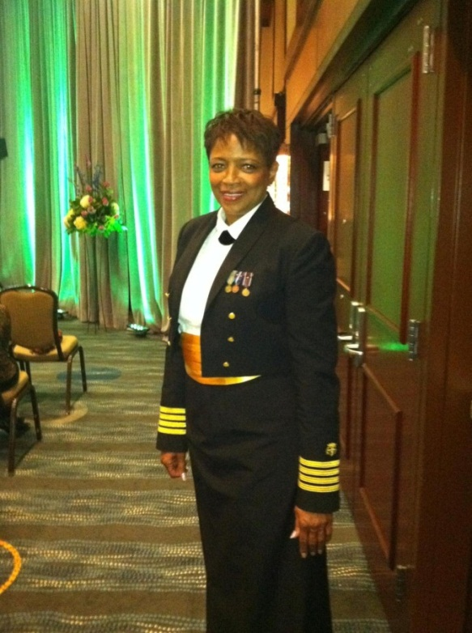
Captain (ret.) LESLIE COOPER
Category:
Nurse
Position: Epidemiologist Institutes of Health (NIH),
National Institute on Minority
Health & Health Disparities (NIMHD)
Service time: 30 years
Practice areas:
Minority Research
Cancer research
PHOTO
Notes:
I’d now like to introduce you to two Commissioned Corps BCOAG officers, one former and one fairly new. Their careers will give you an idea of the incredible and varied opportunities presented by the Corps.
Meet CAPT (Ret.) Leslie Cooper, Ph.D.,M.P.H., B.S.N a Commissioned Corps nurse who recently completed her service to the Corps with the National Institutes of Health, where she served, at seven of the twenty-seven Institutes (the NIMHD, NCRR, NCI, NIDA, NHLBI, NINR, and NICHD). She has dedicated her career to advancing science to improve public health outcomes both domestically and internationally to some of our most vulnerable populations.
Her career goals included: helping to stimulate and advance research practice to improve the identification, understanding and reduction of health disparities; integrate basic, clinical, socio-behavioral, translational, and population based science to improve health outcomes both domestically and globally; and advance the training of emerging investigators and health care professionals in the elimination of health disparities.
She says, “Joining USPHSCC will be one of the BEST career decisions you will ever make. It provides both personal and professional growth, and a sense of satisfaction that cannot be measured.”
CAPT (ret.) Cooper also served as a dedicated member of the Public Health Service Team, serving as mentor to many, helping interested health professionals to enter the Service, and serving as a valuable member on several key deployments, to include the Gulf Hurricane deployment.

Slide 19
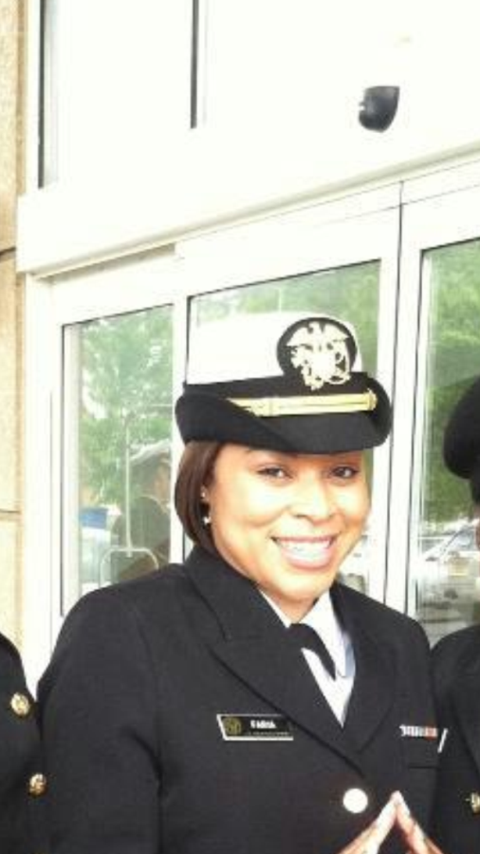
LIEUTENANT Aisha FARIA
Category:
Health Services Officer
Position:
Senior Public Health Analyst,
HRSA-Office of Regional Operations
(Headquarters)
Service time: 16 months
Practice areas: Public Health
Health Policy
Health Administration
PHOTO
Notes:
LT Faria has a BS in Human Services from Cornell University and a MS in Health Policy, Management and Behavior from the University of Albany-School of Public Health. She converted from Civil Service to join the Corps, with the goal of having the opportunity to stay in touch with the “on the ground” public health experience. Prior to joining the Corps and coming into government service, she managed both state and federally funded public health grants for the New York City Health and Hospitals Corporation and for the New York City Department of Health.
She has a keen interest in increasing access to quality health care for underserved populations.
LT Faria says of being in the Corps: “It’s the best career decision that I’ve made. I am able to work on public health issues on both the macro and micro level. I believe you have to do both to truly understand public health.”
19

Slide 20
What you can do: Student opportunities
Notes:
20

Slide 21
COSTEP OPPORTUNITIES
Junior COSTEP:
One year of medical, dental, or veterinary school/
2 years in specific health disciplines
Work 1 to 4 months during school breaks
No obligation after graduation
Senior COSTEP
Full-time students in specific health disciplines
At least 8 months remaining in their final year
Obligated to work for twice the amount of time
sponsored by the Corps
Notes:
Before I describe the Commissioned Corps any further, let me point out that these same exciting options are open to students selected for our Junior and Senior COSTEP. COSTEP is an acronym for the Commissioned Corps Officer Student Training and Extern Program.
Our Junior COSTEP program is for students with at least 1 year to 2 years in selected health fields. Students in this program work 1 to 4 months during school breaks and have no obligation to work for the Corps after graduation. However, after students have had an opportunity to work in labs at the National Institutes of Health near Washington, DC, or help provide medical care to Americans living in remote but beautiful corners of our country, another job may seem a little dull.
Our Senior COSTEP program is open to full-time students who have at least 8 months of education left in their final year. We currently are giving priority to students in dentistry, nursing, pharmacy, engineering, and physical and occupational therapy. In return for financial assistance, SRCOSTEP participants agree to work for the Commissioned Corps after graduation. The service obligation is equal to twice the time the Corps sponsor them.
Both programs are highly competitive. Applications are on the U.S. Public Service Web site.
[Depending on time of year, add]
A SRCOSTEP application must be postmarked by December 31 of the year before students begin their final year of school.
Both programs also offer excellent benefits, many of which are the same as those available to Corps officers. You’ll hear more about these benefits later.

Slide 22
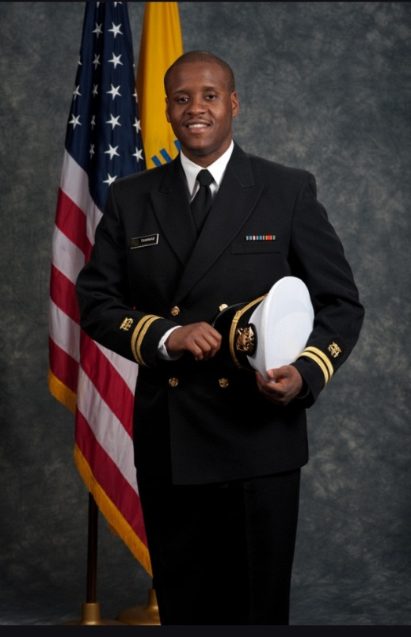
LT Nuri Tawwab
Position:
Former:
JrCOSTEP- Indian Health Service,
Aluquerque, MN
SrCOSTEP- Aide-de-Camp for Deputy Surgeon General
Current:
Pharmacist-Indian Health Service @Kayenta Health Center
Service time: 2 years
Practice areas:
Childhood obesity
Community health education
Notes:
LT Tawwab had the great opportunity to serve a Junior Costep (JrCOSTEP) in 2011 through the Indian Health Service in Albuquerque, NM. Through pharmacy patient counseling skills and mentoring advice he received, he realized that USPHS would be his career of choice upon graduation from pharmacy school. Once he returned back to school, he and fellow JrCOSTEP classmate LT Chelsea Sealey gave a presentation to their school titled “Endless Opportunities with the United States Public Health Service”. Within a year, he was selected for a Senior Costep (SrCOSTEP) position that allowed him to not only secure a job opportunity upon graduation, but also receive the many benefits of being a commission officer. LT Tawwab took every opportunity he could to truly engage in the life of being a commission corps officer. As an ENS, he volunteered at the ASHP mid-year pharmacy convention as an ambassador for the Corps. There he was able to tell many future clinicians about the career opportunity they had of being a commission officer. One of the most memorable experiences for the LT was being the Aide-de-Camp for Deputy Surgeon General Scott Giberson at the American Pharmacist Association meeting in Los Angeles. As an Aide, LT Tawwab was able to gain leadership advice and a clear understanding of the many responsibilities that pharmacist have to the Corps and to the health of the nation. To end off a great SrCOSTEP, former Surgeon General Dr. Regina Benjamin gave the commencement speech at his pharmacy school graduation at Hampton University. LT Tawwab believes the COSTEP programs are great introductions to becoming a commission officer, and appreciating the mission of the USPHS. These lessons still remain with him today as he is working towards fighting childhood obesity on his reservation and giving presentations to local school high school native American to increase future Native American health professionals in IHS.
22

Slide 23
What the Corps Offers You
Corps Benefits
Notes:
A highly rewarding professional career is just one of the benefits of serving as a medical officer with the Corps.

Slide 24
Corps benefits
Competitive compensation package
Health care and dental care at no cost
Tax-free housing and meal allowance
Thirty days paid vacation—beginning the first year
Paid sick and maternity leave
Notes:
As a career choice, the Commissioned Corps has never looked better. The Corps offers competitive starting pay that increases with promotions and years of service.
Corps benefits are excellent, and include:
Health care and dental care at no cost
30 days of paid vacation—beginning the first year
Paid sick and maternity leave.

Slide 25
Corps benefits
Malpractice insurance coverage
Retirement plan with benefits eligibility beginning after 20 years of service
Thrift Savings Plan—retirement savings and investment plan similar to 401(k)
Low-cost life insurance
Low-cost health care for your family
Notes:
We also receive:
Paid malpractice insurance! and
Retirement benefits that can begin after just 20 years of service

Slide 26
Corps benefits
Military base lodging and recreational facilities
Military base grocery and department stores
Paid moving and travel expenses
Veteran benefits
Notes:
In addition, you have access to:
Military base lodging and recreational facilities
Military base grocery and department stores
Paid moving and travel expenses related to your job, and
Veteran benefits.
Tuition and long-term training opportunities may be available to support your professional growth.

Slide 27
What You Have To Offer the Corps
Corps Requirements
Notes:
At the beginning, I stated that the Commissioned Corps was an elite team of highly trained professionals. Not everyone is qualified to serve.

Slide 28
requirements
Basic qualifications:
U.S. citizen
Less than 44 years of age
Medically qualified
Qualifying degree from an accredited institution (varies depending on profession)
Additional requirement:
Current, unrestricted professional license (if applicable)
Notes:
All Commissioned Corps officers must meet several basic qualifications.
You must be:
A U.S. citizen
Less than 44 years of age, (can be offset by up to 8 years of prior uniformed service or by waiver) and
Pass a physical evaluation.
A bachelor’s degree is a minimum requirement, and your security suitability will be confirmed. There are additional requirements for each professional category—mainly degree and licensure requirements.
You can check specific requirements for various professions on our Web site: visit usphs.gov and click on Professions.

Slide 29
My Personal Experience
Corps Rewards
Notes:
I’m now going to introduce you to one more Commissioned Corps officer—myself—and tell you how rewarding my career in the Corps has been.

Slide 30
YOUR RANK & NAME, TITLE
Category:
Position:
Service time:
Practice areas:
PHOTO
Notes:
This is where you tell your story. You can add your photo to the slide as well. (Try to mirror the examples on slides 15 and 16.)

Slide 31
Answering the Call
What’s at Your Professional Core?
Notes:
Please consider joining the Commissioned Corps. The Corps may be the right professional choice for you if you want to:
Go beyond a typical profession practice.
Use your professional training in new and challenging situations.
Improve the Nation’s public health, and
Serve your country.
The Corps is an organization where professional, commitment, and patriotism come together.

Slide 32
U.S. PUBLIC HEALTH SERVICE
Commissioned Corps
America’s Health Responders
For more information, call
1–800–279–1605
or visit www.usphs.gov.
Notes:
For more information, call us at 1–800–279–1605 or visit our Web site at www.usphs.gov.
We look forward to hearing from you. Thank you.
32

Slide 33
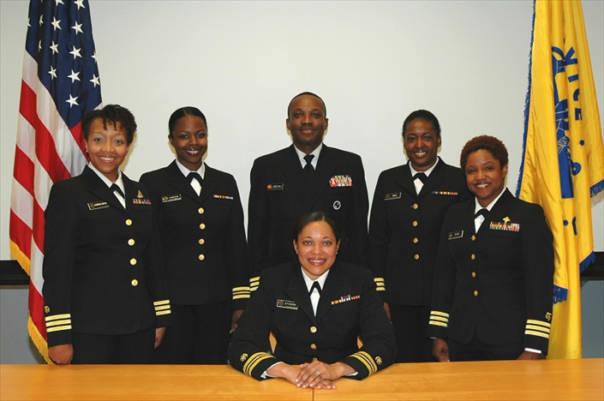
For more information about BCOAG, visit:
http://www.usphs.gov/corpslinks/bcoag/
or email us at: BCOAG.org@gmail.com
2013 BCOAG Executive Committee

