Slide 1
United States Public Health Service Commissioned Corps
An Overview
Rank Name

Slide 2


Today’s Commissioned Corps
Who We Are

Slide 3
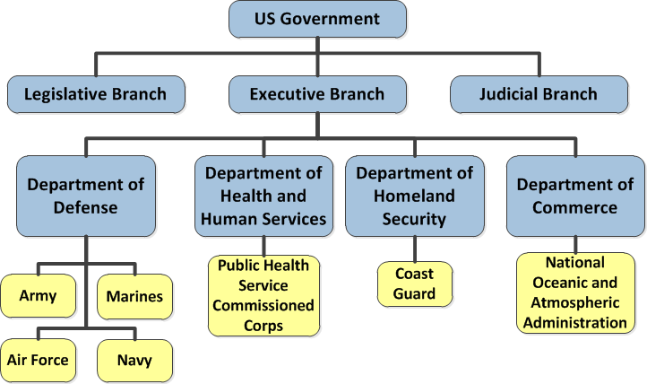
Seven Uniformed Services of the U.S.

Slide 4
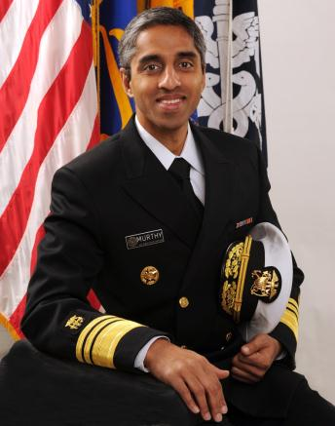
Led by the SURGEON GENERAL
Vice Admiral (VADM) Vivek H. Murthy , M.D., M.B.A.
19th Surgeon General of the United States
PHOTO
http://www.surgeongeneral.gov/about/biographies/biosg.html
Notes:
The Surgeon General, oversees the Commissioned Corps . The Surgeon General is America’s chief health educator, responsible for giving Americans the best scientific information available on how to improve their health and reduce the risk of illness and injury.
In carrying out all responsibilities, the Surgeon General reports to the Assistant Secretary for Health, who is the principal advisor to the Secretary on public health and scientific issues. The Surgeon General is appointed by the President of the United States with the advice and consent of the United States Senate for a 4-year term of office.
4

Slide 5
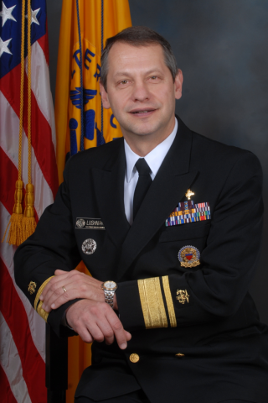
Rear Admiral (RADM) Boris D. Lushniak, M.D., M.P.H.
Deputy Surgeon General of the United States
PHOTO
http://www.surgeongeneral.gov/about/biographies/bio-deputy.html
Notes:
5

Slide 6
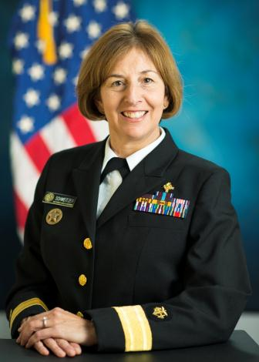
Rear Admiral (RADM) Pamela Schweitzer, PharmD, BCACP
Chief Professional Officer, Pharmacy, USPHS
PHOTO
http://www.usphs.gov/profession/pharmacist/cpo.aspx
Notes:
6

Slide 7
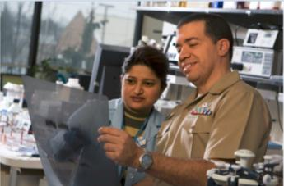
Who We Are
6,700+ well-trained, highly qualified public health professionals
Essential component of the largest public health program in the world
Notes:
Under the leadership of the U.S. Surgeon General, the Commissioned Corps is part of the U.S. Public Health Service. Commissioned Corps officers are an elite team of over 6,700 well-trained, highly qualified public health professionals. We are dedicated to delivering the Nation’s public health promotion and disease prevention programs and advancing public health science.
As part of the U.S. Public Health Service, the Commissioned Corps is an essential component of the largest public health program in the world.

Slide 8
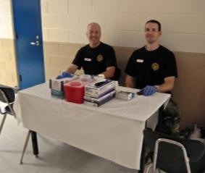
Who We Are
Physicians
Dentists
Clinical psychologists
Clinical social workers
Nurses/Nurse Practitioners
Pharmacists
Engineers
Environmental health officers
Optometrists
Physician assistants
Scientists/Researchers
Physical, occupational and respiratory therapists (SLP and Audio)
Veterinarians
Many other health-related disciplines
Notes:
Originally, the Corps was composed only of physicians.
However, as the scope of public health has grown over time, so have the variety of professionals needed to carry out the Corps’ responsibilities.
Today’s Corps includes a number of professions involved in public health.

Slide 9

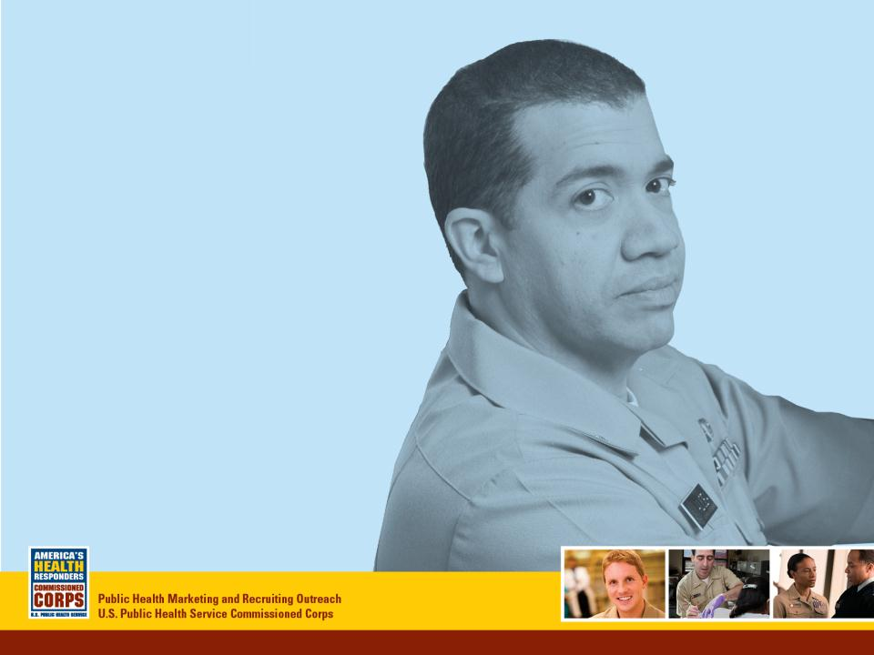
Today’s Commissioned Corps
Why We Are Here

Slide 10
Why We Are Here
Mission
To protect, promote, and advance the health and safety of our Nation.
Notes:
The mission of the Commissioned Corps is to protect, promote, and advance the health and safety of our Nation.
We pursue our mission through:
Rapid and effective response to public health needs
Leadership and excellence in public health practices, and
Advancement of public health science.
This has been the Public Health Service’s mission and method since 1798, when John Adams—the second President—signed into law the Act for the Relief of Sick and Disabled Seamen.

Slide 11

A proud history
From Ellis Island…
…To tribal lands.
Across America
Around the World
Protecting health and safety
For more than 100 years…
Source: www.nlm.nih.gov/exhibition/phs_history/intro.html
Notes:
The earliest predecessor of the Commissioned Corps was the Marine Hospital Service. At the time—the early 1800s—our country relied on a healthy merchant marine for trade and security. Our seamen traveled widely. Often, those who became ill brought their sicknesses back home, which made their health care a Federal concern.
The Marine Hospital Service eventually grew into the Public Health and Marine Hospital Service. In 1912, Congress shortened this name to the U.S. Public Health Service, with the Commissioned Corps as its uniformed service.
The responsibilities of the U.S. Public Health Service also changed, as new threats to our country’s public health emerged.
Congress charged the U.S. Public Health Service with preventing the introduction and spread of major epidemic diseases such as smallpox, yellow fever, and cholera. To meet this responsibility, the service and its Corps took over many national quarantine, disinfection, and immunization functions.
Congress also charged the U.S. Public Health Service to carry out the medical inspection of arriving immigrants, such as those landing at Ellis Island in New York.
The workplace environment and its effect on the health of workers became a major concern for the service in the early 1900s.
By 1912, the U.S. Public Health Service was authorized to investigate human diseases (such as tuberculosis, hookworm, malaria, and leprosy), sanitation, water supplies, and sewage disposal.
The Office of International Health Relations was established in 1943. Today’s Commissioned Corps officers work abroad as well as in the United States to help prevent the spread of infectious and communicable diseases. New threats to our public health, such as SARS, avian flu, drug-resistant TB, and MRSA—continue to develop.
That’s a very brief history of the Corps.

Slide 12
Our Origins
1798 Creation of Marine Hospitals to provide care and relief of sick and disabled seaman
1870 Marine Hospitals were centralized to the Marine Hospital Service under the position of a Supervising Surgeon
1889- Formalized by Congress as the US Public Health Service Commissioned Corps and uniformed services component of the Marine Hospital Service
1912 Name shorted to Public Health Service because of broadening responsibilities
1939 Became part of the Federal Security Agency
1953 Became part of the Department of Health, Education, and Welfare
1980 Became part of the Department of Health and Human Services
Notes:
Created in 1798, as Marine Hospital Service
Reorganized in 1870 along military lines
Established officially along military lines by Congress in 1889, with rank and pay similar to Navy
Renamed PUBLIC HEALTH SERVICE in 1912
After 141 years in the Treasury Department, PHS became part of the Federal Security Agency in 1939.
This agency later became the Department of Health, Education and Welfare and in 1980 the Department of Health and Human Services

Slide 13

PHS Seal
Fouled Anchor = seaman in distress
Caduceus (winged wand with 2 serpents intertwined)
  Associated with the Greek god Mercury, used to symbolize trade or commerce (hence, PHS’ relationship with merchant seaman and maritime industry)

Slide 14
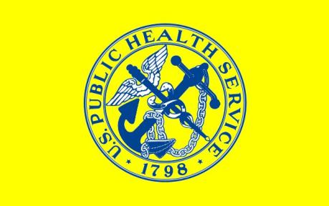
PHS Flag
Evolved out of the quarantine flag used by the Service on quarantine vessels and stations
Blue and yellow colors of the PHS represent its roots in maritime and quarantine activities

Slide 15

Today’s Commissioned Corps
What We Do

Slide 16
What We Do
Serving underserved populations
Health care delivery
Disease control and prevention
Behavioral health care to include wounded warriors and their families
Biomedical, psychological, dental and craniofacial research,
Regulation of food, drugs, and medical devices
Administration of National Public Health Programs
Emergency and humanitarian response
Notes:
For more than 200 years, the U.S. Public Health Service has been our Nation’s front line against the spread of disease from sailors returning from foreign ports, from immigrants entering the country, and from health threats posed by natural and manmade disasters.
We continue the battle for better public health today, and on multiple fronts. Corps medical officers are involved in:
Disease control and prevention
Biomedical research
Regulation of food and drugs
Mental health care
Substance abuse treatment
Health care delivery
International health, and
Emergency and humanitarian response.
I’m going to spend a few minutes highlighting this last area.

Slide 17
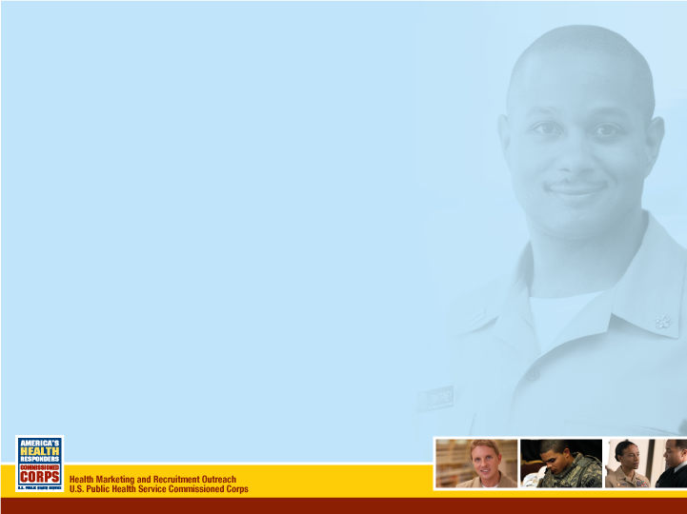
Today’s Commissioned Corps
How We Serve

Slide 18
How We Serve
Perform clinical practice
Educate individuals and communities about public health
Develop and implement public health programs and lead public health organizations
Participate in disaster response efforts as part of multi-disciplinary teams
Notes:
A career in the USPHS allows you to also pursue a variety of individual interests, like one of our dental officers who is a clinical dentist detailed to a USCG clinic, yet uses her expertise in dental forensics to identify victims of disasters.

Slide 19


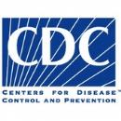









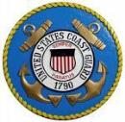



Where We Serve
Notes:
Commissioned Corps officers serve throughout the U.S. Department of Health and Human Services and also with some Federal agencies outside of the Department.
Corps officers may apply to any of a variety of Federal agencies and programs that are involved in public health. These agencies are as diverse as the Centers for Disease Control and Prevention, the Indian Health Service, the National Institutes of Health, and the Bureau of Prisons, just to name a few. This slide shows a selection of some of the agencies that employ Commissioned Corps officers.
For example, at the Centers for Disease Control and Prevention, Commissioned Corps officers conduct and report on disease surveillance activities.
At the Bureau of Prisons, Commissioned Corps officers work for the Health Services Division and provide and manage a variety of physical and mental health care services.
At the Environmental Protection Agency, Commissioned Corps officers write and implement safe drinking regulations, and conduct waste management programs to contain contamination to public water systems.
At the Food and Drug Administration, Commissioned Corps officers ensure the safety and effectiveness of drugs and medical devices, work on new drug applications and adverse reaction reports, function as field inspectors and consumer safety officers, and serve on expert advisory committees and review panels.
At the Immigration and Customs Enforcement within the Department of Homeland Security, which administers the Nation's immigration laws, Commissioned Corps officers are assigned to the Division of Immigration Health Services. We provide medical consultation and technical assistance about detainees' health care, provide medical escorts for international and domestic air transport operations, and deploy medical teams on domestic and international missions.
At the Indian Health Service, Commissioned Corps officers provide health care to American Indian and Alaska Native populations. This service may take our officers to the remotest corners of our country.
At the National Institutes of Health, Commissioned Corps officers plan, support, and direct clinical research programs.
Whatever your particular interest, the chances are that you can pursue a career as a Commissioned Corps officer.

Slide 20
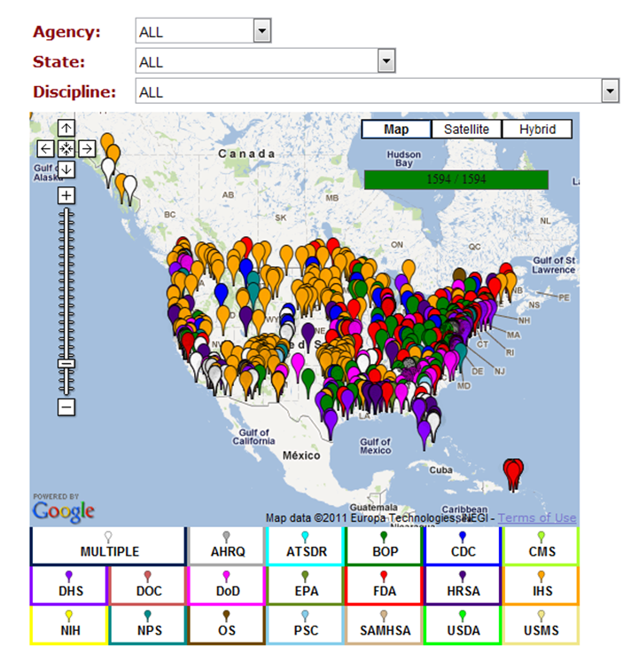
Where We Serve
PHOTO
Notes:
As you can see, our officers are located in duty stations across the U.S.
There are hundreds of duty stations in which Corps officers serve across the country (and around the world). The federal agencies I just talked about have offices in many locations. So whether you’re inclined to stay close to where you are now, or are interested in having different experiences in new places, you can probably find a place in the Corps that suits you.
For a full list of duty stations, please go to our Web site www.usphs.gov.

Slide 21


Slide 22
Bureau of Prisons – Correctional Health is Public Health
BOP protects society by confining offenders in the controlled environments of prisons and community-based facilities that are safe, humane, cost-efficient, and appropriately secure, and that provide work and other self-improvement opportunities to assist offenders in becoming law-abiding citizens.
BOP Core Values are Correctional Excellence, Respect, and Integrity.
BOP Pharmacy Program delivers positive outcomes through collaborative patient care.

Slide 23
Bureau of Prisons – Correctional Health is Public Health
Over 215,000 male and female adult offenders throughout 119 institutions located in 38 states, in urban and rural locations. Institutions are classified based on both security level and acuity of care.
Similar chronic health concerns to the non-incarcerated adult population, higher rate of HIV and Hepatitis C.
Iron Law of Corrections: 95% of our population will return to their communities. This represents a tremendous opportunity to make an impact on the individual and society.

Slide 24
Bureau of Prisons – Correctional Health is Public Health
Over 190 pharmacist-specific positions. Opportunities for administrative positions such as Health Service Administrator, Executive positions, Informatics, etc.
Collaborative Practice Agreements in diabetes, anticoagulation, hypertension, dyslipidemia, and more.
Pharmacist Clinical Consultants for Hepatitis C, HIV, and Mental Health.
APPE rotation sites, SrCOSTEP program, and a PGY1 residency.

Slide 25


Slide 26
Centers for Disease Control and Prevention (CDC)
Mission:
CDC works 24/7 keeping America safe from health, safety, and security threats, both foreign and domestic. Whether diseases start at home or abroad, are chronic or acute, curable or preventable, human error or deliberate attack, CDC fights disease, and supports communities and citizens to do the same. CDC is the nation’s health protection agency — saving lives, protecting people from health threats, and saving money through prevention.

Slide 27
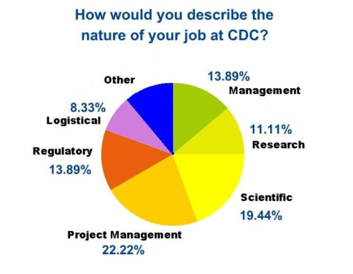
Centers for Disease Control and Prevention (CDC)
Over 30 pharmacists working across the agency and world
Work settings for pharmacists:
  CDC Drug Service
  Strategic National Stockpile (SNS)
  Regulatory
  HIV/AIDS
  Medication Safety
  Injury
  Agency for Toxic Substances and Disease Registry (ATSDR)
  Adolescent Health
  Birth Defects
  Quarantine
  Chronic Diseases
Based on Aug. 2009 CDC Pharmacist survey results

Slide 28
Opportunities for a Pharmacist
Types of positions Pharmacists have served in:
  Behavioral Scientists
  Biologists
  Emergency Response Specialists
  Epidemiologists
  Health Education Specialists
  Health Informatics Specialists
  Health Scientists
  Medical Officers
  Microbiologists
  Public Health Advisors
  Public Health Analysts

Slide 29
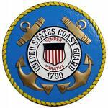

Slide 30
US Coast Guard
Mission – Provide health care to members in support of Coast Guard missions; To ensure health readiness of all members to maintain worldwide deployment status; To continually develop and maintain a highly competent Health Service Technician workforce to serve operational assets required to operate in remote locations for extended periods; To ensure the availability of quality, cost effective health care for all eligible beneficiaries.
Vision – To continually improve and optimize the care and services we provide to our beneficiaries in order to support the full range of Coast Guard missions and sustain the health of those entrusted to our care.
Goals - Ensuring medical readiness, maintain and further develop contingency response capabilities, provide quality, accessible and efficient care, create Chief Financial Officer compliant process and achieve full operational capability and modernization of Coast Guard Mission Support.

Slide 31
US Coast Guard
Location of USCG Pharmacist Sites:
-Alameda, CA
-Cape Cod, MA
-Cape May, NJ
-Clearwater,FL
-Elizabeth City, NC
-Kodiak, AK
-Miami, FL
-Mobile, AL
-New London, CT
-Norfolk, VA*
-Petaluma, CA
-Portsmouth, VA
-Seattle, WA
-Washington, DC (2)*
*Administrative Billet

Slide 32
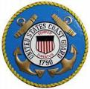
Opportunities for a Pharmacist Attached and Detailed to the US Coast Guard
U.S. Coast Guard (USCG) pharmacists are assigned to small, one-pharmacist ambulatory care settings where they actively engage with other healthcare personnel and patients routinely. In addition to the area clinics where pharmacists are assigned, pharmacists responsibilities are vast and include oversight of numerous afloat and ashore sickbay units, logistical activities, inventory management and, most importantly, education the USCG independent duty corpsmen on safe pharmacy operations. Pharmacy patients consist of active duty members and reservists, retirees and other eligible dependents.

Slide 33


Slide 34
Center for Medicare & Medicaid Services (CMS)
Mission: As an effective steward of public funds, CMS is committed to strengthening and modernizing the nation’s health care system to provide access to high quality care and improved health at lower cost.
Vision: A high quality health care system that ensures better care, access to coverage and improved health.
CMS Strategy: The Road Forward 2013-2017 http://www.cms.gov/About-CMS/Agency-Information/CMS-Strategy/Downloads/CMS-Strategy.pdf

Slide 35
Opportunities for a Pharmacist
Providing operational oversight of Medicaid coverage
Providing operational oversight of Medicare Parts A&B (hospital and out-patient coverage)
Conducting oversight, market surveillance, public outreach and compliance activities for Medicare Parts C&D (managed care organizations and prescription drug plan sponsors)

Slide 36
Opportunities for a Pharmacist
Supporting policy and operations for implementing the Prescription Benefit portion of the Health Insurance Marketplace and Parts C&D drug benefit (e.g. formulary analysis).
Researching, writing, and enacting regulatory and sub-regulatory changes to the Part D prescription drug benefit.
Providing direct support to beneficiaries, providers, suppliers, state agencies, governments, and members of Congress.

Slide 37


Slide 38
Food and Drug Administration (FDA) Mission
Protect the public health by assuring the safety, efficacy and security of human and veterinary drugs, biological products, medical devices, our nation’s food supply, cosmetics, and products that emit radiation.

Slide 39







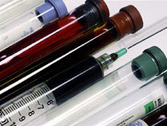
Office of the
Commissioner
Office of Foods
Office of Medical Products
& Tobacco
Office of Global Reg. Ops & Policy
Center for
Food
Safety &
Applied
Nutrition
Center for
Biologics
Evaluation &
Research
Center for
Drug
Evaluation &
Research
Center for
Tobacco Products
Office of
Regulatory
Affairs
Center for
Veterinary
Medicine
Center for
Devices &
Radiological
Health
Notes:
Chicago District FDA
39
What does FDA regulate?
Foods
safety of all food products
(except for most meat and poultry products, which are regulated by the U.S. Department of Agriculture)
labeling
bottled water
food additives
infant formulas
Dietary Supplements
Human Drugs
product approvals
OTC and prescription drug labeling
drug manufacturing standards
Vaccines, Blood Products, and Other Biologics
product and manufacturing establishment licensing
safety of the nation's blood supply
research to establish product standards and develop improved testing methods
Medical Devices
from simple items like tongue depressors, to complex technologies such as heart pacemakers
premarket approval of new devices
manufacturing and performance standards
tracking reports of device malfunctioning and serious adverse reactions
Electronic Products
products that give off radiation, such as microwave ovens and X-ray equipment
radiation safety performance standards for microwave ovens, television receivers, diagnostic
x-ray equipment, cabinet x-ray systems (such as baggage x-rays at airports), laser products,
ultrasonic therapy equipment, mercury vapor lamps, and sunlamps
accrediting and inspecting mammography facilities
Cosmetics
safety
labeling
Veterinary Products
livestock feeds
pet foods
veterinary drugs and devices
veterinary biologics not regulated by USDA are considered new animal drugs
Tobacco Products

Slide 40

Notes:
To carry out its mission, FDA employs approximately 14,000 people who work in locations around the country.
FDA staff who work at headquarters in Silver Spring, MD, focus on product review and regulatory policy.
The network of 236 field offices is generally the first point of contact for the public and regulated manufacturers. The employees in these offices focus on inspection and surveillance, laboratory work, and public and industry education.
Opportunities for RPhs at FDA:
FDA employs over 400 pharmacists to ensure the safety of drugs and related products. Locations range from FDA headquarters in Silver Spring, Maryland, to one of 150 cities nationwide with FDA operations. While the FDA hires a few new graduates most positions are filled by pharmacists with at least two years experience in clinical practice. FDA pharmacists may work: in pharmacology, toxicology, and pharmacokinetics; on new drug applications and adverse reaction reports, some are drug information specialists; as field inspectors and consumer safety officers.

Slide 41
Where Pharmacists Work at FDA
USPHS Pharmacists at FDA Headquarters (Silver Spring, MD): 85.8%
USPHS Pharmacists in FDA Field Offices Across the Country: 14.2%

Slide 42

Opportunities for Pharmacists
Roles:
Project Manager Drug Information
Field Investigator Clinical Reviewer
Safety Evaluator Pharmacologist
FDA Pharmacy Student Experiential Program
http://www.fda.gov/AboutFDA/WorkingatFDA/FellowshipInternshipGraduateFacultyPrograms/PharmacyStudentExperientialProgramCDER/default.htm

Slide 44
Health Resources and Services Administration
(HRSA)
Mission: To improve health and achieve health equity through access to quality services, a skilled health workforce, and innovative programs
Vision: Healthy Communities, Healthy People
Goals:
  Improve access to quality care and services
  Strengthen the health workforce
  Build healthy communities
  Improve health equity

Slide 45
Opportunities for a Pharmacist
Opportunities for pharmacists to serve within HRSA include but are not limited to:
  Telehealth / Telemedicine (Rural Health)
  Health Workforce Strengthening
  American Indian / Alaska Native Health Equity
  Countermeasure Injury Compensation Program
  Community Health Centers
  Maternal and Child Health
  Office of Pharmacy Affairs
  Global Health
  Poison Control
  Organ Donation
  HIV/AIDS
Notes:
Project Officer/ Program Analyst overseeing grants awarded to community health centers and other organizations to improve health and achieve health equity through access to quality services, a skilled health workforce and innovative programs.

Slide 46


Slide 47
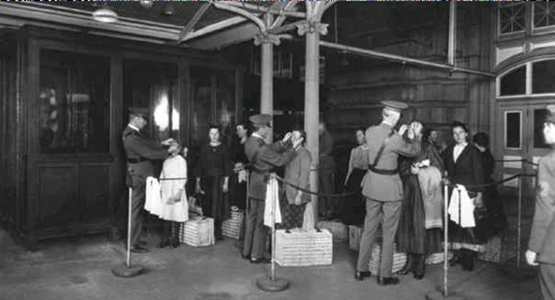
Immigration and Customs Enforcement (ICE) Health Service Corps (IHSC)
Mission:
To protect America by providing health care and public health services in support of immigration law enforcement

Slide 48
ICE Health Service Corps (IHSC)
IHSC serves as the medical authority for ICE within the Department of Homeland Security.
Direct patient care to approximately 15,00 detainees housed at 21 designated facilities.
Oversees medical care provided to an additional 19,000 detainees housed at 240 non-ICE Health Service Corps staffed detention facilities across the country.
13 IHSC pharmacies in 9 States.
19 Pharmacists (including the Chief Pharmacist & 2 Regional Pharmacy Consultants) & 23 Pharmacy Technicians.

Slide 49
Opportunities for a Pharmacist
Pharmacy Positions
IHSC Chief Pharmacist
Eastern Regional Pharmacy Consultant
Western Regional Pharmacy Consultant
13 Chief Pharmacists for facilities
3 Staff/Clinical Pharmacists

Slide 51
Indian Health Service
Mission: To raise the physical, mental, social, and spiritual health of American Indians and Alaska Natives to the highest level
Goal: To assure that comprehensive, culturally acceptable personal and public health services are available and accessible to American Indian and Alaska Native people
Foundation: To uphold the Federal Government's obligation to promote healthy American Indian and Alaska Native people, communities, and cultures and to honor and protect the inherent sovereign rights of Tribes

Slide 52
Indian Health Service
566 Federally-Recognized Tribes
2 Million American Indians and Alaska Natives
12 Service Areas in 35 States
Over 700 Pharmacists in over 230 locations

Slide 53
Opportunities for a Pharmacist
Clinical positions
  Staff pharmacists
  Clinical specialty pharmacists
    Anticoagulation
    Hypertension
    Diabetes
    Oncology
Non-clinical positions
  Pharmacy management and directors
  Quality Assurance/Quality Improvement
  Research/epidemiology
  IT Analyst

Slide 54


Slide 55
The National Institutes of Health Clinical Center Vision Statement
“As America’s research hospital, we will lead the global effort in training today’s investigators and discovering tomorrow’s cures”

Slide 56
Who Serves in the various Institutes of the NIH?
Pharmacists serve in the 240-bed Clinical Center (CC) of the NIH in Bethesda
Pharmacists also serve in other areas of the NIH extramural program

Slide 57
Opportunities for Pharmacists at NIH
Pharmacists staff the Inpatient and Outpatient Section of the CC Pharmacy
Clinical pharmacy specialists provide services to study participants of the various Institutes
Radiopharmacists serve in Nuclear Medicine and other areas of the CC
The CC Pharmacy provides a PGY2 Oncology residency and a 2-year pharmacokinetics fellowship

Slide 58

Office of the Secretary (OS)

Slide 59
Office of the Secretary (OS)
16 Staff Divisions (STAFFDIVS) in OS
Each STAFFDIV has its own Mission, Vision and Goals
  For example, Assistant Secretary for Preparedness and Response (ASPR)
    ASPR Mission: “Leading the nation in preventing, responding to and recovering from the adverse health effects of public health emergencies and disasters, ranging from hurricanes to bioterrorism."

Slide 60
Pharmacist Positions in OS
Most positions in OS are Multi-Disciplinary
Pharmacists occupy many positions including leadership positions
  Director of DCCPR
  Director of Medical Reserve Corps

Slide 61
Opportunities for a Pharmacist in OS
Since most of the positions are Multi-Disciplinary, there are numerous opportunities in many STAFFDIVS
ASPR
  Office of Emergency Management (OEM)
    Division of Logistics
      Branch Chief
      Program Manager
      Program Analyst
      Warehouse Manager

Slide 62
Speaker: Update your own content here
(Rank, Name, Title)
Current Position:
Service time:
Practice areas:
Notes:
This is where you tell your story. You can add your photo to the slide as well.

Slide 63
Emergency Response Deployments

Slide 64
3 Tiered Deployment Response Team
Tier One: Five Rapid Deployment Force teams and ten Incident Regional Coordination Teams
        expected to report to a point of departure within 12 hours of notification
Tier Two: Five Applied Public Health Teams and five
Mental Health teams
        expected to report to a point of departure within 36 hours of notification
Tier Three: All other active duty officer in the Commissioned Corps
        expected to report to a point of departure within 72 hours of notification
        deployment on a regular basis, either to augment Tier 1 or Tier 2 teams, or to provide specific requested skills when required

Slide 65
What Roles Do Pharmacists Play in Emergency and Humanitarian Responses?
Serve underserved and vulnerable populations
Provide disease control and prevention
Deliver health care and pharmacy services
Research: Biomedical, psychological, dental and craniofacial
Regulate food, drugs, and medical devices
Administer National Public Health Programs
Provide mental and behavioral health care to include wounded warriors and their families
Engage in emergency and humanitarian response
Liaise to HHS agencies or other USG partners
Provide planning, operational, logistical, or administrative support Risk Communication
Notes:
For more than 200 years, the U.S. Public Health Service has been our Nation’s front line against the spread of disease from sailors returning from foreign ports, from immigrants entering the country, and from health threats posed by natural and manmade disasters.
We continue the battle for better public health today, and on multiple fronts. Corps medical officers are involved in:
Disease control and prevention
Biomedical research
Regulation of food and drugs
Mental health care
Substance abuse treatment
Health care delivery
International health, and
Emergency and humanitarian response.
I’m going to spend a few minutes highlighting this last area.

Slide 66
Emergency and Humanitarian Response
Types of missions:
  Ebola response in Liberia & throughout the U.S.
  Earthquake response in Haiti
  Hurricane responses to Sandy, Katrina, Gustav, Isaac, & others
  Community Health and Service Missions (CHASMs) - assistance to rural America such as Kentucky, Texas and South Dakota
  Suicide response in American Indian community
  Oil spill clean-up, toxic exposure alerts in the Gulf Coast area
  Flooding in the Midwest
  Critical Staffing Shortages with IHS / DoD Augmentation
  Global Health Diplomacy/Humanitarian Missions
    Sustainable Collaborates with DoD, USG interagency, NGOs, and other partners
  National Special Security Events: Inauguration, State of the Union, Super Bowl, 4th of July Celebration in D.C.
Notes:
Increasingly, the Commissioned Corps is being recognized for the broad public health expertise its officers can provide in response to emergency and humanitarian needs, both here in the United States and abroad.
On September 9, 2014, the Secretary of the Department of Health and Human Services, Secretary Burwell, authorized activation and deployment of the Commissioned Corps to support the Ebola crisis. As of October 26, 2014, there was a team of approximately 65 USPHS Commissioned Officers in Liberia to support Operation United Assistance. These Officers will staff a 25 bed hospital to treat medical providers who fall ill after treating Ebola patients.
On January 12, a 7.0 magnitude earthquake hit Haiti at 1653 hrs, approximately 10 miles from Port-Au-Prince (near Leogane), and On January 20, at 0600 hrs, a 6.1 magnitude earthquake occurred with epicenter approximately 35 miles WSW of Port-Au-Prince. There were 1.4 Million Internally Displaced Persons (IDPs). Not only were PHS Officers tasked with rescue, recovery, and medical care, they were also tasked with public health concerns including vector control, air and water quality, noise polution, and waste removal.
The Indian Health Service deployed Corps officers to South Dakota in response to a spike in the number of attempted and completed suicides among American Indians. The suicide rate among American Indians, and particularly among younger Natives, is much higher than that of our general population. As a result, the Commissioned Corps is responding immediately to situations where we can possibly help prevent any future deaths to suicide among a people who are so much a part of our Nation and its heritage.
A mission for the Centers for Disease Control and Prevention deployed Corps officers to Louisiana and Mississippi to deliver test results to residents whose FEMA trailers had high formaldehyde levels. Exposure to toxic levels of formaldehyde can cause numerous health problems, including cancer.
This mission for CDC was in addition to services that we already had provided in response to Hurricanes Katrina and Rita. More than 2,400 Corps officers were deployed to the Gulf Coast region before, during, and after these hurricanes. They set up and staffed field hospitals and emergency medical clinics, treated sick and injured evacuees, conducted disease surveillance, and worked closely with local and State health authorities to prevent public health disasters.
As I mentioned earlier, the Corps is for people who want a career that goes beyond standard clinical or research practice.

Slide 67
Emergency and Humanitarian Response
Roles pharmacists can play during these missions
  Logistics
  Administrative
  Leadership
  Clinical
    Dispensing
    Immunizations
    Blood sugar screening
    Brown bag medication counseling
    Post-dental procedure medication teaching
    Etc.
Notes:
For more CHASM information - http://dcp.psc.gov/ccmis/CHASM.aspx

Slide 68
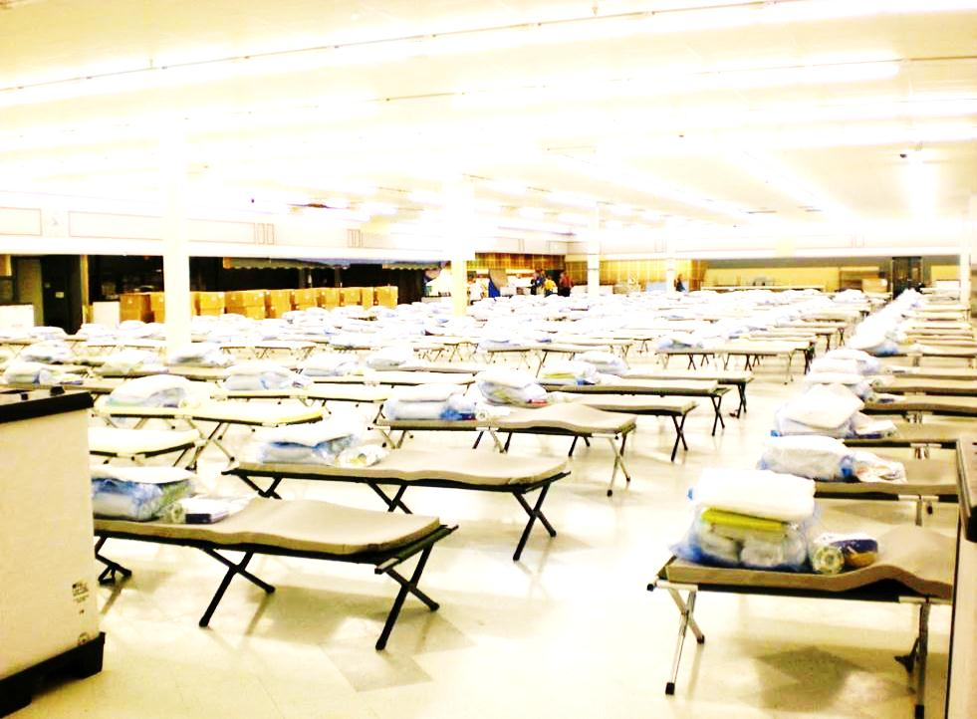
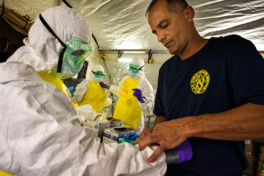

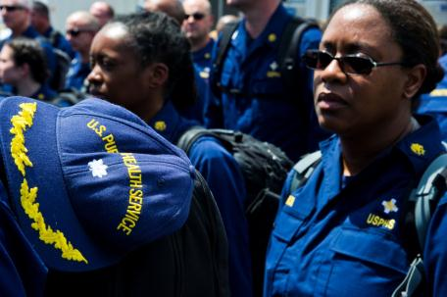
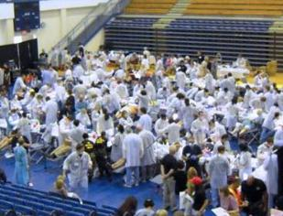


Emergency and Humanitarian Response

Slide 69
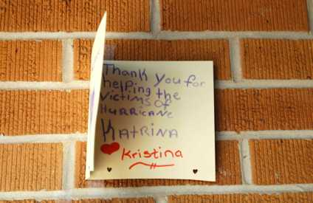
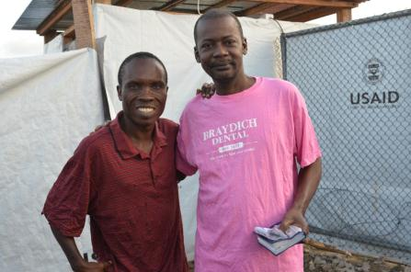
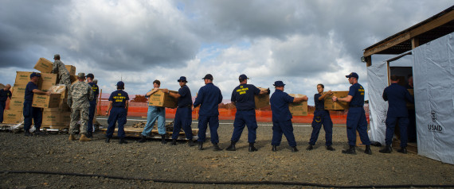
Helping Those in Need
As an Officer in the U.S. Public Health Service, you have a unique opportunity to make a difference in people’s lives, domestically and internationally

Slide 70

America’s Health
Responders
For more information, call
1–800–279–1605
or visit www.usphs.gov and www.facebook.com/usphs
#USPHSPharmacy
#USPHS
Notes:
MMU in Monrovia, Liberia. Wall of survivors from Ebola Virus Disease (EVD).
70

Slide 71

Student Opportunities
What You Can Do

Slide 72
Junior Commissioned Officer Student Training and Extern Program (JRCOSTEP)
Eligible after just one year of health professional school for a specific set of professions
Paid a salary during externship
Work 1 to 4 months during school breaks
No obligation after graduation
Testimony
  ENS Mark Glasgow from the State University of New York at Buffalo, Environmental Health, MPH – stationed at CDC
  “Once on duty, I quickly realized my capacity as part of an elite team. I have participated in several internships, but my JRCOSTEP experience has, by far, been the most fulfilling and empowering.”
Read more at http://www.usphs.gov/student/jrcostep.aspx

Slide 73
Senior Commissioned Officer Student Training and Extern Program (SRCOSTEP)
Highly competitive
Full-time students in specific health disciplines
Paid a salary and active duty benefits while finishing final year of health professional school (up to 18 months)
Obligated to the Corps for twice the amount of time sponsored
Testimony
  LTJG Lauren Brewer, RN in BOP, Fort Dix, NJ
  “While 50% of my nursing class did not have a job at graduation, I had a job in place from day one of my senior year in college. This was made possible by the SRCOSTEP experience.”
Read more at http://www.usphs.gov/student/srcostep.aspx.

Slide 74
Educational & Training Opportunities
Center for Disease Control and Prevention Epidemic Intelligence Service (EIS) Program: two-year, post-graduate program service and on-the-job training for health professionals in epidemiology.
National Health Service Corps (NHSC) Scholarship Program: a competitive program awarding in return for a commitment to provide care in underserved communities.
Indian Health Service (IHS) Loan Repayment Program: assists health professionals in repaying their student loans while they help fill the staffing needs of Indian health programs.
The Uniformed Services University of the Health Sciences (USU): a health science university run by the Federal government, providing training to military physicians, nurses, and educators.
Notes:
Center for Disease Control and Prevention Epidemic Intelligence Service (EIS) Program: a unique two-year, post-graduate program of service and on-the-job training for health professionals in the practice of epidemiology.
National Health Service Corps (NHSC) Scholarship Program: a competitive Federal program that pays tuition and fees and provides a living stipend to students in return for a commitment to provide care in underserved communities.
Indian Health Service (IHS) Loan Repayment Program: offers health professionals the opportunity to pay off their qualified student loans while assisting the IHS in meeting the staffing needs of Indian health programs.
The Uniformed Services University of the Health Sciences (USU) is a health science university run by the Federal government, providing training to military physicians, nurses, and educators.

Slide 75
Post-Graduate Opportunities
Indian Health Service Residency Program
  PGY1 Pharmacy Practice Residencies throughout the United States
  http://www.ihs.gov/pharmacy/resident
Bureau of Prisons Residency Program
  Clinical Pharmaceutical Care and Primary Care
  http://www.usphs.gov/corpslinks/pharmacy/documents/Residency_Training_Program_Flyer_2012.docx
NIH Clinical Center Pharmacy Department
  Pharmacokinetics/Pharmacogenetics Fellowship
  PGY2 Oncology Specialty Residency
  http://www.cc.nih.gov/phar

Slide 76
Corps Requirements
What You Have to Offer the Corps

Slide 77
Basic Qualifications
  U.S. citizen
  Less than 44 years of age (with waivers, up to 50)
  Medically and physically qualified
  Ability to pass a suitability review
  Qualifying degree from an accredited institution (varies depending on profession)
  Current, unrestricted, and valid license to practice in one of the 50 States; Washington, DC; Commonwealth of Puerto Rico; U.S. Virgin Islands; or Guam.

Slide 78
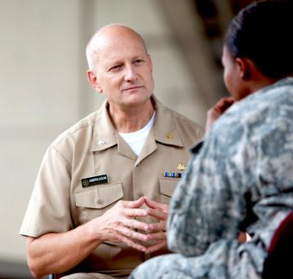
PHOTO
Officer Video Profiles
http://www.usphs.gov/newsroom/multimedia/profiles.aspx

Slide 79
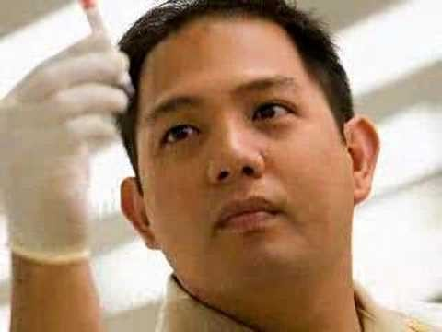
PHOTO
America’s Health Responders Video
http://www.usphs.gov/newsroom/multimedia/misc.aspx?id=LmWzPeTO_tk

Slide 80
America’s Health
Responders
For more information, call
1–800–279–1605
or visit www.usphs.gov and www.facebook.com/usphs
#USPHSPharmacy
#USPHS
Notes:
For more information, call us at 1–800–279–1605 or visit our Web site at www.usphs.gov.
We look forward to hearing from you. Thank you.
80

