Slide 1
U.S. Government Malaria Control Efforts in Sub-Saharan Africa _________________________________
CAPT Richard W. Niska, MD, MPH, USPHS
Resident Advisor (Nigeria)
Malaria Branch
Division of Parasitic Diseases and Malaria, CDC
18 May 2016

Slide 2
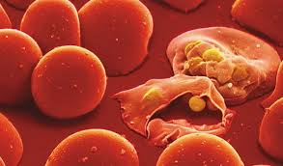
What is malaria?
Parasite (Plasmodium species):
Five species naturally infect humans
P. falciparum is the most serious.
Also vivax, ovale, malariae, knowlesii
Parasites invade liver first and develop there.
P. falciparum emerges into bloodstream in about a week
Others may emerge weeks later
Parasites then invade red blood cells & multiply
Rupture red blood cells
Clog blood vessels

Slide 3
Malaria symptoms
Symptoms of falciparum malaria usually within in 7-30 days
High fevers (main symptom)
Shaking chills
Non-specific flu-like illness (headache, muscle aches, vomiting, abdominal pain)
Malaria causes severe illness and death.
Symptoms of vivax malaria can rarely take up to a year to develop
Relapse for which initial blood stage may have been suppressed
Delayed emergence from liver (unusual exception)
Health care provider should be made aware of travel history.

Slide 4
How is malaria transmitted?
Mosquito bites (Anopheles species)
Mosquitos pick up parasites from infected people
Parasites develop in mosquito
Parasites then passed on to other people
Night biters (generally)
Can tell most resting adult Anopheles species by abdomen sticking up in air when resting

Slide 5
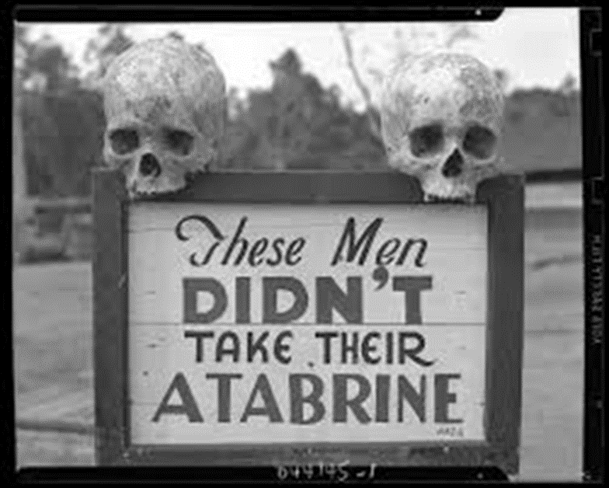
How to protect yourselves & your families
Antimalarial prophylaxis
Medication choices vary with area of the world
Consult health care provider before traveling
Insect repellents
Long-sleeve shirts, pants, socks and shoes in evening outside
Insecticide-treated nets

Slide 6
Overall status of malaria in Africa
Africa most affected due to:
Efficient mosquito (Anopheles gambiae) is responsible for high transmission.
Predominant parasite species is Plasmodium falciparum
Falciparum is the species most likely to cause severe malaria and death.
Local weather often allows transmission to occur year round.
Scarce resources and socio-economic instability hinder control activities.
Nigeria reports more malaria deaths than any other country
http://www.cdc.gov/malaria/malaria_worldwide/impact.html
(22 September 2015)

Slide 7
Overall status of malaria in Africa
Most vulnerable are persons with no or little immunity
In sub-Saharan Africa, most vulnerable are:
Young children – haven’t yet developed partial immunity
Pregnant women - immunity is decreased by pregnancy
Travelers coming from areas with little malaria transmission
http://www.cdc.gov/malaria/malaria_worldwide/impact.html (22 September 2015)

Slide 8
Overall status of malaria in Africa
In 2015, sub-Saharan Africa was home to:
88% of malaria cases
90% of malaria deaths globally
Some 15 countries account for:
80% of malaria cases
78% deaths globally
Since 2000, the decline in malaria incidence in these 15 countries was 32%.
Other countries globally: 53%
http://www.who.int/mediacentre/factsheets/fs094/en/ (January 2016)

Slide 9
Overall status of malaria in Africa
Africa continues to bear the brunt of the global burden of malaria.
Between 2000 and 2015, the number of malaria cases declined by 42%
Malaria death rate declined by 66% in Africa
http://www.afro.who.int/en/malaria/ (2015)

Slide 10
Overall status of malaria in Africa
A child dies every minute from malaria in Africa
9 out of 10 malaria deaths occur in Africa
In 2013, there were 528,000 malaria deaths
78% were in children under 5 years of age
http://www.afro.who.int/en/malaria/ (2015)

Slide 11
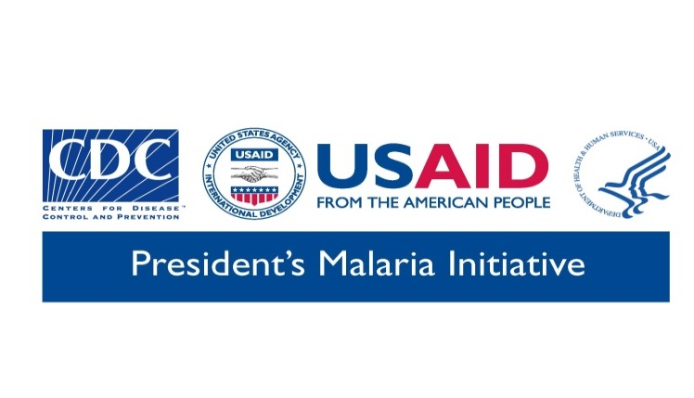
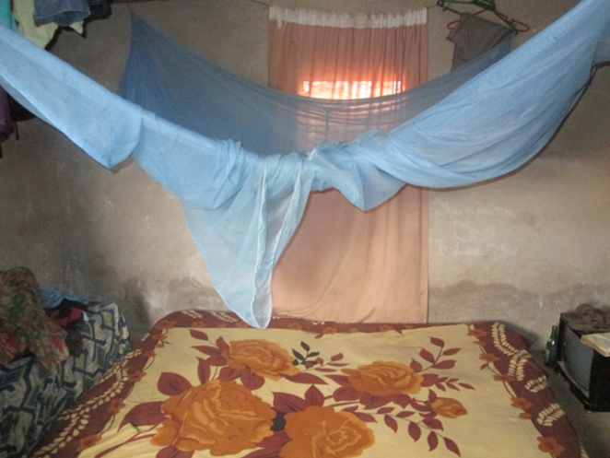
What is the US government doing?
President’s Malaria Initiative
USAID is lead agency
CDC co-implements
Launched in 2005 with goal to reduce malaria mortality by 50% across 15 countries in sub-Saharan Africa
Current focus on 19 countries in sub-Saharan Africa
Supports a comprehensive package of interventions with a goal of 85% coverage of:
Children under age five years
Pregnant women

Slide 12
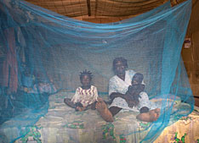
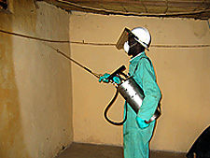
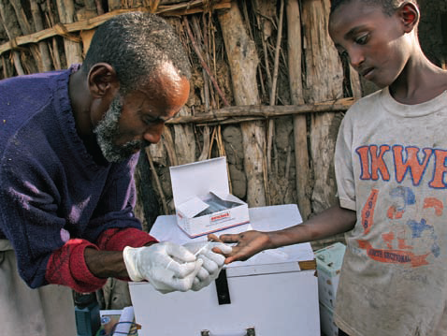
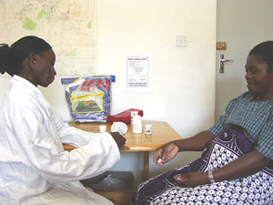
Key Success Factor: Implementation of Four Effective Interventions to Prevent, Detect, and Treat Malaria
Long-lasting insecticidal nets (LLINs)
Indoor Residual Spraying
(IRS)
Rapid Diagnostic Tests (RDTs)
&
Artemisinin-based
Combination Therapy (ACTs)
Intermittent Preventive Treatment for Pregnant Women (IPTp)
10
Notes:
The first factor of PMI’s success is PMI’s implementation approach that relies on proven, effective tools.
The four main interventions, a quick reminder of the efficacy for each (clockwise from upper left):
Long-lasting insecticidal nets
(reduce malaria episodes by 50% and ACCM by 20%)
indoor residual spraying of homes with insecticides
(more or less same efficacy)
intermittent preventive treatment for pregnant women
(reduces maternal anemia by 38%, LBW by 43%, and perinatal mortality by 27%)
Rapid diagnostic testing (and microscopy) leading to treatment of uncomplicated malaria with ACTs
(prompt tx with ACTs nearly eliminates the risk of progression to severe malaria and the high mortality associated.
PLUS, considerable attention to Surveillance, Monitoring and Evaluation

Slide 13
PMI Contributing to Unprecedented Global Progress Against Malaria
Between 2000 – 2015*:
1
6.2 million malaria deaths averted
5.9 million in children under five
2
Dramatic reductions in estimated malaria mortality rates:
↓by 60% of all ages
↓by 65% of children under 5 years of age
3
Gains against malaria account for 20% of total progress in reducing preventable child and maternal deaths
Majority of progress has been observed since 2007,
PMI’s efforts indisputably a major factor
* WHO and UNICEF report on "Achieving the malaria MDG target: reversing the incidence of malaria 2000-2015".
Notes:
The fight against malaria over the past 15 years represents one of the greatest success stories in the history of public health.
The US Government has substantially contributed to the unprecedented progress in malaria prevention and control.
According to the World Health Organization – between 2000 and 2015:
6.2 million malaria deaths averted
➔5.9 million in children under five
Dramatic reductions in deaths associated with malaria:
↓by 60%: all ages
↓by 65%: children under 5 years of age
The Majority of progress has been observed since 2007, and thus we can conclude that PMI’s efforts indisputably have been a major factor
Also important to note is that the Gains against malaria account for 20% of total progress in reducing preventable child and maternal deaths.

Slide 14
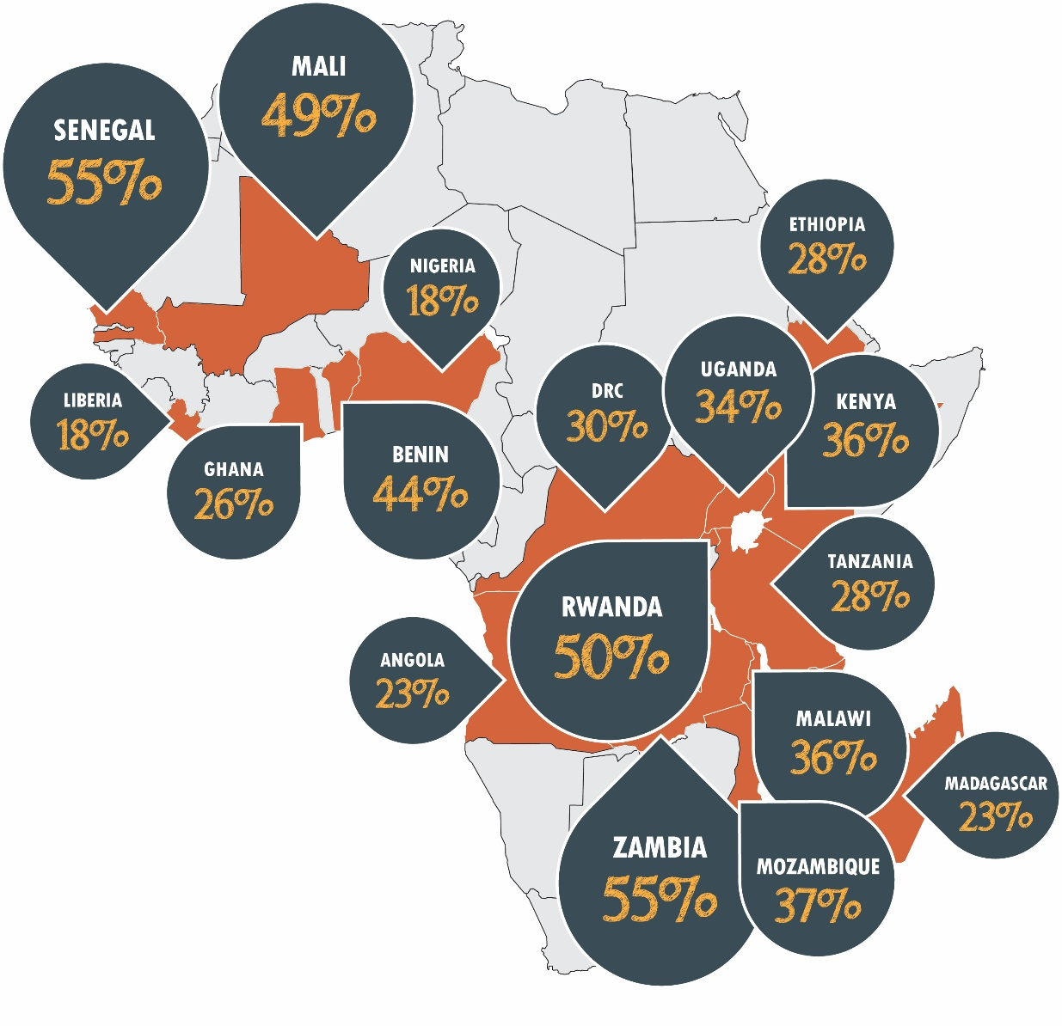
PMI is Saving Children’s Lives
All-cause mortality rates of children under the age of five have declined in 17 PMI focus countries
Declines range from 18% (in Liberia and Nigeria) to 55% (in Senegal and Zambia)
Notes:
Focusing specifically on PMI supported countries in Africa:
With the support of PMI, the Global Fund and other partners, we have seen reductions in all-cause child mortality in 17 of our 19 countries.
Impact evaluations carried out in several PMI countries indicate that malaria control efforts were major contributors to these child mortality reductions.
Some countries also have documented reductions in malaria cases with approximately one-third of PMI countries having a realistic possibility of eliminating malaria from all or part of their countries in the next 10-15 years.

Slide 15
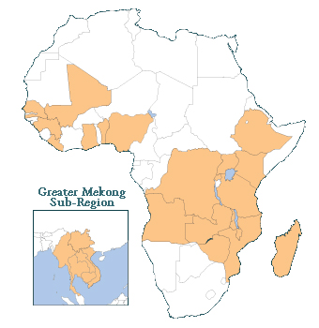
Countries supported by PMI
Angola
Benin
DR Congo
Ethiopia
Ghana
Guinea
Kenya
Liberia
Madagascar
Malawi
Mali
Mozambique
Nigeria
Rwanda
Senegal
Tanzania
Uganda
Zambia
Zimbabwe
Burma
Cambodia
China
Laos
Thailand
Vietnam

Slide 16
More information
CDC Travelers’ Health (Malaria)
http://wwwnc.cdc.gov/travel/diseases/malaria
CDC Health Information for Travelers
http://wwwnc.cdc.gov/travel/destinations/traveler

