Slide 1
Acute Upper Extremity Injury Protocols
Diagnosing and Managing Acute Upper Extremity Injuries within the Bureau of Prisons
Therapist Category Day
June 12, 2014
CDR Phil Chorosevic, OTR/L, CHT, MBA
Deputy Director, Rehabilitation Services
FCC Butner NC

Slide 2
Conflict of Interest
Declaration
The faculty for this program have declared that neither they nor their family members have a relevant financial arrangement or affiliation with any manufacturer of the product(s) or service(s) to be discussed in this continuing education activity.

Slide 3
Diagnosing and Managing Acute Upper Extremity Injuries within the Bureau of Prisons
OBJECTIVES
Discuss the need for a consistent, research-based approach for treating upper extremity injuries.
Recognize and discuss the most practical stepwise approach for diagnosing the 10 common upper extremity injuries.
Describe the evidence-based algorithms set forth for the non-operative treatment of these specific disorders.

Slide 4
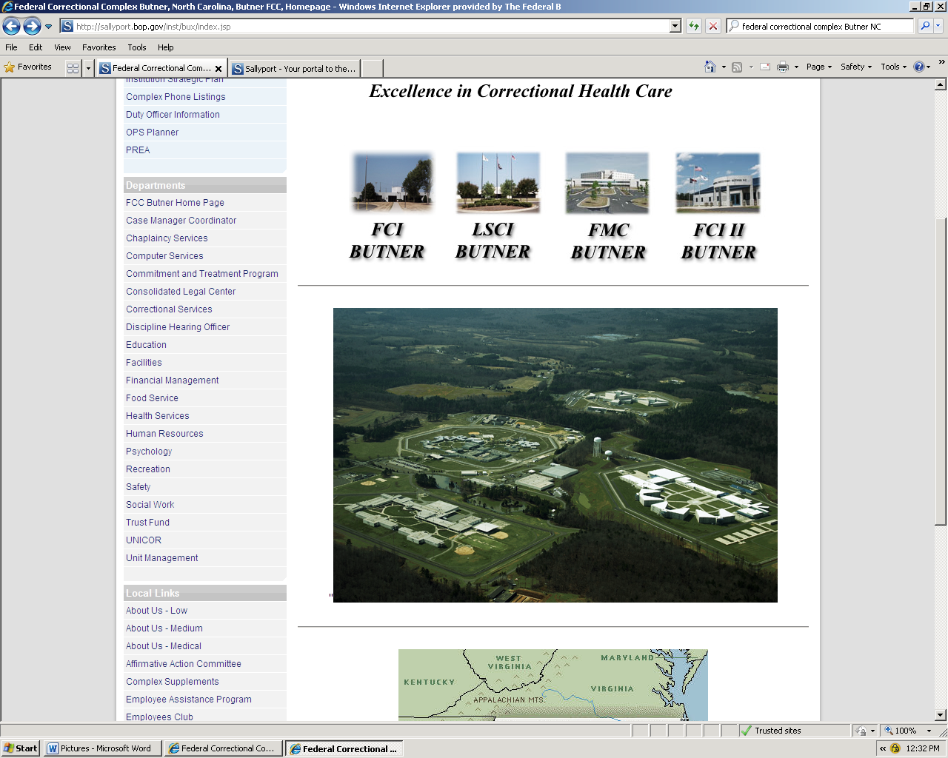
Federal Correctional Complex Butner NC

Slide 5
Acute Hand Injuries Task Force
Formed at the end of 2010 in response to feedback from the regional medical directors.
Goal
  Develop researched-based clinical guidelines for managing acute hand injuries to ensure a timely referral with preliminary objective data is initiated to a hand therapist and/or specialist when appropriate.
Task Force Members
  Dr. Reginald Hall, MD, Orthopedic Surgeon, FCC Butner
  CDR Damien Avery, DPT, OCS, Orthopedic Specialist, FCC
  Butner
  CDR Phil Chorosevic, Task Force Lead, FCC Butner
  CDR Julia Woodard, OTR, FCI Ft Worth
  CDR Karen Kilman, PT, DPT, OCS, IHS, Phoenix, AZ
  LCDR Chris Eaker, OTR/L, CHT, MPH

Slide 6
Accomplishments
Collaborated with Dr. Hall and identified the most common acute hand injuries treated in the BOP environment. DEC ’10
Collaborated with Dr. Hall and identified the standardized format for protocols and pathways. DEC ’10
Distributed diagnoses to the team for draft write-up. JAN ’11
Draft protocols/pathways completed. APR ’11
Drafts reviewed by Hall and Avery and returned with recommendations/edits. MAY ‘11
Final review and edits. JUN ’11
Protocols forwarded to Chief Therapists and BOP Regional Medical Directors for review. AUG ‘11
Protocols forwarded to Central Office for approval. NOV ‘11

Slide 7
Accomplishments Continued
Medical Director's CENTRA July, 2012 served as the main introductory session and included overview of the protocols
  Why the protocols were developed
  Expectations of the clinicians
  General features
Coordinated effort with Dr. Hall presented protocols in greater detail during break out sessions at the BOP Clinical Directors Residential Training Program August, 2012. Feedback received from CDs and HSAs.
Over a period of 5 months, collaborated Dr. Allen, Chief of Health Services, BOP and with editor from Lippman and Strong to complete final product.
Practice guidelines released to the field January, 2013.
Currently, located on the Health Services Division webpage of the BOP home page.

Slide 8
The Protocols
Evidence-based
A means of getting the front-line clinician more comfortable and confident with treating these specific injuries.
Emphasis on thorough examination and routine, timely follow-up.
The KISS Principle
  Limited use of acronyms
  Anatomical terms AND basic descriptors as well as pictures
    Ex., snuffbox, cascade of the hand

Slide 9
The Protocols Continued
Distal radius fractures
Acute flexor digitorum profundus tendon ruptures
Fight Bites to the fingers
Metacarpal fractures
Proximal interphalangeal dislocations, including fractures and non-fractures, dorsal and volar surfaces
Radial and ulnar collateral ligament injuries of the thumb
Scaphoid fractures
Chronic shoulder pain

Slide 10
The Protocols
Both an electronic and hard copy option that mirror each other
Possible expansion in the future
Easy to follow
  Electronic version with active tabs
  Hard copy with colored tabs

Slide 11
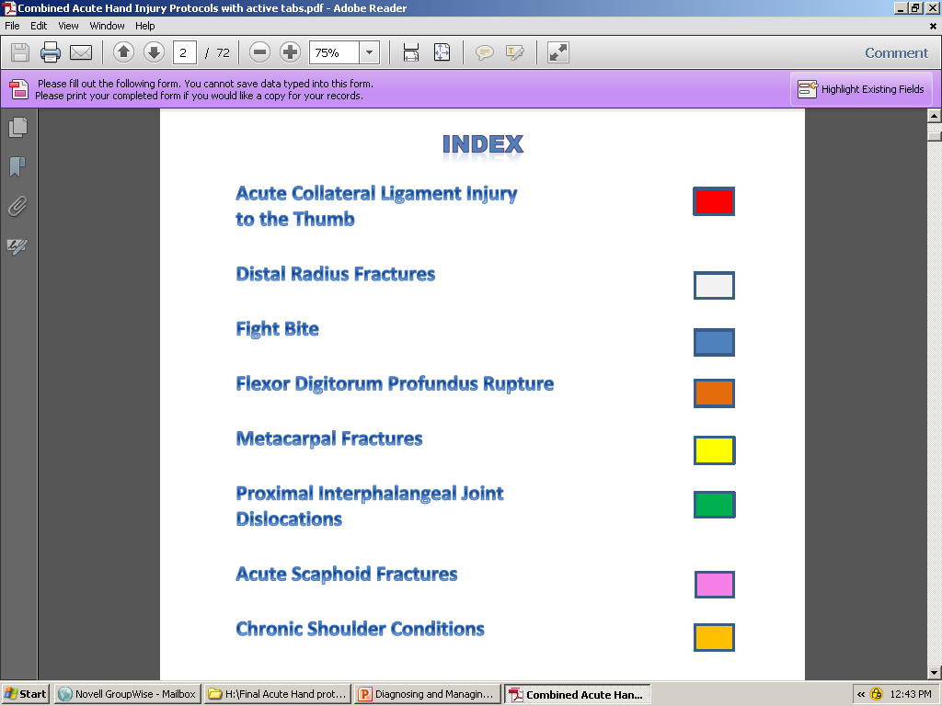

Slide 12
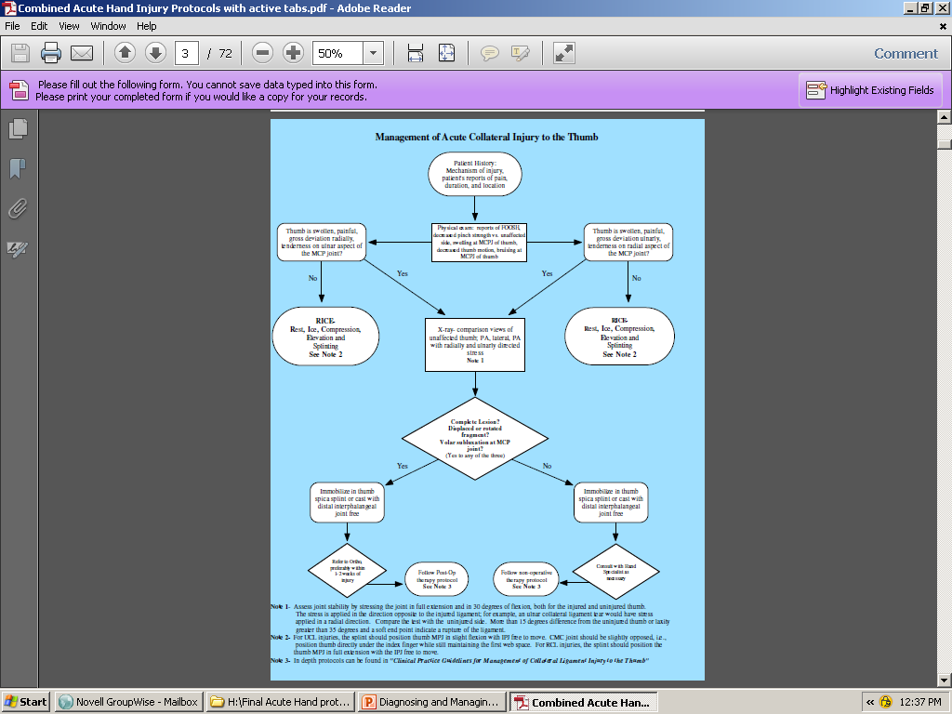
The Protocols

Slide 13
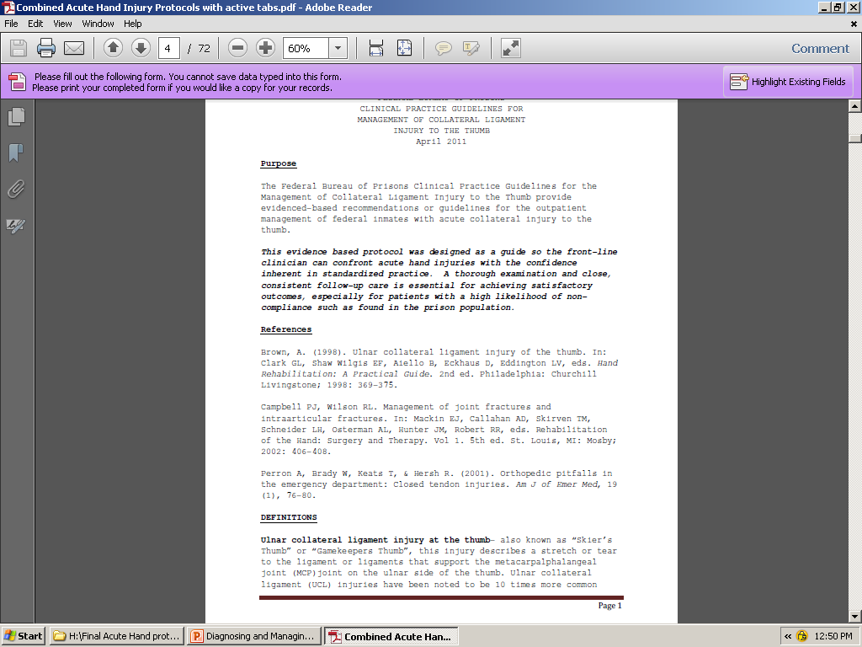

Slide 14
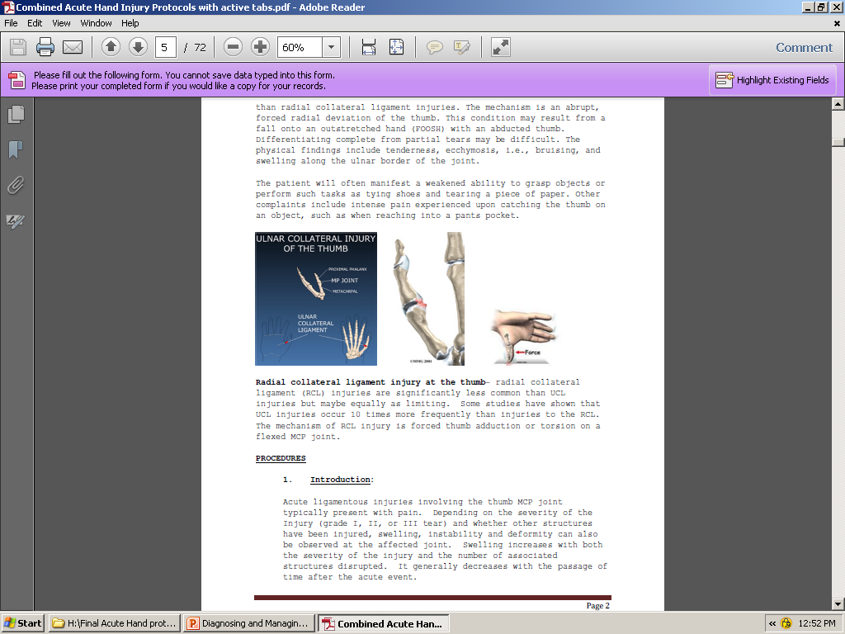

Slide 15
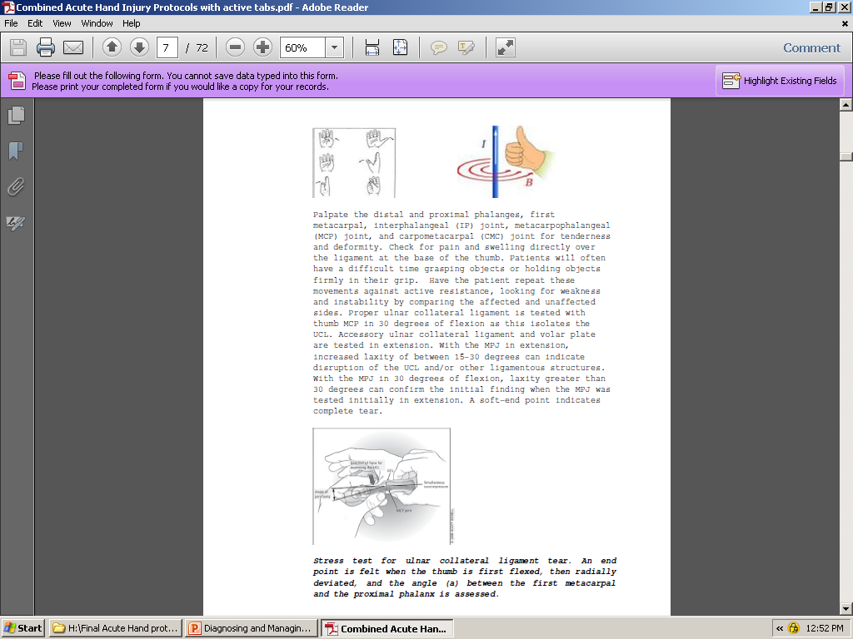

Slide 16
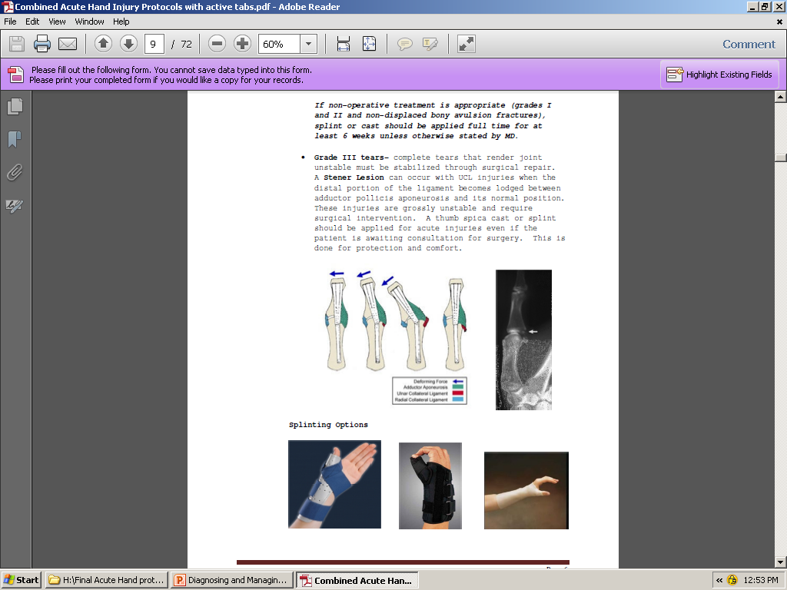

Slide 17
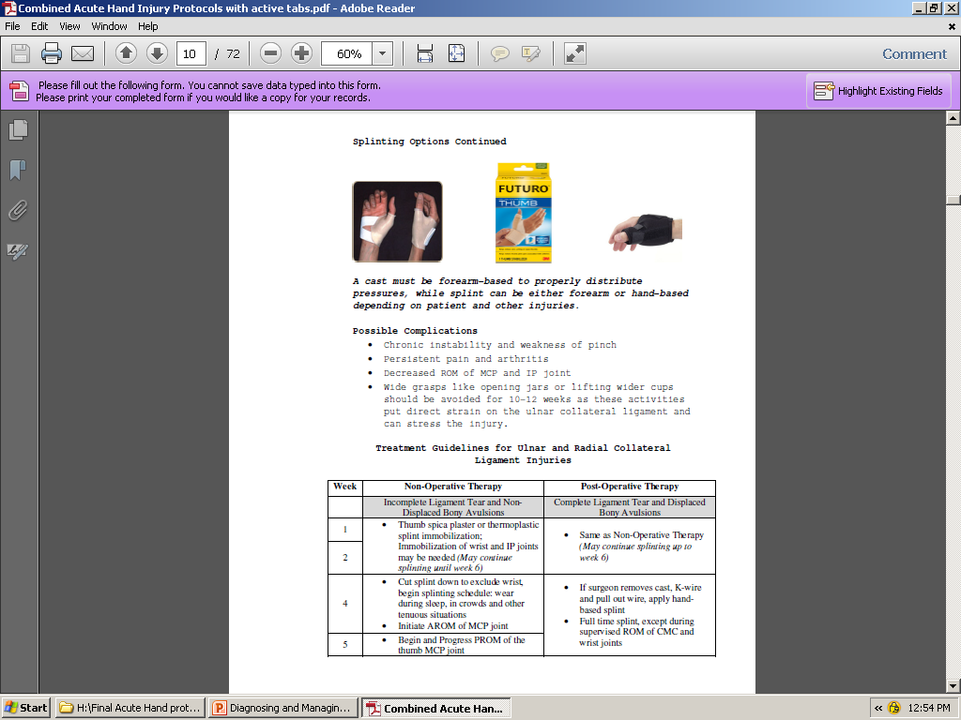

Slide 18
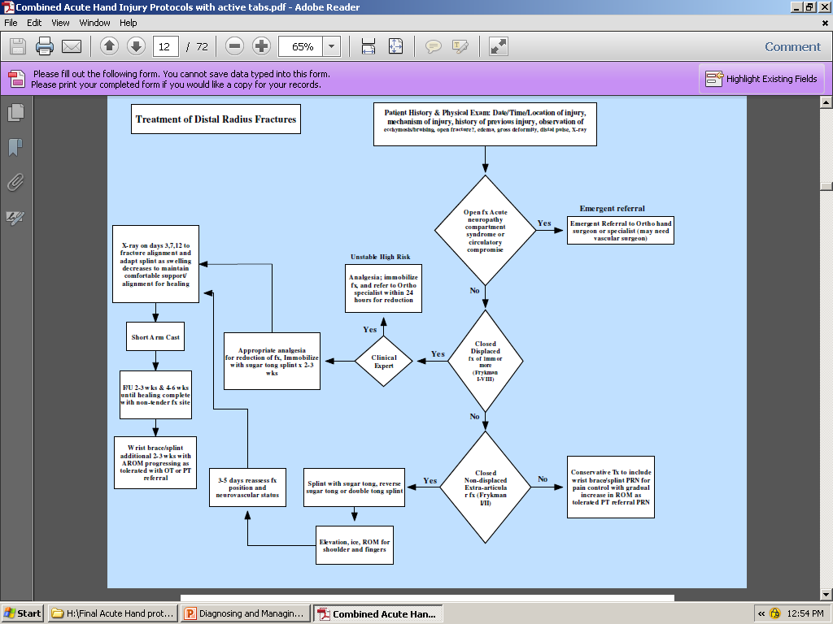

Slide 19
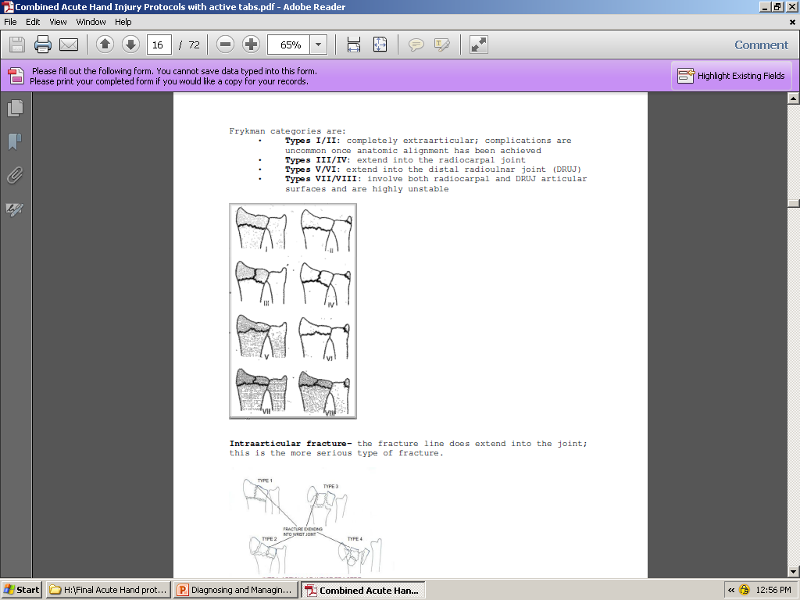

Slide 20
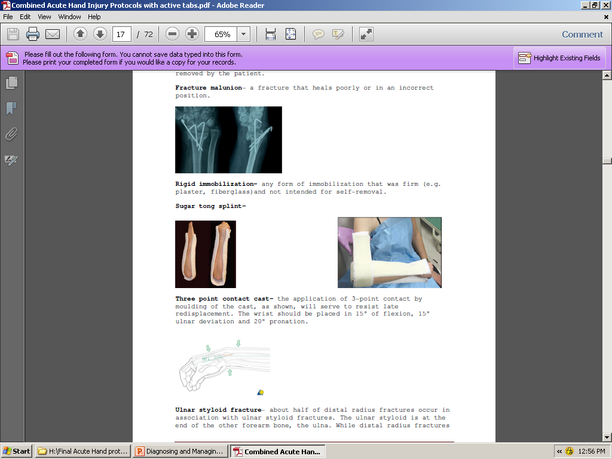

Slide 21
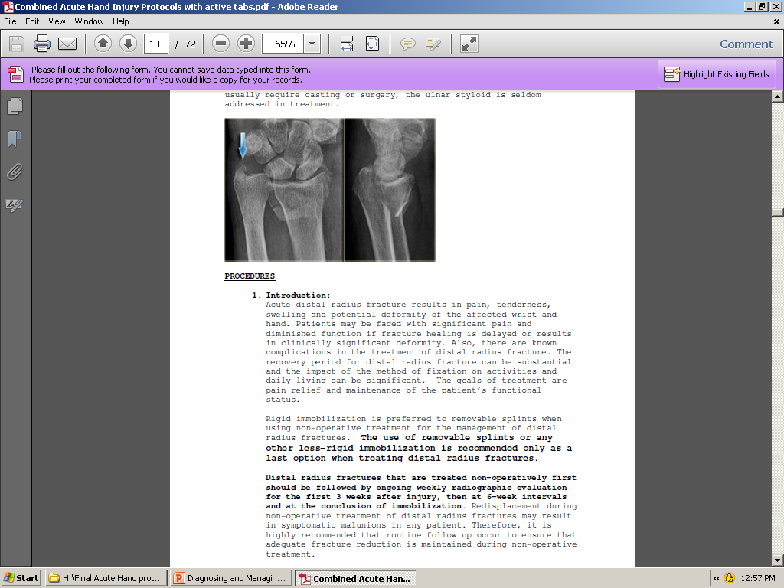

Slide 22
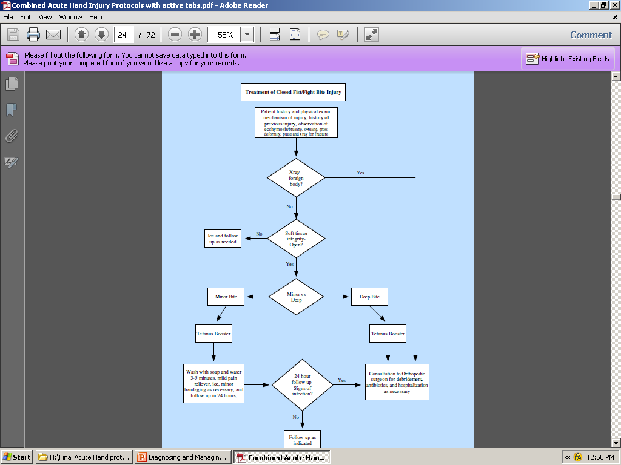

Slide 23
Importance of initial and follow up x-rays
37 y/o fight bite injury- DOI-11-20-13
Subsequent 2 wks s/p I&D with abx- DOS- 11-27-13
Right middle finger tenosynovitis
AROM right middle finger
  MPJ- 0/70 deg; PIPJ- (-)20/30 deg; DIPJ- (-)10/20
PROM right middle
  MPJ- 0/90 deg; PIPJ- (-)20/60 deg; DIPJ- (-)10/40
Therapy initiated 12-11-13

Slide 24
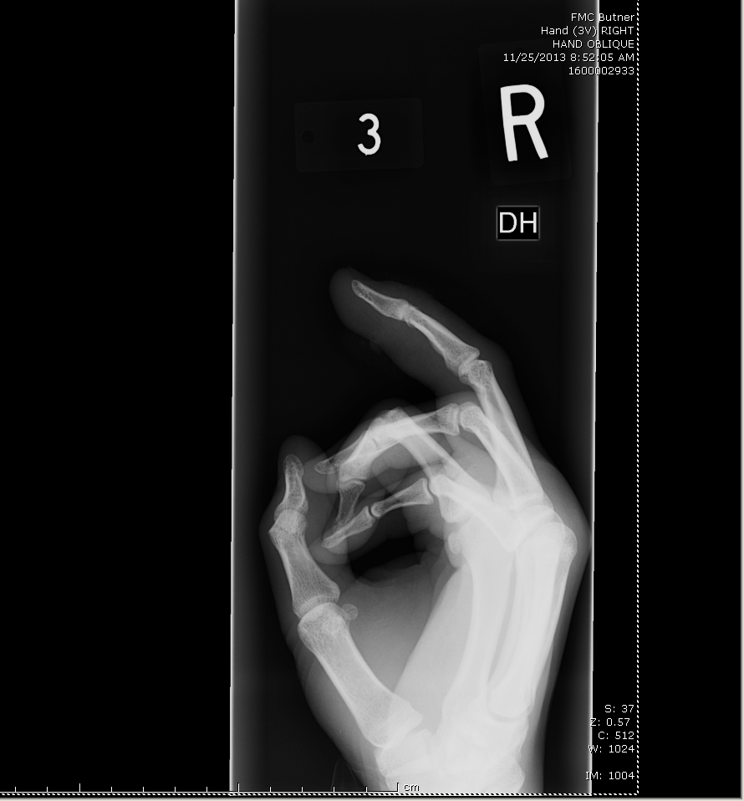
X-rays at 5 days s/p injury

Slide 25
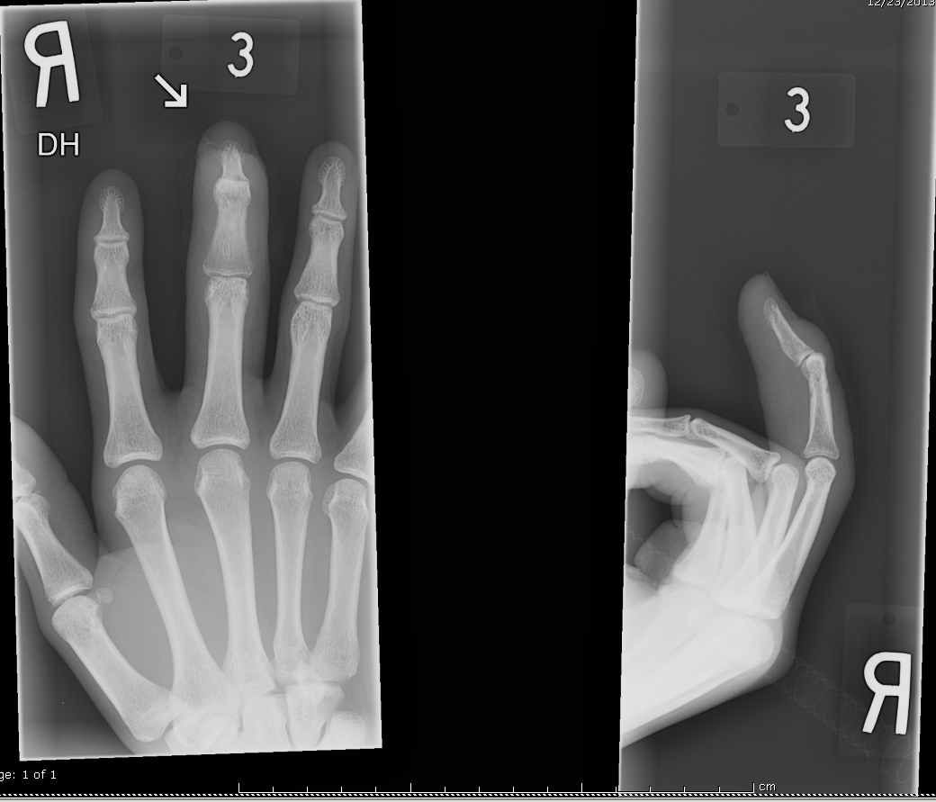
X-rays at 4 wks s/p I&D

Slide 26
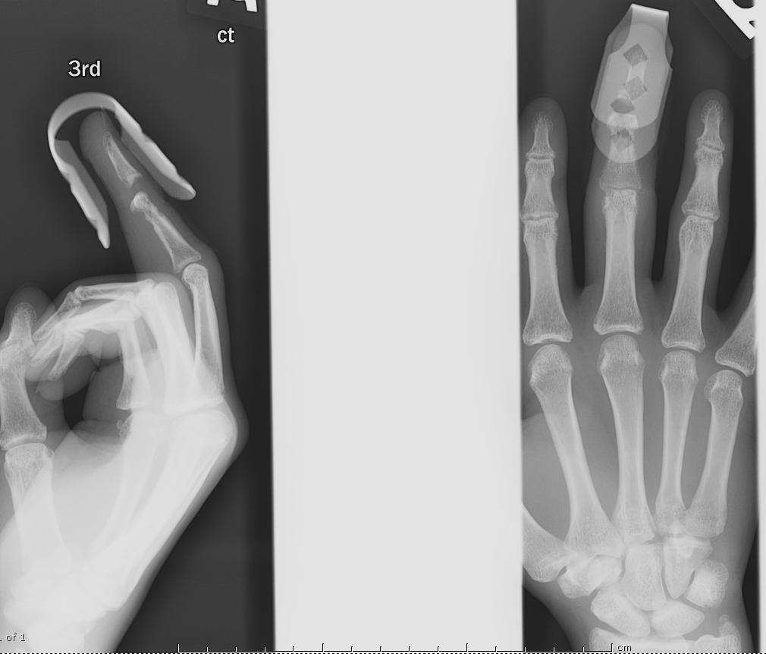
X-rays at 4 weeks after initiating therapy s/p 6 wks I&D
Obvious loss of joint congruency (> 3 mm distraction) with erosive changes

Slide 27
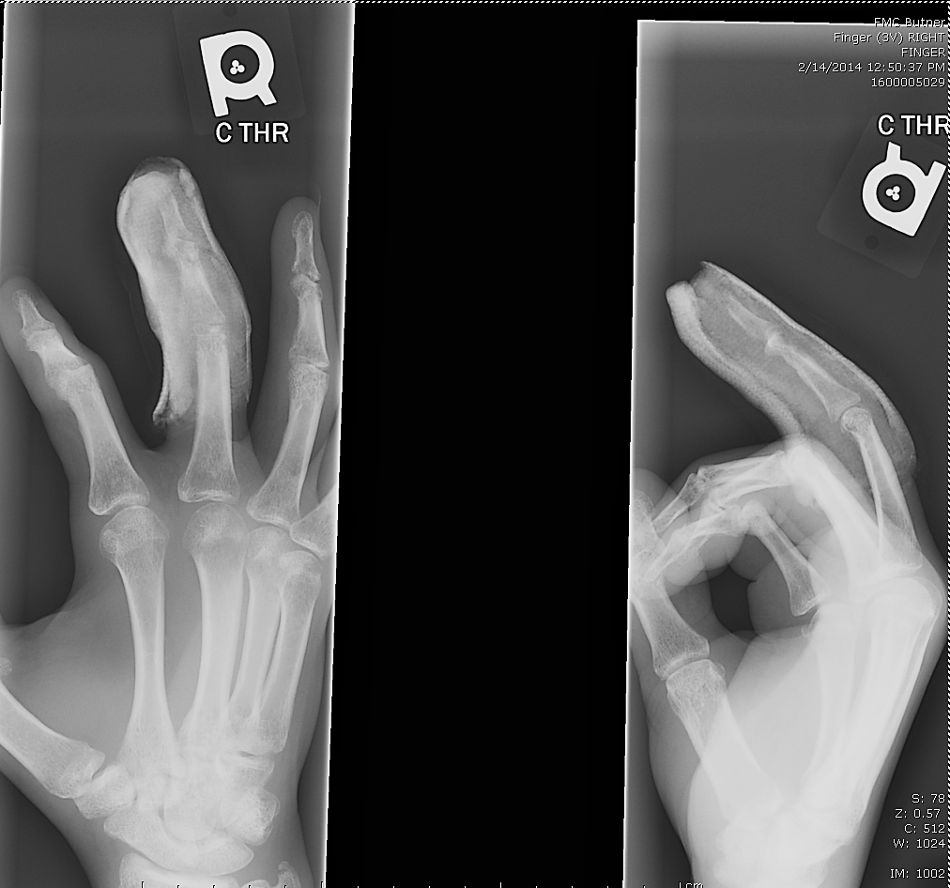
X-rays at 5 wks after cast immobiliation of PIP and DIPJ and 4 wks s/p after 2nd I&D procedure
+3 mm space at the DIP joint obviously reduced

Slide 28
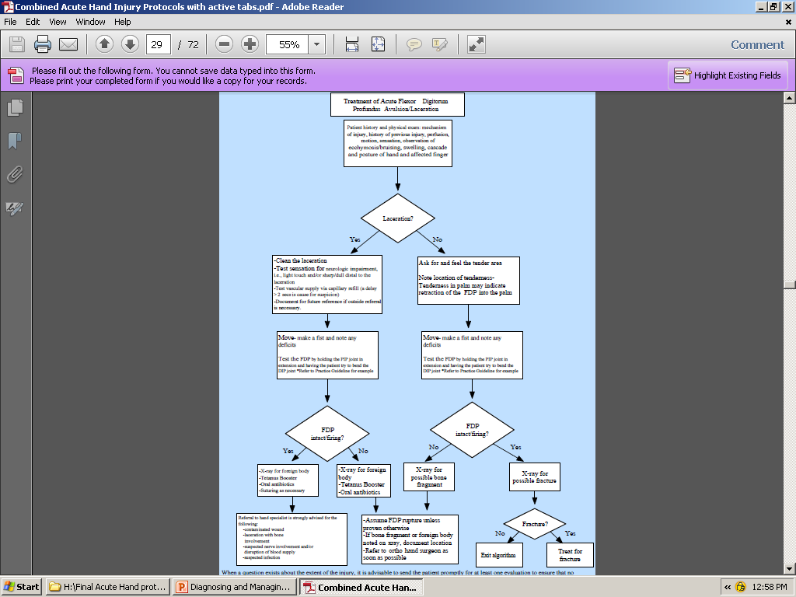

Slide 29
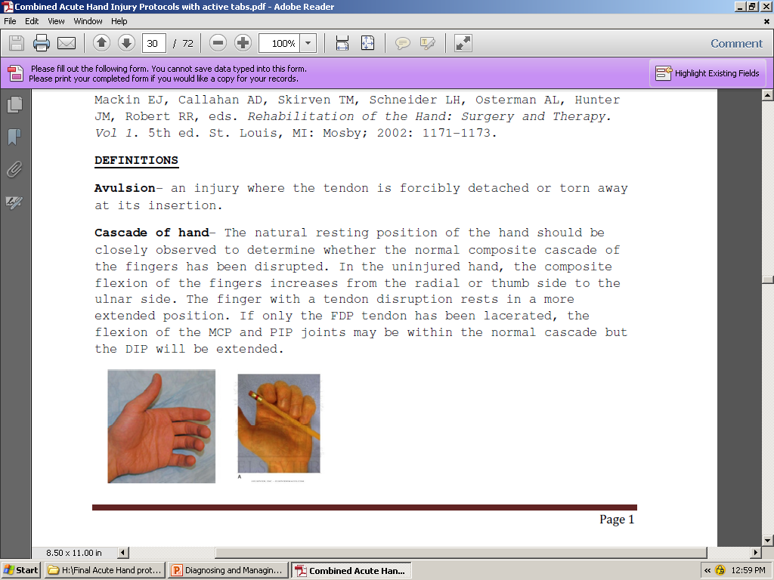

Slide 30
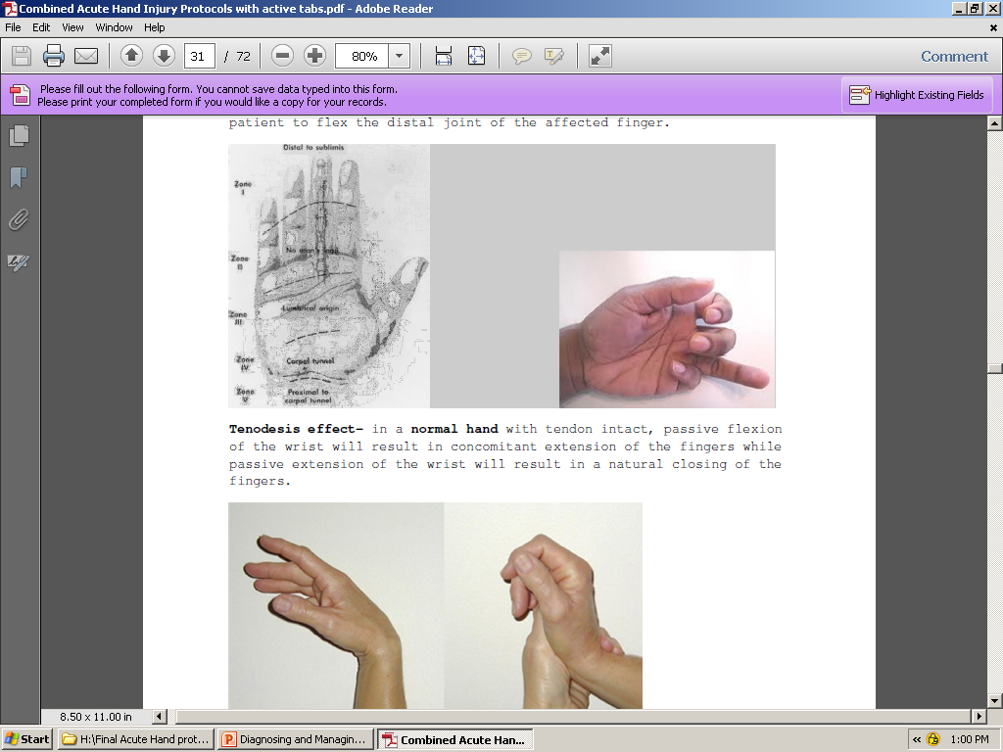

Slide 31
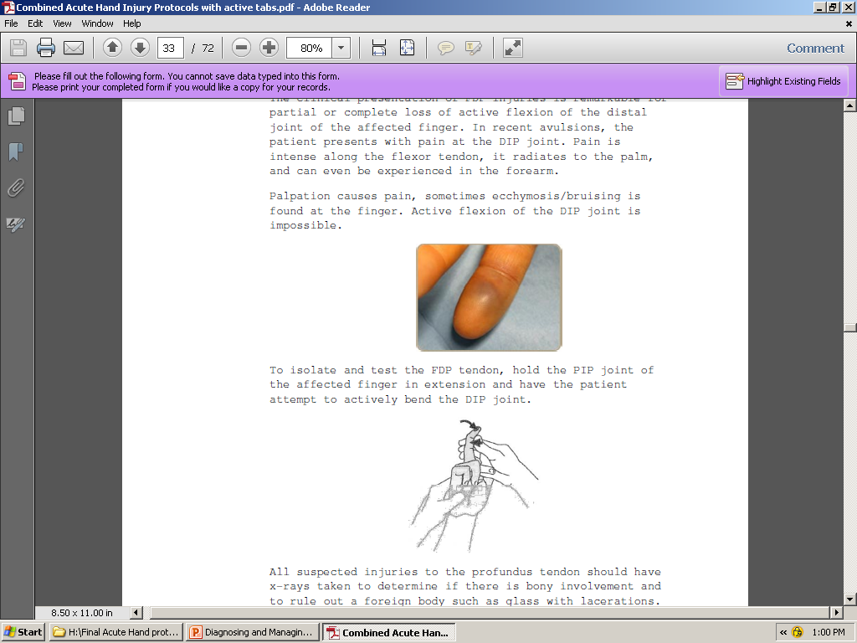

Slide 32
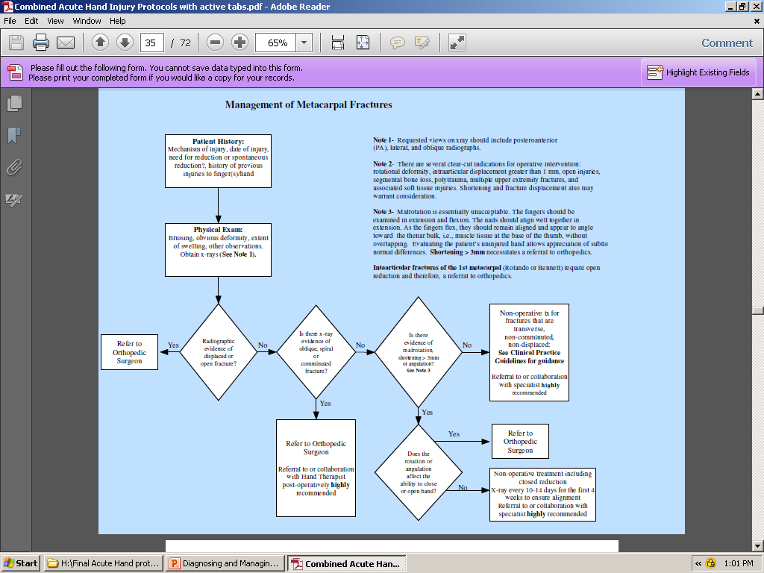

Slide 33
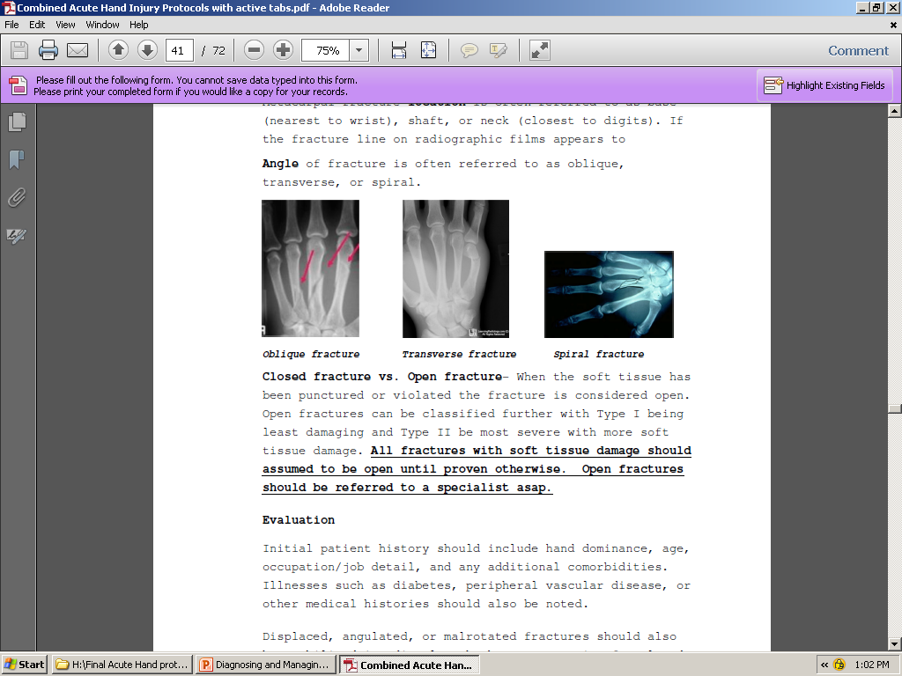

Slide 34
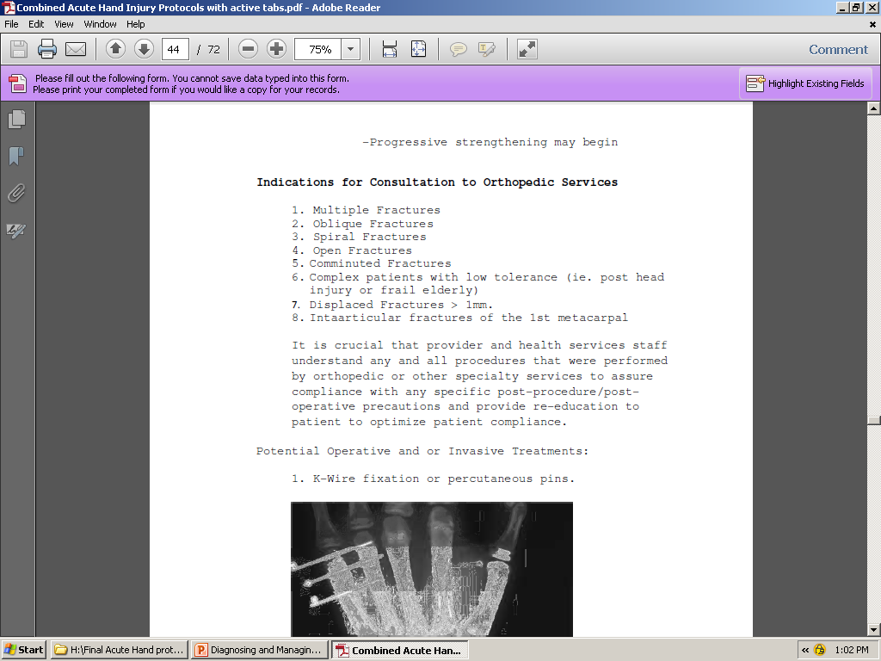

Slide 35
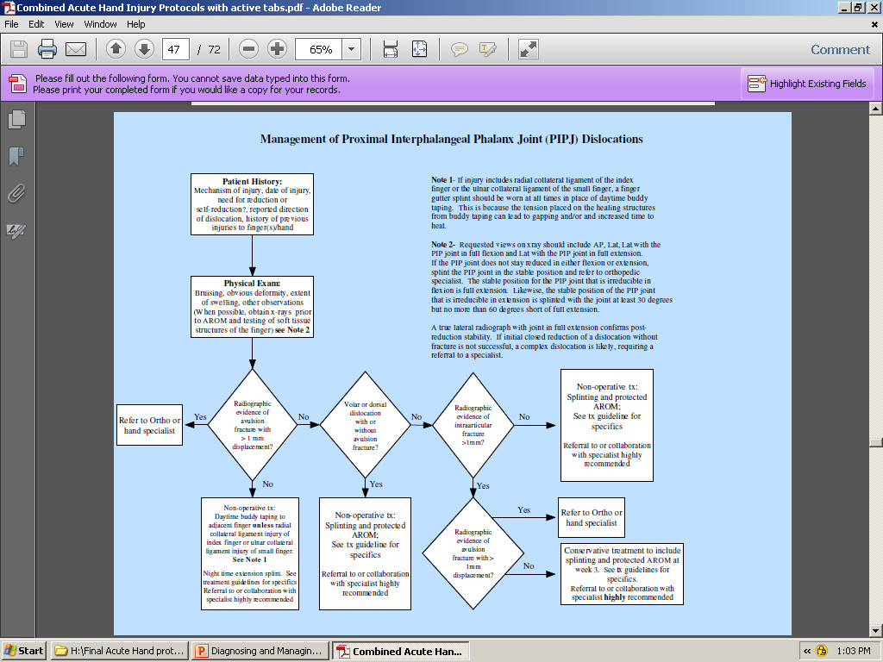

Slide 36
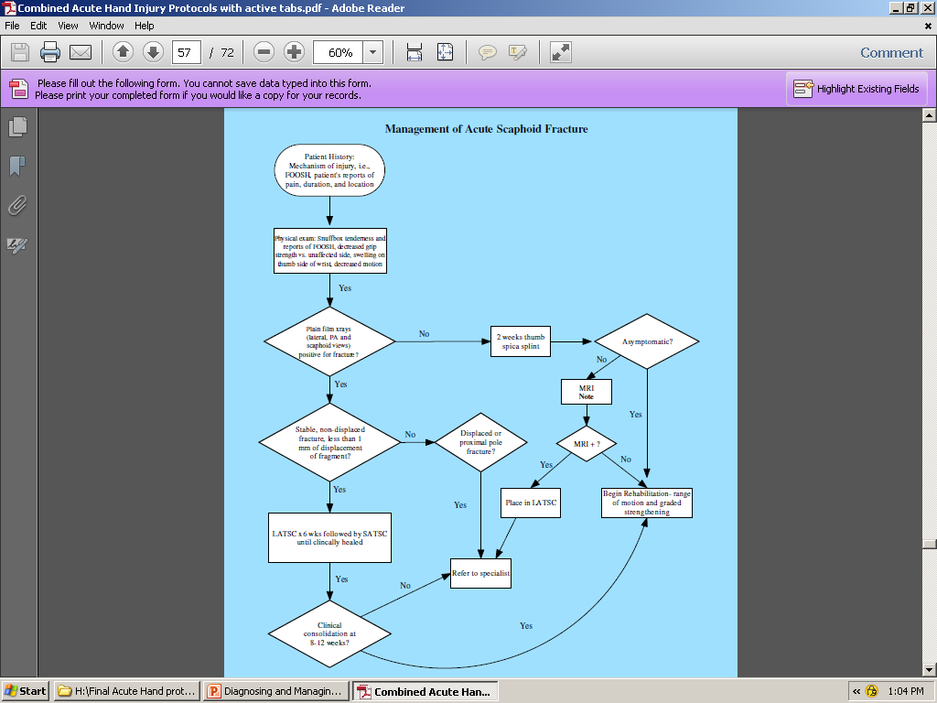

Slide 37
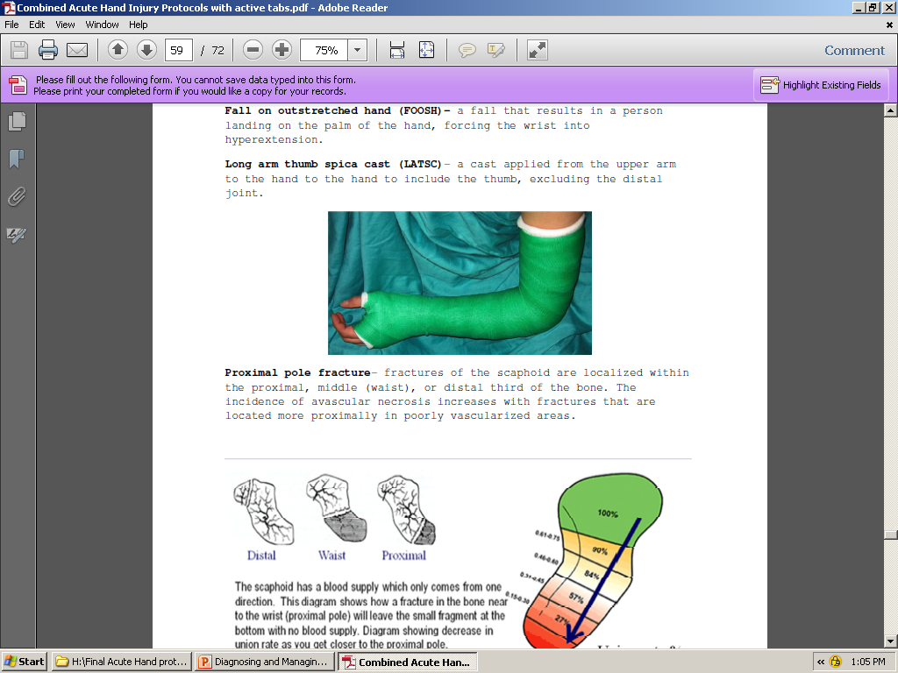

Slide 38
Case Study
29 y/o inmate was playing football when he tripped and fell on his outstretched hand (FOOSH), forcing his hand into hyperextension.
Inmate presented 2 day later to sick call and was seen by the MD, who checked for a wrist fracture by requesting a plain
x ray of the wrist.
X ray revealed no bony injury and a simple wrist sprain was diagnosed.
Inmate was discharged with following instructions-
immobilize wrist using a prefabricated wrist cockup splint that was issued
Prescription of 800 mg of motrin to be taken 3 times daily.
Was this the community standard of care for this type of injury?

Slide 39
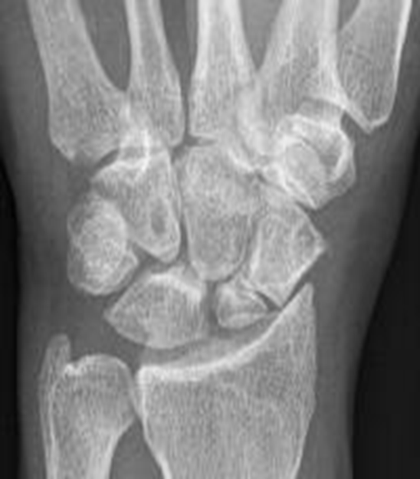
Case Study Continued
8 months after the initial injury, this inmate reported to sick call with persistent wrist pain and reduced wrist AROM.
What do you suspect?
What study(s) would you order?

Slide 40
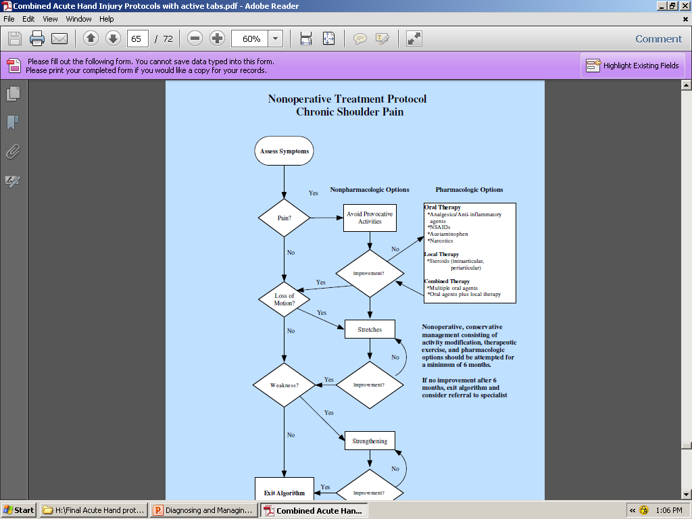

Slide 41
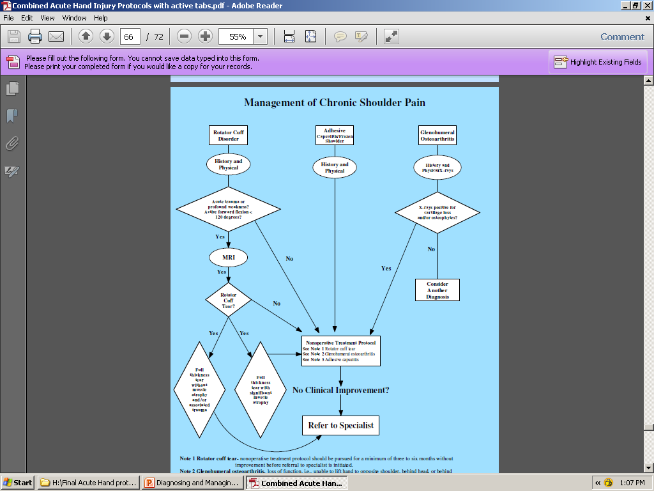

Slide 42
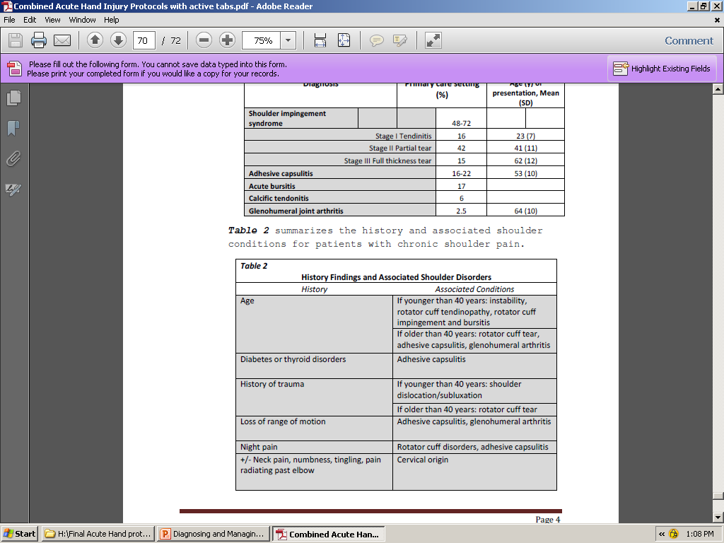

Slide 43
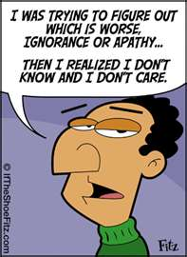
Perceived Barriers
Lack of knowledge
Insufficient training
Enabled- continues
Apprehension/Fear
Attitudinal- continues
  Unwilling
  Apathetic

Slide 44
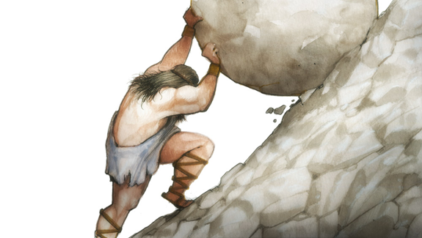
Phase III- Outcomes (ship currently dead in water?)
Expectation(s)- Dr. Ballom, Clinical Specialty Consultant, Carswell FMC
Reduce the legal ramifications and administrative remedies as a result of misdiagnosed and/or delayed treatment of the most common upper extremity injuries.

Slide 45


Questions/Comments/Suggestions

